Slide 1
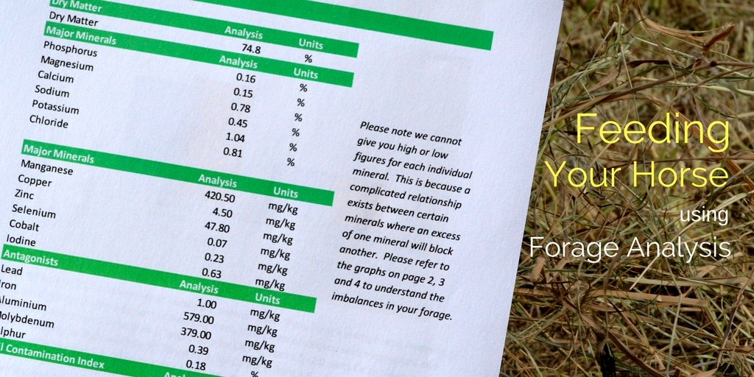

Slide 4


Slide 8
Ration Balancer

Slide 9
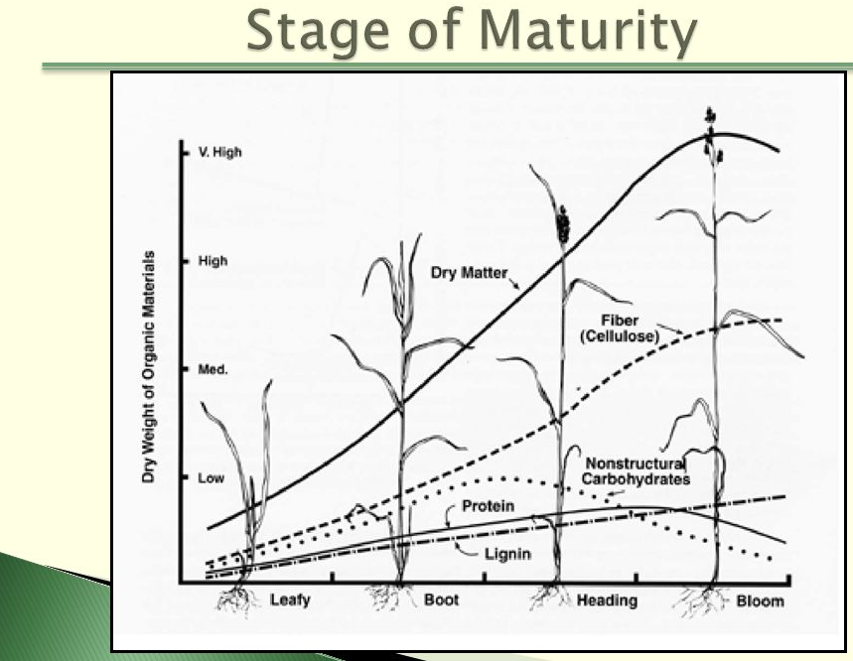
Stage of Maturity

Slide 10
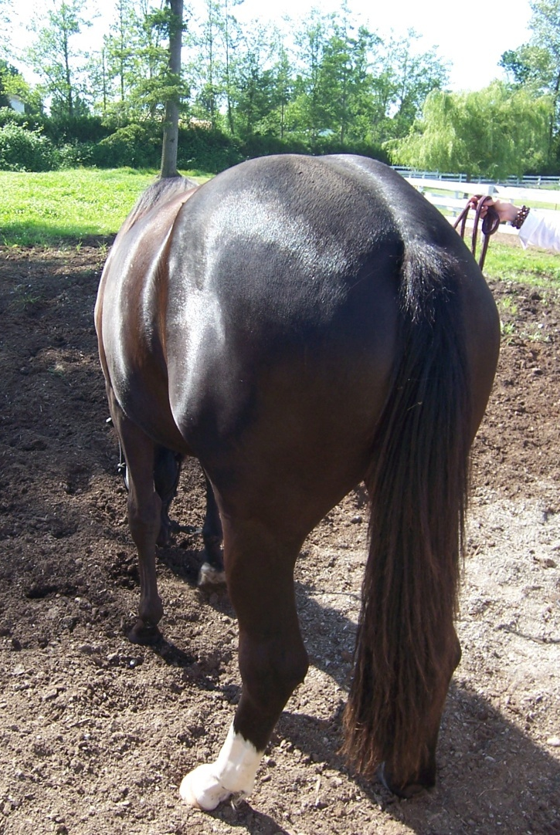
The End

Slide 11
Crude Protein (CP)
Protein is second most important nutrient behind water
Hays fall anywhere between 4-20% on average depending on maturity at harvest
Effects on Crude Protein - fertilization, environmental conditions, forage species, yield, soils, resistance to disease
Maturity offers more yield, but lowers quality
Alfalfa Stages – Bud, early bloom mid bloom, full bloom
Timothy Stages – Joint, pre-bloom head, fully headed

Slide 12
Grass Hay
Grass hays store their energy as sugars in leaves and stems
1
Grass hays can be very high in sugars if dairy hays selected for high fructans
2
Grass hay can be low in protein high in sugar if not fertilized
3
Vary in energy level
4
Lower in calcium/ph (minerals) and vitamins, and trace minerals (orchard)
5

Slide 13
Legume (Alfalfa)
Higher in protein and energy
1
They store their energy as starch and sugars in the leaves. No fructans!
2
Ideal for rehabilitating starving horses
3
High in Calcium and K+ and Ph, can be low in trace minerals
4
A natural buffer
5

Slide 14
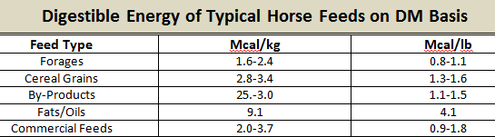
Energy
Expressed as either Mcal/Kg or Mcal/lb
16.65 Mcals per day
Depends on workload and metabolism
Easy Keepers / Hard Keepers
Activity factors can influence these numbers greatly

Slide 15
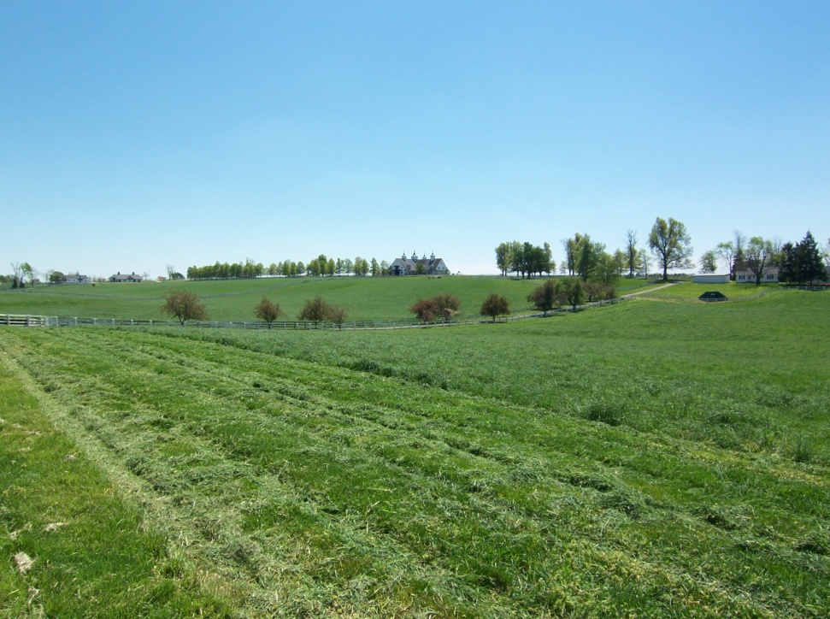
Moisture
Median average is 10-12%
Excessive moisture leads to hay heating, quality losses, nutrient losses and even fires >15-18%
Excessive moisture leads to spoilage, unpalatable
Control storage- ventilation –lge. Quantities
Mould – antigen – consumes nutrients and heat stress will produce toxins
Mould spores are tiny and invisible
Once inhaled they cause respiratory problems
If too dry it can also cause impaction colic <5%

Slide 16
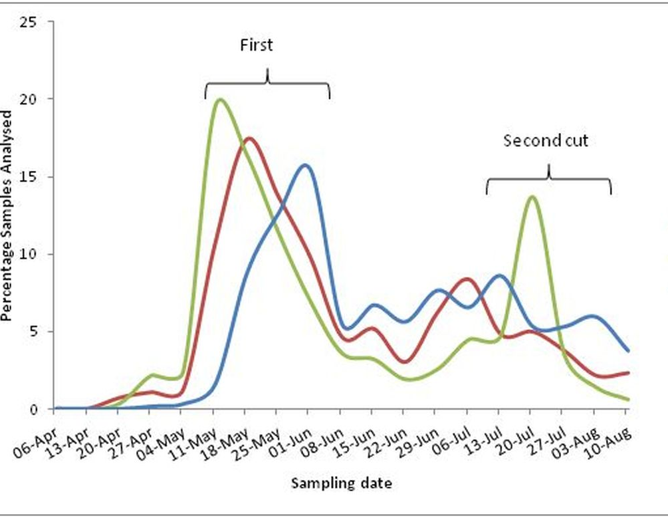
Dry Matter (DM)
Dry Matter is fundamental and an important analytical procedure, this is total solids once moisture is removed
To calculate DM content simply subtract moisture content from 100
Forage evaluation is on a DM or as fed basis (sample received). As fed includes moisture in each nutrient and always smaller values
But, nutrients are used on a dry matter basis regardless of a concentrate or forage

Slide 17
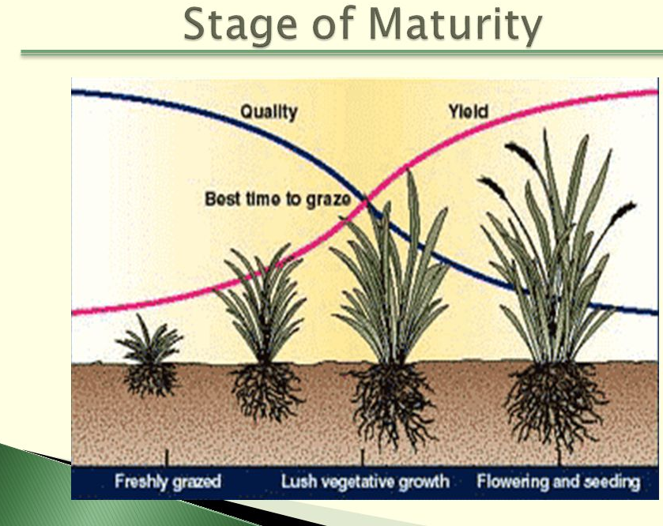
Crude Protein (CP)
Protein is necessary for producing enzymes, muscle tissue and bone density
Every cell in the body contains hundreds of proteins that function as enzymes driving the cellular functions
If protein is low <4%, it lacks the necessary enzymes to break down sugars, fibre is insoluble and necessitates additional amino acids to improve protein quality

Slide 18
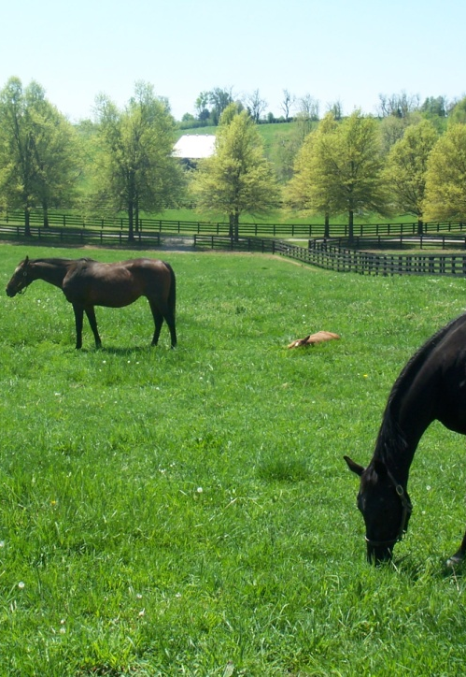
Acid Detergent Fibre (ADF)
Measures fibre concentration
Less digestible carb found in cell walls, includes lignin and cellulose - difficult to digest – releases endotoxins
Microbes needed to ferment hay
>41%, digestibility decreases and protein is less available
<32%, higher energy and intake, nutrients are more available, more palatable
If more palatable, sugars more available - if overfed

Slide 19
Neutral Detergent Fibre (NDF)
Forage Grade | Description | If the ADF is: | If the NDF is:
Prime | Excellent | Under 30 | Under 40
1 | Premium | 31-35 | 41-46
2 | Good | 36-40 | 47-53
3 | Fair | 41-42 | 54-60
4 | Poor | 43-45 | 61-65
5 | Reject | Over 46 | Over 66
Often considered indicator of forage quality
Total plant cell wall carbs, ADF, hemi-cellulose
>60%, digestibility decreases and lowers intake
<52%, higher energy and intake, nutrients are more available, more palatable, more calories
If NDF is high, reject, too much waste and not desirable, predicts intake

Slide 20
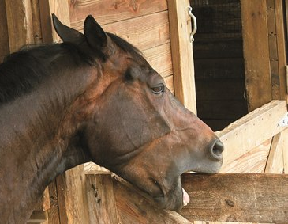
Lignin
Provides strength and protection to plant
Indigestible
As plants mature – increases- stiffening agent
We hope for approx. 5% on grass hays, 6% Alfalfa
Too soft – quidding /wadding - impaction (dry and dusty, watch for colic)
Too stiff, very difficult to chew
Substitute cubes or super fibres (non lignified) - if fibre is not desirable

Slide 21
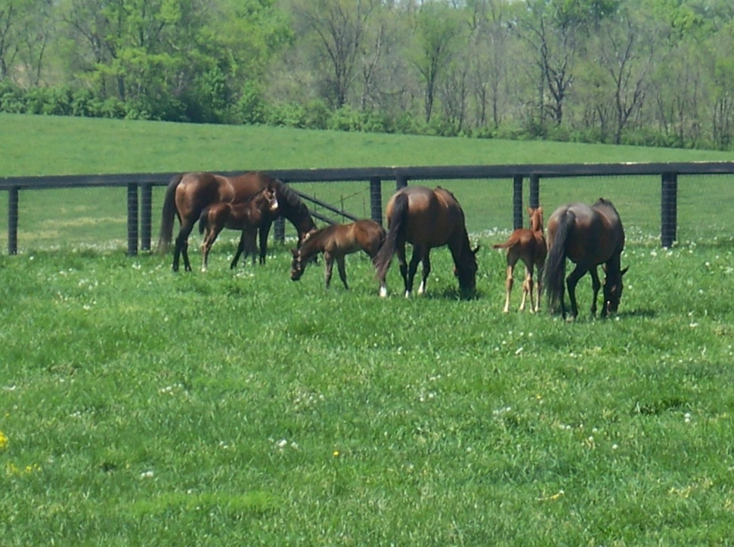
Ethanol Soluble Carbohydrates ESC
Carbs dissolved in ethanol solution
Primarily digested in the small intestine (glucose, sucrose)
Higher glycemic response – (high blood sugars)
Generates short term energy
Some benefits for hard working horses, not so much for horses that are sensitive to blood sugar changes, IR
Sugar sensitivities – Cushings (PPID), tying up
Abdominal stress associated with ESC (short chain fructans) as this sugar ferments rapidly
If acute laminitis or very high insulin, suggest keeping <8%

Slide 22
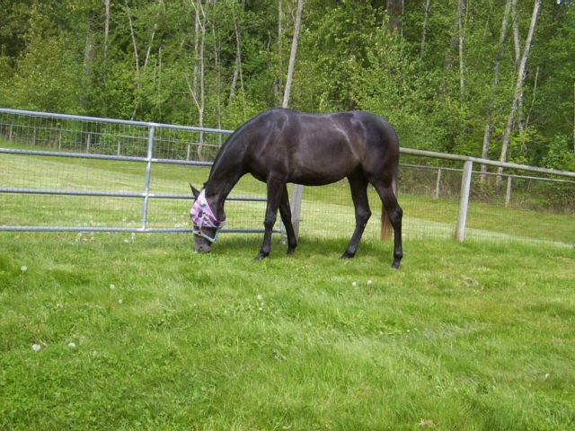
Water Soluble Carbohydrates WSC
Carbs that are extracted with water includes simple sugars and fructans
High levels might indicate high fructans in grass hay or high simple sugars in non-grass
Good for endurance, not laminitis
If watching for colic, diarrhea, laminitis, need to keep this value <10%
Wise to feed by weight and not volume

Slide 23
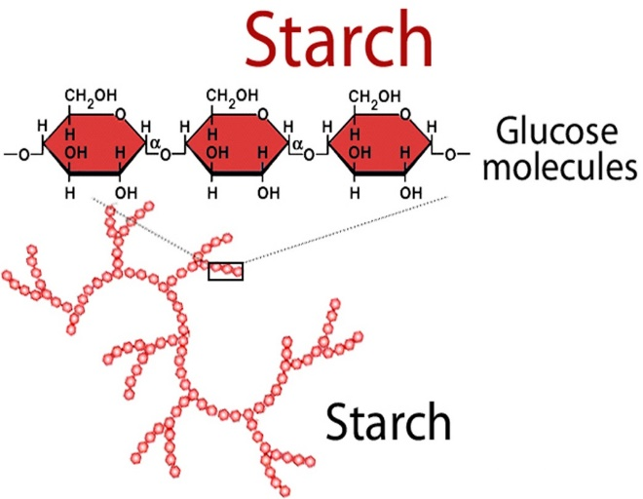
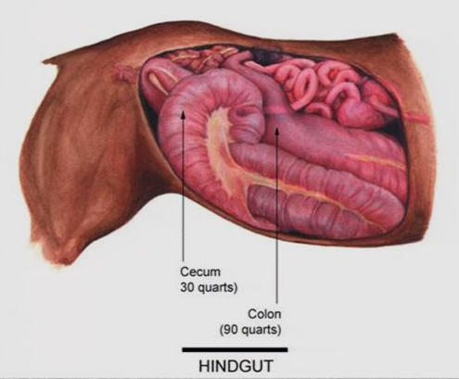
Starch
Mostly digested in small intestine broken down and absorbed as glucose (simple sugar)
Low Starch – for IR
High Starch – for quick energy
Problems arise when excess reaches/ferment in the hind gut
Rapid buildup of acid
Hindgut acidosis leads to laminitis
Destroys B Vitamins

Slide 24
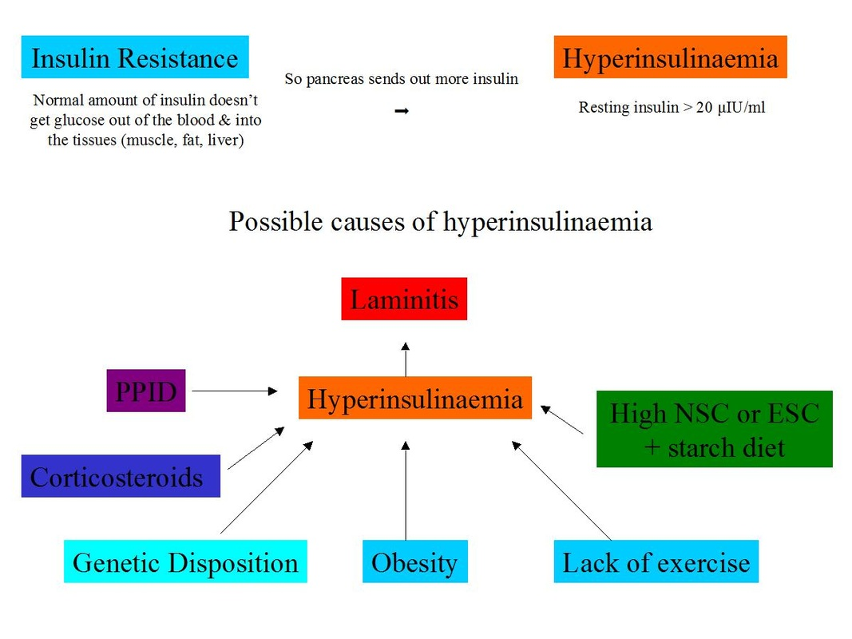
Starch
70% of starch is dumped into hind gut
Gas production during starch fermentation causes pain and colic
Fibre digestion reduced
Manure – soft and vomit smell (acidic aroma)
Feed little and often - oats
Grams per hour

Slide 25
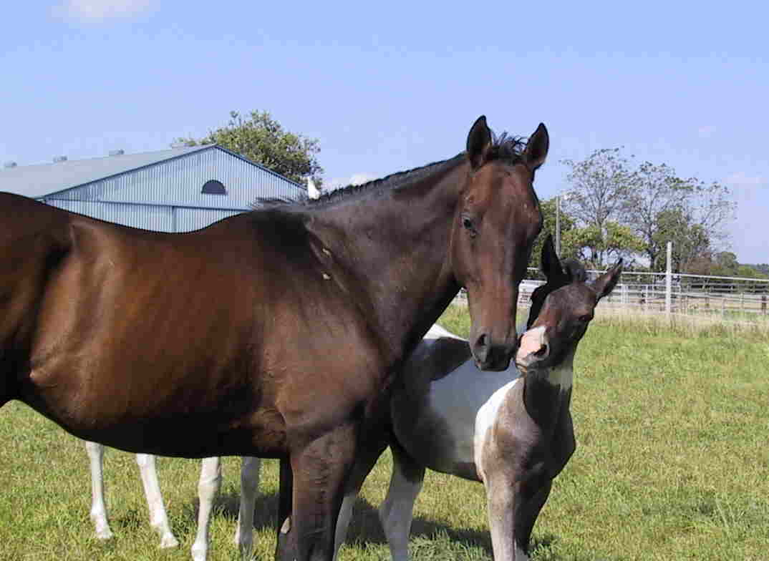
Fructans
Can trigger colic or laminitis from toxic effects from a lower PH level
Fructans can be 30-40% and they only ferment in the hind gut. Fructans vary in type and fermentation rate.
Lactic acid forms from low ph and then good microbes die (D and L)
Not digested in small intestines only hind gut
Excessive caloric intake, obesity #2 behind colic
Found in cool season grasses but not alfalfa
Try and avoid being without any forage for longer than 4-5 hours or problems may occur

Slide 26
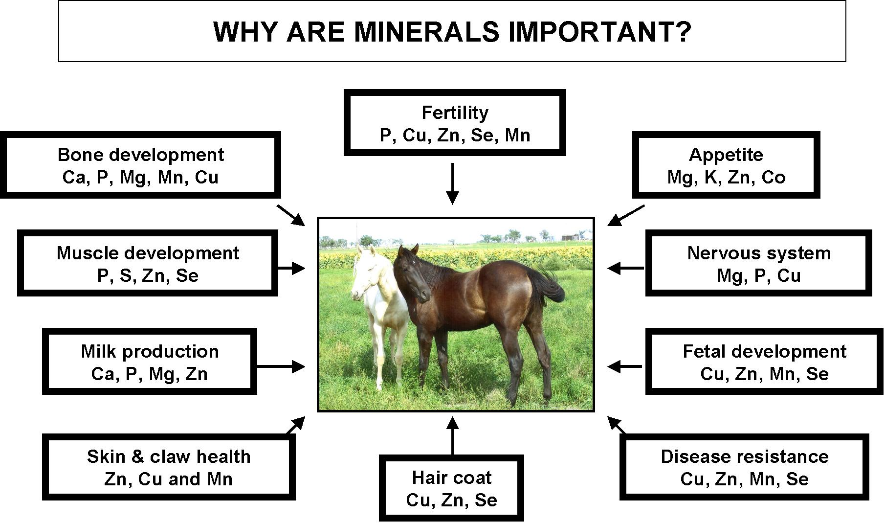
Minerals

Slide 27
Forage for Horses

Slide 28
Forage for Horses

Slide 29
Forage for Horses

Slide 30
The End

