Slide 1

B.C. Horse Council Travelling Road Show
Wendy Bennett
September 2018.
Notes:
Good morning (afternoon)
By show of hands, can you please tell me how many of you are employers – you are registered as an employer with WCB? Great!!! Everyone who raised their hand is automatically a member of AgSafe and if you haven’t already taken advantage of our FREE services, I would strongly recommend it. AgSafe is funded through a levy that is collected as part of the WCB assessments that agriculture employers pay – we are not the same as WCB – we are funded by the agriculture employers in the province so we provide all our services back to agriculture at no additional charge.
We have a Safety Consultant in your area who can visit your site and provide any information you need to keep your facility and your workers safe and in compliance with the WCB regulations. A safe work facility means a safe facility for your clients and customers as well, so it’s a definite benefit to have one of our team come out and help you……….and it’s FREE!!!

Slide 2

Notes:
So, now I have a question for you….
In 2016, how many injuries in the horse industries resulted in at least one day time loss from WCB?

Slide 3
24
Separate injuries resulting in at least one day time loss
Notes:
That may not seem like a lot, but those are JUST the injuries that were reported to WorkSafeBC, involved at least one doctor’s visit and at least one day of reported time lost from work. So….given that, how many injuries are far more likely to have actually occurred? I would hazard a guess of about 100 times more given how the ratios work statistically.
In 2017 there were 26 and as of April 30, 2018 there were already 12 accepted time loss claims for 2018
The injury rate for your industry was 6.6 in 2016 which means for every 100 full time workers, 6.6 of them will sustain a time loss injury. The rate for all of B.C. including all the jobs that you would consider to be dangerous was 2.2.

Slide 4
Notes:
Of these 24 injuries in 2016, how many days work were lost in total??

Slide 5
2332
Days lost due to injury
Notes:
These 24 separate injuries resulted in over 2300 days lost in 2016. That’s an average of 97 days per injury – that’s work days – this equates to more than 4 months!! PER INJURY

Slide 6
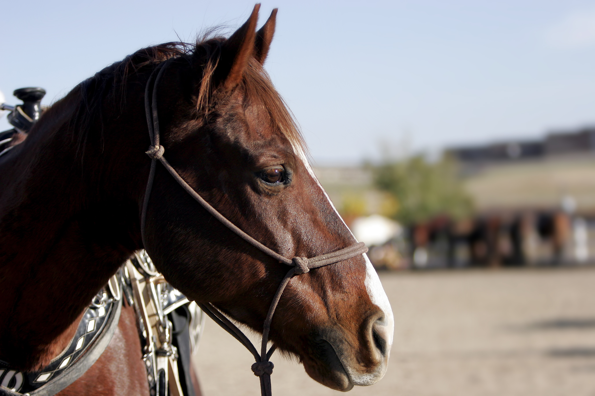
Notes:
How many of these 24 injuries had anything at all to do with a horse???

Slide 7
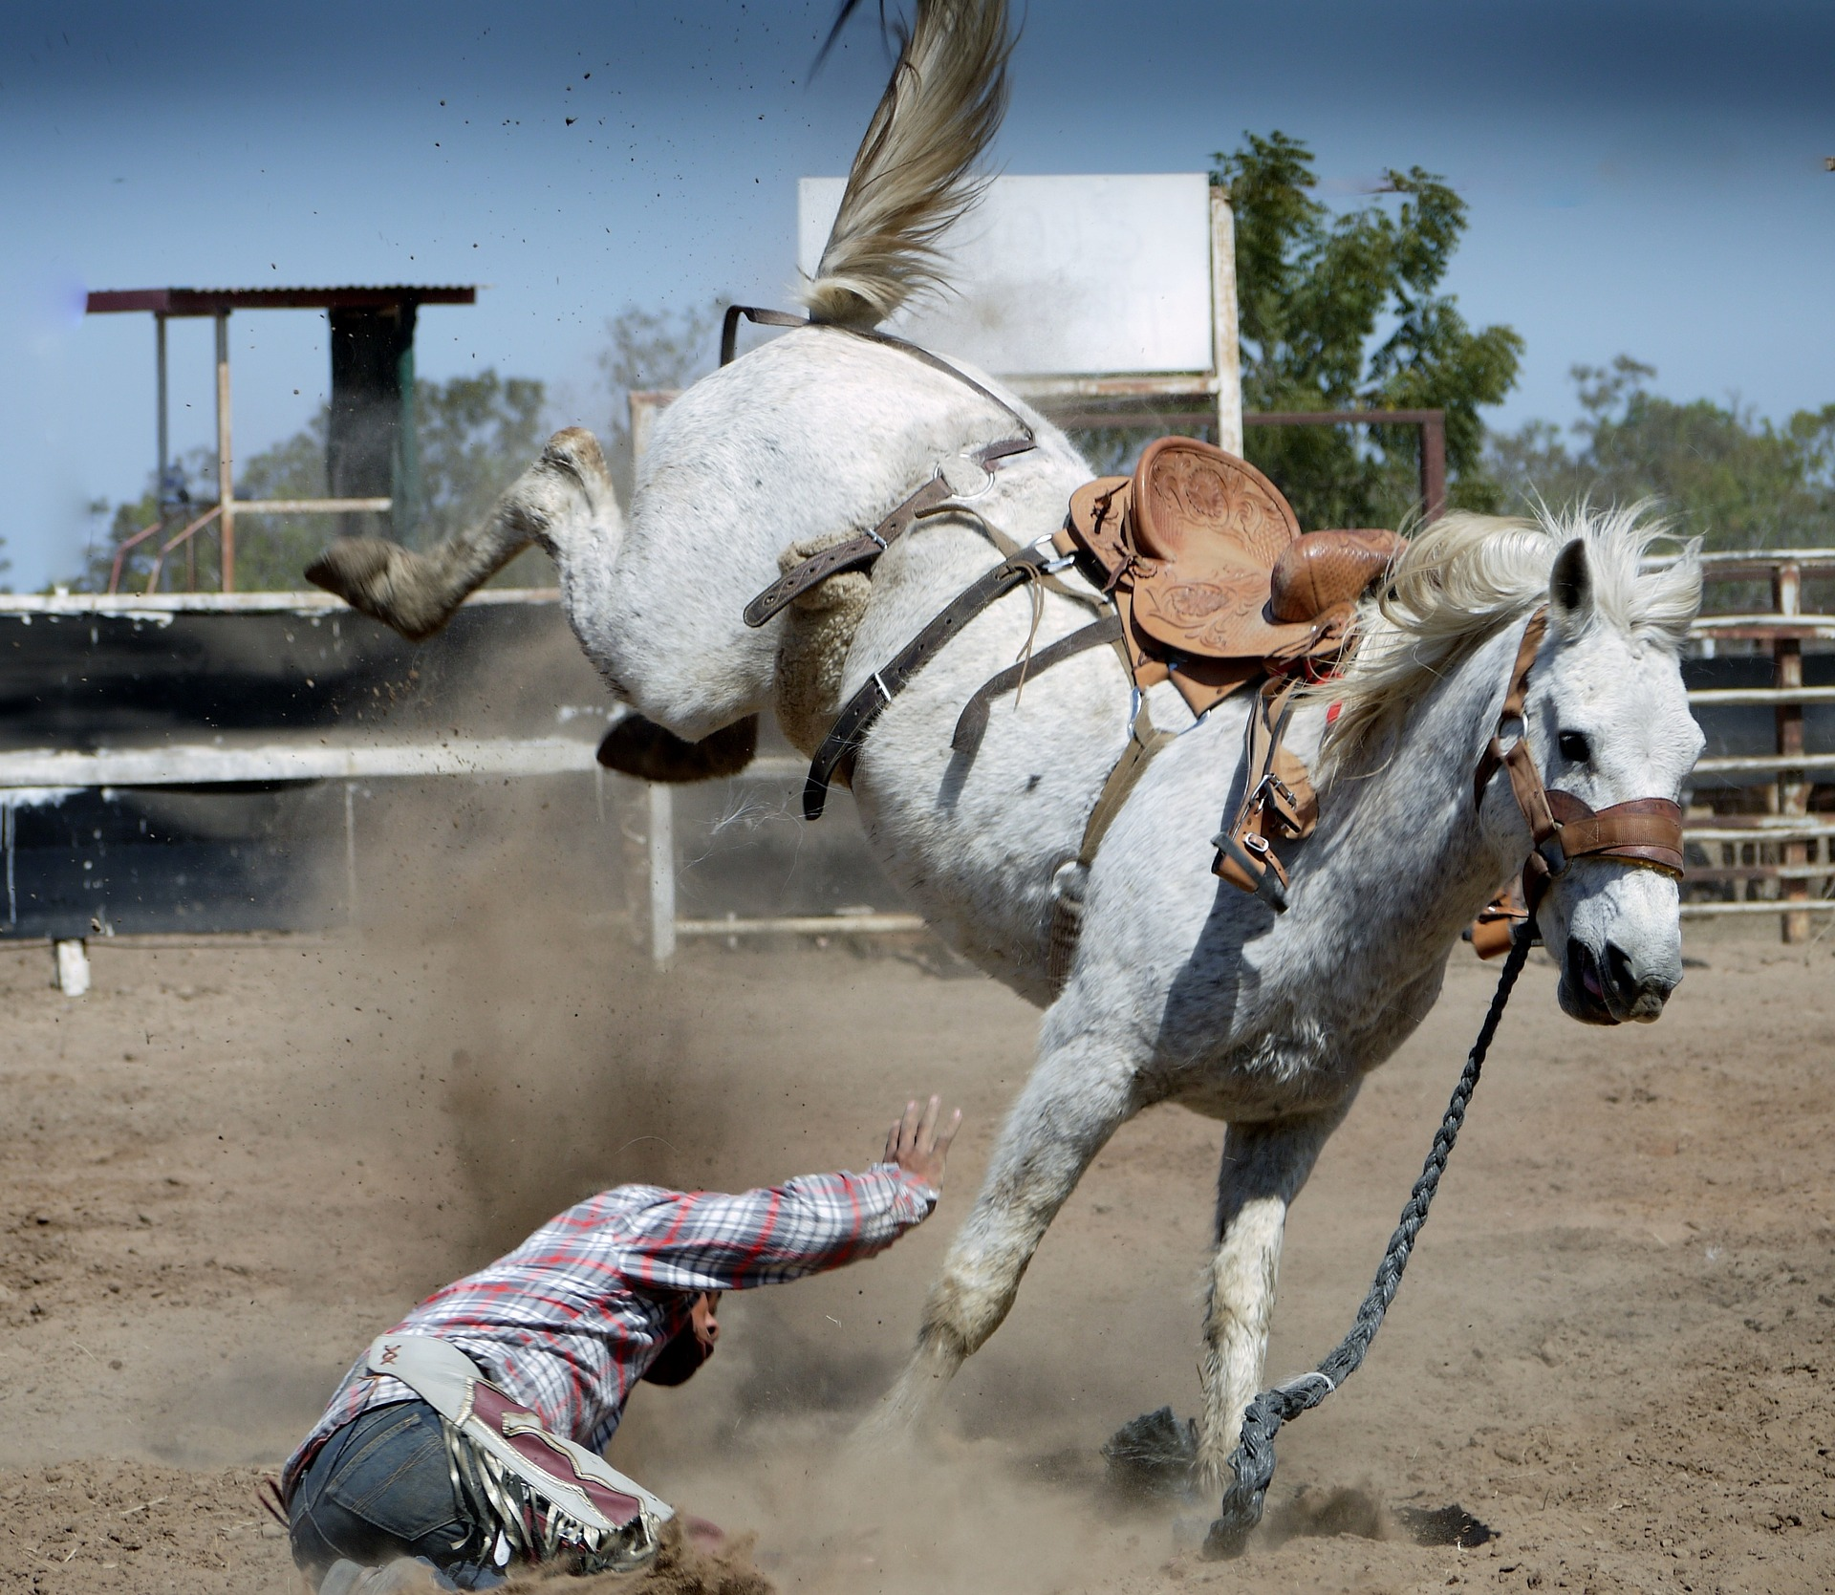
Horse’s Fault
15
Notes:
Of these 24 injuries, fully 15 of them were directly related to the horse.
Now, I realize this a rodeo picture, but falling off a horse because it bucked or reared up is a very real factor in the incidents that caused injury.

Slide 8
So Where Did They Come From?????
Notes:
Groups – brainstorm how people are getting hurt in the industry
By table – writing it down on the paper provided (we are at a hotel so pads/pens are always available)
5 minutes to brainstorm – one minute per group to discuss – ensure each group selects a spokesperson to summarize

Slide 9
Actual Injuries
What happened? | How Many? | Resulting Injury
Fell from the horse | 4 | Fracture / concussion
Kicked by the horse | 8 | Fracture / concussion
Other contact by the horse | 1 | Concussion / laceration / fracture
Sudden movement – no fall | 2 | Back strain / shoulder strain

Slide 10
Notes:
What body part was injured the most?

Slide 11

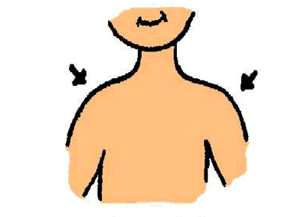
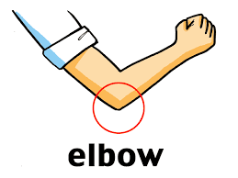
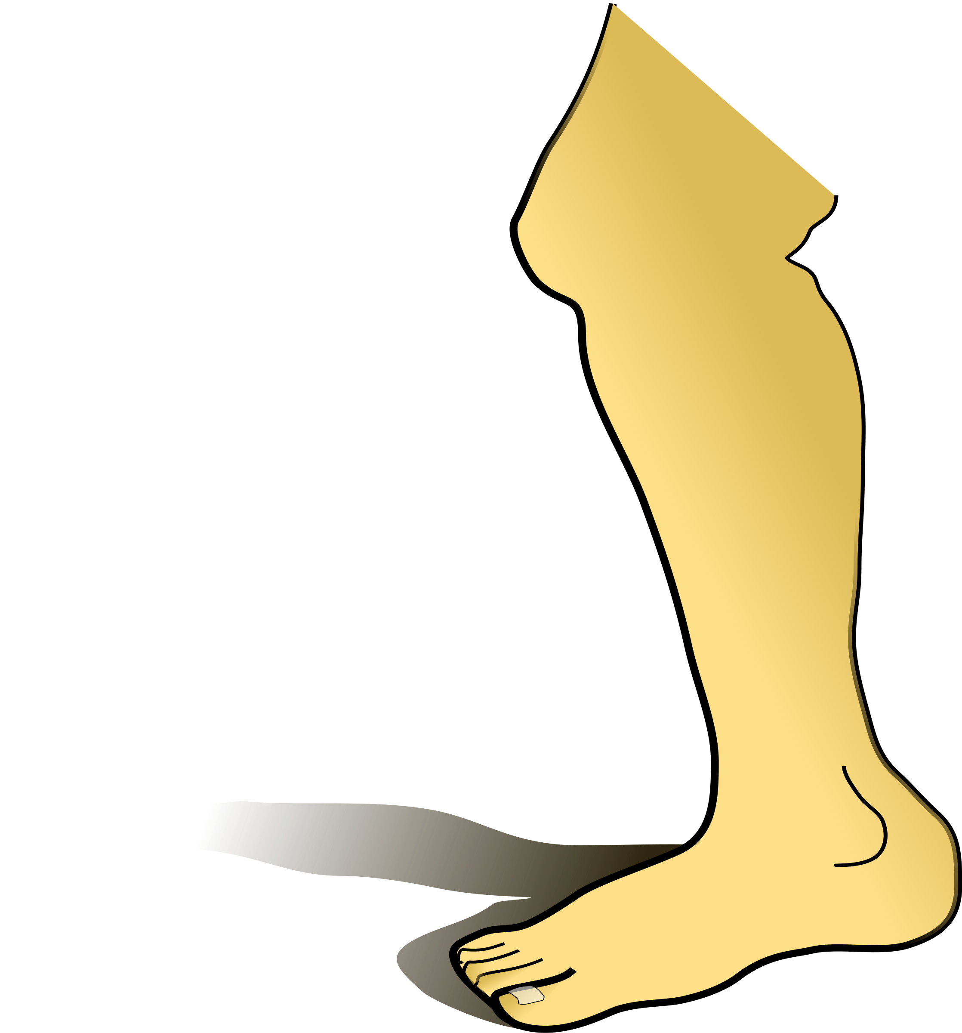
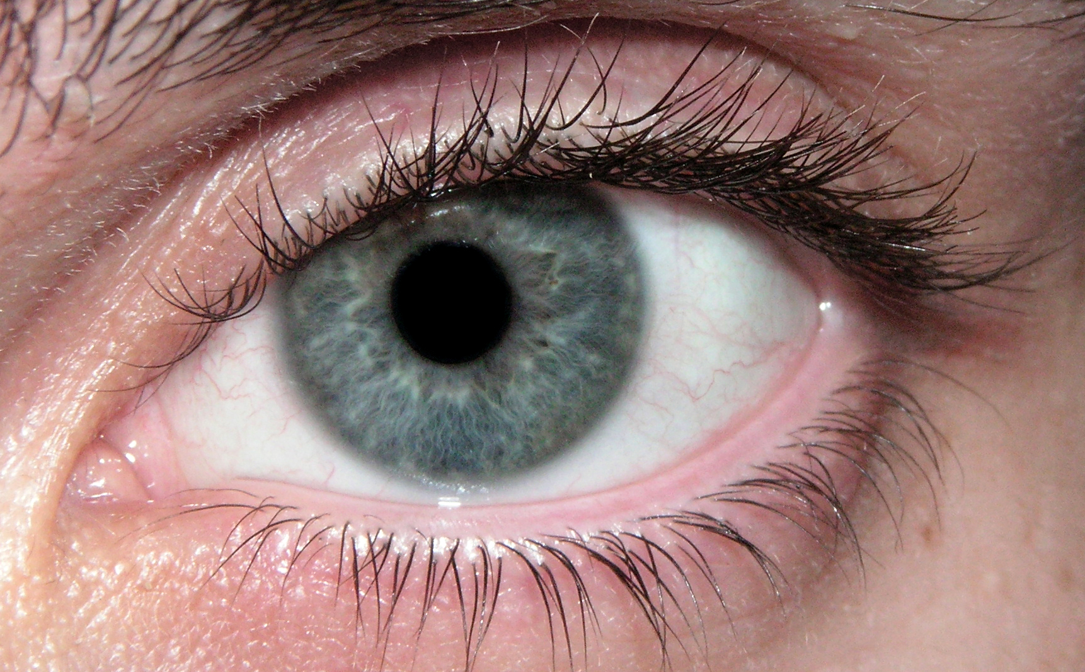
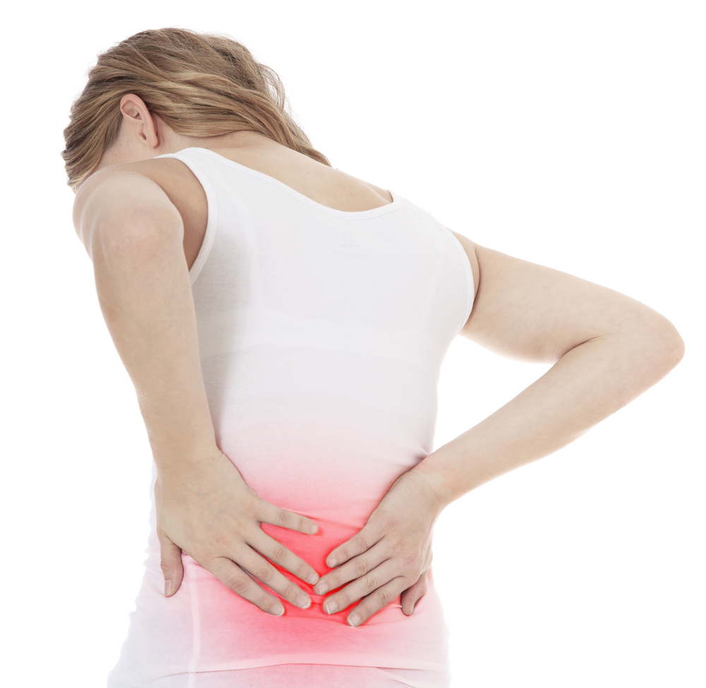

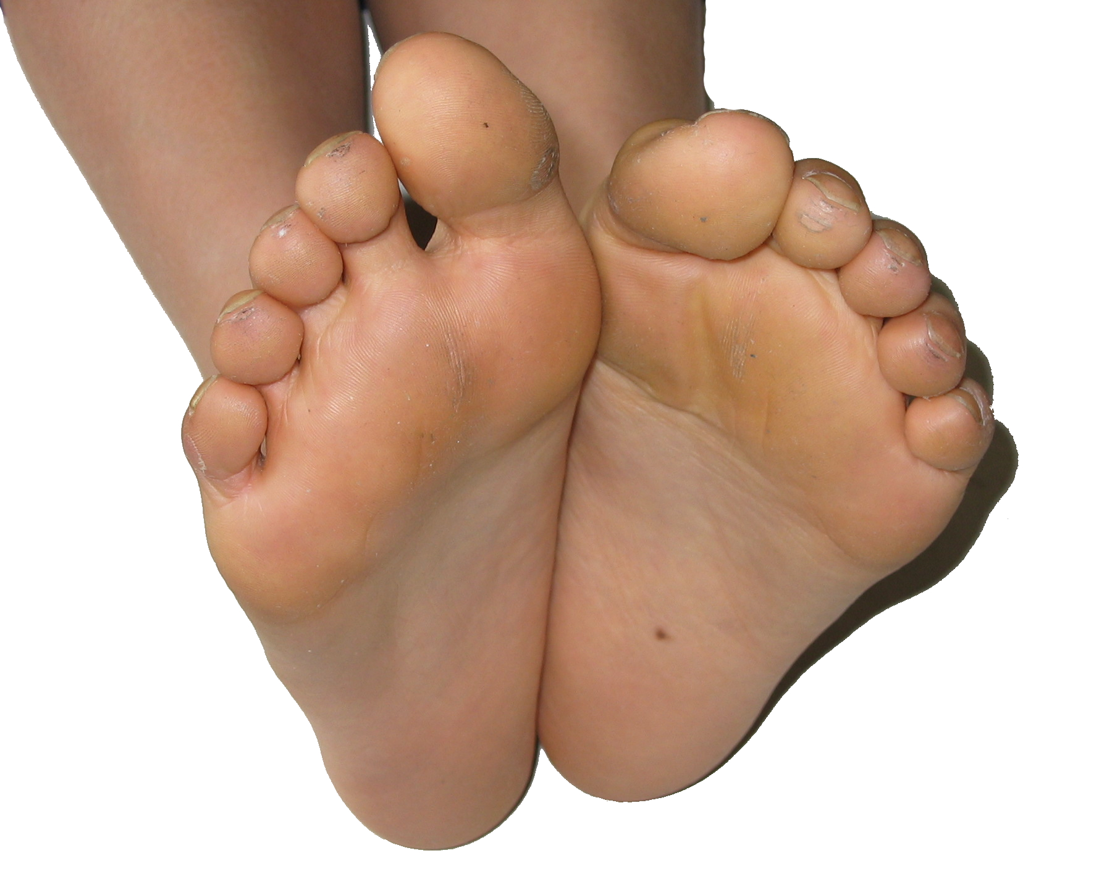
Brainstorm
This Photo by Unknown Author is licensed under CC BY-SA
This Photo by Unknown Author is licensed under CC BY-SA
This Photo by Unknown Author is licensed under CC BY-SA

Slide 12
Injured body parts
Head, Face & Ears | 6
Wrist, Fingers & Hand | 4
Back | 5
Ankle, Toe & Feet | 2
Arms & Shoulders | 3
Hips, Legs | 3
Notes:
Does this make sense to you? When you look at the work activities in your day to day operations, does it make sense that these are the areas where individuals sustain injury?

Slide 13
15-24
25-34
35-44
45-54
55-64
65+
Notes:
What age group do you fit into? Are you a millennial – in the first two groupings? Or are you somewhat older than that? How about those of us who are just old?
So given that you know about your age and the age of those around you, what age group would you say has the most injuries?

Slide 14
Age group | Number of injuries
15-24 | 7
25-34 | 4
35-44 | 1
45-54 | 3
55-64 | 8
65+ | 1
Notes:
Does this surprise you?
Remember that these are injuries that were reported to a doctor and subsequently to WCB that resulted in at least one day off work. So if you consider the number that went unreported or were treated and then the injured person returned for their next scheduled shift, the number of injuries is much much higher.

Slide 15
15-24
25-34
35-44
45-54
55-64
65+
Notes:
What age group has the most time loss?

Slide 16
Age group | Number of injuries | Days lost
15-24 | 7 | 518
25-34 | 4 | 212
35-44 | 1 | 12
45-54 | 3 | 324
55-64 | 8 | 1209
65+ | 1 | 57
Notes:
Now the next slide, I am going to provide you with brief descriptions of some of the injuries with the most time loss. If you know the place that this happened at, and it is not your own, please don’t say anything out loud. Information here is to be treated with a degree of confidentiality – while we get the injury information from WorkSafe, we don’t get any names or personal details.

Slide 17
Head & Face – 463 days
 | Nature of Injury | Age | Days
1 | Fracture | 15 – 24 | 402
2 | Fracture | 15 – 24 | 26
3 | Concussion | 15 – 24 | 12
4 | Fracture | 15 – 24 | 6
5 | Laceration | 15 – 24 | 5
6 | Concussion | 35 – 44 | 12
Notes:
1. Riding a playful and excited horse back to the barn, worker’s body weight was thrown forwards and leg became caught in in the reins. Worker fell from horse
2. Walking the horse, the horse’s blanket strap unbuckled & fell off the horse, worker went to retrieve it and the horse kicked worker in face.
3. Holding onto the lead rope with the horse on right side, horse turned suddenly & head butted worker in face, workers head was snapped back.
4. Worker was kicked in the face by a horse
5. Worker was bringing horse out of paddock when it took off, worker stepped to side to allow horse to pass by when it struck out hind hoof and struck worker
6. Riding a horse & demonstrating a jump, the horse stumbled as landed, worker hit chin on horse’s neck and then fell off the saddle onto the sandy ground

Slide 18
Back – 224 days
Nature of Injury | Age | Days
Back Strain | 25 – 34 | 80
Fracture | 25 – 34 | 65
Back Strain | 25 – 34 | 10
Back Strain | 45 – 54 | 12
Back Strain | 65+ | 57
Notes:
Worker was riding a horse, it bucked suddenly jolting worker
Worker was working a horse around a track ~ 30 miler per hour, the horse did a quick turn and worker flew forward off horse onto the track.
While lifting a 6 ft metal gate weighing ~ 30 lbs, worker felt pain in lower back
Worker did heavy lifting of hay bales, feed bins and horse blankets which were often wet
Animal attack, kicked by a horse while walking

Slide 19
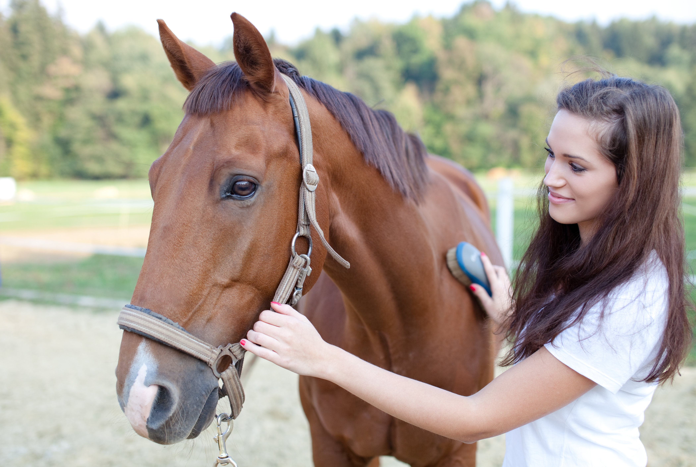
Are they a worker?

Slide 20
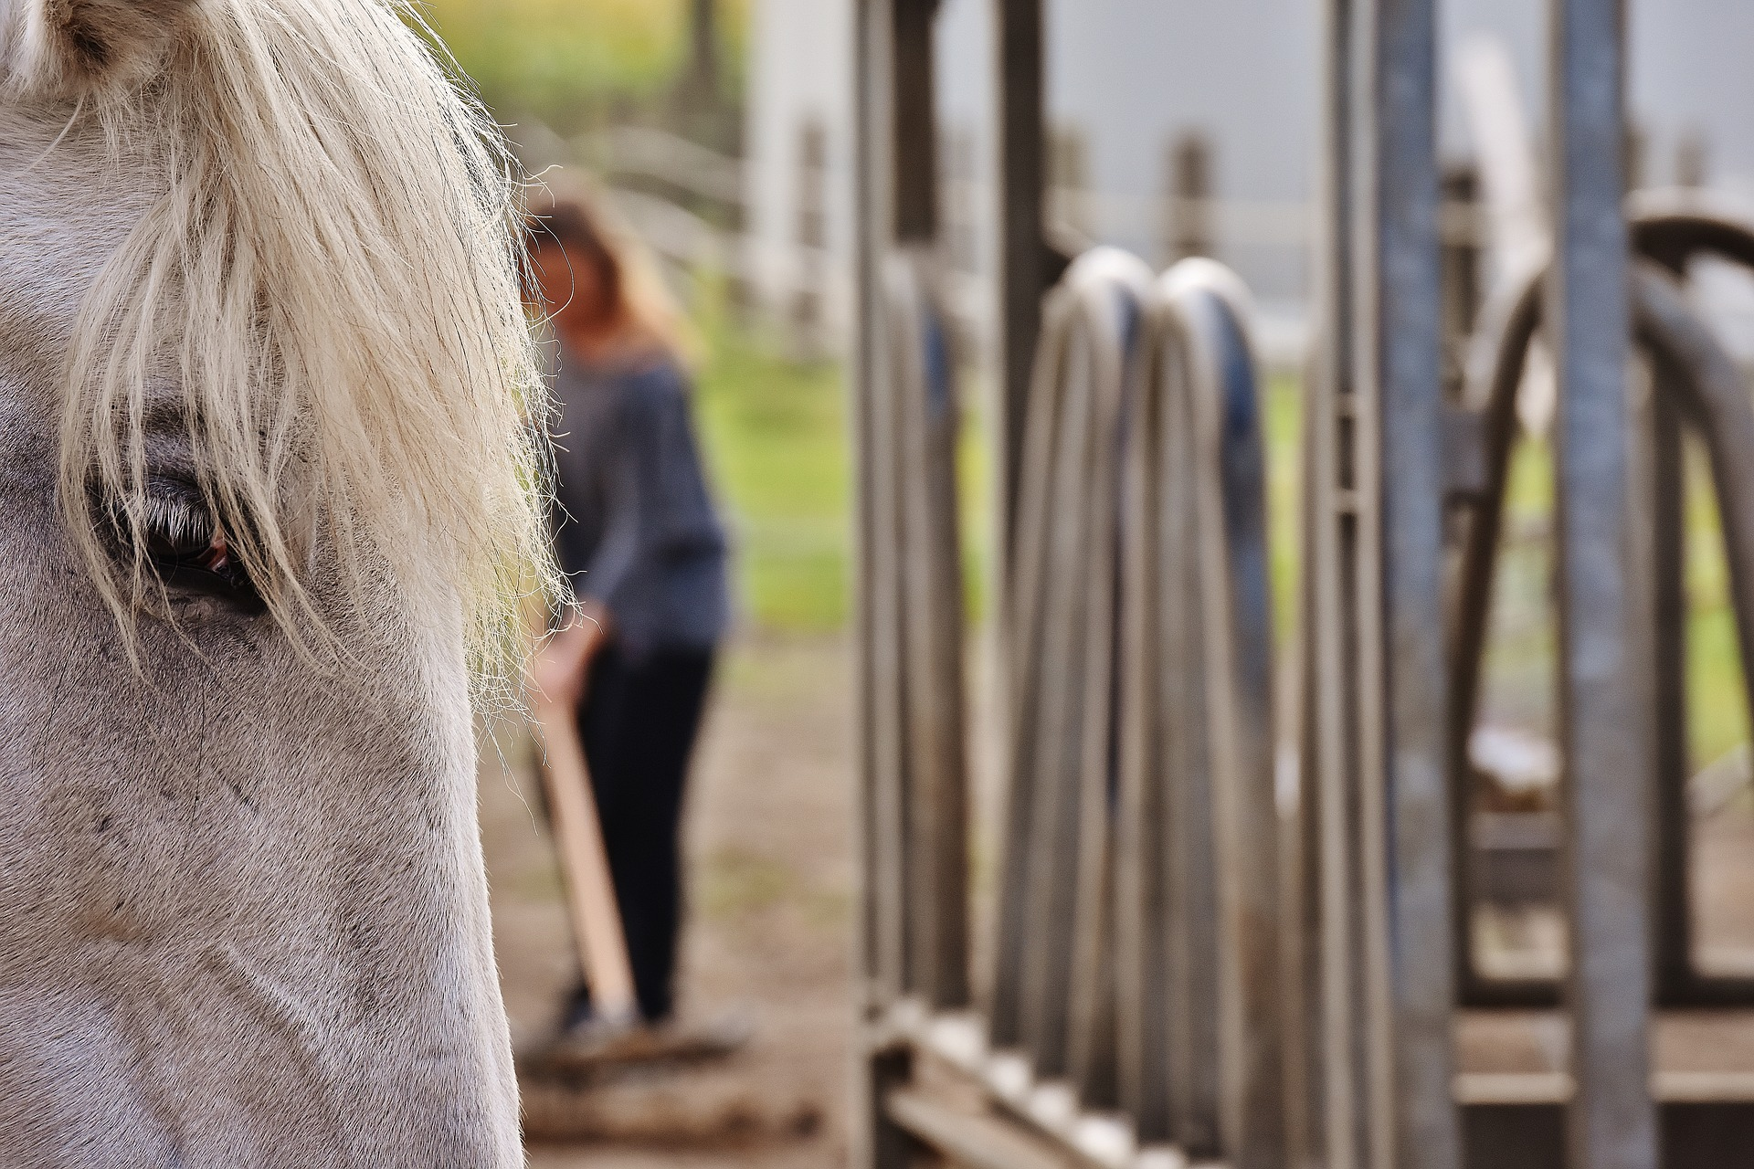

Slide 21
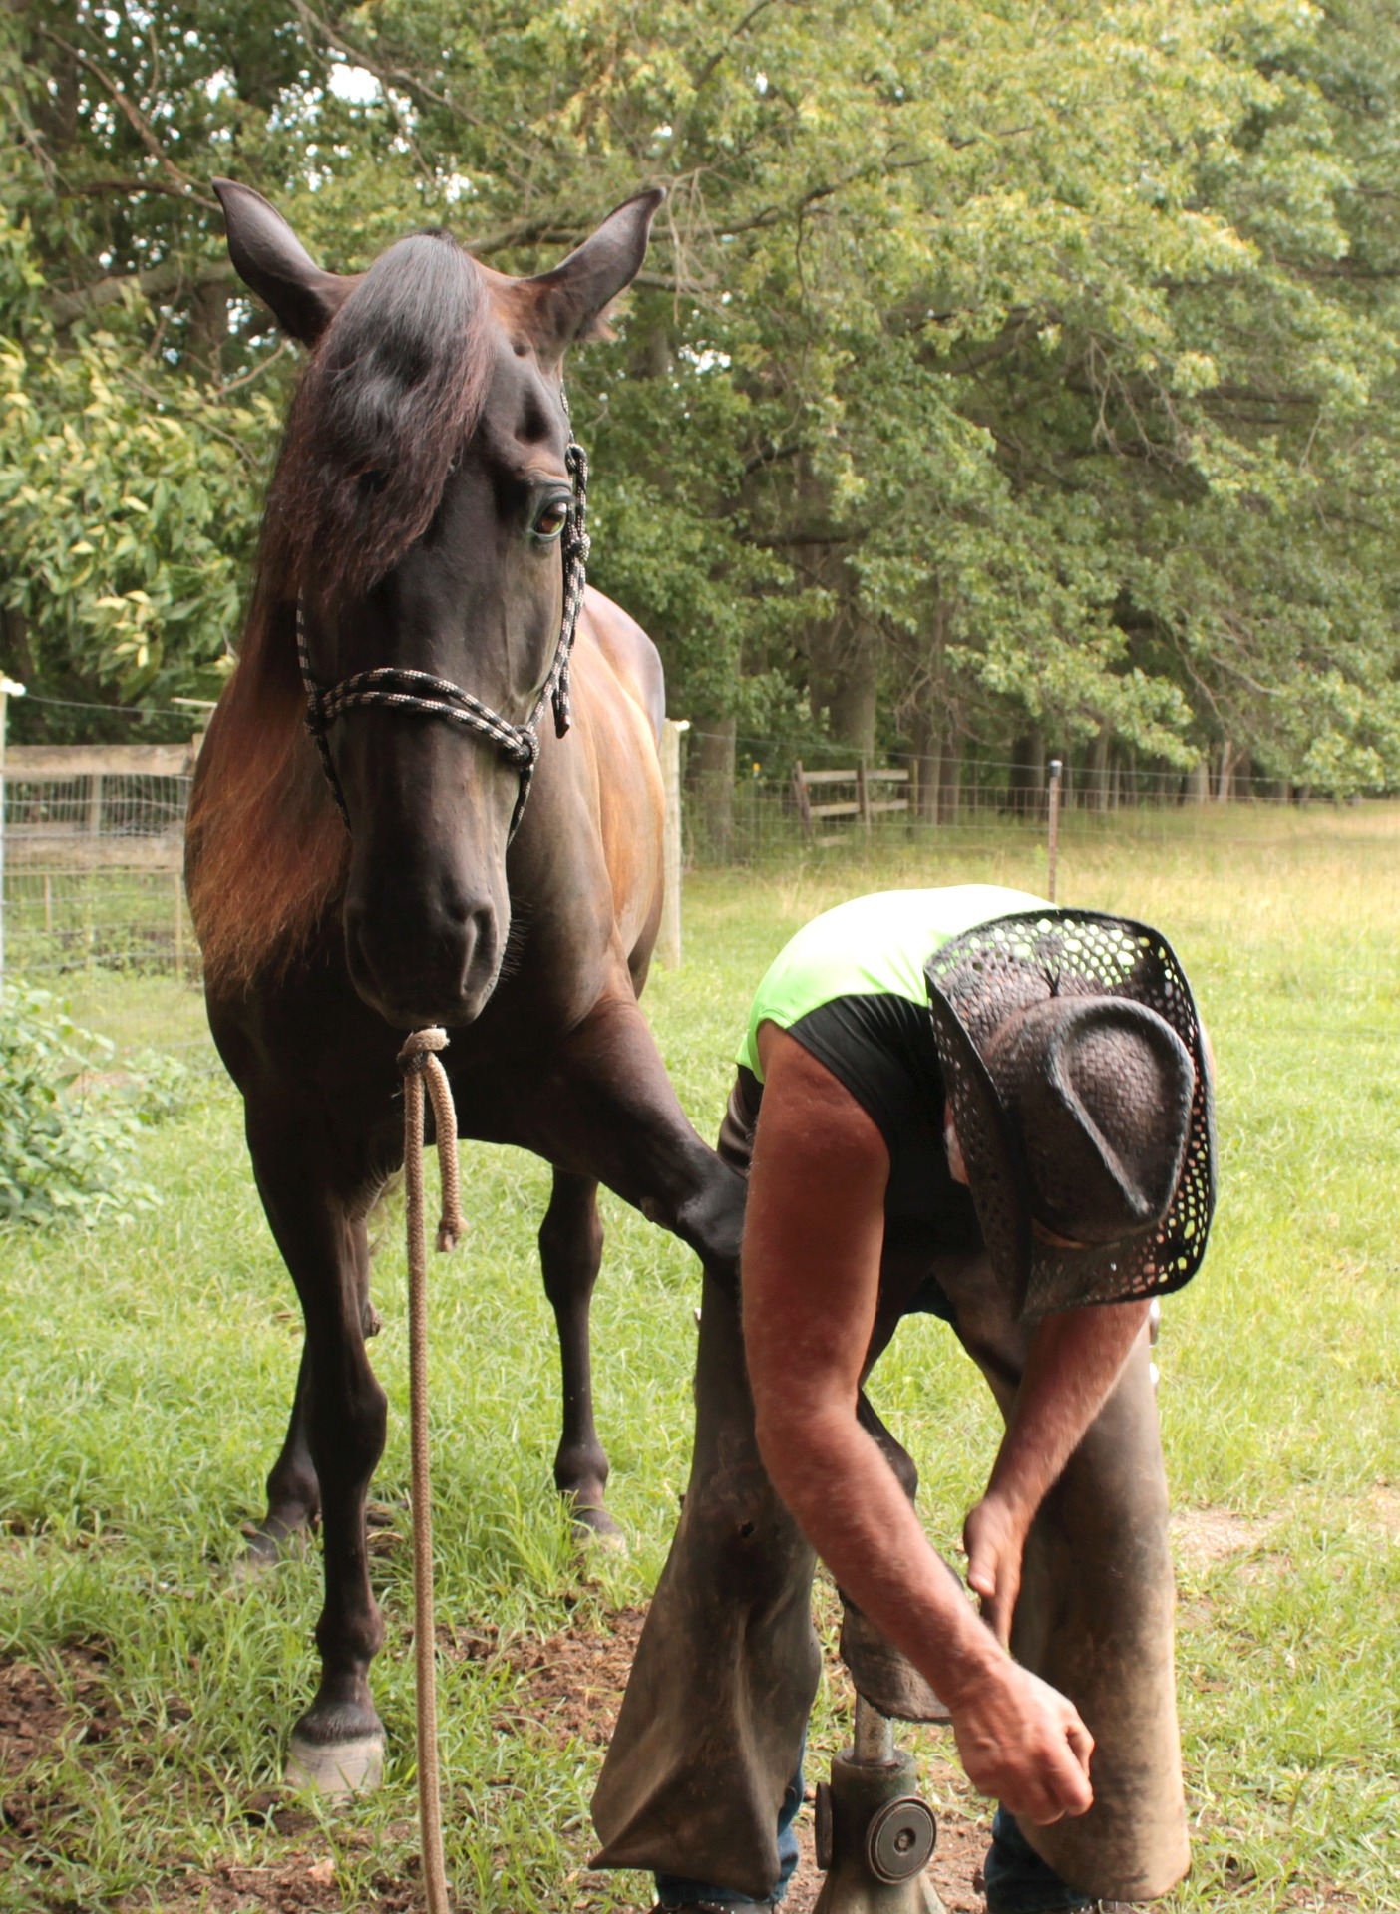

Slide 22
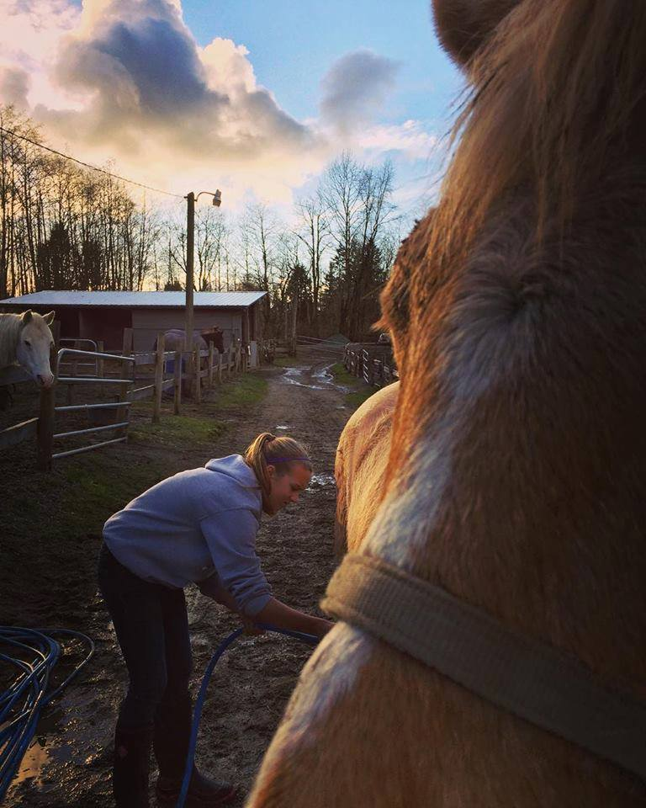

Slide 23
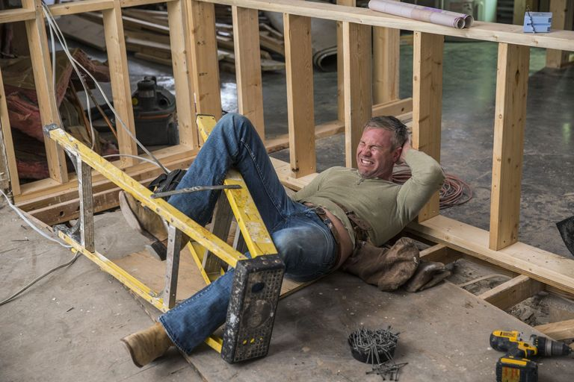

Slide 24

Being Prepared
Notes:
The best way to prevent these injuries from happening, or at least reduce the impact if they do, is to ensure that you have a plan to recognize hazards at your worksite and take steps to mitigate those hazards. AND, if an incident happens and results in an injury, that you have plan in place to address the incident and provide alternate work for the injured worker.

Slide 25

First Step
Notes:
Prevent injuries from happening
Now the goal is always zero, but we know that is very difficult to achieve, but that is still where we have to aim.

Slide 26
HOW?
Groups
Look at the How
Come up with a prevention
Notes:
Back to your groups with your list of how people are getting hurt in your industry.
For each ‘how’ that you wrote down, write down one thing that could be done to prevent this from happening in the future.
You have 5 minutes again and then I would ask that you have a spokesperson to represent and provide your highlights

Slide 27
IT’S TIME TO PLAY….
Safety Jeopardy

Slide 28

Questions?

Slide 29

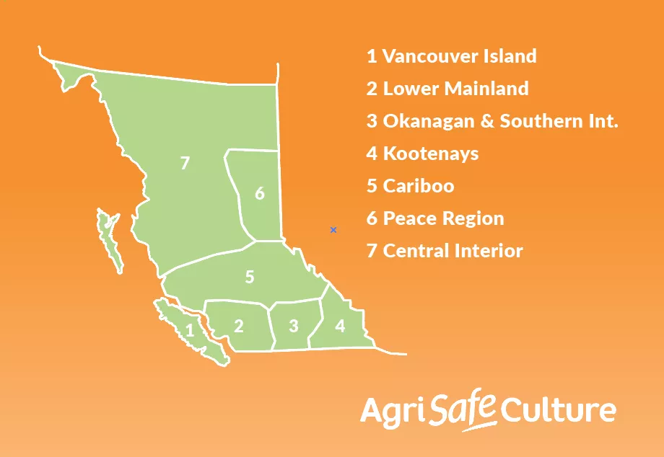

THANK YOU
1-604-881-6078 (Local)
1-877-533-1789 (Toll Free)
COR@agsafebc.ca (Email)

