Slide 1


A Heavy Burden: Obesity and Associated Health Risks in Horses
Julia B. Montgomery, Med Vet, PhD, DACVIM (LAIM)
Assistant Professor, Western College of Veterinary Medicine
September 9, 2018

Slide 2
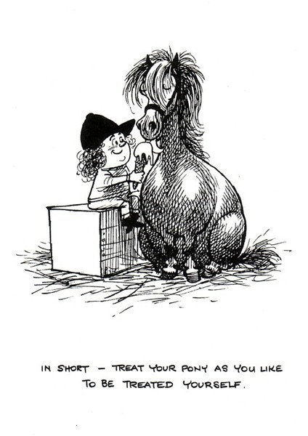
Overview
From table to stable: equine obesity
Equine Metabolic Syndrome (EMS)
  Definition
  Clinical presentation
  Diagnosis
  Management
  Prevention
EMS research at the WCVM
http://www.lorileeart.co.uk/1962-thelwell-pony-icecream-print_AISHK.aspx

Slide 3
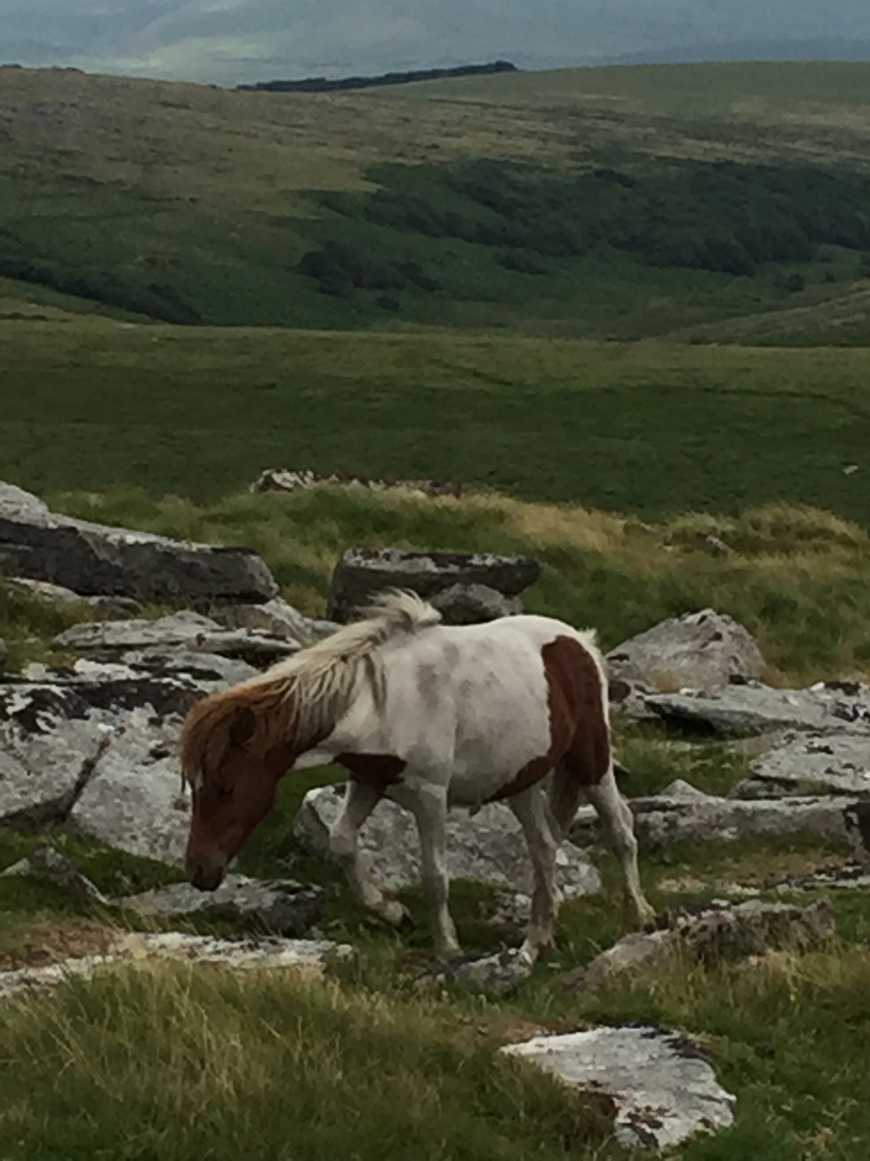
From Table to Stable
The obesity epidemic has reached the barn
  Changing lifestyle
  The new “normal”
  Overweight or obese horses >20% in several countries
Survey of 290 horses in SK
  20.3% over-conditioned (BCS = 7)
  8.3% obese (BCS = 8 or 9)
EMS-associated laminitis
  Most diagnosed cause of laminitis

Slide 4
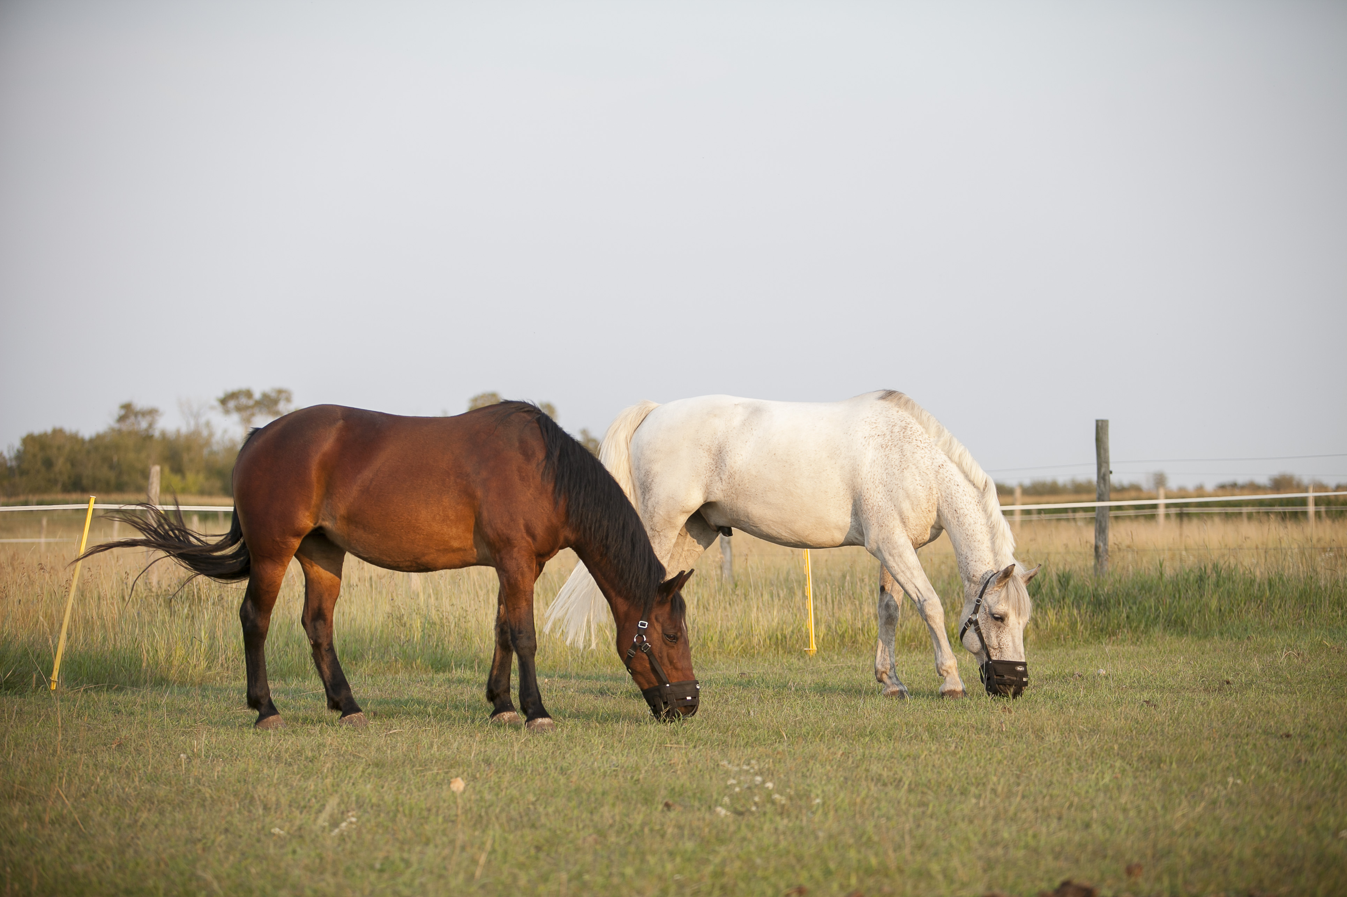
“Easy keepers”
“Hardy” breeds
  Ponies
  Morgans
  Arabians
  Paso finos
  Domesticated mustangs
History of laminitis
Equine metabolic syndrome (EMS)
WCVM

Slide 5
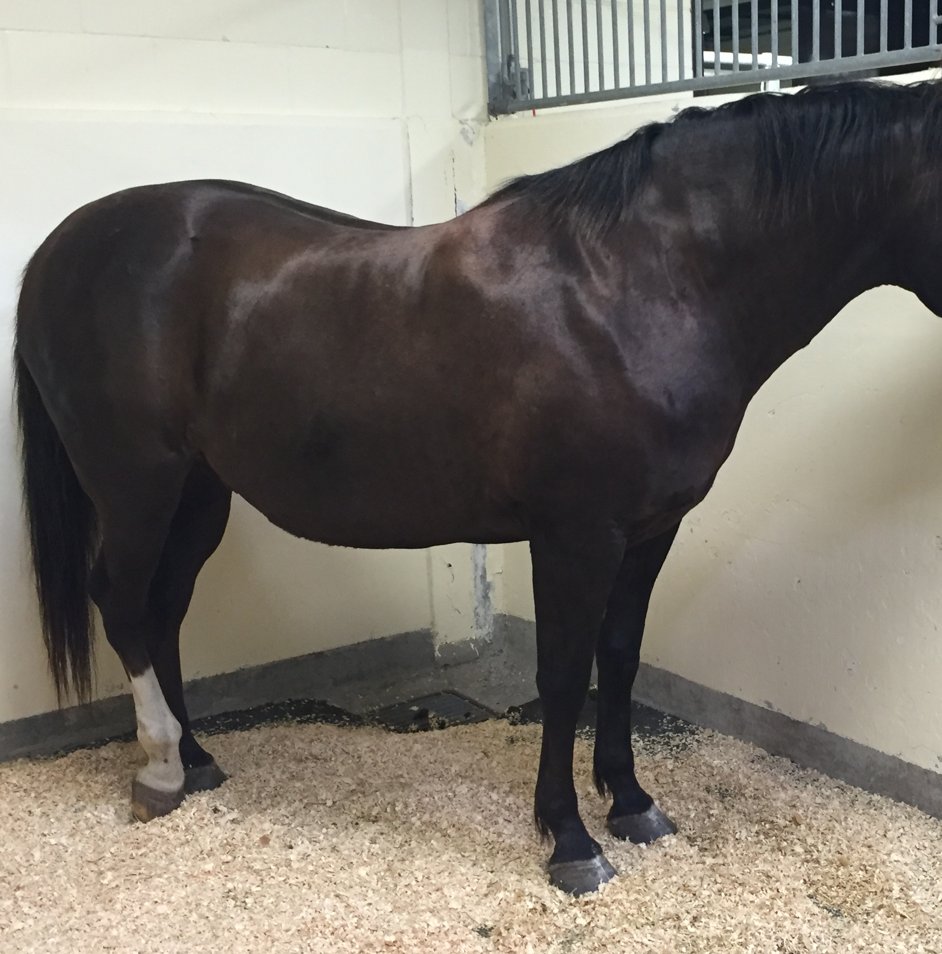
EMS Definition
Abnormal insulin metabolism (insulin dysregulation)
Obesity and/or regional adiposity
  Cresty neck
  Fat deposits over shoulder and rump
  Crease down back
Weight-loss resistance
Abnormal fat metabolism
Predisposition for laminitis

Slide 6
Insulin Dysregulation
Any combination of:
  Fasting hyperinsulinemia
    Elevated blood insulin after fasting
  Postprandial hyperinsulinemia
    Elevated blood insulin after a meal
  Tissue insulin resistance
    Abnormal metabolic response to insulin
Note: insulin is responsible for glucose uptake into tissues

Slide 7
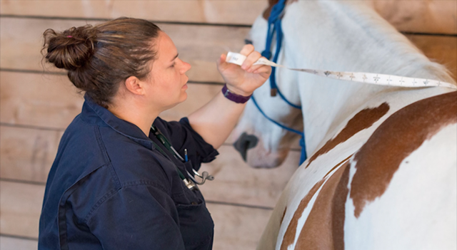
EMS Clinical Presentation
“Easy keeper”
Normal or increased body condition score (BCS)
Regional adiposity/increased cresty neck score (CNS)
Laminitis
  Acute & historical
WCVM today

Slide 8
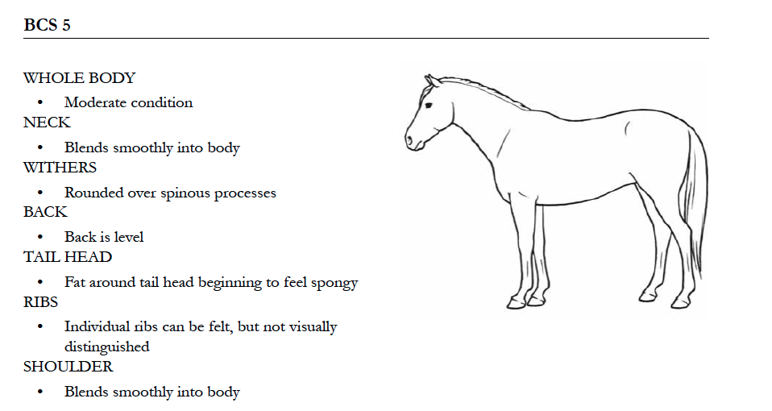
Body condition score (BCS)

Slide 9
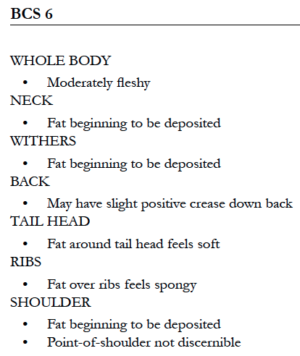
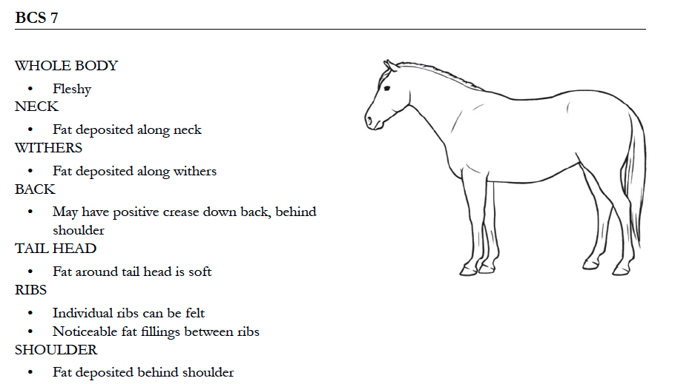

Slide 10
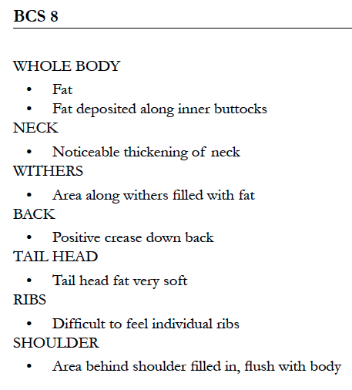
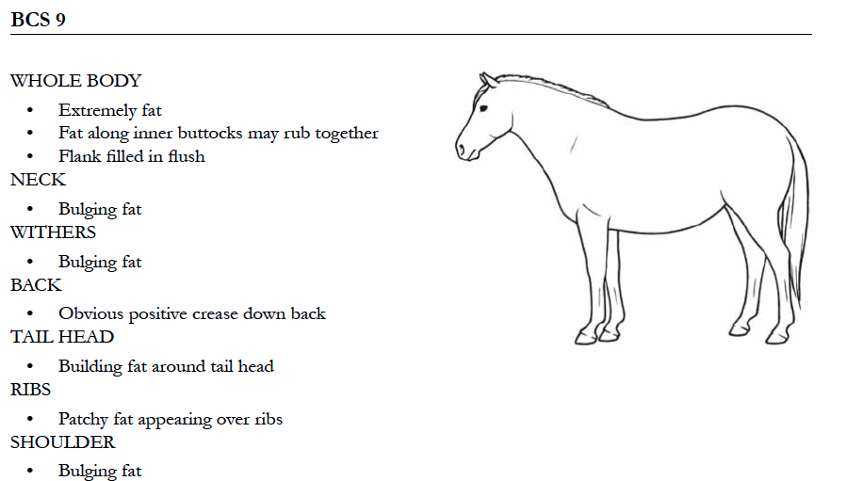

Slide 11
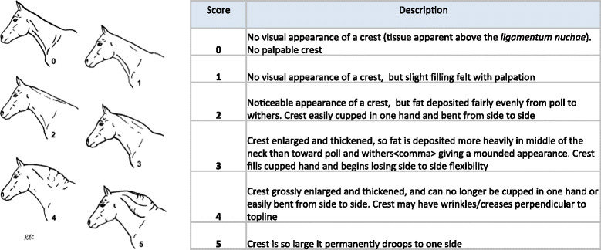
Cresty neck score (CNS)
Carter et al. Vet J 2009
Notes:
Morphometric measurements

Slide 12
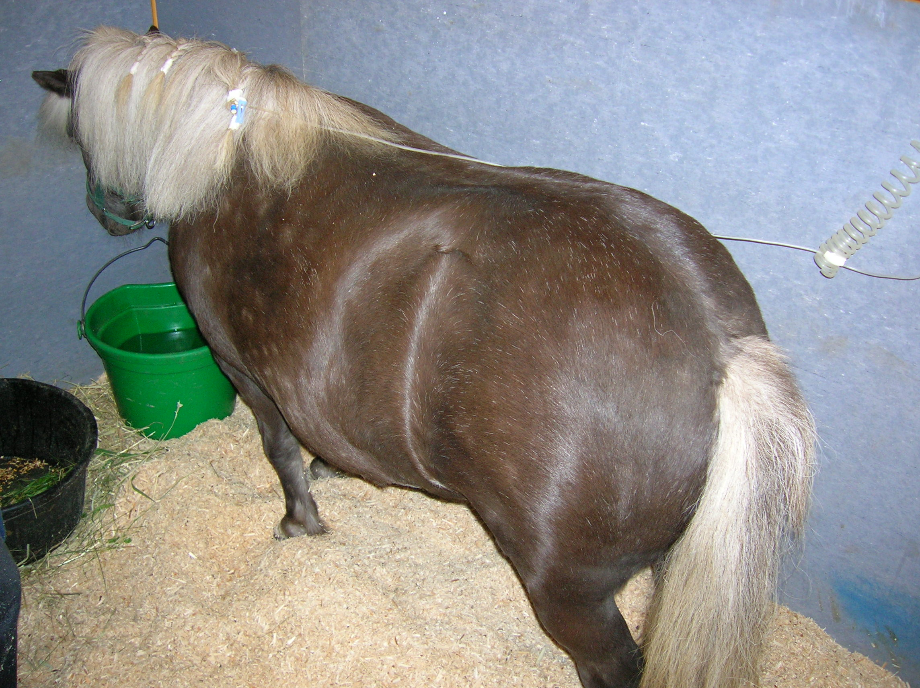

Slide 13
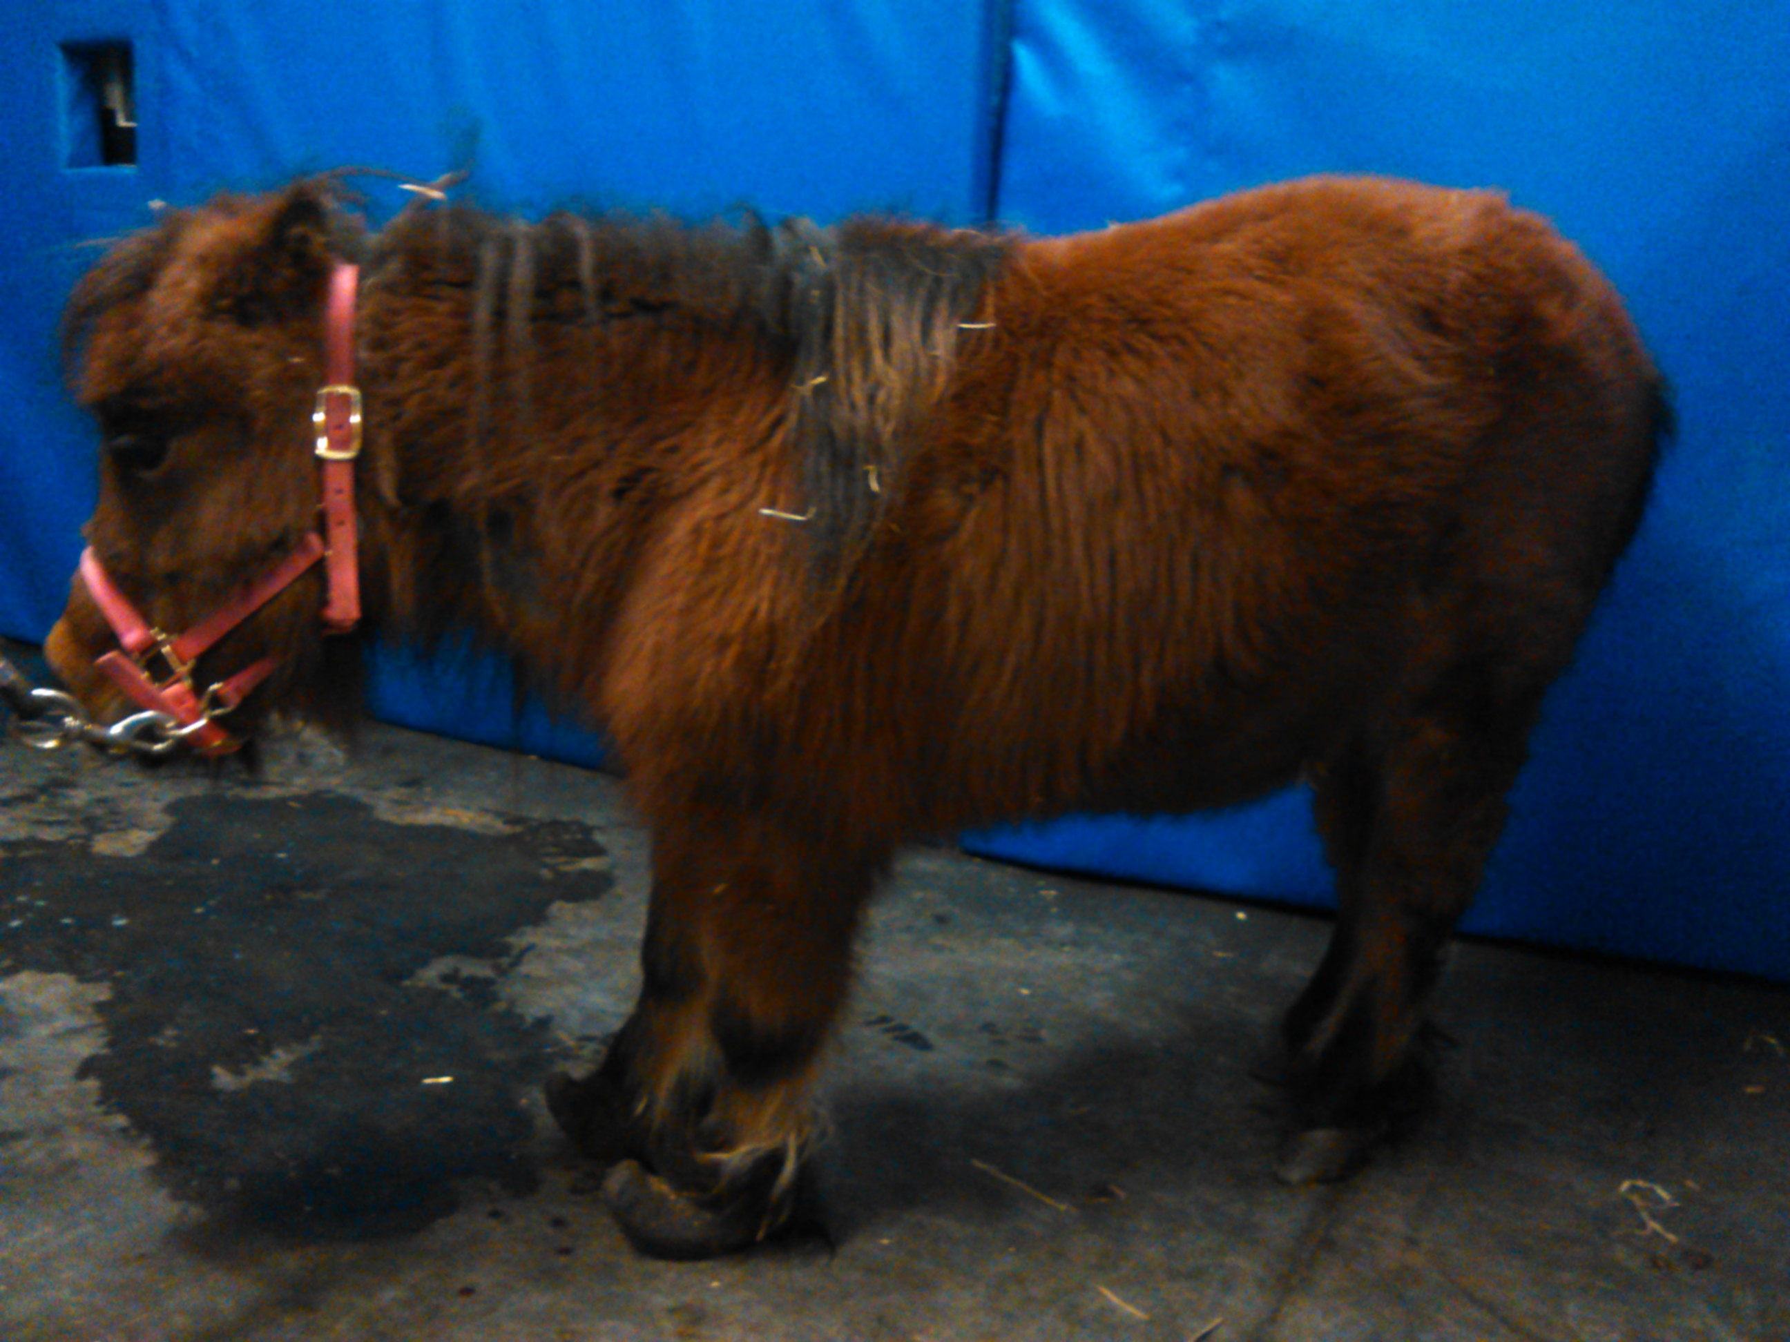
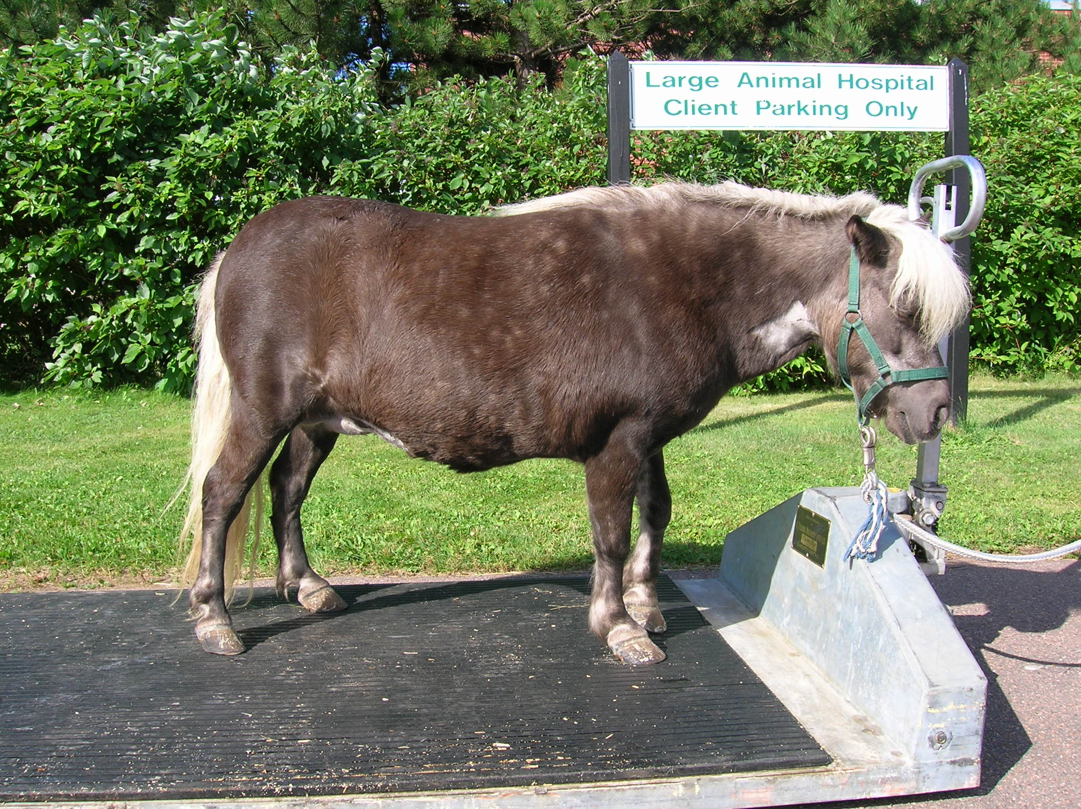
Clinical importance
Laminitis
V. Ragno - WCVM
Notes:
We can’t fix laminitis, so we want to do everything we can to prevent it.

Slide 14
Clinical importance
Other consequences of EMS:
Cardiovascular: high blood pressure; evidence of heart disease: left ventricular hypertrophy (Heliczer et al., 2017)
Systemic inflammation (Vick et al., 2007)
  Low-grade chronic inflammation
Notes:
EMS can also have other consequences that we are just starting to understand…
State of low-grade chronic inflammation related to adipose tissue, “metaflammation”

Slide 15
EMS Diagnosis
Physical characteristics of the horse (signalment)
  Breed
History
Clinical findings
Diagnostic testing
  Currently no gold standard test
  Why are there so many different tests?

Slide 16
Insulin Dysregulation Testing
Static
  Baseline glucose
  Baseline insulin
  Proxy measures (indices used in humans)
Dynamic
  Tissue insulin sensitivity
  Enteroinsular axis

Slide 17
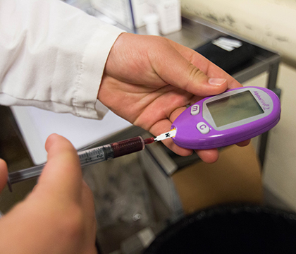
Static insulin sensitivity testing
Baseline glucose
Advantage: stall-side
Disadvantage: affected by stress
Most EMS horses are normal or only borderline high
Caitlin Taylor, WCVM
EMS study (unpublished data)
Notes:
Baseline glucose: if hyperglycemia, it should be called diabetes
Compensated IR means that the insulin level is (chronically) elevated, but still sufficient glucose is transported into the cells keeping the blood glucose on a normal level, often towards the higher end of the reference.
If not stall-side, should use NaF tubes (check with lab)

Slide 18
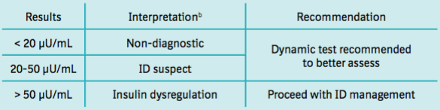
Static insulin sensitivity testing
Baseline insulin
Fasting insulin no longer recommended
On hay:
Equine Endocrinology Group, 2016
Specific but not sensitive
Seasonal variation on pasture
Notes:
Baseline insulin: don’t feed grain in previous 4 hours. If on grass is mostly to assess management
Only about 30% of EMS horses have high resting insulin
>188uIU/mL predicted laminitis and non-survival at 1 year with Se, Sp >90%

Slide 19
Dynamic insulin sensitivity testing
Tissue level
  Combined insulin glucose tolerance test (CGIT)
  2-step insulin tolerance test (ITT)
  Others used in research setting but not practical on farm
Enteroinsular axis
  Oral sugar test (OST)
  Oral glucose test (OGT)

Slide 20
Management of EMS
Weight loss
  Dietary management
  Exercise (except acute laminitis)
Hay only diet (+ vitamin/mineral supplement)
  Start with 1.5% of current body weight
    Can go as low as 1% of bodyweight but not lower
  Lower to 1.5% of ideal body weight as weight loss occurs
  <10% dry matter non-structural carbohydrate content (NSC)
  Soak in cold water for 30 minutes to reduce soluble CH
Limit pasture turn out; beware of spring/fall pasture

Slide 21
Proposed feeding strategies
Hay with low NSC
Balanced vitamin/mineral supplement
Soaked molasses-free beet pulp (fiber)
If caloric needs not met by a hay only diet
  (Corn) oil added to feed; up to 1 cup/horse (2 cups)
    Corn oil commonly recommended but may not be best choice
    May have to supplement additional vitamin E
  Complete feed formulated for horses with metabolic issues
    Low NSC/starch content
Aside from low NSC hay none of these recommendations are substantiated by significant research
Notes:
Purina: equlibrium equilizer (1lb/day)
Hoffmans IR; step 7/8

Slide 22
Managing risk of pasture-associated laminitis
Management to minimize nonstructural CH (NSC) intake
  Be aware of seasonal changes
    Temperatures < 5ºC for 2-3 weeks during the night
  Drought stress (summer)
  Tall thick grass ideal (self-shading)
  Graze in the shade
  Restrict intake (e.g. grazing muzzle)
  Feed average NSC < 10% of dry matter
WCVM

Slide 23
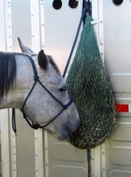
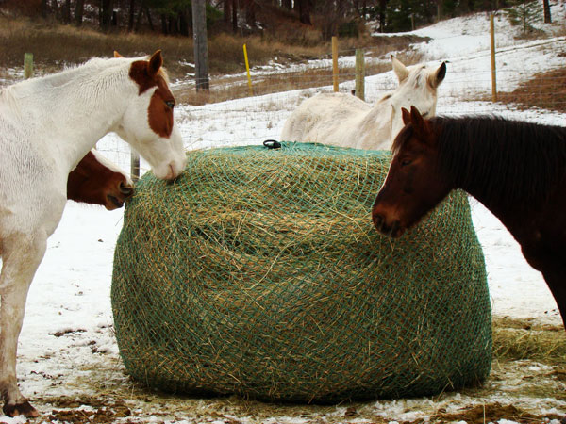
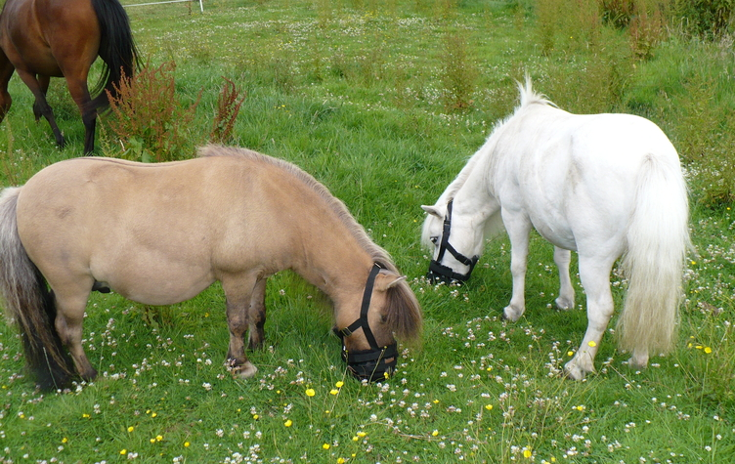
Challenge of feed restriction
Balance nutritional & behavioural needs
  Slow feeder hay nets
  Grazing muzzle to allow pasture turn out
http://www.slowfeeder.com
http://www.slowfeeder.com
http://www.tackandturnout.co.uk/Dinky-Grazing-Muzzle-Mk3

Slide 24
More questions than answers
slideplayer.com

Slide 25
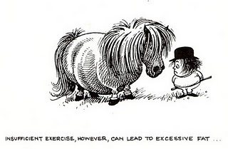
EMS Prevention
Early recognition of “at risk” horses
  Physical characteristics
  Biomarkers
Dietary management
  Evidence-based dietary recommendations
Exercise
  Encourage increased activity
    Environmental enrichment
Reduce laminitis-risk
http://thelittlewashhouse.wordpress.com/2011/09/23/thelwell/

Slide 26
EMS Research at WCVM
EMS biomarkers
Dietary management
Environmental enrichment

Slide 27
EMS Biomarkers
Baseline insulin was significantly associated with insulin dysregulation in univariate analysis (P < 0.05),
but not in multivariate logistic regression
Horses with cresty neck score ≥ 3 had 11 times higher odds of having insulin dysregulation
(OR 11.3, 95% C.I. 2.04-63.08, P < 0.05)
D-lactate and the other metabolic and
inflammatory biomarkers were not good
predictors of insulin dysregulation
Notes:
These results, and the NaF project, have been presented as posters at the 2018 GS poster day, but more importantly have been accepted as oral research abstract presentations at the 2018 ACVIM forum in Seattle. Equine Metabolic Syndrome is a very hot topic and we would like to keep investigating in this field.

Slide 28
Adiposity
Weight (kg) median (range): all 522 (316-609)
R 463 (316-562)
S 526 (371-609)
BCS <7 vs ≥ 7
P = 0.15
CNS <3 vs ≥ 3
P = 0.006
Notes:
Fisher’s exact test
mean all 490 ±71kg
R 493 ± 101 S 497 ± 62

Slide 29
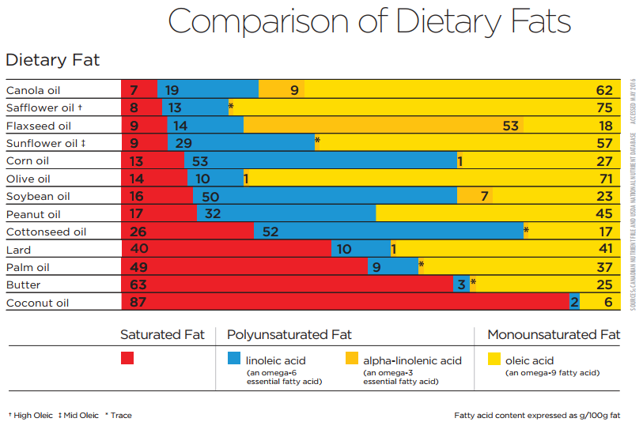
Dietary Management
Partial replacement of dietary carbohydrates with fat might improve insulin sensitivity
  Not all fats are created equal
Notes:
Discuss important characteristics of the oil.
What is the goal/aim of oil supplementation?

Slide 30
Oil supplementation survey
Rationale
  Currently feeding oil
  Type of oil
  Perceived benefits of oil supplementation
  Perceived BCS
  EMS awareness

Slide 31
Preliminary survey results
The proportions of respondents feeding oil supplements to their horse did not differ greatly between owners that were aware of EMS and owners that were not aware of EMS
The proportions of respondents feeding oil supplements may be correlated with perception of their horse’s current BCS

Slide 32
Preliminary survey results
Other interesting findings that require investigation:
  Response proportions for reasoning behind oil supplementation: 80% improve coat quality; 56% advertised health benefits; 20% weight gain/maintenance; 10% veterinarian recommendation
  Owner reported BCS: 27% responded overweight; 63% indicated ideal

Slide 33
Looking for your participation
https://www.surveymonkey.ca/r/NTYYWGX

Slide 34
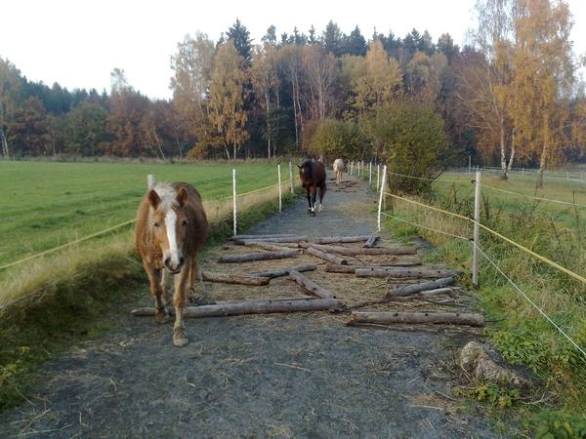
Environmental Enrichment
Paddock/pasture paradise
Equicentral system
Encourage natural behaviour of movement & foraging
  Opening/closing gates
  Feeding stations
  Obstacles/different terrain
https://www.aanhcp.net/pages/welcome-to-paddock-paradise

Slide 35
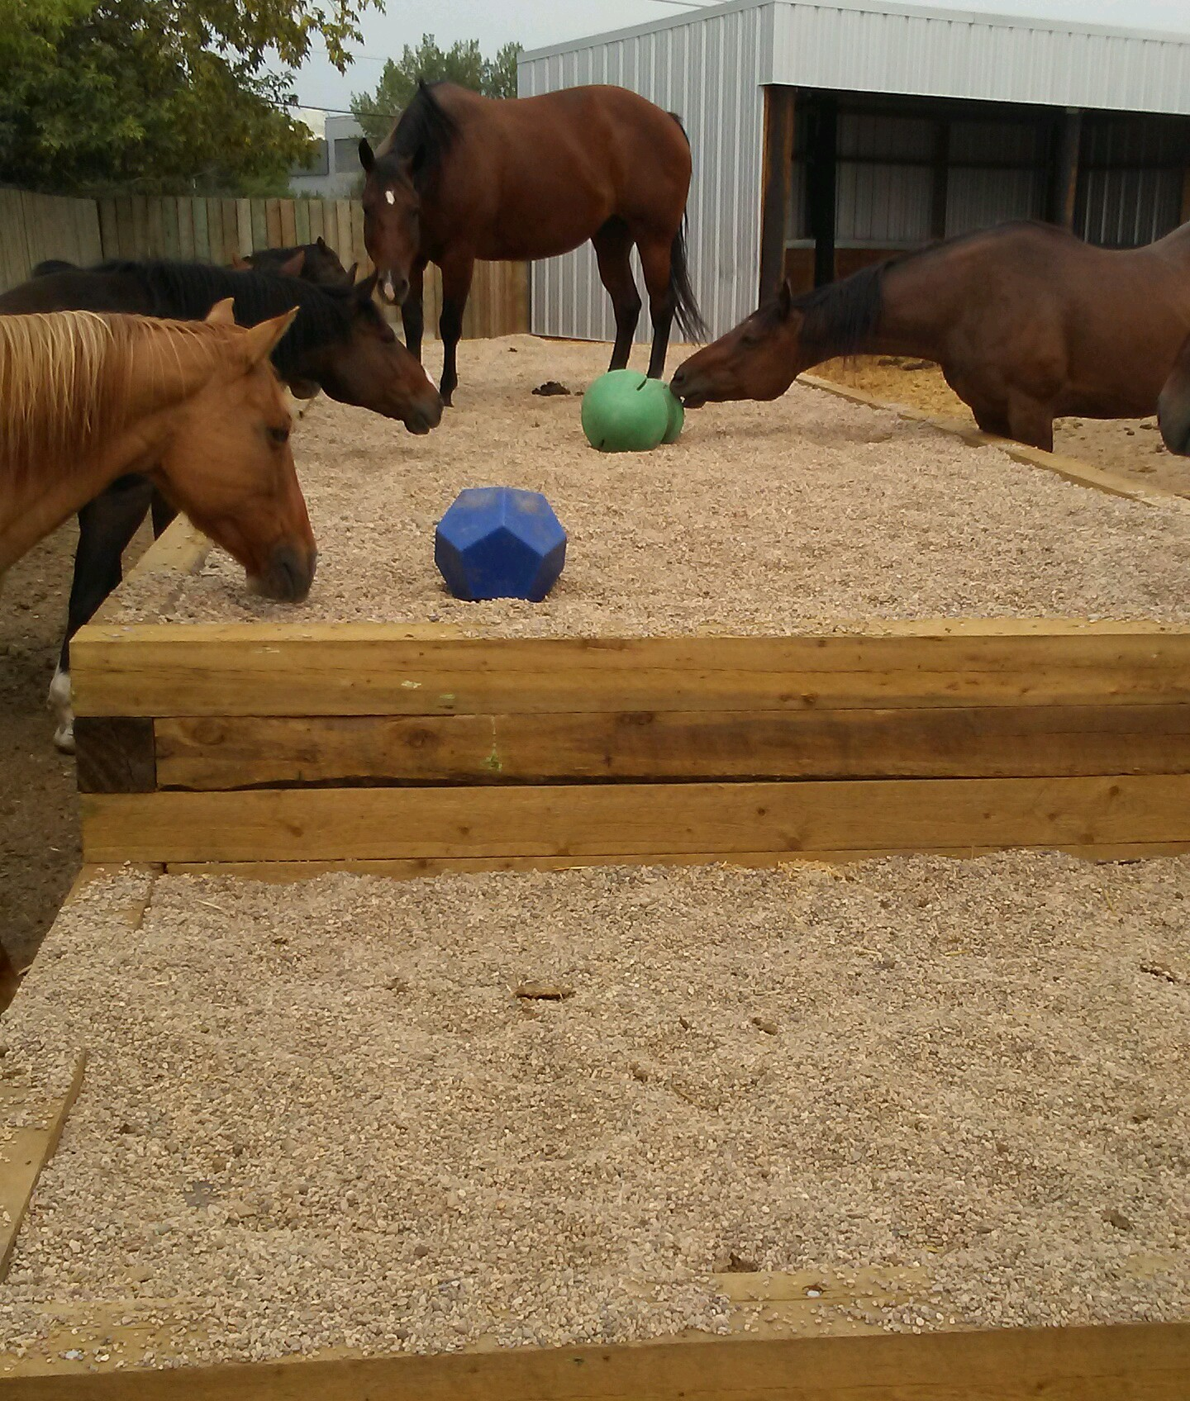
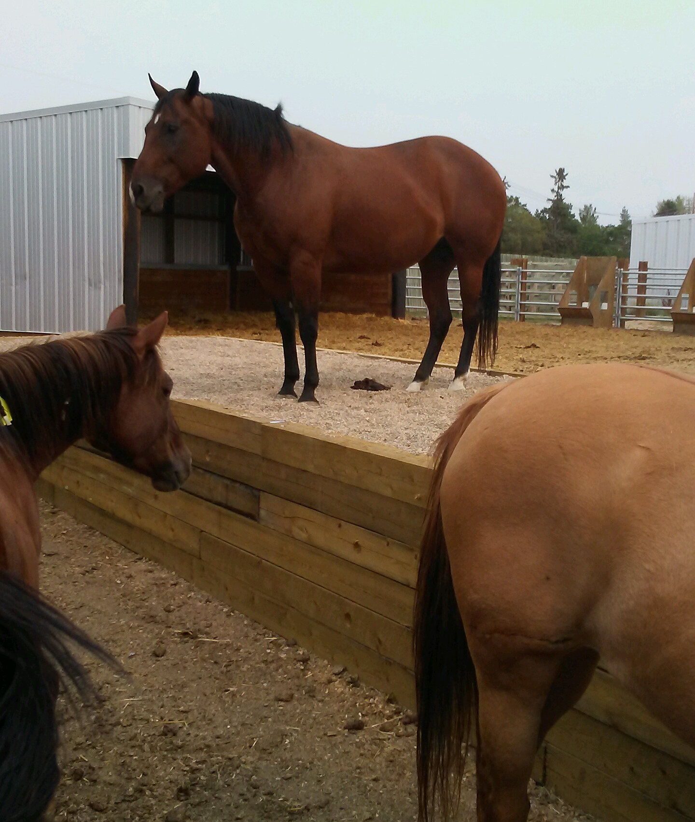
WCVM Teaching Horses

Slide 36
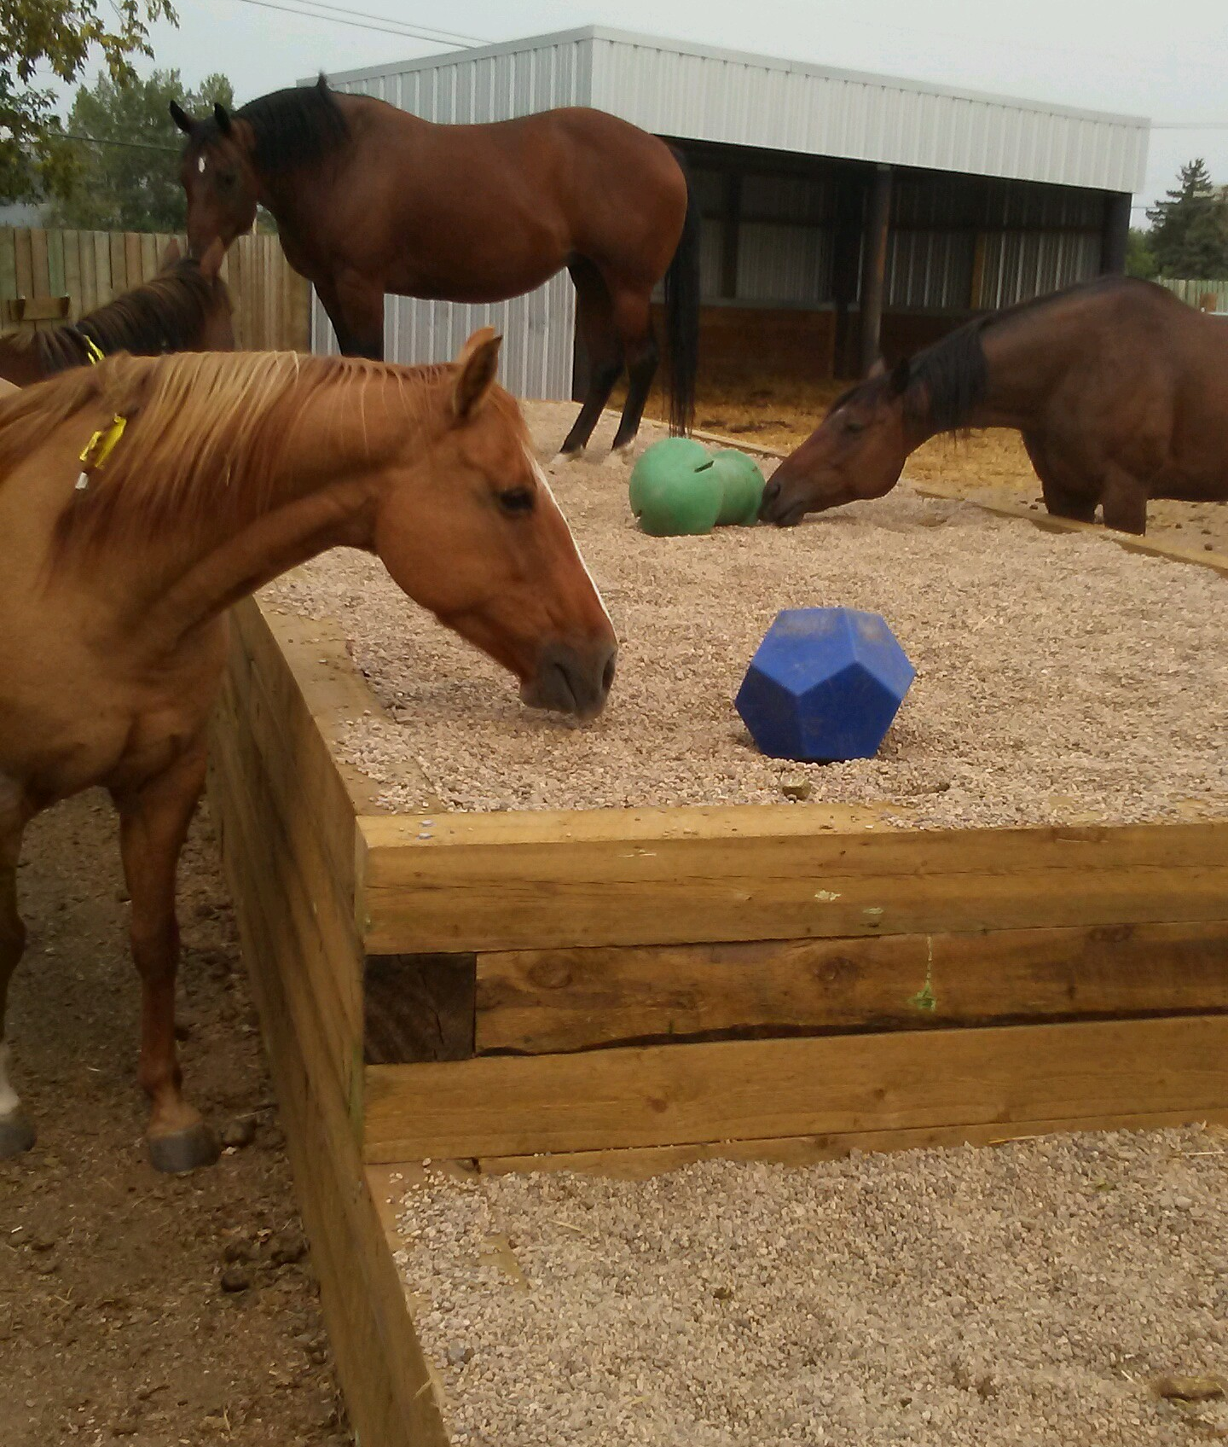
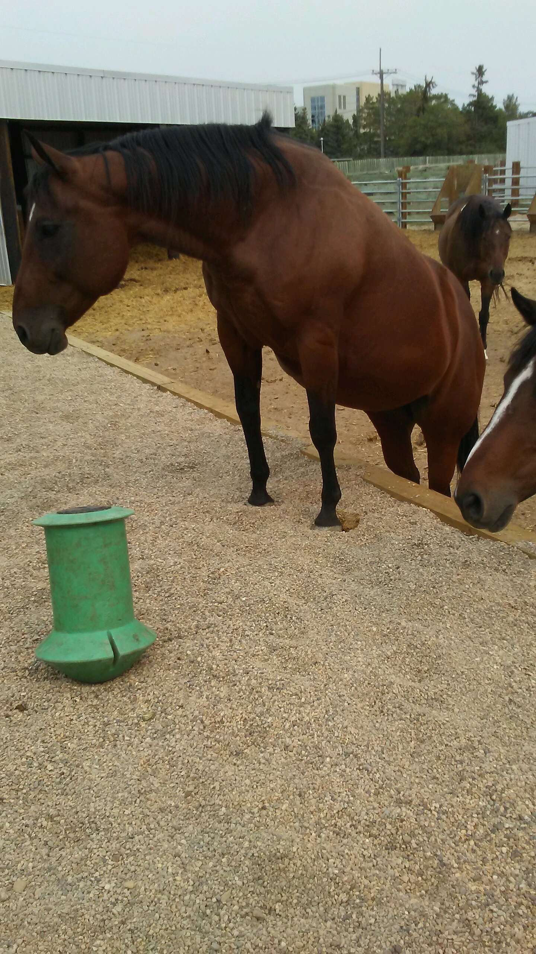

Slide 37
Acknowledgements
Co-Investigators
  Fabienne Uehlinger
  Kate Robinson
  Gordon Zello
Students
  Valentina Ragno (MSc candidate)
  Colby Klein
  Nicole Sereda
  Katie Dudko
  Brendan Loewen
Funding
  WCVM Townsend Equine Health Research Fund
  WCVM summer student funding

Slide 38
Questions?
Julia B. Montgomery
Department of Large Animal Clinical Sciences
Western College of Veterinary Medicine
julia.montgomery@usask.ca
https://wcvm.usask.ca/departments/lacs/lacs-people/julia-montgomery.php
Veterinary Medical Centre
(306) 966 7178
Oil supplementation survey: https://www.surveymonkey.ca/r/NTYYWGX
Thank You!

