Slide 1
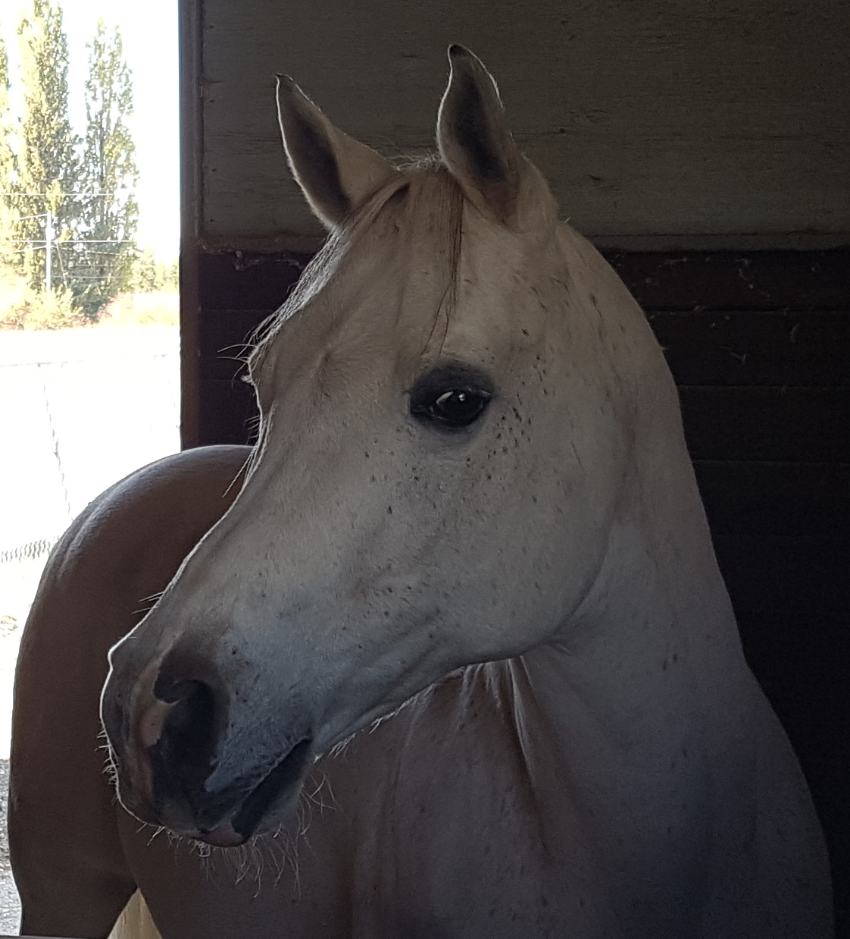
Mystic

Slide 2
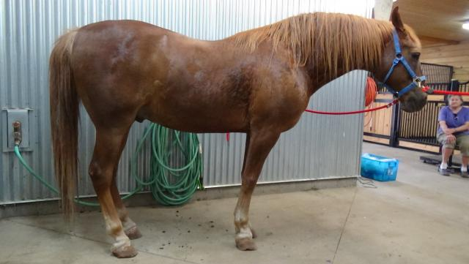
Over –conditioned ponies and horses
Considered over weight if
Between 7-9 henneke scale
Between 4-5 maryland scale
Excessive fat deposition that can be palpated eg crest pf neck along sides of withers, across the ribs, behind the shoulders, on top of the loin,on sides of the tail head.
Over conditioning found in 20-51% of populations.

Slide 3
Disorders related to over conditioning
Equine metabolic syndrome
BCS over 7.0 is obese
Insulin resistance
Laminitis
Lipomas
Hyper lipidemia
Osteochondritis dessecans
Reproductive irregularities
Lack of heat tolerance.
Concussion on feet

Slide 4
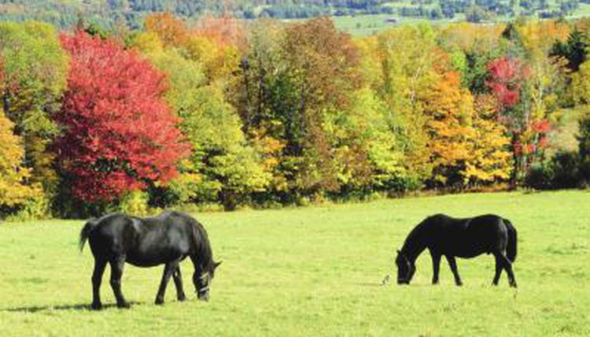
The horse is a grazer, eating many small meals over as much as 16-17 hours/day
The horse is a superb athlete. They have evolved on open range.
They have speed to escape predators and endurance necessary in the search for nutrition.
Selective breeding has further modified these traits.

Slide 5
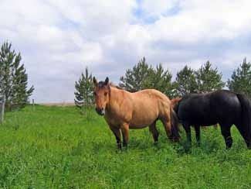
The horse has great athletic capacity . The number one need is energy. Nutrients provide energy, the fuel for all metabolism.
The athletic capacity related to
High maximal aerobic capacity (or VO2 max) and CV system.
Large intra muscular stores of energy ,particularly glycogen
High respiratory capacity of skeletal muscle
Splenic contraction ,increases oxygen carry capacity of blood by 50% soon after the onset of exercise.
Highly efficient and adaptable gaits
Well-developed capacity for effective thermoregulation.
Energy is produced either with oxygen or without , the aerobic or anaerobic pathways

Slide 6
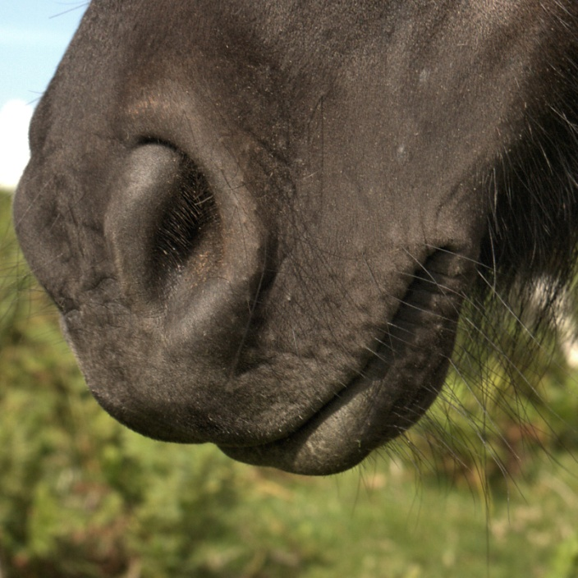
To provide nutrients for energy production the Horse digestion-begins with selection ,apprehension and chewimg.
The horse can select a diet 10-20 % higher in overall nutrient content than an average sample of pasture.
Horses evolved to be quite cold tolerant provided lots of feed available.
Range horses may actually have more tooth ware from soil on grass leaves or grazing low to the ground.
Eruption of teeth from the jaw stops at around 21 . From then on grinding surface decreases, may become loose.

Slide 7
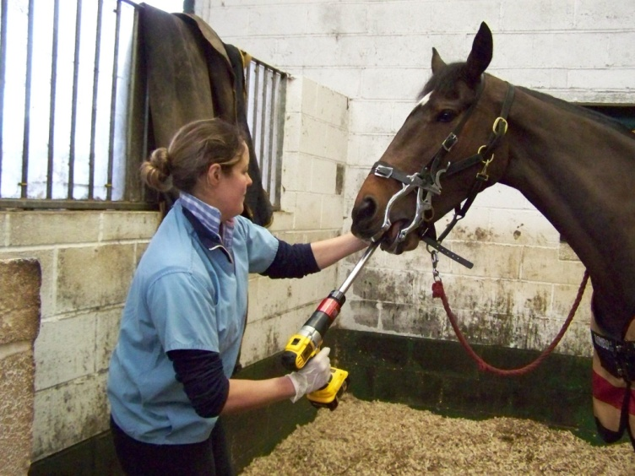
Basic Nutrition of the Horse-
Teeth require maintenance. Maintenance Recently proven to aid digestion . Significantly reducing particle size.
Horses do not chew lower quality forage more times or better. .
A horse cannot drool, the saliva flows after tactile feel on the palate.
Horses are prone to choke if dehydrated.
The horse must moisten a bolus and push it back and over a cuff of tissue protecting the tracheal opening.

Slide 8
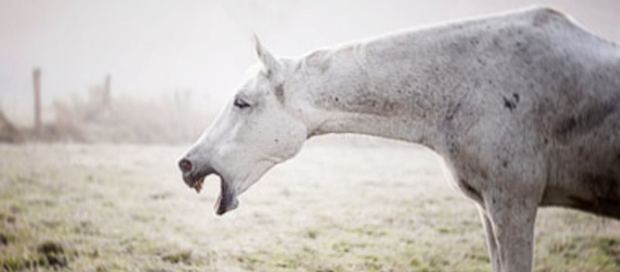
Choke-a blockage of the esophagus
Choking makes it impossible to swallow. It does not stop breathing and may resolve on its own.
In severe cases it can cause scarring which then increases the risk of future chokes.
Gobbling food like hay cubes, hard dry pellets and unsoaked beet pulp are common causes.
Saliva and feed coming from the nose and coughing or gagging call your vet

Slide 9
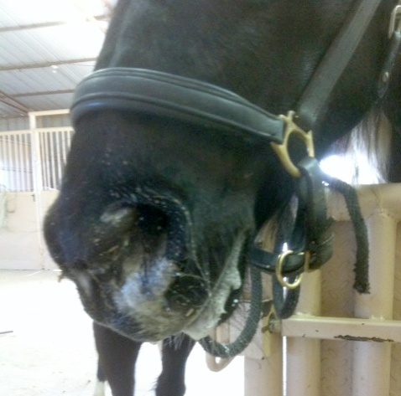
Guard against choke
Prevent choke By Soaking feed
Feed on the ground in shallow pans or tubs with large rocks added to further slow feeding.
Regular dental
Bite sized treats –cut up apples, carrots into thumb sized chunks before offering.
Even very dry hay can be an issue if your horse eats it too fast. Use slow feed nets and or soaking.

Slide 10
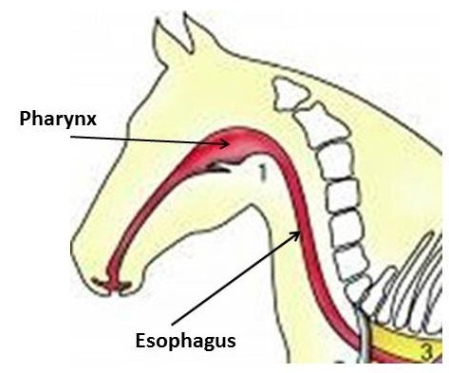
Basic Nutrition of the Horse-Saliva-has sodium bicarbonate and mucus.
Esophagus has striated muscle for initial 2/3ds. A strong sphincter at either end.. Cannot force swallowing
Adult horses may secrete up to 35-40 liters per day with a pH of 8.6-9.1
Rate of secretion is stimulated by food intake and mastication. Greater the dry matter within the food, the greater the amount of saliva re physical composition of meal and time needed for adequate mastication.
Feed only takes 1 and ½ hours to reach cecum.

Slide 11
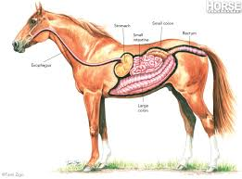
Does not secrete amylase in saliva to start digestion of starch.
Primary purpose of saliva is lubrication of bolus and buffering of gastric contents which may promote intra-gastric bacterial activity.
A one way system. Horses cannot belch or vomit . Powerful sphincters control opening to esophagus and pylorus region of stomach to small intestine.
Always feed hay before grain.
Horses need 5-10 gallons of water a day.

Slide 12
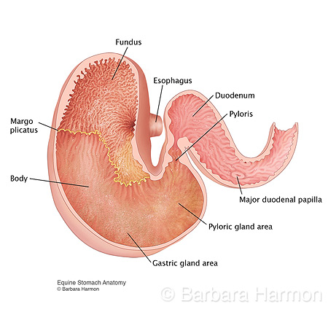
Basic Nutrition A two compartment stomach-in natural grazing never completely full.
A relatively small stomach (8-15 l) =8-9% of gut volume.
-top half not protected from acid., relatively alkaline, No secretory glands in top half.
Lining stratified sqaumous epithelium. similar to esophagus.
pH 5-7 top -may allow fermentation of rich pasture or grain.
Because the stomach is small and inelastic, with tight sphincters, grass colic or grain overload is a concern. Feed hay before turn out on rich pasture

Slide 13
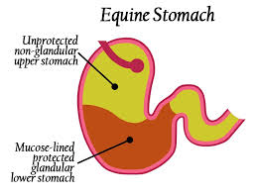
Bottom half –secretes hydrochloric acid 24/7-at a variable rate even if empty
Bottom lining secretes mucus and bicarbonate buffer -contains a highly acidic environment .
If empty there may be reflux into the stomach from the small intestine of strong bile salts causing glandular ulcers.
Do not allow a horse to go without feed for longer than 5 hours. A horse needs to buffer The acid continuously secreted into the stomach.
The pH of this higher density more liquid area is lower at bottom with pH 2-3

Slide 14
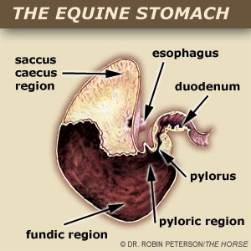
Bottom half –secretes hydrochloric acid 24/7-at a variable rate even if empty. The horse will seek out something to chew
Decreased roughage intake i.e. if with held , (or early morning naturally eat less), the mean pH in the upper part drops to 4 or less.
If pH drops dramatically Omega 6 essential fatty acids promote protection of the mucosa by enhancing mucus and bicarb production in cells lining the glandular area.
Also linoleic acid at 20 ml/kg corn oil (40% linolenic acid) 1-2 cups /day corn oil significantly increased PGE2 and reduced gastric acid output by direct inhibition.

Slide 15
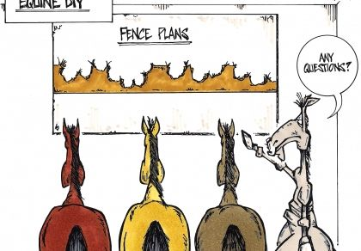
stomach
Select hays with some crunch or chew factor for good gut health.
Micro organisms may be present in upper area if pH over 4
If pH drops below 4 in the upper area, that mucosa may ulcerate with no protection.
Feeding alfalfa hay will help provide some protection against the acid challenge. Possibly through buffering effects of calcium and protein and potassium.
Use timing of alfalfa.

Slide 16
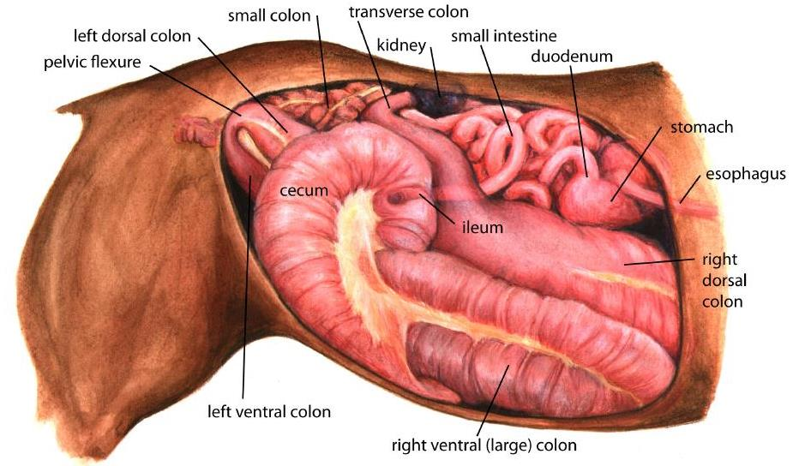
Small intestine-21 m long
-55-70 liters
-28-30% of git
Where digestion of sugars, starch , fats occurs along with other nutrients as per monogastrics.
Feed only stays 1-2.5 hours in stomach and small intestine.
Relatively short time –possibly why difficult to reload muscle glycogen compared to man ?
i.e. Horses 72 hrs vs man 24 hours. Yet skeletal muscle is higher in glycogen content than man initially.

Slide 17
Limited Starch Digestion
A 300 lb pig can digest more starch than a 1000 lb horse.
Hind gut -Vulnerable to starch over load.
Max starch 1-1.5 grams per kg bw /meal
Max concentrate per meal 5 lbs old recommendation. Possibly 1.5 kg ideal.
Max concentrate per day= 1% BWT. 10 lbs /1,000 lbs
The starch and sugar in Grain escaping to the hind gut is fermented to lactic acid by bacteria who thrive on sugar and starch. A large amount of LA will drop pH which may kill off fiber digesting bacteria who release harmful substances like endotoxin and other compounds causing diarrhea and damaging the gut lining (leaky gut). It may trigger laminitis or colic.

Slide 18
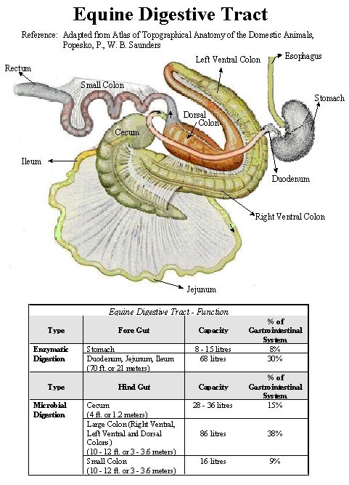
The incretin effects
Special cells in the small intestine sense the presence of sugars . GIP and GLP stimulate insulin production before the glucose is actually increasing in the blood. This allows tight control of blood glucose levels .
ID is a common and poorly understood disorder that increases the risk of laminitis.
Recent data show the condition may be associated with alteration of the entero insular axis and enhanced glucose bioavailability.

Slide 19
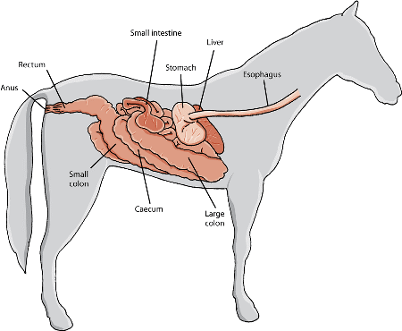
Hind gut=60-62% of git
Cecum =33 liters
Large colon =80-90 liters
Small colon =19 liters
Rectum =1-3 liters
Total git =188 liters

Slide 20
The hind gut
Bacteria ferment fiber producing VFA’s (volatile fatty acids).
The VFA’s are taken directly into the blood stream and delivered to tissues without being packaged .
Vfa’s are transported to the liver where butyrate and propionate are taken up .
Acetate appears to remain in blood.
Propionate is largely glucogenic, 50-61% of blood glucose is derived from colonic propionate, depending on the diet.
Butyrate is converted to acetate and ultimately acetyl –CoA (coenzyme A) which can be oxidized via Krebs cycle or used for fat synthesis.

Slide 21
Hind gut
Acetate 70%
Propionate 17%
Butyrate 8%
Others 5%
Acetate may be 32% of total energy supply to the hind limb.
Higher concentrate diets shift to more propionic and less acetate.
Excess sugar , starch and OF will be fermented to LA.

Slide 22
Water
Most medium sized drink 5-9 gallons a day
Double in hot weather
May drink less in winter
Drink more at about 20C
Horses do not drink water if very cold as it deadens the thirst reflex.
A horse will not drink if excited or fearful.
Horses sweat is iso to hyper tonic . A horse cannot tell if it is dehydrated. 4% loss in BW as water a problem , 7% fatal
It is difficult to estimate water loss.
Training to drink saline water will enhance water intake and hydration.
Proper training will enhance plasma volume by 10% and heart size by 10% aiding cooling and performance .

Slide 23
Forage vs ulcers
Ulcers =95% of race horses
90% of elite endurance horses during race season and 46% during off season.
80% of lower level endurance horses
57% of dressage horses
70% of foals at weaning time
20-30% of pleasure horses
20-40% of wild horses
Nearly 100% of cribbers

Slide 24
Forage
Provides energy as VFA’s as slow release over time. The VFA propionic acid is largely gluconeogenic about 50-60% of blood glucose , acetate remains in blood can be used directly for energy or stored as fat.
butyric converted to acetate – converted to acetyl co A and enters energy cycle and provides energy to cells lining the gut promoting good health.
Forage stimulates water intake and water holding in the gut .
One lb of forage stimulates 3.5-4 lb water intake whereas grain only stimulates 2-2.5 lbs water intake.
Super fibers help as forage substitutes. They provide highly fermentable fiber and water soluble fiber that helps hold water in the GIT.
The large intestine may hold 8-10% of body weight as water and 10-20% of total body sodium, potassium and Chloride.

Slide 25
Forage is the foundation
Average levels of exercise e.g. Lower level endurance riding have about 78% of the ration as forage.
The average amount of grain may be 2.27 kg/day
Provide a minimum of 1.5% body weight as forage . This is 15 lbs for a 1000 lb horse.
Include 1% of body weight as long stem forage to encourage chewing activity which enhances saliva flow and the bicarbonate it carries. This may also help with behavior reducing stress and gastric ulcers.
Alfalfa - a small amount may be fine as a natural buffer.
Never turn a horse out on rich pasture with an empty gut. Feed hay first to prevent grass colic.

Slide 26
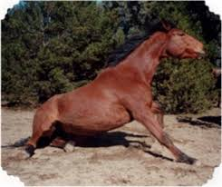
Forage quality is critical.
Moisture over 15% leads to moldy hay.
Avoid moldy hay.
Horses are very sensitive to mold. It is a one way system.
Spoiled forage such as haylages may have clostridium botulinum .
The amount of botox a mouse can stand will kill a horse.
Low levels of botox will paralyze the gut inducing colic.

Slide 27
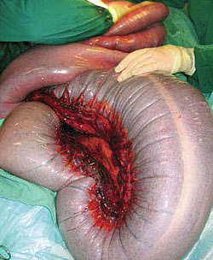
Forage and water add ballast

Slide 28
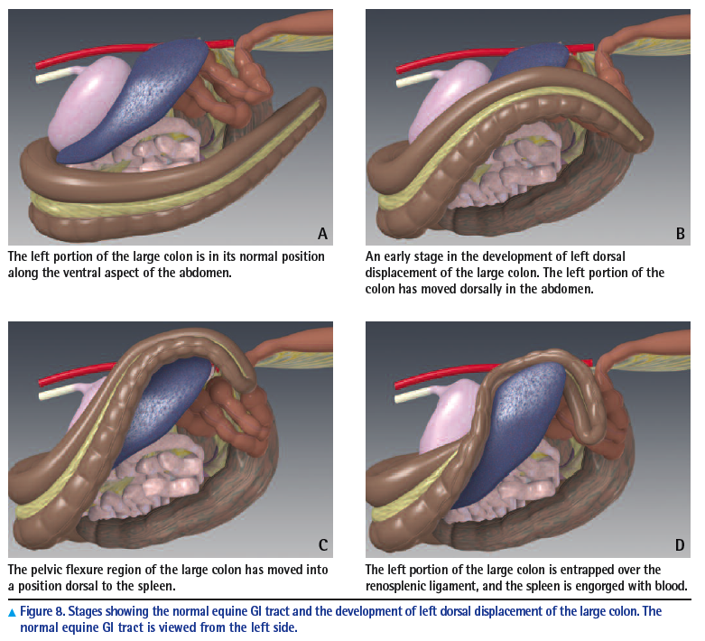
Ballast

Slide 29
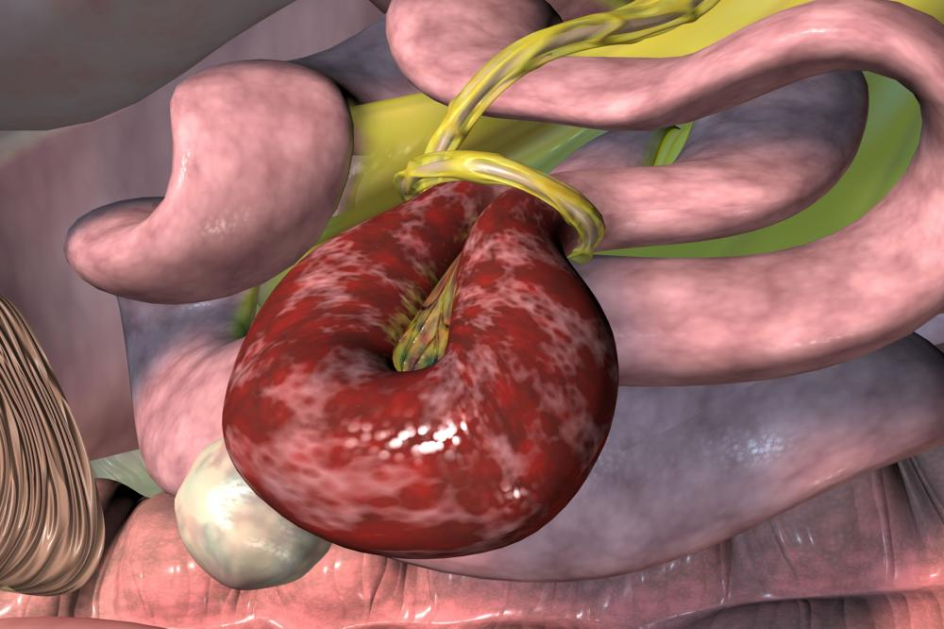
The obese horse is at risk of lipomas and pedunculated fat

Slide 30
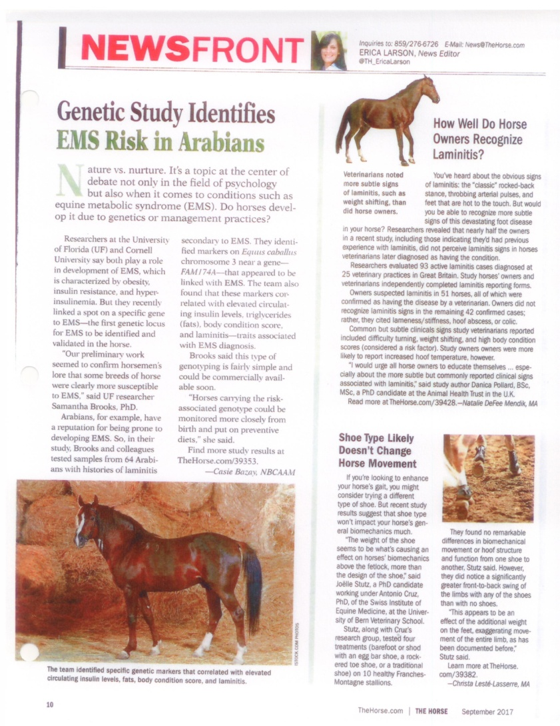
Concentrates
Supplemental energy can come from grains or fat (veg oils).
Some breeds tend to be easy keepers.
Limit starch intakes to a maximum of 1-1.5 grams per kg per meal.
Limit meals of grain to a max of 1.5 kg for a 450 kg horse
Total grain intakes max at 1.0% body wt/day .
Horses eat about 2.5% of body weight total -hay and grain combined

Slide 31
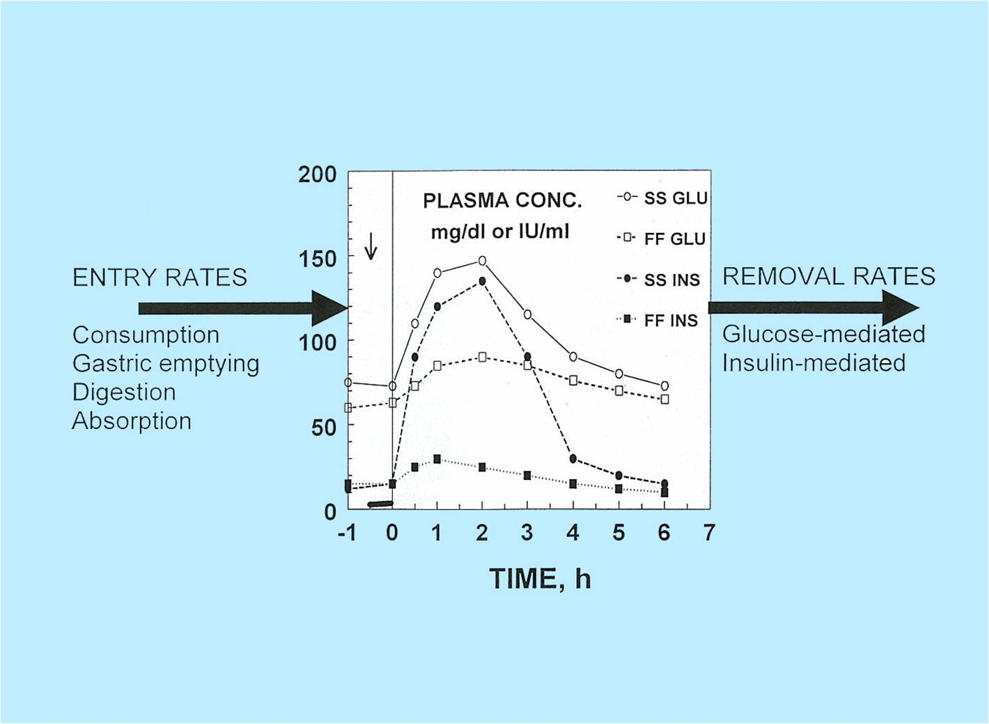

Slide 32
insulin
Creates fuel reserves
Insulin activates glycogen synthase promoting storage of glucose.
At adipose tissue insulin activates lipoprotein lipase facilitating the shuttling of triglycerides from within chylomicrons and lipoproteins to adipose tissue.
Insulin also has a negative effect on gluconeogenesis , amino acid catabolism, and lipolypis
Insulin controls the vascular system via the NO/ET-1 system
Hormone sensitive lipase may be impaired by IR.
The main substrates for energy production are carbohydrates and fat.
Exercise intensity determines energy source. Fat cannot be burned anaerobically. Horses use a combination depending on type of work
Schedule exercise around feeding times.

Slide 33
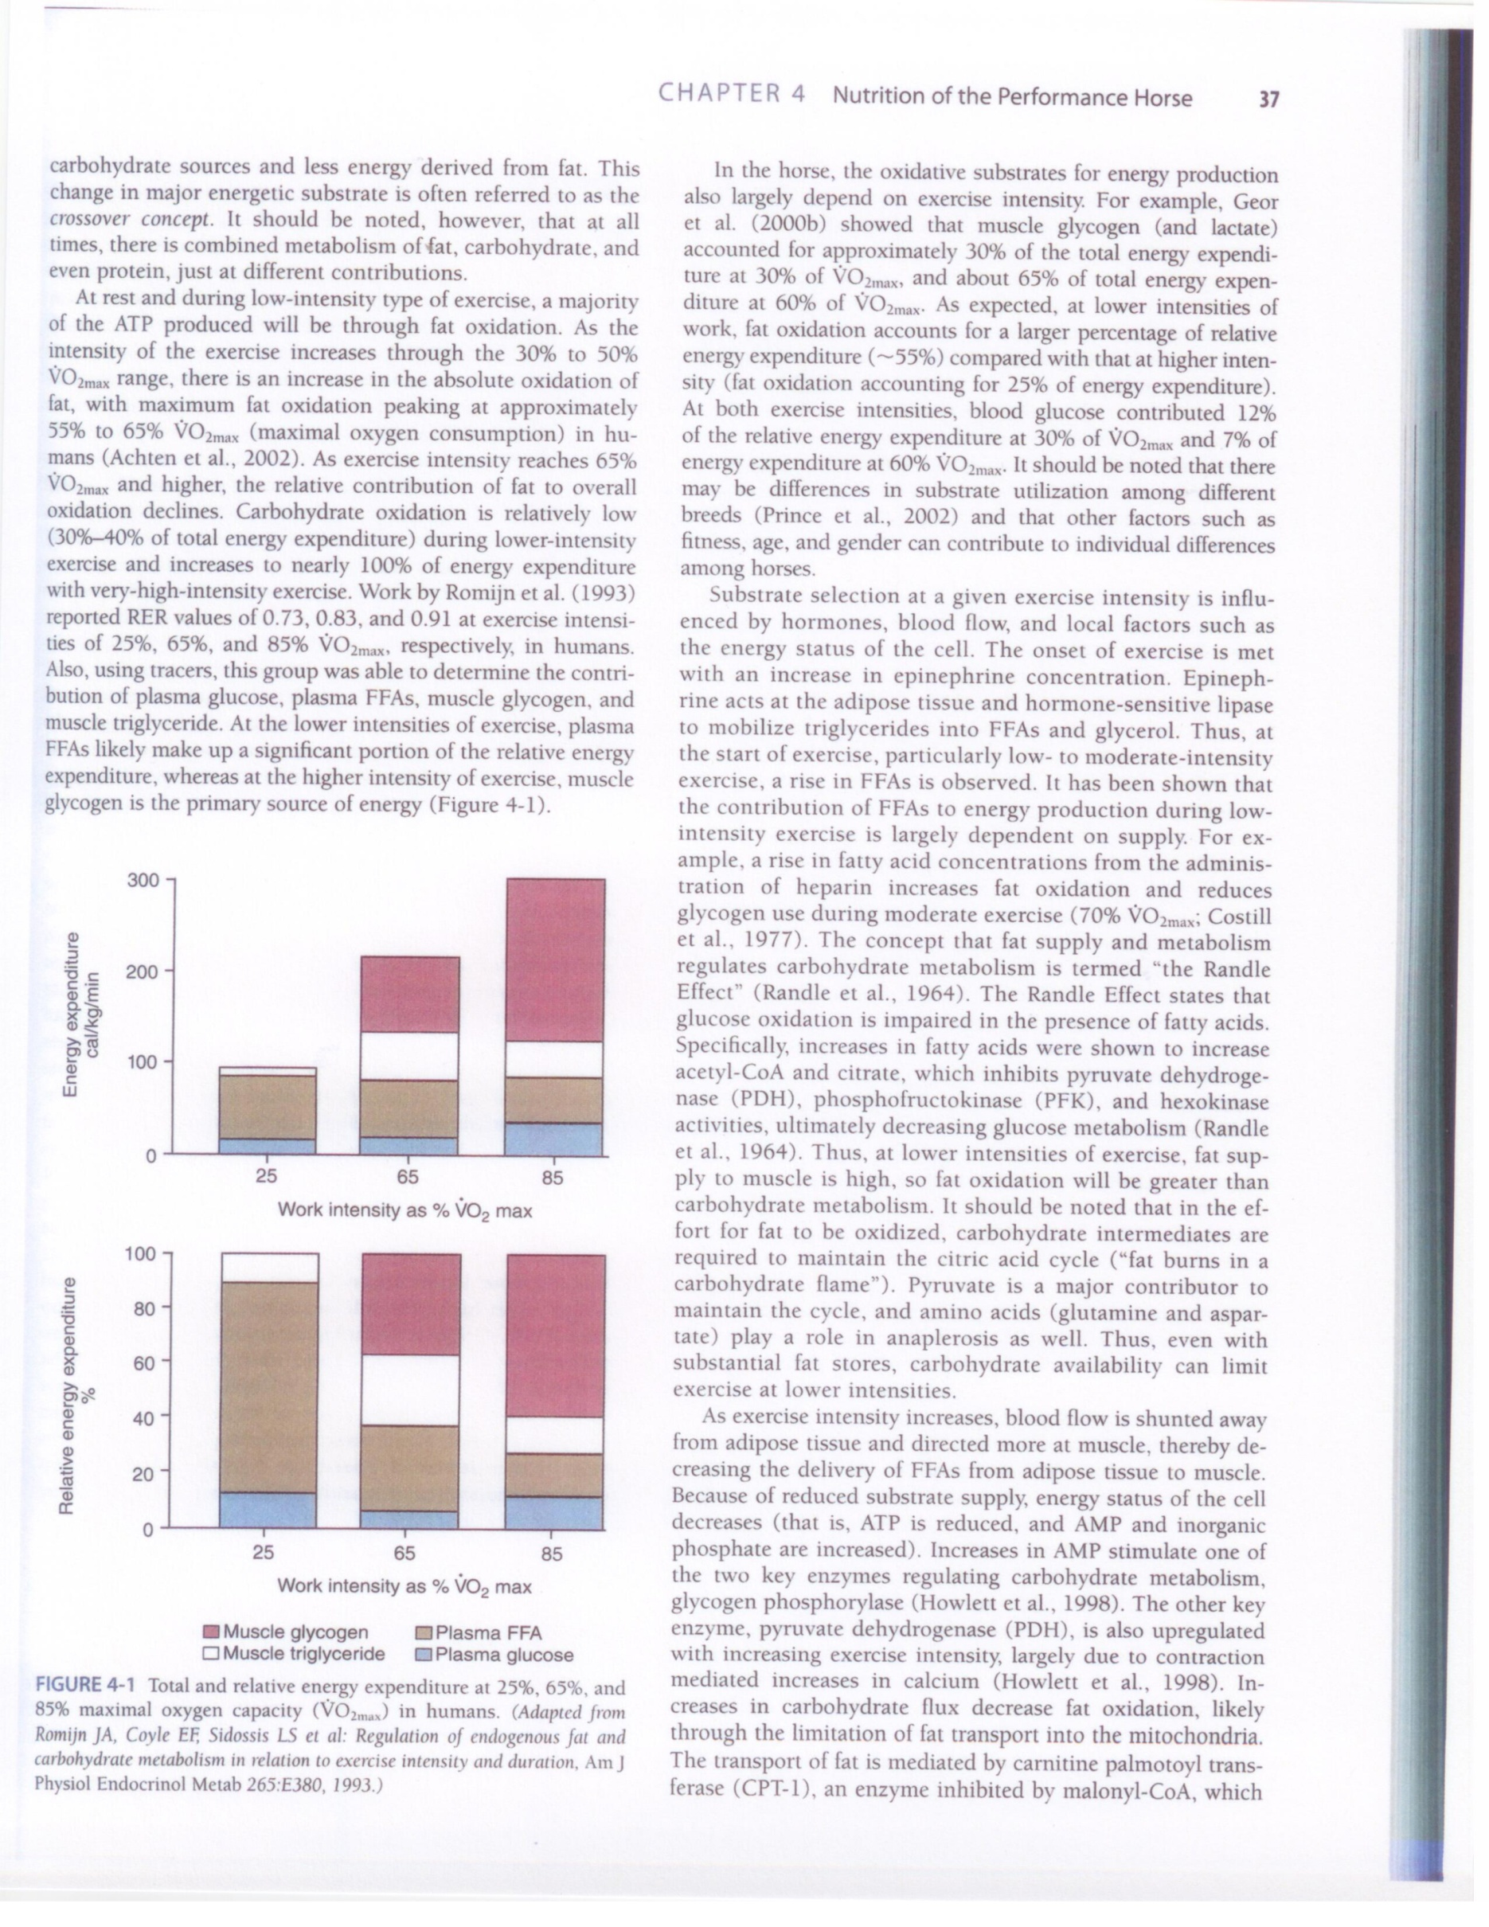

Slide 34
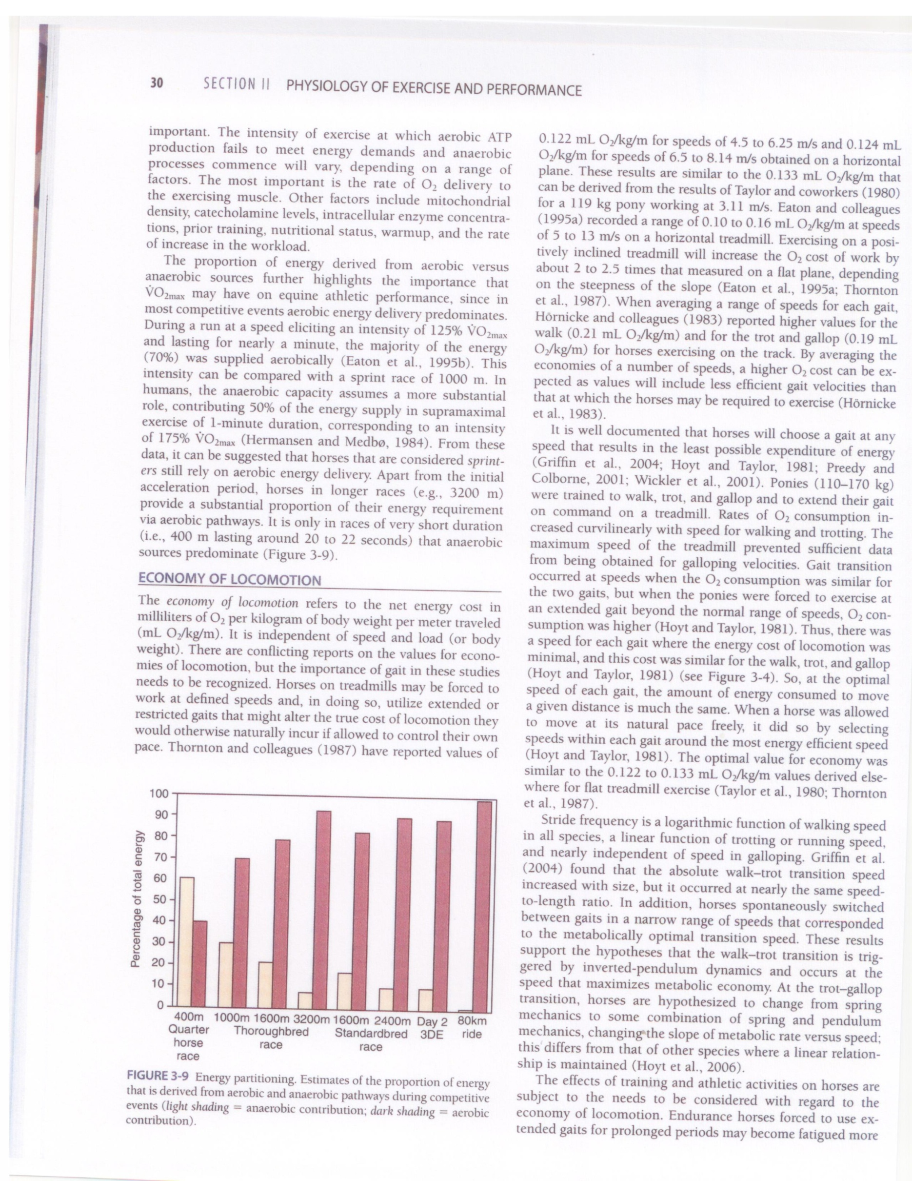

Slide 35
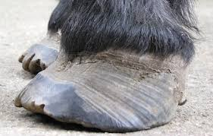
Insulin Resistance (IR) vs Hyperinsulinaemia (HI) and the Incretin Effect.
Incretins also slow gastric emptying.
IR is the inability of tissues to respond adequately to insulin.
Hyperinsulinaemia is the circulation of an inappropriate amount of insulin after a given stimulus.
Hyperinsulinaemia can be symptomatic of tissue IR when it occurs as a compensatory response to peripheral tissue IR.
EMS, due to IR, obese BCS>7.0, history of laminitis?
Insulin dysregulation is a better term

Slide 36
Insulin Resistance (IR) vs Hyperinsulinaemia (HI) and the Incretin Effect.
Insulin dysregulation a better description.
Horses do not show pancreatic exhaustion over time and can run high compensatory insulin due to IR for years. Compensatory IR.
Blood glucose will be normal.
Now called insulin dysfunction.
Glucose remains the main stimulus for insulin release .
New-ponies with ID/incretin effects may have greater capacity for post prandial uptake of glucose.
GLP-2 is co secreted with normal incretins, but it has an intestinal trophic function. L cells respond to nutrient intake and stimulates intestinal cell proliferation while inhibiting apoptosis and gastric motility.
Increased secretion of GLP-2 leads to an increase in the absorptive surface area of the small intestine and, therefore enhanced capacity for nutrient absorption.

Slide 37
Glucose uptake vs Incretins EVJ (2018) 1-6
Glucose uptake is facilitated by sodium-glucose cotransporters (SGLT) expressed on intestinal epithelial cells.
In humans with metabolic dysfunction , enhanced glucose uptake occurs through SGTL upregulation.
It is feasible that GLP-2 may contribute to enhanced absorptive capacity through its intestinotrophic activity.
This may make it a potential therepeutic target in animals with ID.
This is the first data in support of the theory that the gastrointestinal peptide GLP-2 may play an important role in ID in ponies. ID ponies had substantially increased levels vs normal ponies.the ID and normal ponies did not differ in bcs when allowed grazing

Slide 38
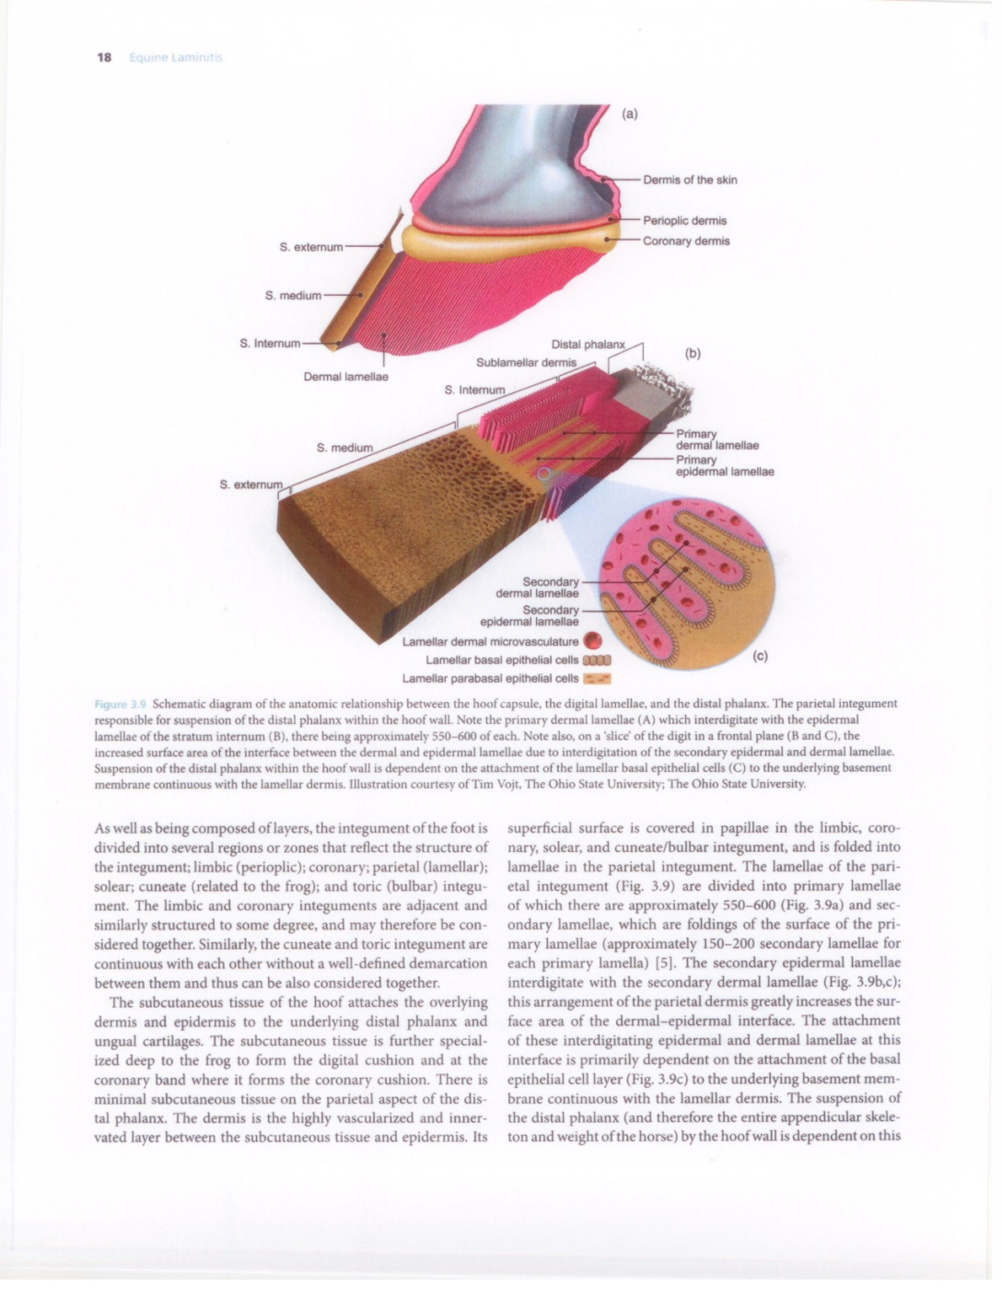

Slide 39
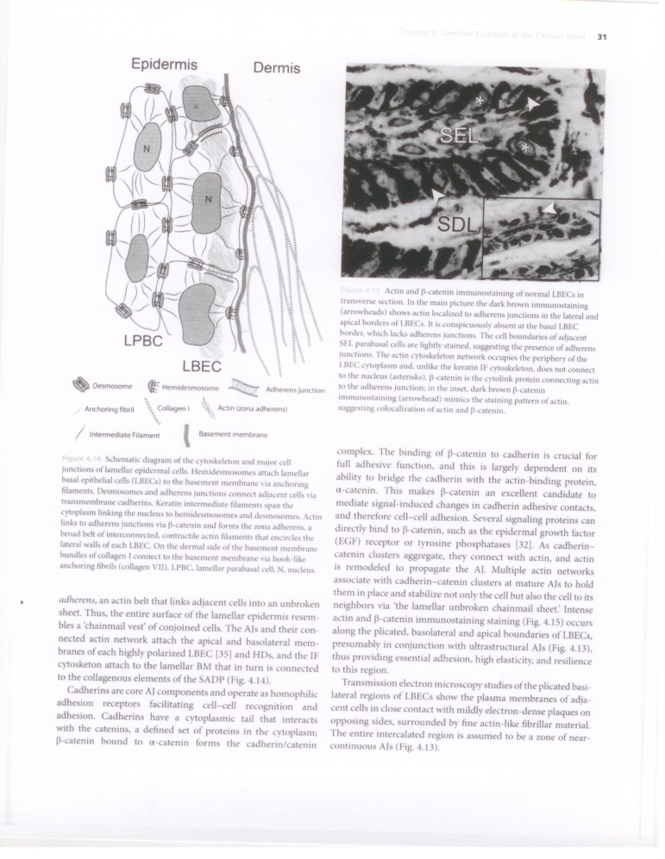
Endocrinological laminitis-includes EMS and ECD and direct injection of corticosteroids
Inflammation of (the lamellae)? Not usually present .
Massive separation from the basement membrane may not be present.
Not a feature of EMS laminitis?
A slow insidious stretching and lengthening of SEL and eventually PEL. Often No pain showing .
Primary lamellae and the secondary lamellae most affected. Lamellar basal epithelial cells Parabasal cells
Basement membrane Dermal lamellae gradually affected.

Slide 40
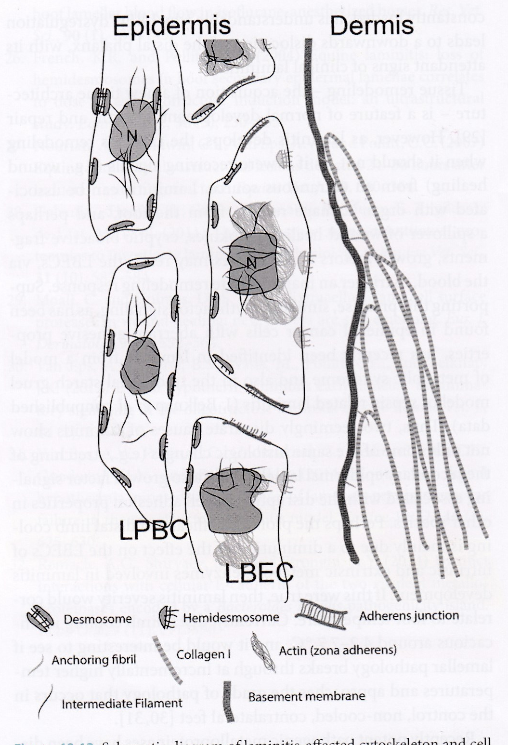
Insulin-is laminitis similar to skin cancer?
Controls many metabolic functions
Uptake of glucose into insulin sensitive tissues
Also amino acids and fatty acids into AT
Controls vaso contraction via the NO/ET-1 system
Also a powerful mitogen for cell division and death, wound healing and growth or binds with IGF-1 receptors which does the same.. ID may turn on this system setting in motion lamellar changes .
No major inflammatory effects?

Slide 41
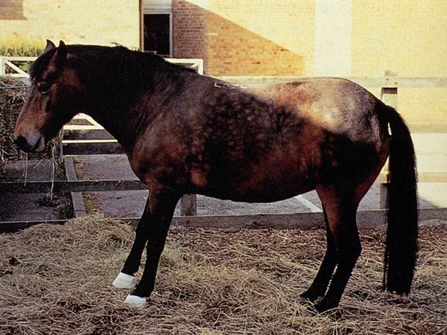
This process is called the entero-insular axis.
The pancreas begins secreting insulin even before blood glucose levels rise which normally is stimulating insulin production.
This pre-emptive increase ensures blood glucose is tightly controlled.
Oral supply of glucose can result in a 2-3 times increase in blood insulin compared to the same dose of glucose given IV in humans .
Some breeds may react more than others. Especially the Spanish breeds.
The Entero-insular Axis may be dysfunctional for various reasons or due to genetics. Hyper insulinaemia may result but only temporairly?
Insulin Resistance (IR) vs Hyperinsulinaemia (HI)

Slide 42
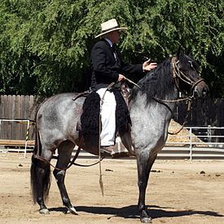
This system, if altered, can result in an excessive insulin response to glucose and other nutrients ***without concurrent tissue IR*** .
This results in transient HI and demonstrates HI can be present without tissue IR. It is the cushings horse with HI who gets laminitis ?Obesity seems a factor as well.
Genetics related E.G. Spanish breeds.
Therefore, tissue IR and HI may represent 2 different arms of a pathological process that can precipitate laminitis.
The Entero-insular Axis
Insulin Resistance (IR) vs Hyperinsulinaemia (HI)

Slide 43
Hi /ID Insulin ? There are no insulin receptors on lamellar tissue
There are insulin receptors on lamellar endo thelial cells
Vaso spasm can occur?
There are receptors for IGF-1 a powerful mitotic hormone and insulin can bind with these receptors.
IGf-1 causes cell division, growth and controls cell death.
Endo crinopathic Laminitis is a slower, stretching of the SEL and lengthening of PEL
Certain enzymes that damage the ECM like ADAMTS and other genes get turned on or off.

Slide 44
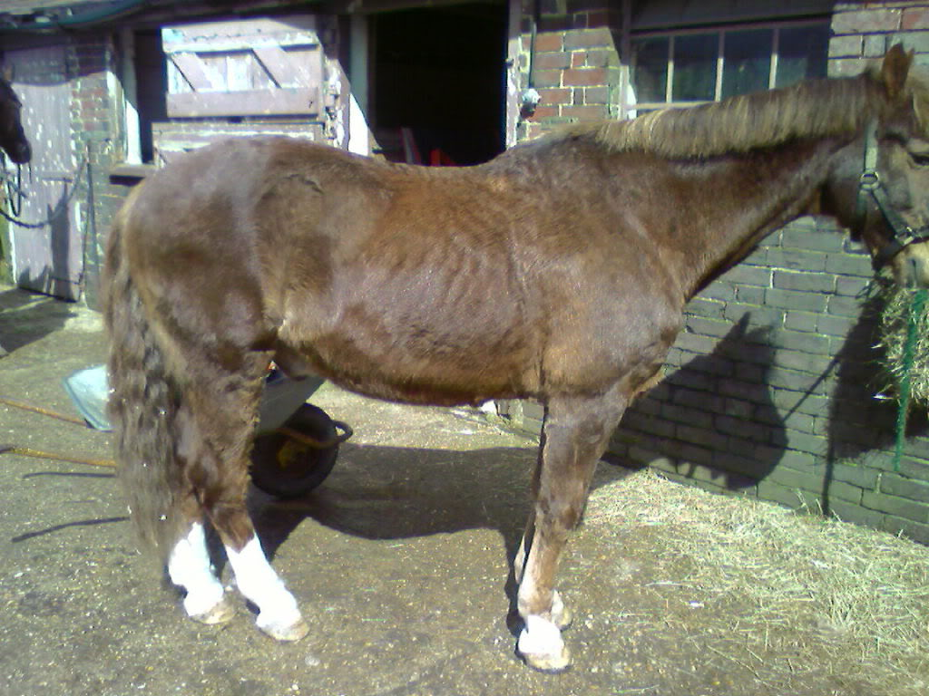
ECD-15-30% of horses over 15
-the obese ECD horse may be a EMS horse.
Not all ECD run high cortisol not all ECD have AC hypertrophy laminitis may occur if HI
Wt loss associated with ECD
can also be simply old age
IR, HI, ID –HI is the key for laminitis
parasitism,
chronic bacterial infections,
muscle atrophy and age related factors
ECD –may need more deworming.
It may be only HI that is assoiated with lamellar issues.
resting cortisol is often within resting range.ppid and ems may simply coincide.
Ppid may aggravate the EMS

Slide 45
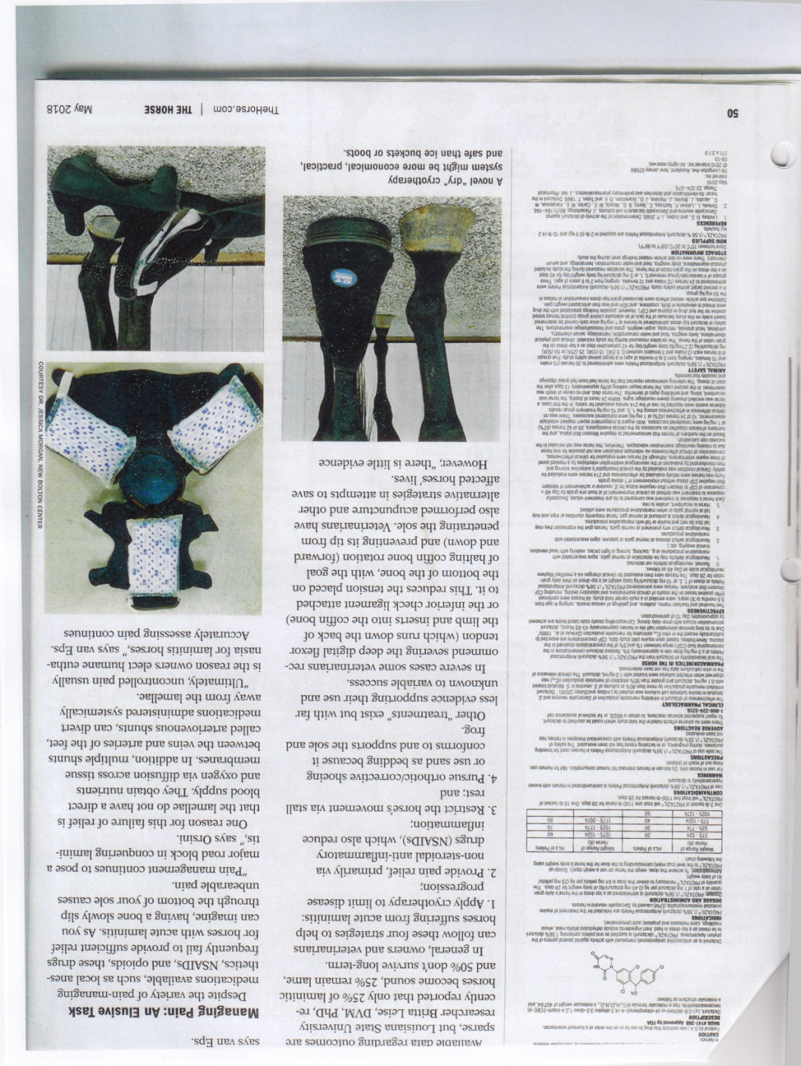

Slide 46
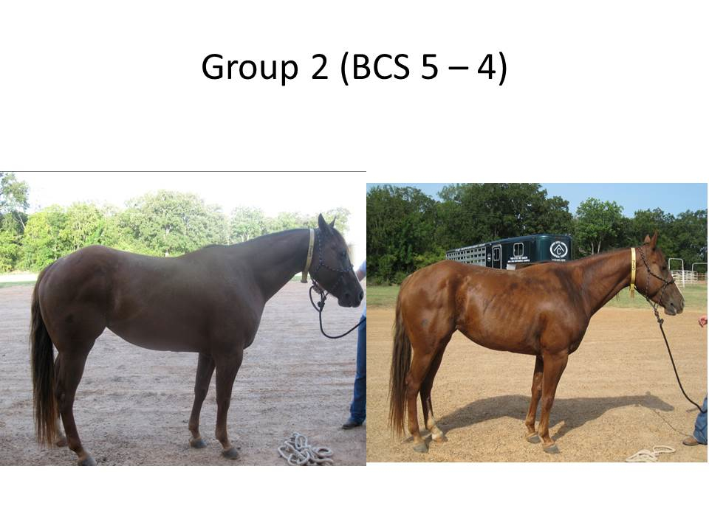
Determine requirements
EG NRC DE
Strive for BCS 5.0
Base line is energy obesity may result in ID if over bcs 7
The DE rquirements at thermal neutral zone
DE = 0.033 x BWt =Maintennce /light work
DE = 1.20 x Maintenance= light-moderate work
DE = 1.40 x Maintenance=heavy work
DE= 1.60 x Maintenance =heavy work
DE = Maintenence increased as follows
DE=(0.036 x BW) x 1.90

Slide 47
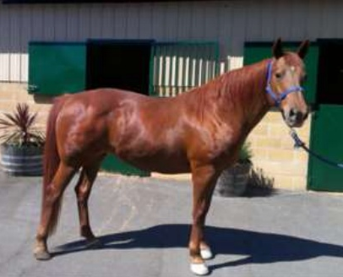
EMS-control IR and HI/ID
10% of horses are HI
HI-obesity-laminitis thin horses may be IR obese horses may have normal Insulin
The size of the nuchal crest and excessive fat in this area important . Why does obesity increase ID. Vs metabolically active fat tissue.
Surveys show 30-70% of horses are obese.
Overnight fasting insulin normal less than 20 uIU/mL
Control wt no more than 1% loss BW /week re hyperlipemia
Control NSC-hay only
Levo thyroxine?-reduction in wt, and neck circumference
Mag oxide
Exercise
Metformin under vets advice

Slide 48
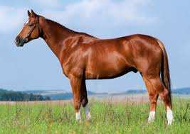
most horses eat 2-2.5% bw DM ponies may eat 2.5-3.0% bw DM
Horses in light to moderate work can obtain most of the energy needed from forage.
Use as much forage as possible-
Encourages chewing , which stimulates saliva production with the bicarb it carries.
It reduces stereotypy behavior
Forage encourages more water intake ie
3-3.5 water to one forage
2.O0-2.5 water to one grain.
Relieves boredom
More forage and water intake provides ballast, preventing colic.

Slide 49
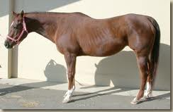
After max forage add concentrates
Gut health is compromised if forage is below 1.5% OF BWT DM BASIS
Harder working horses may need 1.5% BW as good forage. plus up to 1.0% BW as high energy concentrates.
Forages provide some sugars and starch, but they provide majority of their energy by bacterial fermentation of plant fiber and fructan in the hind gut, producing volatile fatty acids (VFA’s).

Slide 50
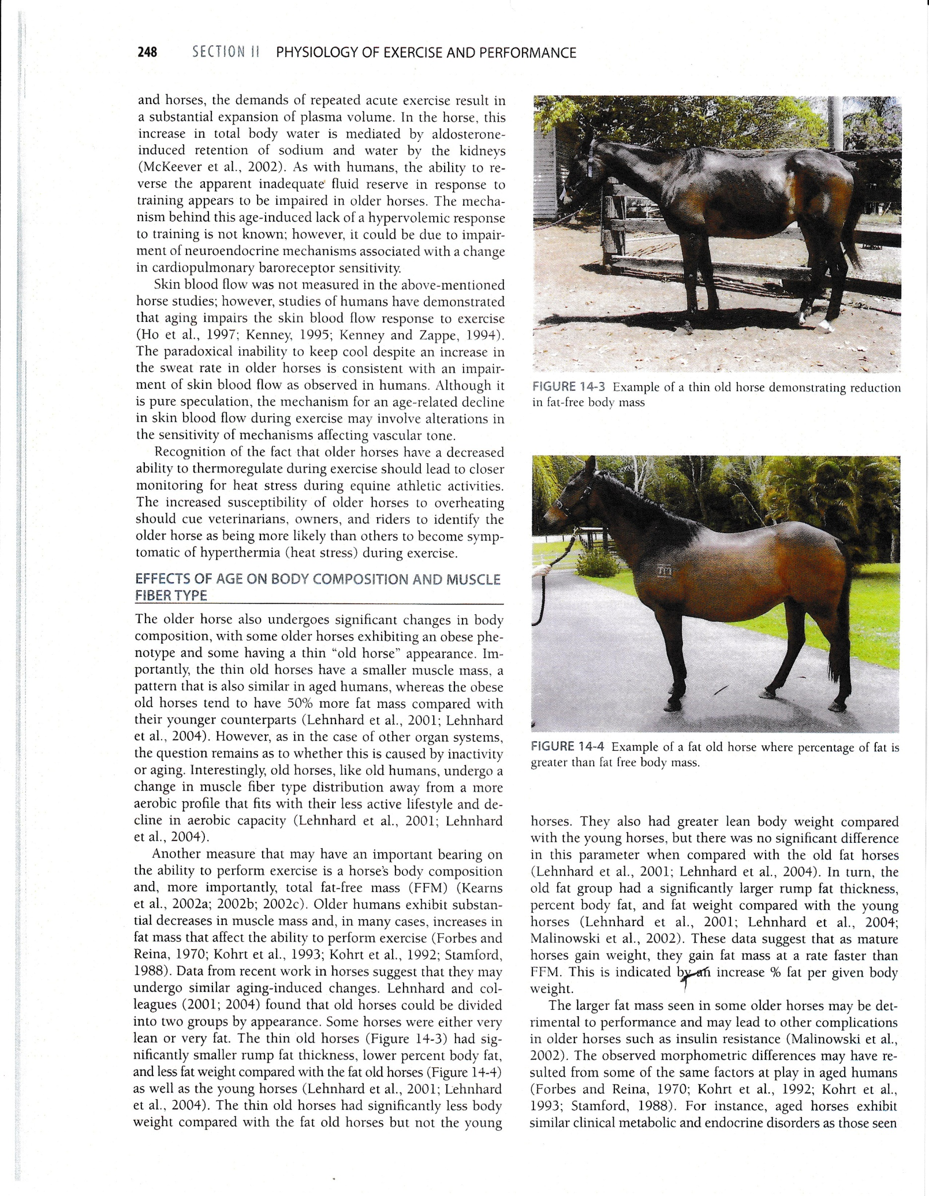

Body condition for old horses

Slide 51
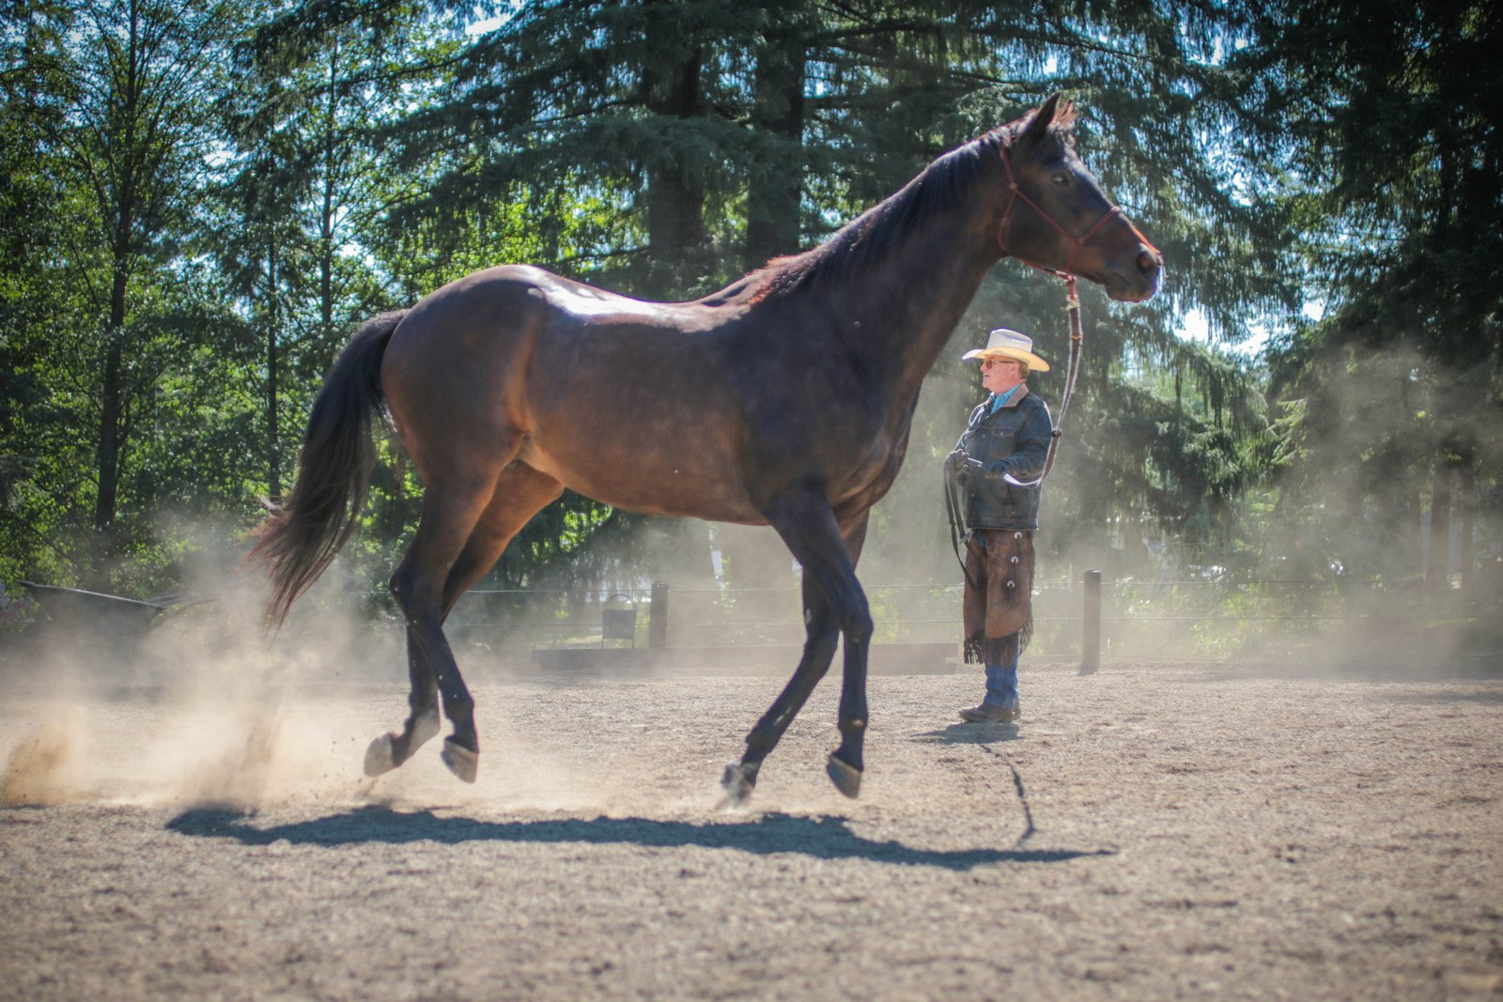

Slide 53
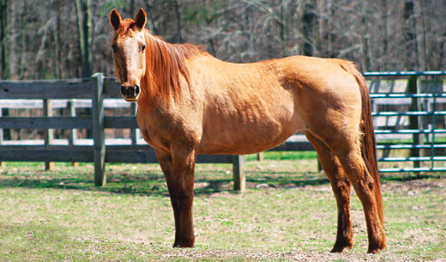
Special needs-THE OLDER HORSE –movement vs ageing vs inactivity.
They lose aerobic MF’s decreases in M Mass they gain fat mass faster than M Mass.
Age related changes-Influences thermo regulatory function-
Older horses reached a core temp of 40Cin half the time required by the young horses, and their HR’s were substantially greater.
However both groups were similar HR’s and core temperatures by 10 min after exercise.

Slide 54
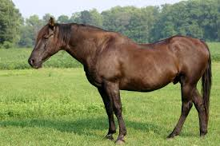
Older mares compared to younger mares exercise test
During sub max exercise, the older mares were not able to thermo regulate as effectively as younger mares.
The greater HR means greater cardiac out put is required , and they were still unable to dissipate heat as quickly.
In aged horses CO is limited, therefore insufficient blood flow.
Plasma volume is also lower & lack of hypervolemic response! Possibly a neuro endocrine effect.
An impairment in skin blood flow may occur re VASCULAR EFFECTS.

Slide 55
Lose MF structure and function. Connective tissue in muscle increases as collagen which interferes with normal contractile function.
Possibly decreases in blood capillarity and decreases in blood flow. Lower ability to dilate blood flow to the periphery with hormonal changes.
They switch away from fibers related to aerobic metabolism to more anaerobic types of MF’s. Hence a decrease in VO2 max means less oxygen to tissues.
Suppression of thirst may occur. Thyroid function may be lower, other hormones are lower decreasing CO, aerobic and exercise capacity. Decreased immune function, impaired nutrient utilisation , decreased N retn, decreased lean body mass.

Slide 56
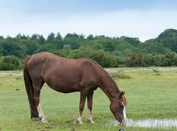
Age and Diet Effects-EVJ-50 (2018) 690-696
Insulin responses to IV or enteral NSC challenge increase with age in healthy horses regardless of diet fed
.
SI was lower in aged horses regardless of diet. SS vs FF
Adaptation to a SS diet may or may not occur? Requires research. Is a low NSC diet beneficial.

Slide 57
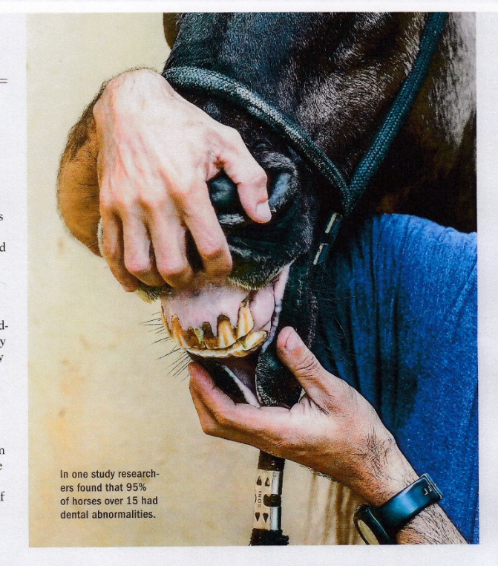
95% of horses over 15 had dental abnormalities.

Slide 58
Senior horses-avoid obesity.
.They may be prone to lipomas.
Strangulating fatty tumors .
Wrap around the small intestine and cut off circulation or cause an obstruction.
Along with arthritis two most common life threatening issues.

Slide 59
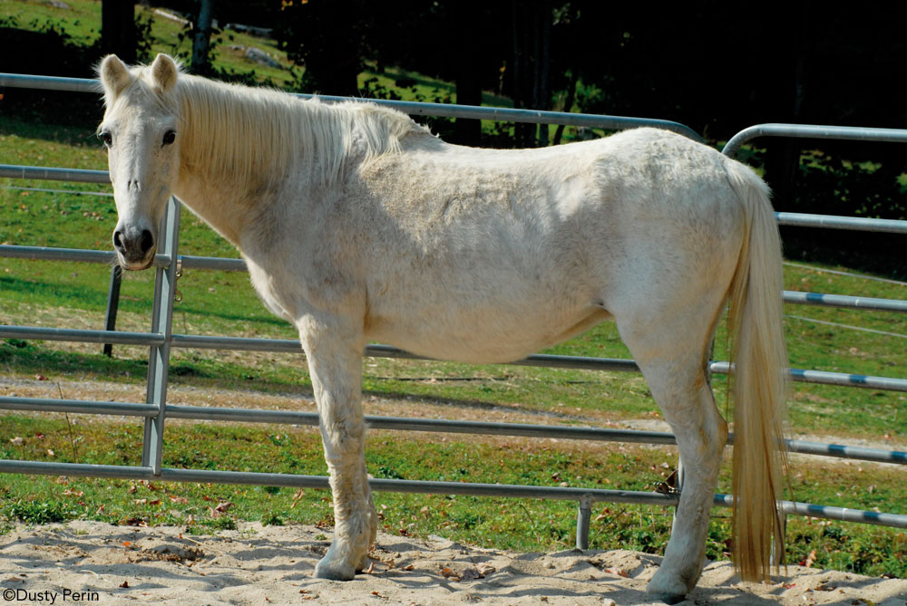
Equine odontoclastic tooth resorption and hypo cementosis
Re canine and incisor teeth
Dental disease probably plays a large role in the incidence of large colon impaction and esophageal choke.
Weight loss may also be related.
Test for ppid
Adjust diet accordingly

Slide 60
Energy
Not a nutrient-energy comes from burning through chemical reactions the nutrients in feed like carbohydrates, and fats and even protein plus the by-products of fermentation of fiber in the hind gut namely the VFA’s.
These nutrients are stored as glycogen in the liver and skeletal muscle in the case of carbohydrates, and fat in various fat deposits.
Energy is moved by sources allowing formation of a high energy compound called ATP
Aerobic energy delivery –a function of HR, stroke volume and O2 extraction by muscle –is the result of a complex chain of events involving the oxygen transport chain. The by product is Co2 and water. Oxygen is required. It is slow but yields a high level of energy over time.

Slide 61
Energy 2
In contrast, anaerobic energy production is more direct and predominates in the rapid delivery of energy for brief periods of intense exercise.
Oxygen is not required. Energy release is very fast but it cannot be sustained for very long. It is not very efficient.
The by products are lactic acid. Increasing acidity is a contributor to fatigue during exercise of very high intensity and short duration.

Slide 62
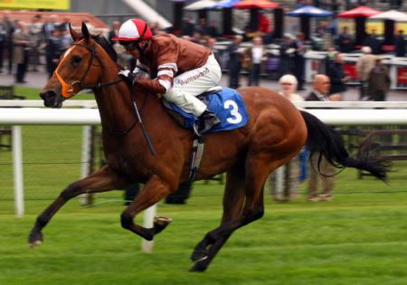
More anaerobic.

Slide 63
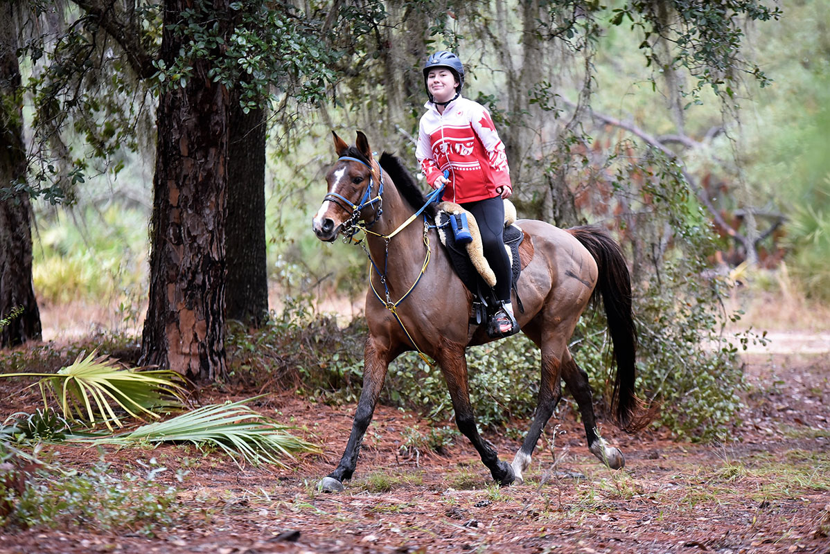
More aerobic

Slide 64
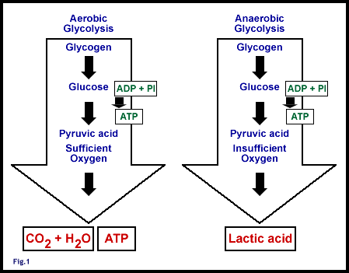
Energy 3

Slide 65
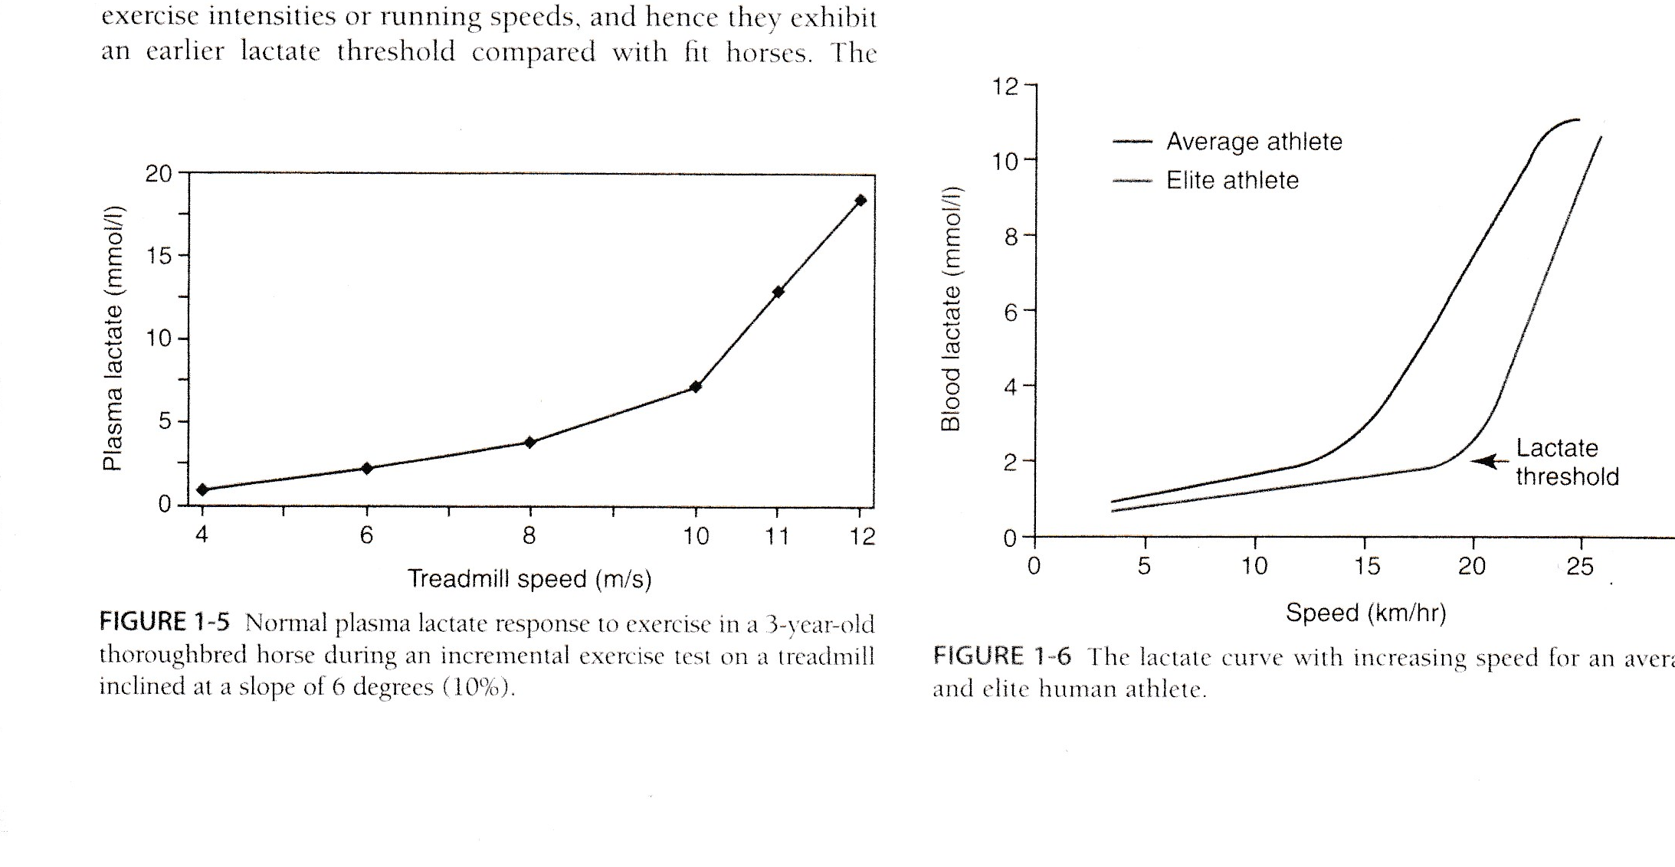
VLA4-the break point aerobic vs anaerobic

Slide 66
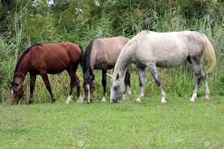
Feeding -begin with NRC define the horse and work level and any factors affecting energy needs.
The horse-average metabolism. Calculate DE required (plus other nutrients).
Horses “usually” eat about 2-2.5% body weight as forage and concentrates combined.
Provide pasture with caution .
Sugar and energy levels may be very high in spring and fall.
Horses have a poor appetite regulation, and when allowed rich pasture, horses may consume 3-3.5% of body weight and ponies may eat 3.5 – 5% body weight dm.

Slide 67
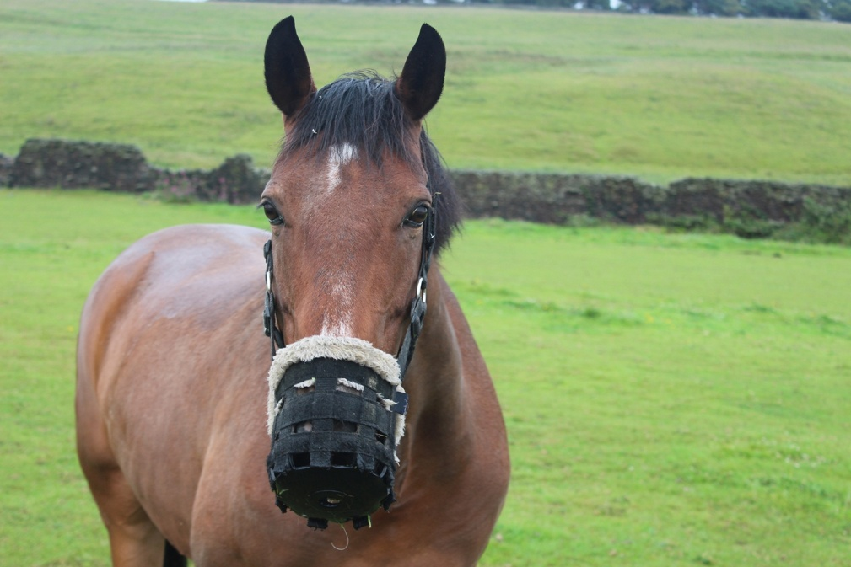
Pasture turn out- possible with a grazing muzzle. Reduces intakes 30-80%
Restricting grazing time may not work
Pasture while ideal may have drawbacks if high in fructans-
Limit time feeding on good pasture resulted in ponies consuming 1% body weight as forage within 3 hours. Hard to control.
Grasses may double their sugar content in one day from 15%-30% or more. Some reports of 40% dm nsc’s
Usually turnout early in the morning helps mitigate sugar levels but not if night time temperatures are below 5C

Slide 68

Grazing Muzzles
Why grazing muzzles?
Certain breeds are very efficient with their nutrition and can store fat readily.
While an advantage in cold climates horses gain weight rapidly in moderate conditions.
Rich pastures can promote IR /ID and lead to laminitis.
Reduced IS may occur creating the basis for EMS.

Slide 69

Grazing muzzles-help with EMS and PPID and fat horses without limiting pasture turnout.
Many older horses develop a different disease equine Cushing’s disease-that can lead to laminitis via a similar mechanism.
A muzzle may help prevent these issues in a healthy horse.
They may take a week to adjust
And be keen to figure out how to use it.

Slide 70
muzzles
Introduce gradually longer each day
If aggressive or not eating use dry lot
Not needed year round-if body weight ok
Do not remove for breaks as horses and ponies can eat a lot in one day.
Keep on no longer than 10-12 hours then dry lot. Otherwise leave on watching weight.
Fit so two fingers around the face.check for rub marks daily
Marks indicate too small
Use breakaway safety features.
Some horses and ponies just wreck them and need dry lot.
Some Research shows muzzles only decrease intakes of pasture 30%.
A recent study with ponies shower they ate 1% body weight over 12-14 days.

Slide 71
muzzles
Horses should slowly and safely lose weight over time
Provided water and access to the pasture most of the day.
Water source should accommodate the muzzle
Ensure diet is balanced
Not suited for use with hay
A horse may lose 1% body weight per week
You may not notice the drop until 3-4 weeks.
Rapid weight loss may put some equids at risk of hyperlipemia
Eg donleys and minis. Excessive mobilization of fat can cause liver and kidney damage.
If not losing weight, check fit, limit additives, increase turn out.

Slide 72
muzzles
Muzzled horses do walk more
They will help reduce weight
Allows exercise and socializing.
They are not cruel.

