Slide 1
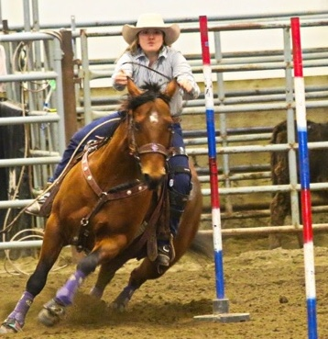
Equine Deworming
Dr Melanie Wowk
Zoetis Manager Veterinary Services- Cattle/EQuine

Slide 2
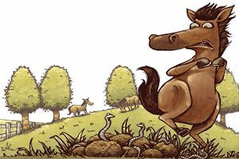
Deworming
Notes:
There have been changes in our thinking about deworming. The AAEP has put out new recommendations.
We can’t remove parasites from a horse’s environment- they can live in harmony with proper management and deworming protocols.
property="og:image" content="http://www.integralequine.com.au/uploads/7/2/9/4/72949239/2f77da5b05-worms-cartoon_orig.jpg" />

Slide 3
Common parasites
Large and small strongyles (Cyathostomes)
Roundworms (Ascarids)
Tapeworms
Pinworms
Bots
Notes:
Each has it’s own unique life cycle.
TWs IH are forage mites

Slide 4
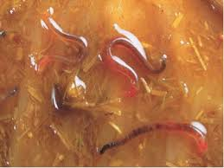
LARGE STRONGYLES

Slide 5
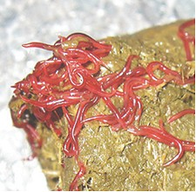
SMALL STROGYLES

Slide 6
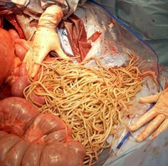
ASCARIDS
Notes:
We want to annihilate! Get rid of them! Deworm, Deworm, Deworm!
Unfortunately, that has been our thinking in the past and as a result have developed…
Photo on right: http://horsehints.org/graphics/Parasitesbots.jpg
Photo on left: Wendy Vaala

Slide 7
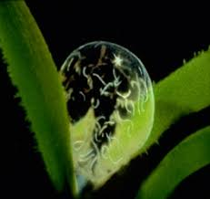
Larval Stages

Slide 8
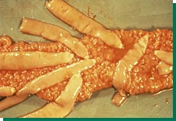
TAPEWORMS

Slide 9
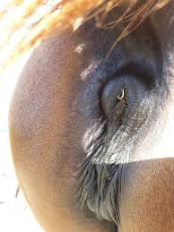
PINWORMS

Slide 10
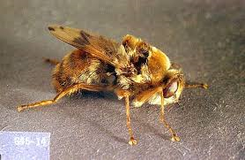
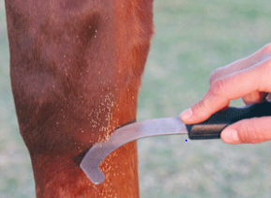
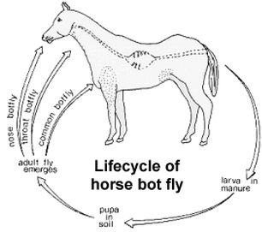
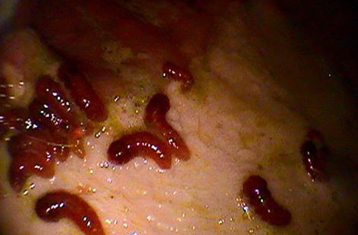
BOTS
Gasterophilus spp.
Notes:
Life cycle of horse bot fly: http://www.eqhc.co.nz/controlling-the-worm-cycle.html and https://www.doctorramey.com/worms/
Image of scraping eggs on leg: https://www.doctorramey.com/worms/
Endoscopy with bots: https://foundationequineclinic.com/blog//horse-stomach-bots
Bots in stomach, lesions: http://helminto.inta.gob.ar/Confe05/fig11.htm

Slide 11
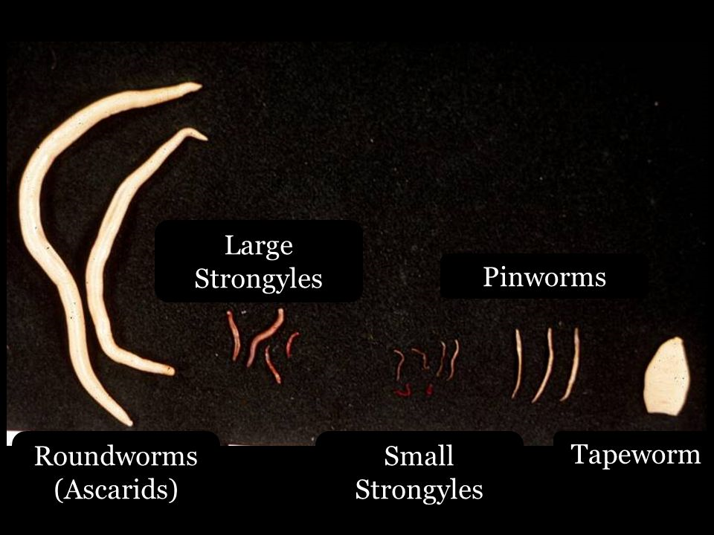

Slide 12
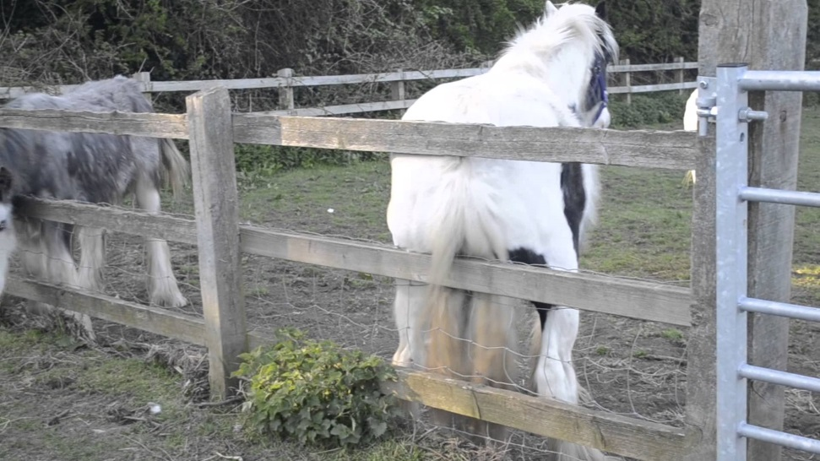
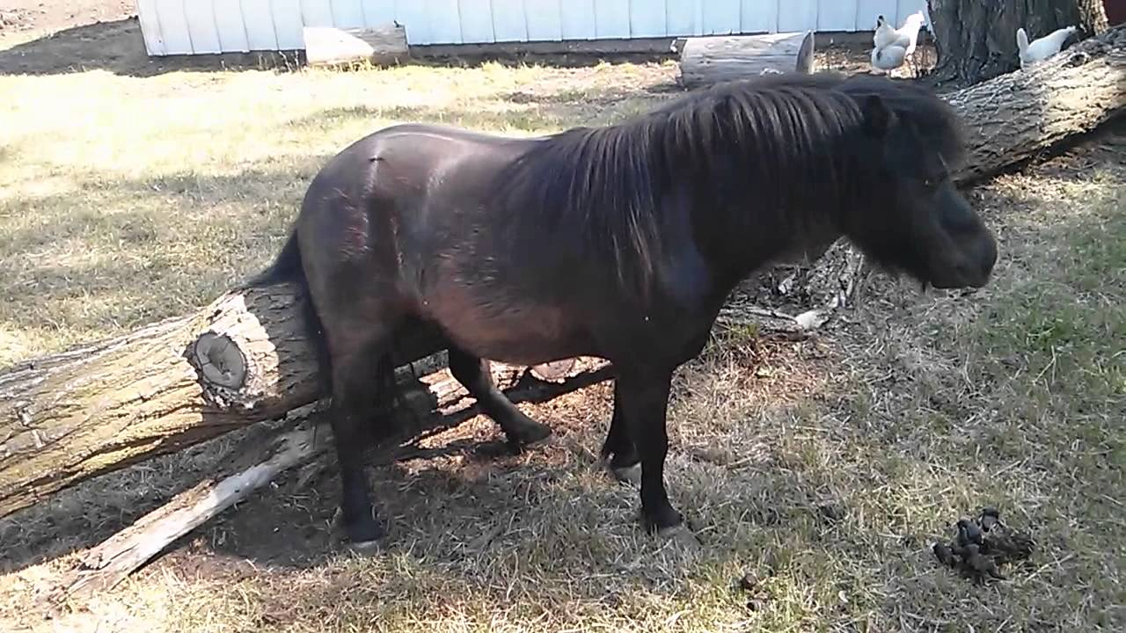
It’s Itchy
Notes:
Damage to fences and waterers unless supplied some other means to scratch
Splinters can result in abscesses- can end up quite deep and hard to locate. Wood doesn’t show up on xrays well.
Photo on left:https://youtu.be/P_o8fNppnvA
Photo on right: https://youtu.be/VK3qeIPn-wY

Slide 13
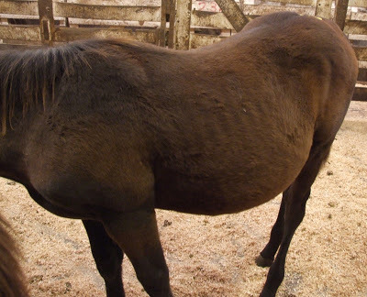

Slide 14

SUPERWORMS
Resistant to dewormers
Notes:
They are able to survive any dewormer you throw at them. They create a population of anthelminthic resistant worms. So how do we prevent this from happening?
We need to step away from past conventional advice to deworm every 6-8 weeks
https://i.ytimg.com/vi/ty6c-fNismI/hqdefault.jpg

Slide 15
Individual plans
It’s ok for your horse to carry some worms- horses and parasites have evolved together
We want some refugia- worms that are not exposed to deworming products
Horses vary in their ability to mount an immune response to parasites
Age of horse is important- horses under 3 and those over 15 years of age
Notes:
Refugia- both in the horse and on the pasture

Slide 16
Who should be dewormed
An excellent opportunity to get input from your veterinarian regarding a plan
Varies with type of horse, number and ages, pasture management, and geography
FECs – to determine those with high worm burdens. These may be the only horses that require increased deworming
-also used to determine level of resistance
Notes:
Foals and yearlings should be treated as high shedders and require more frequent deworming- 3-4Xs/year
Begin deworming foals at 2-3 moa. Warning...
When deworming your youngsters, remember that ascarid impactions are a well-known consequence of therapeutic deworming in juvenile horses. The best way to avoid impactions is a regular control program that never allows a large population of adult ascarids to develop within an individual foal. But how should deworming be implemented for foals which haven't been on a regular control program, or worse, for those which already have developed obvious signs of ascarid infection?
The first step is to enlist the assistance of your veterinarian.

Slide 17
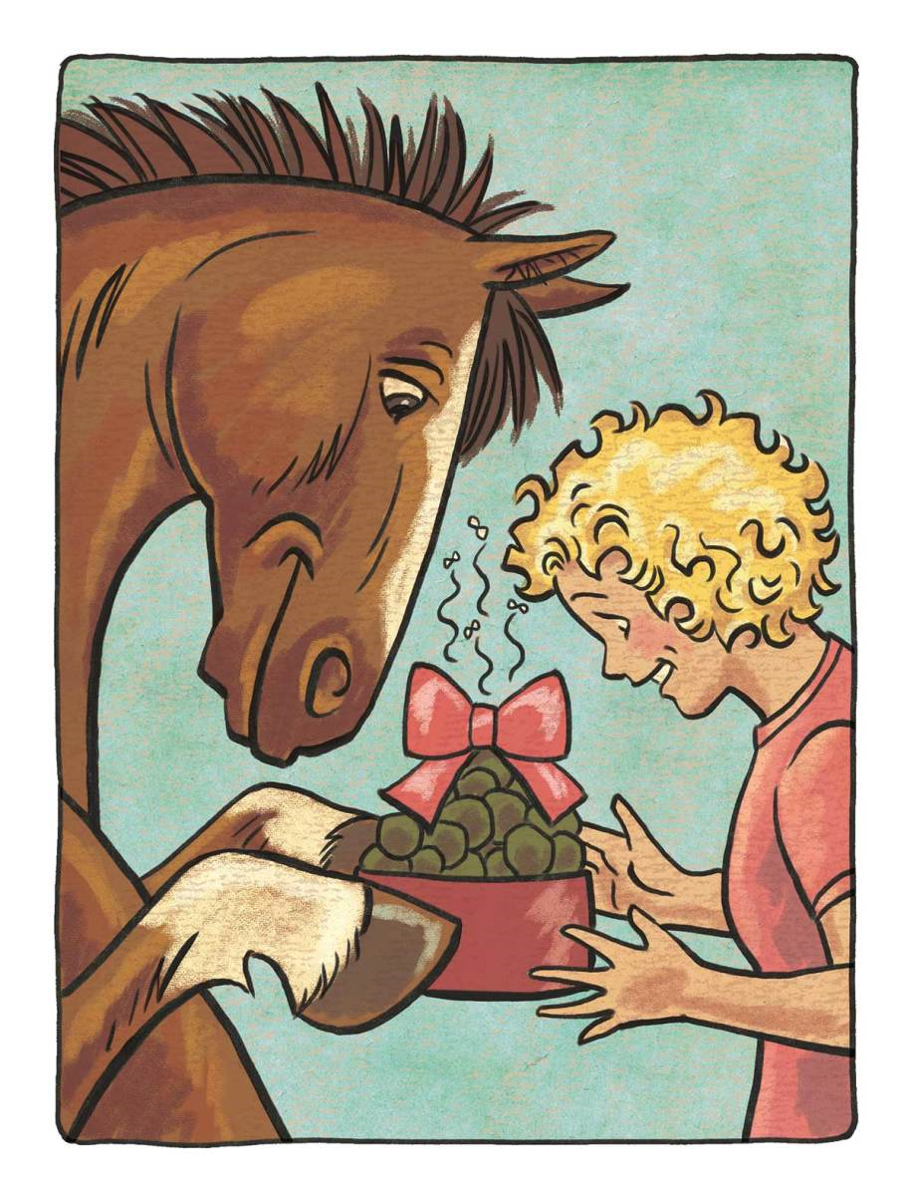
Fecal Egg Counts
DO NOT estimate:
Tapeworm numbers
Pinworms
Encysted small strongyles

Slide 18

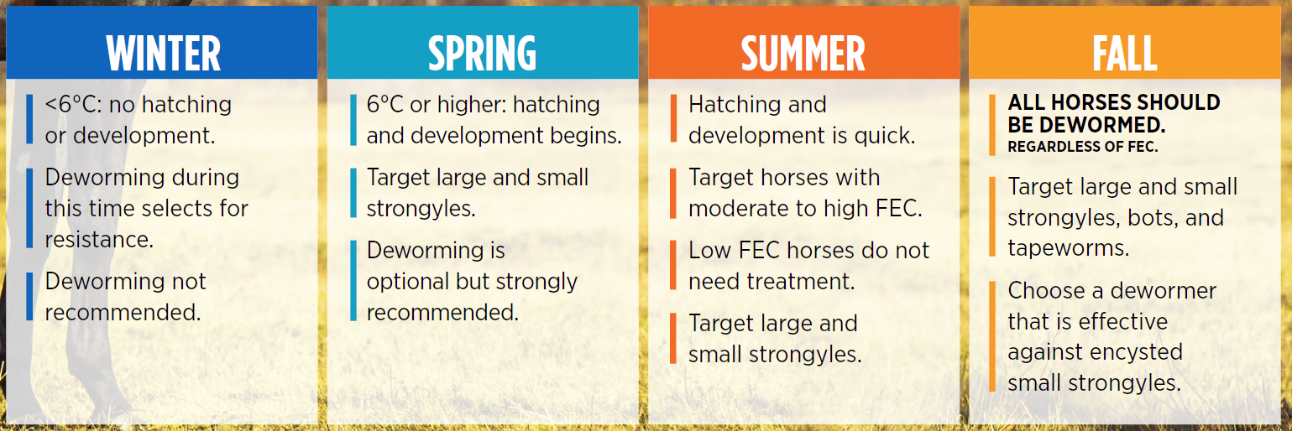
AAEP Parasite Control Guidelines
Full Year Deworming Recommendations
Notes:
“First we are going to go through what the AAEP deworming recommendations are over the course of a full year. To give you the context as to how these recommendations are made, the AAEP does both an extensive literature search on the topic, and they also have a panel of experts that create recommendations. These recommendations are reviewed on a regular basis and updated as needed. The last update was done in 2016. Let’s start with the recommendations for deworming in the winter… etc etc”

Slide 19

Updates in Equine Deworming
As per the AAEP Parasite Control Guidelines
Important changes in the parasitic fauna of horses have occurred such that Strongylus vulgaris and other large strongyles are now rare, and cyathostomins (small strongyles) and tapeworms are now the major parasites of concern in adult horses.
(In mature horses) Consider including a treatment effective against encysted cyathostomins at a time when the mucosal burden is at its peak.
Notes:
“These next two points are taken directly from the AAEP Parasite Control Guidelines, which you will remember that was last updated in 2016. Here they state: Important changes in the parasitic fauna of horses have occurred such that Strongylus vulgaris and other large strongyles are now rare, and cyathostomins (small strongyles) and tapeworms are now the major parasites of concern in adult horses.’ They also go further to state in the section that outlines deworming considerations in mature horses to, ‘Consider including a treatment effective against encysted cyathostomins at a time when the mucosal burden is at its peak.’ This ideal time to target the encysted cyathostomins is in the fall.”

Slide 20
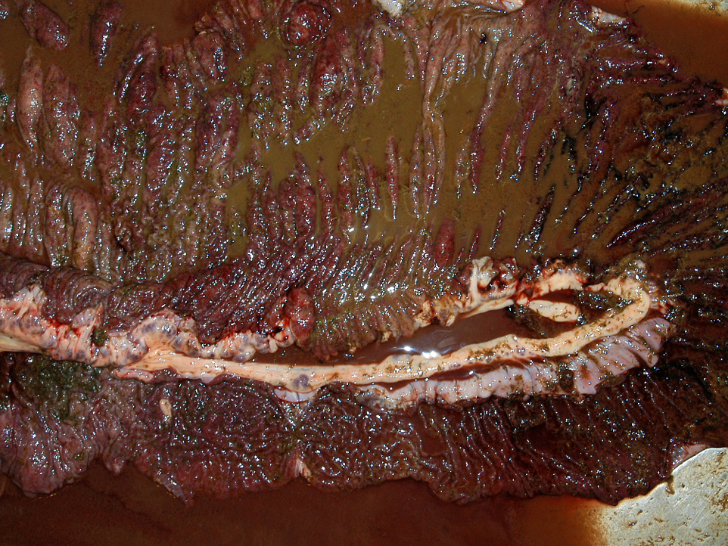
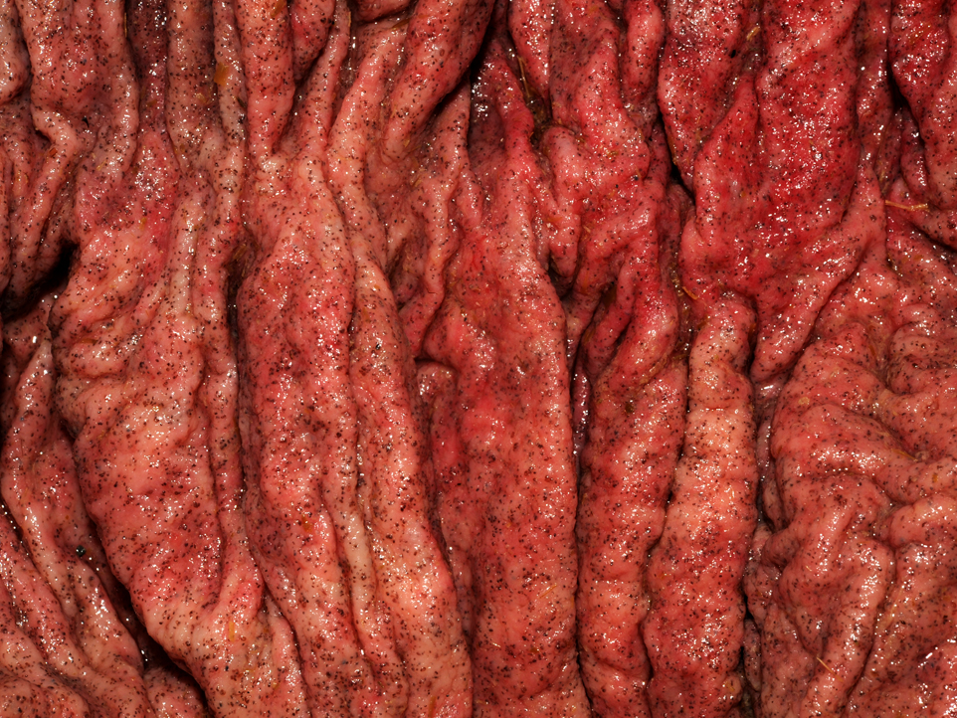
Larval Cyathostominosis
Larval Cyathostominosis Syndrome
40-70%
mortality rates even with aggressive treatment
Notes:
Once at the encysted stage, tens of thousands of encysted larvae may literally cover the mucosa wall, severely damaging it and greatly reducing nutritional metabolism [5]. The wall of the cyst protects the larva, and thus it may be unaffected by conventional dewormers.
Affected horses may be of any age and present with any of the following signs: chronic diarrhoea, oedema, anorexia, dullness, acute weight loss pyrexia [24,33]. Similarly haematology is not diagnostic. A typical clinical picture includes neutrophilia, hypoalbuminaemia, hyperglobulinaemia, especially betaglobulin, all are findings that are consistent with a protein-losing enteropathy. Low total serum protein has been reported.
pictures: http://www.askjpc.org/wsco/wsc_showcase2.php?id=434

Slide 21
Larval Cyathostominosis
Major parasite concern in adult horses
Larvae encyst in and damage gut wall
Diarrhea
Depression
Progressive weight loss, emaciation
Fever, colic or abdominal distress

Slide 22

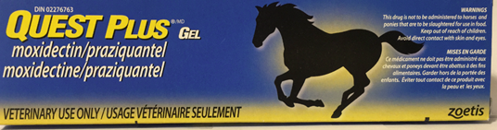
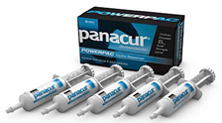
Larval Cyathostominosis
Only 3 products are available in Canada that are effective against the larval stages of small strongyles

Slide 23
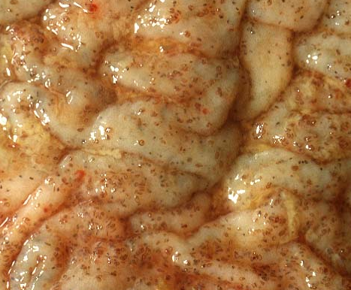
Safety studies - Inflammation
It has been reported in a number of cases that horses developed clinical symptoms of
larval cyathostominosis
(mass emergence of larvae into the gut lumen)
within a short period of time after anthelmintic treatment.
Treatment for encysted small strongyles with fenbendazole, specifically, has been associated with inflammation of the intestinal wall.
  (Steinbach, 2006, Vet Parasitology)
Notes:
This fear of causing inflammation in the gut is real for some veterinarians and owners. I remember treating horse with the 5 day treatment of fenbendazole for suspected cyathostomosis and everybody being afraid of causing more problems with gut inflammation, so we were giving corticosteroids at the same time.
To study this phenomenon of intestinal inflammation was explored further in 2015 by Betancourt et al which is the basis of one of the Tech Bulletins that you have.
Small strongyle infection: Consequences of larvicidal treatment of horses with fenbendazole and moxidectin (Steinbach et al., Vet Parasitology, 2006)
******
Background info:
Statement from Steinbach 2006 study intro: "However, there is an ongoing debate on the real benefit of such drug applications since it was reported in a number of cases that horses developed clinical symptoms of larval cyathostominosis within a short period of time after treatment. Up to date, however, there are no real proofs for these suggestions." (Steinbach, 2006, Vet Parasitology)
This is why the 2006 Steinbach study was done.
”Because anthelmintic treatments have been associated with intestinal reactions^{2,3} and these inflammatory reactions may play a role in the development of parasitic disease post anthelmintic treatment (larval cyathostominosis)⁴,…"
Ref 2 is the Steinbach one. Like we discussed before ref 3 is the paper explained in the tech bulletin on cytokine genes expression. Ref 4: Time since last anthelmintic treatment was significantly associated with chronic diarrhea (type and frequency not significant).
From the Steinbach study with histological evidence of inflammation and the Betancourt study showing increased cytokine gene expression for fenbendazole and not moxidectin, We can now say this inflammation is only with fenbendazole (at least in these 2 studies) and is only related to encysted small strongyles.
Encysted: https://www.askjpc.org/wsco/wsc/wsc99/99l/9w281a.jpg

Slide 24

KEY POINTS: Parasites to target in the fall
All horses should be dewormed, regardless of Fecal Egg Count (FEC).
Target large and small strongyles, bots and tapeworms.
Choose a dewormer that is effective against encysted small strongyles.

Slide 25







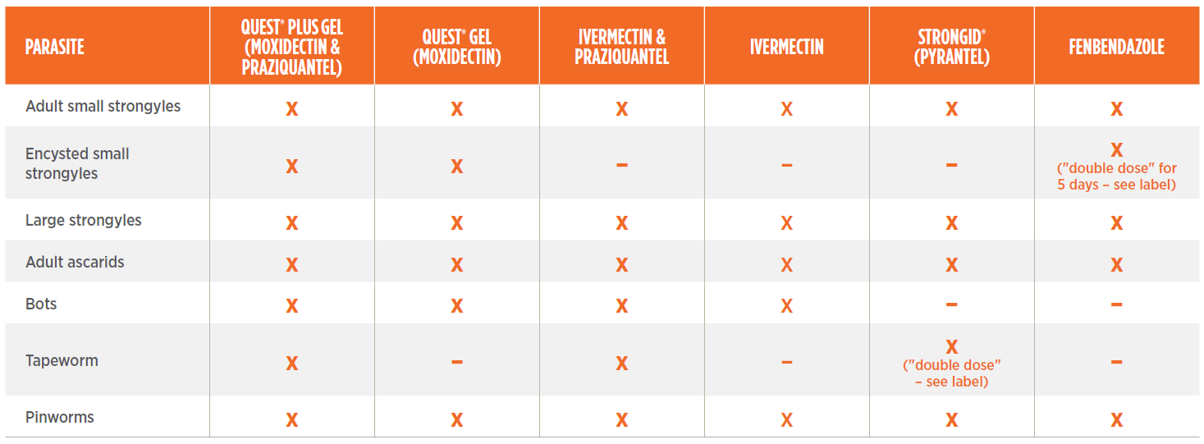

Available Products for Fall Deworming
is the ONLY product to meet all AAEP fall recommendations.
Notes:
When we look at all of the products on the screen, Eqvalan and Eqvalan Gold are our main competitors in this field.
You can think of the Eqvalan brand as the “Kleenex” of equine dewormers, where people automatically associate Eqvalan as the “brand name dewormer of choice.”
However, if you remember from the AAEP Parasite Control Guidelines, they specifically state that small strongyles are now the major concern in adult horses, and that we should “Consider including a treatment effective against encysted cyathostomins.” Which means Quest or Quest Plus!
There is a lack of awareness of the importance of encysted small strongyles and the role they play:
Tell your story about horse owner feedback from when you have presented
Tell your story about the possibility of causing colic
Your role as TMs is to raise awareness of, and to remind people of, the importance of encysted small strongyles as per the AAEP deworming recommendations. This allows you to position Quest Plus as the dewormer of choice this fall.
The competitor product we are positioning ourselves against here is Eqvalan and Eqvalan Gold.

Slide 26
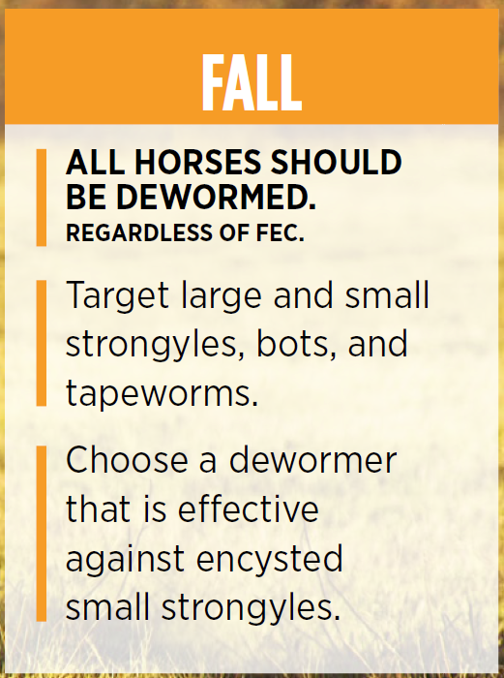
KEY POINTS: Efficacy of available products
Quest Plus is the ONLY product to meet all AAEP Fall recommendations.
Quest and Quest Plus are the ONLY dewormers that treat encysted small strongyles in a single dose, reducing cost and stress to the horse.
ONLY Quest and Quest Plus can suppress the production of small strongyle eggs for 84 days, reducing treatment frequency.

Slide 27
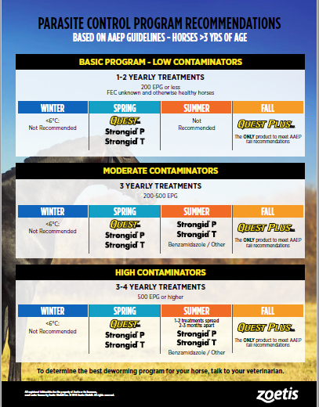

Slide 28
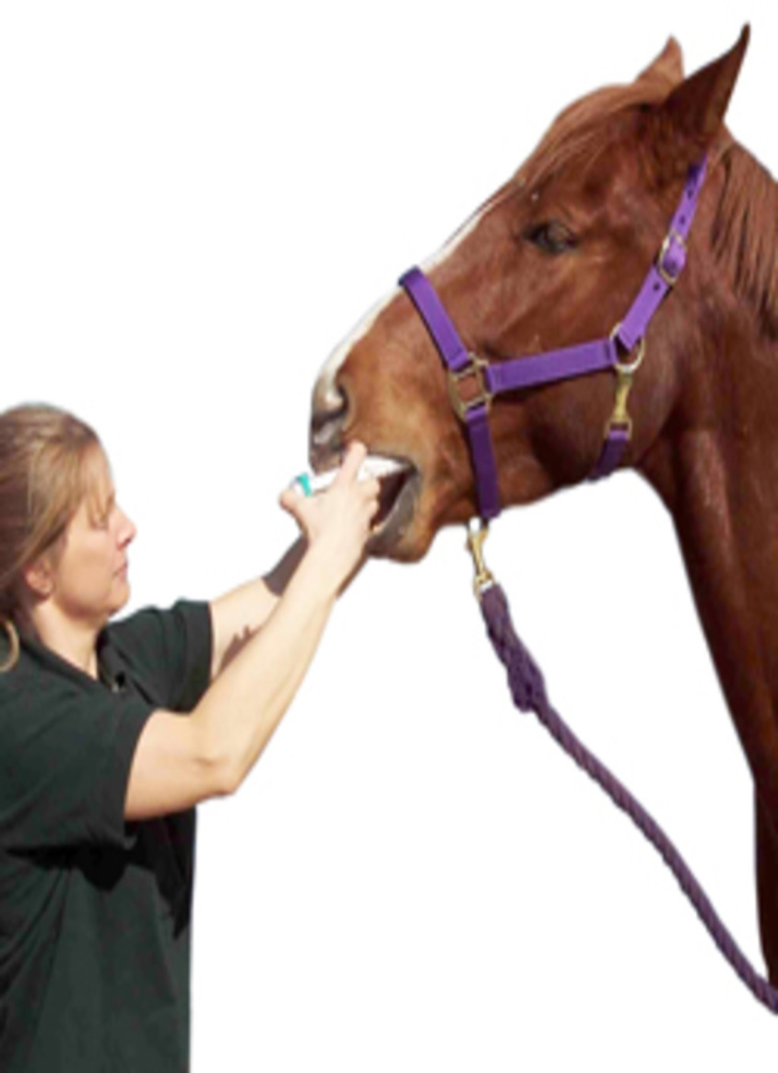
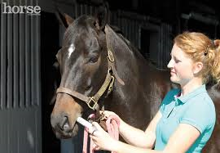
BE SAFE
Notes:
Never stand directly in front.
Photo on right: https://encrypted-tbn0.gstatic.com/images?q=tbn:ANd9GcTc1DGmRniFXxspuh-A-xjyecr5V0Uo7NR_yM6yILZhQxzCI6BaXw
Photo on left: https://valleyvet.ca/files/2013/05/EQ_deworm_250.jpg

Slide 29
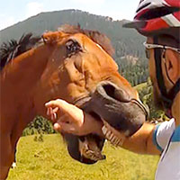
For the “High Spirited”
Preventing Problem Behaviors During Veterinary Procedures
LINK: https://thehorse.com/139462/preventing-problem-behaviors-during-veterinary-procedures/
Notes:
https://www.horsetrainingvideos.com/images/horse-bites-man200a.jpg
Your veterinarian will thank you. As will your farrier, the horse chiropractor, people that happen to be riding their bikes by your pasture.

Slide 30
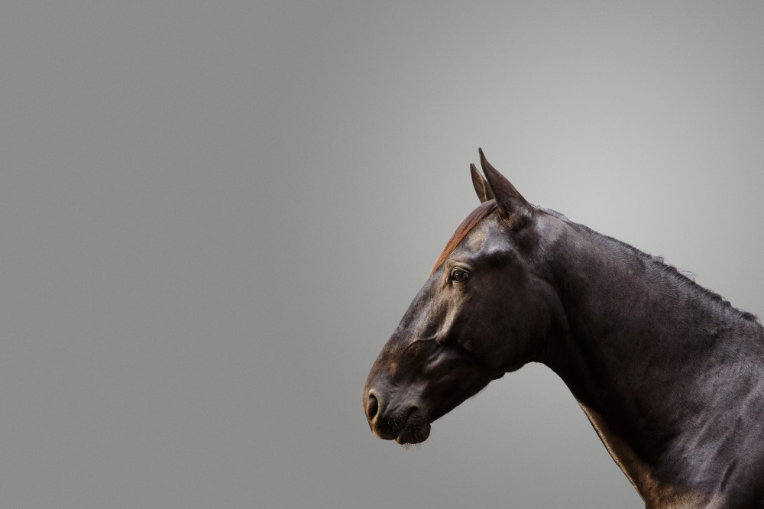
IONS??

