Slide 1
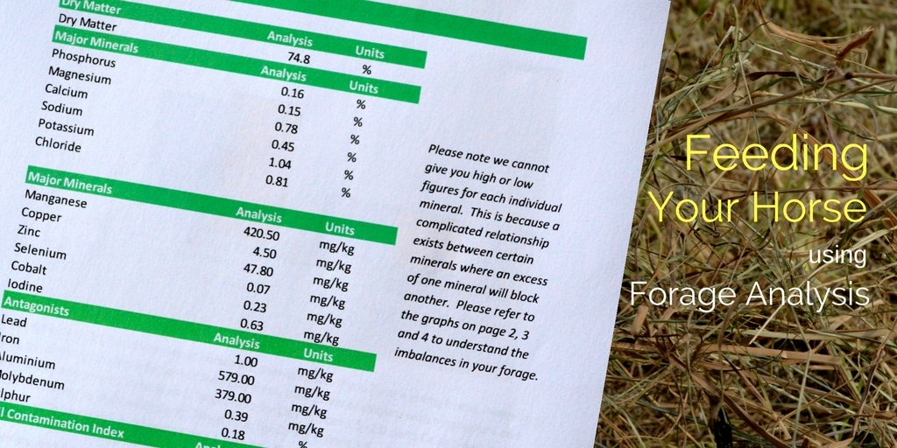

Slide 2
Forage for Horses
As Fed/Sampled – moisture included and always smaller values
Dry Matter – total solids once moisture removed
Nutrients used on a dry matter basis

Slide 3
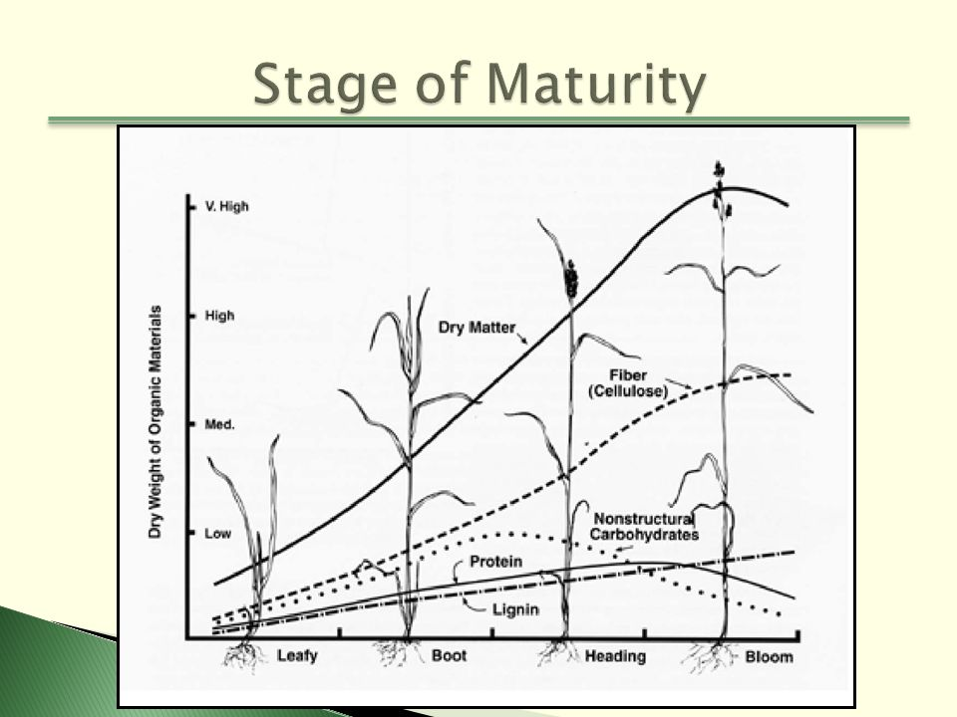
Stage of Maturity

Slide 4
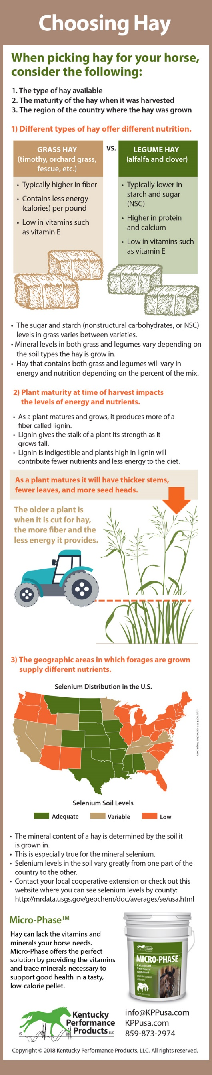
Forage for Horses

Slide 5
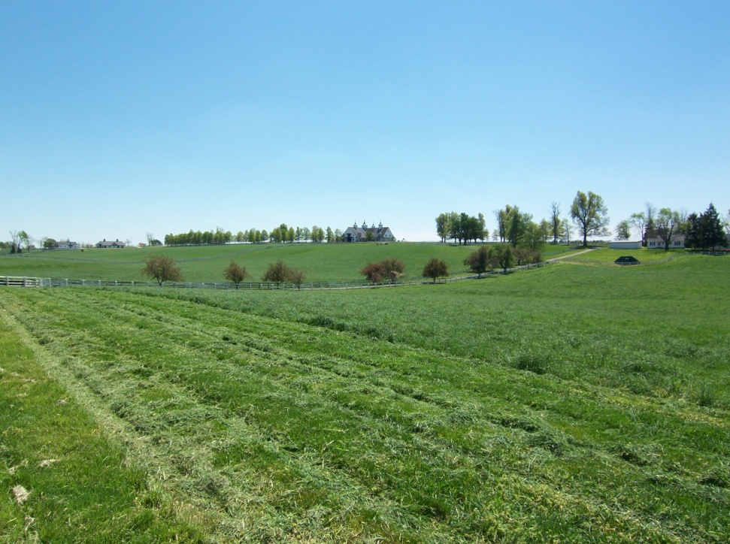
Moisture
Median average is 10-12%
If too dry it can also cause impaction colic <5%
Excessive moisture leads to hay heating, spoilage/mould, quality losses, nutrient losses, respiratory problems once inhaled, and even fires >15-18%
Improve ventilation during storage

Slide 6
Crude Protein (CP)
between 4-20%
<4-6% lacks necessary enzymes
Effects on Crude Protein - fertilization, environmental conditions, forage species, yield, soils, resistance to disease
Every cell in the body contains hundreds of proteins that function as enzymes driving the cellular functions

Slide 7
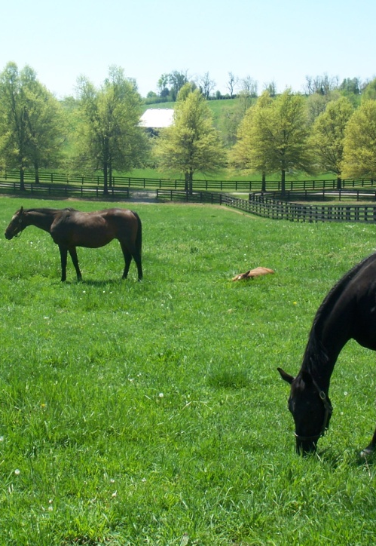
Acid Detergent Fibre (ADF)
Measures fibre concentration
Less digestible carb - difficult to digest – releases endotoxins
>41%, digestibility decreases and protein is less available
<32%, higher energy and intake, nutrients are more available, more palatable, possibly diarrhea if too low
If more palatable, sugars more available - if overfed

Slide 8
Neutral Detergent Fibre (NDF)
Forage Grade | Description | If the ADF is: | If the NDF is:
Prime | Excellent | Under 30 | Under 40
1 | Premium | 31-35 | 41-46
2 | Good | 36-40 | 47-53
3 | Fair | 41-42 | 54-60
4 | Poor | 43-45 | 61-65
5 | Reject | Over 46 | Over 66
Often considered indicator of forage quality
Total plant cell wall carbs, ADF, hemi-cellulose
>60%, digestibility decreases and lowers intake
<52%, higher energy and intake, nutrients are more available, more palatable, more calories
If NDF is high, reject, too much waste and not desirable, predicts intake

Slide 9
Lignin
Provides strength and protection to plant
Indigestible
As plants mature – increases- stiffening agent
We hope for approx. 4-5% on grass hays, 6% Alfalfa
Too soft – quidding /wadding - impaction (dry and dusty, watch for colic)
Too stiff, very difficult to chew

Slide 10
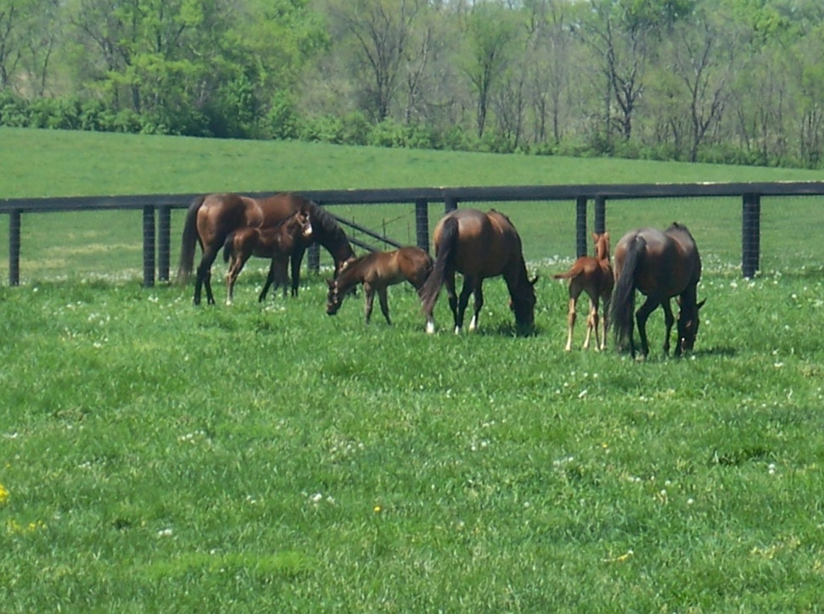
Ethanol Soluble Carbohydrates ESC
Primarily digested in the small intestine (glucose, sucrose)
Generates short term energy
Some benefits for hard working horses, not so much for horses that are sensitive to blood sugar changes, IR
Sugar sensitivities – Cushings (PPID), tying up
Abdominal stress associated with ESC (short chain fructans) as this sugar ferments rapidly
If acute laminitis or very high insulin, suggest keeping <8%

Slide 11
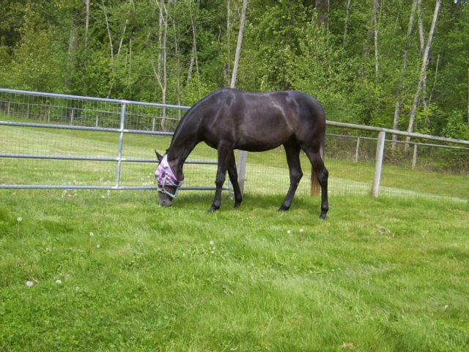
Water Soluble Carbohydrates WSC
includes simple sugars and fructans
High levels might indicate high fructans in grass hay or high simple sugars in non-grass hays
Good for endurance, not laminitis
If watching for colic, diarrhea, laminitis, need to keep this value <10%

Slide 12
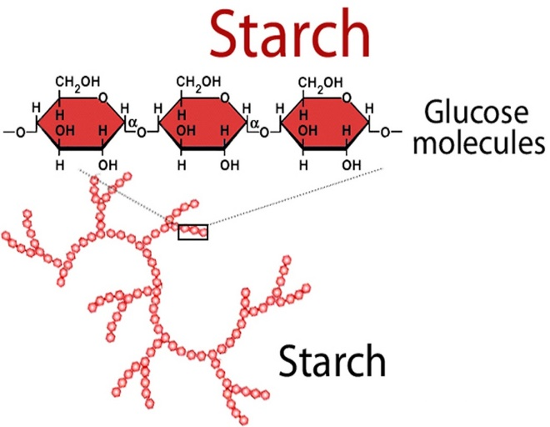
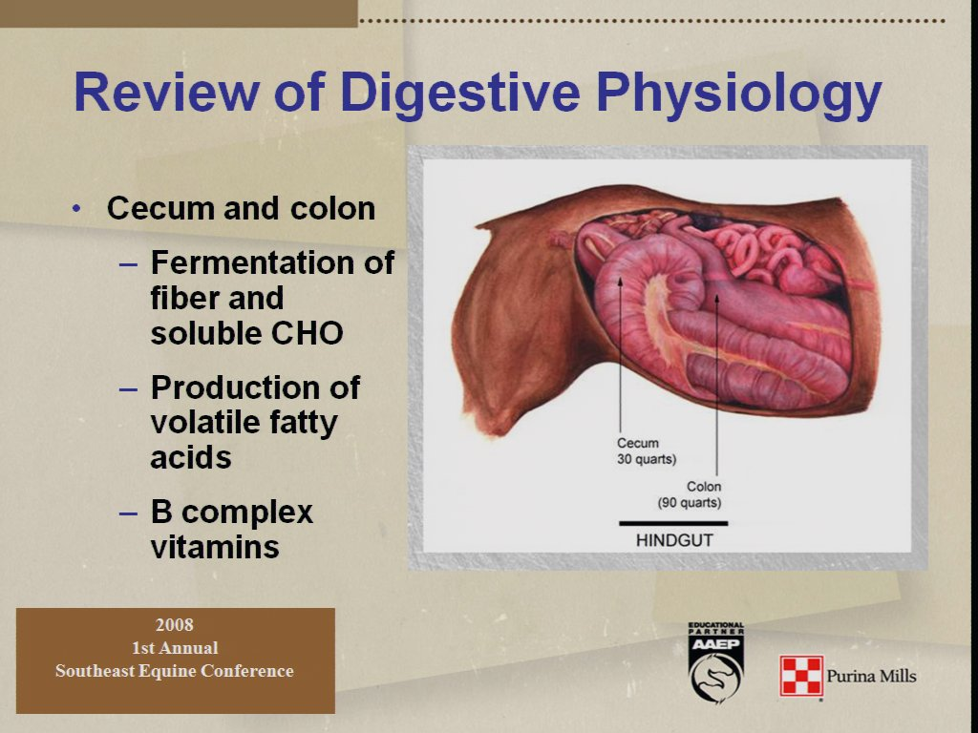
Starch
Mostly digested in small intestine broken down and absorbed as glucose (simple sugar)
Reduced fiber digestion
Low Starch – for IR
High Starch – for quick energy
Problems arise when excess reaches/ferment in the hind gut
Rapid buildup of acid
Feed little and often
Destroys B Vitamins

Slide 13
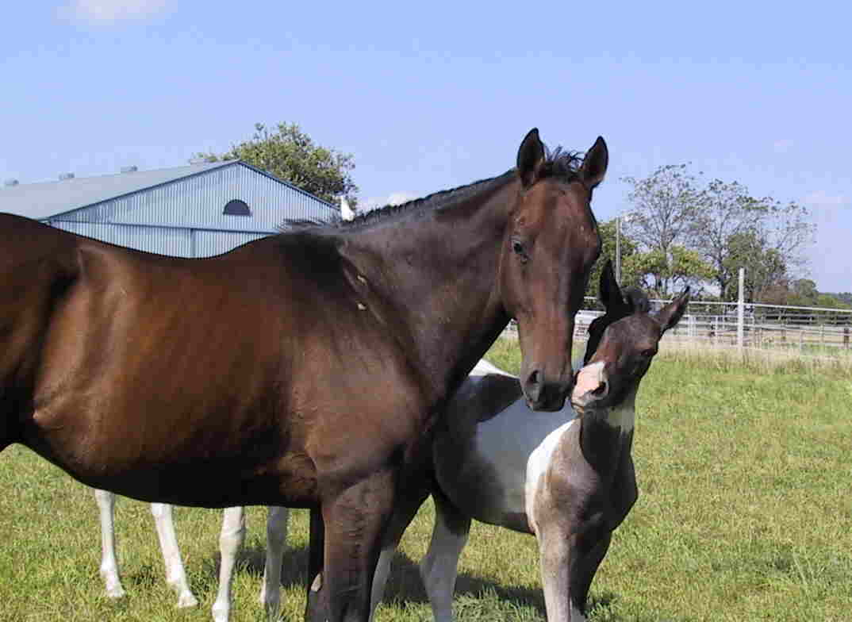
Fructans
Can trigger colic or laminitis from toxic effects, re: lower PH level
Fructans can be 30-40% and they only ferment in the hind gut. Fructans vary in type and fermentation rate.
Lactic acid forms from low ph and then good microbes die (D and L)
Not digested in small intestines only hind gut
Excessive caloric intake, obesity #2 behind colic
Found in cool season grasses but not alfalfa
Try and avoid being without any forage for longer than 5 hours or problems may occur

Slide 14
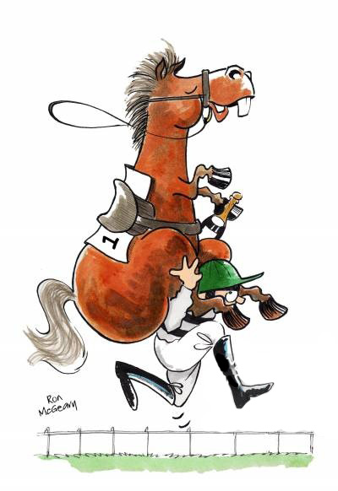
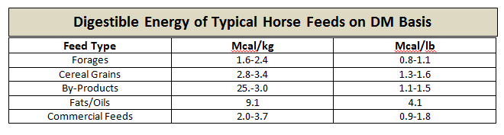
Energy
Expressed as either Mcal/Kg or Mcal/lb
Depends on workload and metabolism
Easy Keepers / Hard Keepers
Activity factors can influence these numbers greatly

Slide 15
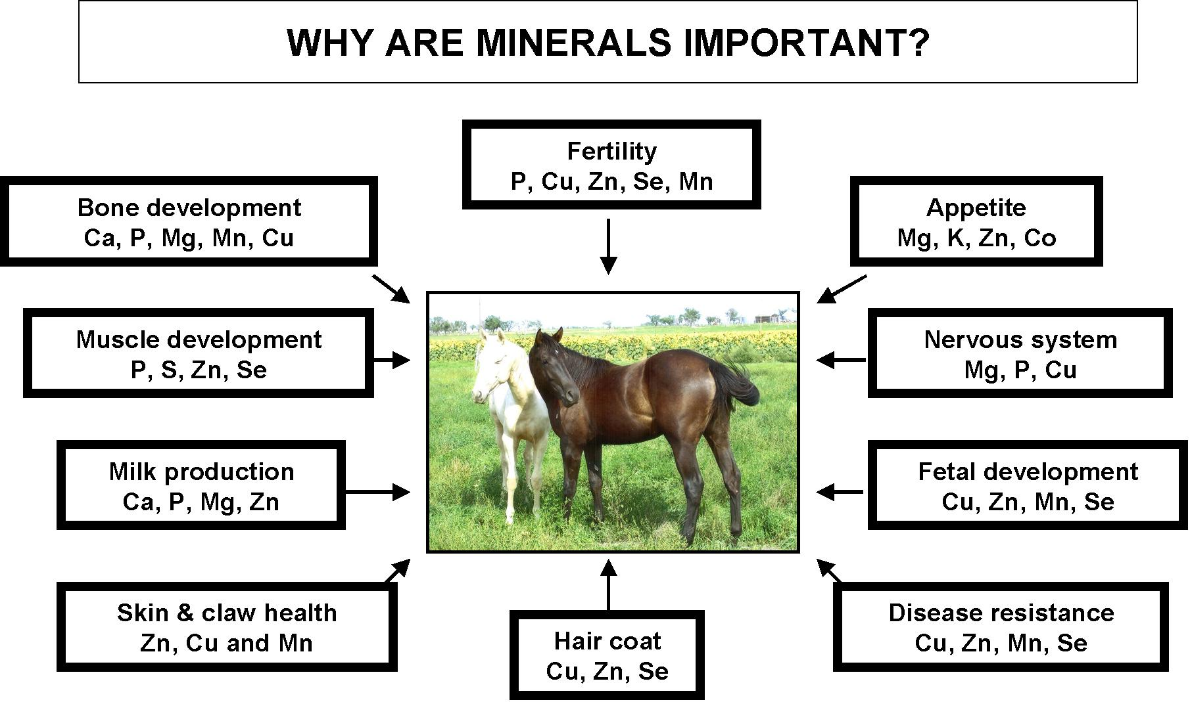
Minerals – soil determines mineral content, especially selenium

Slide 16
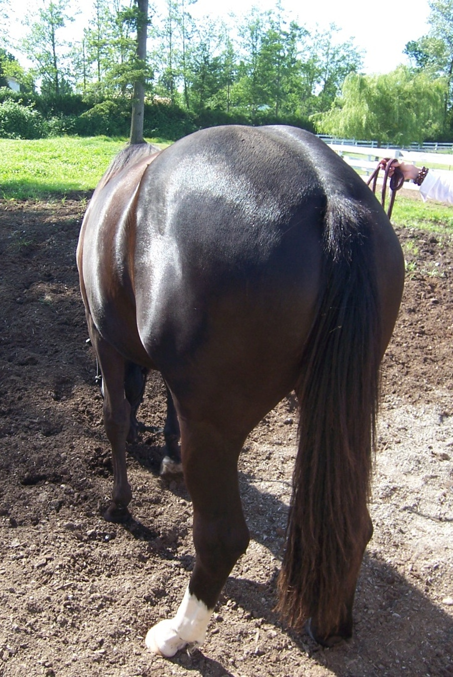
The End

