Slide 1
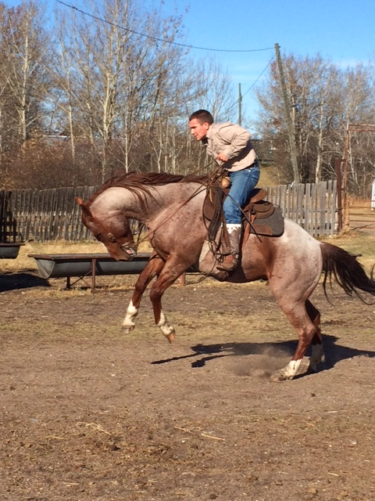
Equine Vaccination
Melanie Wowk, BSc, DVM
Manager Veterinary Services
Cattle/Equine

Slide 2
Equine respiratory disease
Respiratory disease is the leading infectious cause of death in horses of all ages
  10-15% of equine deaths are due to respiratory disease
  Respiratory disease is a common conditions for which antibiotic
  treatment is prescribed.
https://www.aphis.usda.gov/animal_health/nahms/equine/downloads/equine15/Equine15_is_Mortality.pdf
https://www.aphis.usda.gov/animal_health/nahms/equine/downloads/equine15/Eq2015_Rept1.pdf
Accessed November 1, 2017

Slide 3
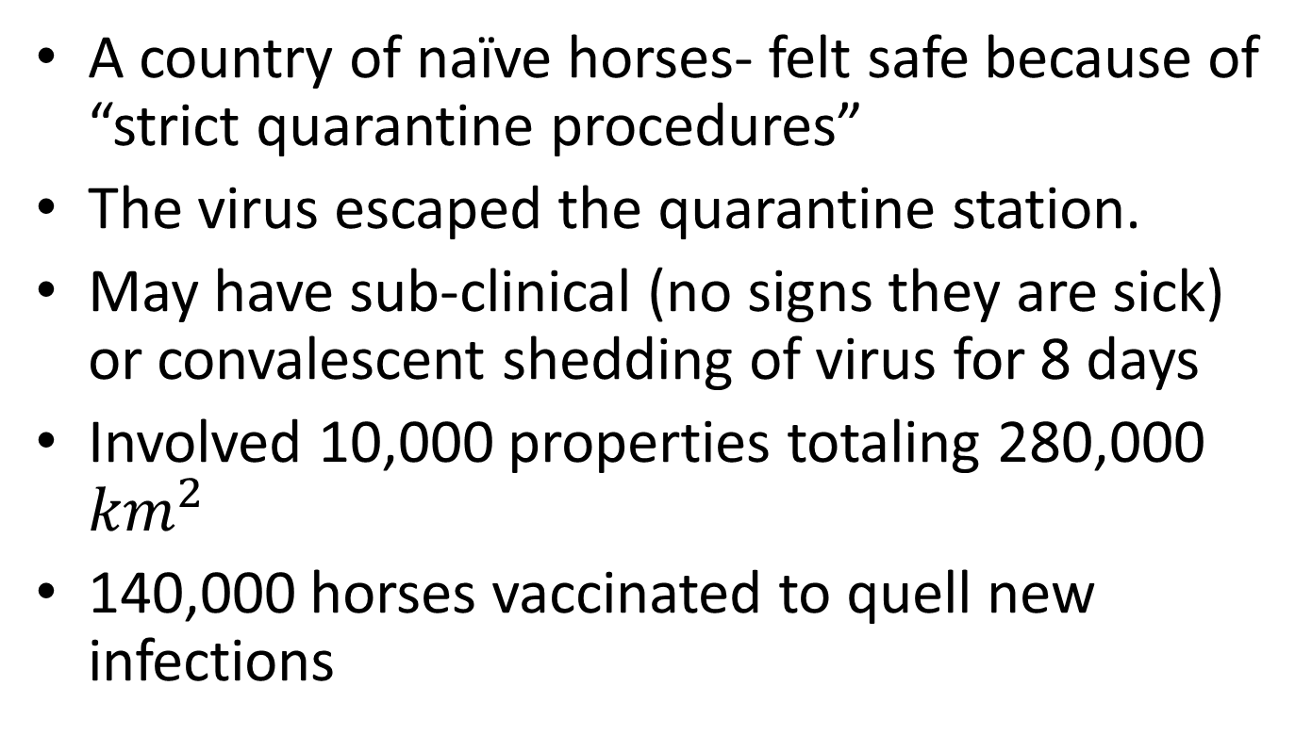
Australian Flu Outbreak 2007
A country of naïve horses- felt safe because of “strict quarantine procedures”
The virus escaped the quarantine station.
May have sub-clinical (no signs they are sick) or convalescent shedding of virus for 8 days
Involved 10,000 properties totaling 280,000 ${km}^{2}$
140,000 horses vaccinated to quell new infections
Notes:
Severe infections of flu may result in recovery taking 50-100days.
Damages respiratory cilia which must be regenerated.

Slide 4
Circulating strains of equine influenza
KY 97
Clade 1 Worldwide Circulation
Clade 2 European Circulation
KY 99
KY 01
KY 01
2002
2003
2004
2004
Newmarket 03
OH 03
2006
2005
2006
2007
2007
2006
2007
2007
KY 07
Richmond 07
KY 14
TX 12
AY 13
Notes:
This slide is probably familiar to most of you- HA! If not, don’t feel bad. As a primarily bovine practitioner it was news to me when I first saw it.
Touch on strain and clade confusion. Stress that all commercially licensed vaccines are accepted by the FEI
There has been some confusion with regards to what strains of flu protect. Fluvac contains Kentucky 97, which over the years has diverged into 2 clades and numerous other strains. The important thing to remember is that even though the strains have different names there is cross protection among them- there is enough genetic similarity that the antibodies the horse makes against the KY97 strain is protective against all the other strains that diverged from it, which are the most common strains we see in NA. Zoetis has conducted studies to demonstrate KY97 protection against the OH03 strain.

Slide 5
West Nile Virus Reaches NA
Spread by mosquitos
Initially a “foreign” disease
First diagnosed in NY in 1999- 36% of infected horses died
West Nile Innovator is credited for helping reduce the number of cases in the US by nearly 70% from 2002 to 2003

Slide 6
IN A 2003 NATURAL OUTBREAK, NAÏVE HORSES WERE 31 TIMES LESS LIKELY TO HAVE DISEASE IF VACCINATED WITH WEST NILE-INNOVATOR®²
Vaccinated
Non-vaccinated
Clinical Disease
Clinical Disease
N = 527
Clinical Disease = 9
N = 348
Clinical Disease = 121
31x
Less likely to get disease
Number of Horses
²Epp T, Waldner C, Townsend HG. A case control study of factors associated with development of clinical disease due to West Nile virus, Saskatchewan 2003. Equine Vet J 2007;39:498-503

Slide 7
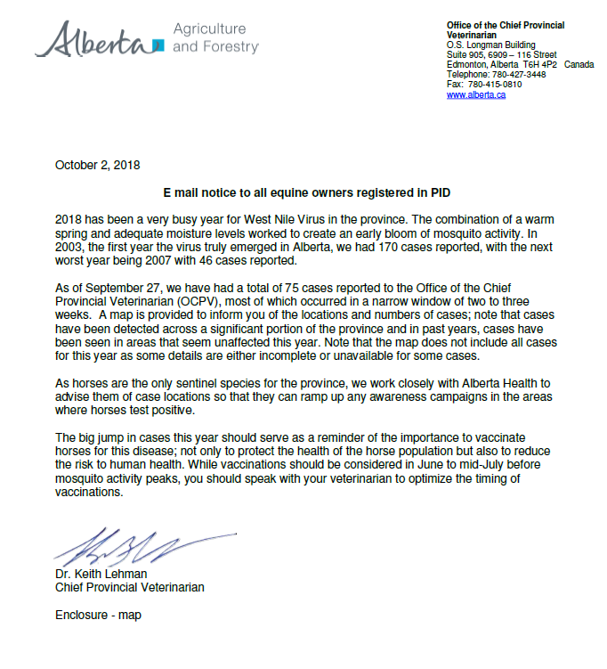
As of September 27, we have had a total of 75 cases reported.
The big jump in cases this year should serve as a reminder of the importance to vaccinate horses for this disease.
While vaccinations should be considered in June to mid-July before mosquito activity peaks, you should speak with your veterinarian to optimize timing of vaccines
⁴Alberta Agriculture and Forestry letter to all equine owners registered to PID, Oct 2, 2018

Slide 8

  West
  Nile
  Virus
  Vaccination
Shown to Be
96.7%
Effective
Against an Outbreak Among Immunologically Naïve Horses²
Incidental Infections
Case mortality
33%
Increases to 70% if horse is recumbent⁷
40%
survivors have residual effects
(lameness, behavioral abnormalities, etc)
²Epp T, Waldner C, Townsend HG. A case control study of factors associated with development of clinical disease due to West Nile virus, Saskatchewan 2003. Equine Vet J 2007;39:498-50
⁶AAEP: https://aaep.org/guidelines/vaccination-guidelines/core-vaccination-guidelines. Accessed March 1, 2018.
⁷MacKay R. Tetanus. In: Sellon DC, Long M, eds. Equine Infectious Diseases, 2nd ed. St. Louis, MO: Saunders Elsevier 2007:368-372.
Notes:
What about the other 3.3%
Decreased severity
Decreased length of disease
Decreased risk of mortality

Slide 9
Tetanus
A soil borne organism that enters through wounds in the skin- even those too small to be seen
Castration, foaling, through the umbilicus- any opening of the skin barrier
The availability of the anti-toxin has been questionable so vaccination is important
Once clinical signs appear survival rates are low

Slide 10
Equine Disease Classifications
American Association of Equine Practitioners (AAEP) classifies equine diseases as
“core” or “risk-based”
CORE
West Nile
Tetanus
EEE/WEE
Rabies
FLU
EHV
Strangles
EVA
Botulism
Anthrax
Rotavirus
PHF
Lepto
Core Diseases: Endemic diseases that pose serious threat to horses and/or public.
Risk-based Diseases: Diseases for which exposure is dependent on geographic region or use of horse.
https://aaep.org/guidelines/vaccination-guidelines/core-vaccination-guidelines
https://aaep.org/guidelines/vaccination-guidelines/risk-based-vaccination-guidelines
Accessed November 1, 2017
Notes:
You should have a discussion with your veterinarian regarding what diseases are most important to protect your horses against.
The AAEP lists the core diseases as the base level for vaccination- all horses should be vaccinated for at least these diseases.
Considerations include- Exposure to other horses (horse gathering like parades, shows, brandings, etc), additions to the herd, time of year, worth (monetarily and emotionally).

Slide 11
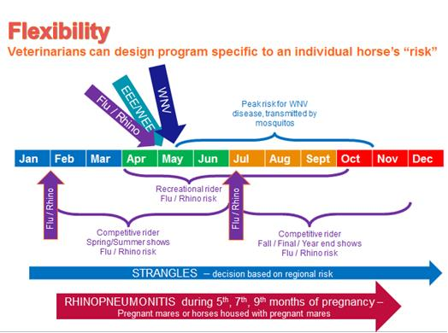
Notes:
Pinnacle: as an aid in the prevention of disease caused by Streptococcus equi. This means it doesn’t always prevent it from happening, but if it does the disease is typically less severe.
Pneumabort K- important to vaccinate ALL horses in contact with pregnant mares. If the viral load present is very strong it can supercede the ability of the vaccinate to prevent abortion.
This is available as a handout.
Flu=Influenza
WNV=West Nile Virus
Rhino=Rhinopneumonitis
EEE=Eastern Equine Encephalitis
WEE=Western Equine Encephalitis

Slide 12
Vaccination DOES
Aid in the prevention of infectious diseases
- reduced veterinary associated treatment $
-maintains performance
-reduce risk of secondary complications
Reduces the risk of transmitting disease to other horses ie. at shows, rodeos, 4H
Saves lives

Slide 13
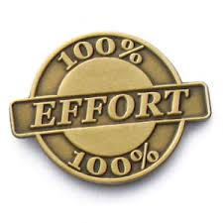
Vaccination is NOT
100% guaranteed to prevent disease
Variables in population- bell curve
Reduced ability to mount immune response
-poor diet – nutrient deficiencies, energy
-chronic disease ie. Cushing’s, EMS
-already exposed and harboring infection
Notes:
Vaccination will not succeed without appropriate managerial practices
Vaccines help the immune system in their effort in fighting disease
EMS=Equine Metabolic Syndrome
Expectations of the horse owner should be realistic

Slide 14
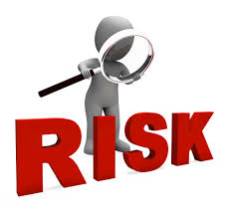
Anaphylaxis = “allergic reaction”
-EPINEPHRINE on hand! Know the dose!
-+/- anti-histamine
Inflammation at injection site
-lumps/bumps
-swelling, heat
Notes:
As with any foreign substance introduced into the body, there is a risk associated in the form of adverse reactions
Safety studies conducted when the product is developed allows for these risks to be minimized so their benefits greatly outweigh the chance of having an adverse event occur.
Please report any adverse events to your veterinarian who can then forward them to the company. They are entered into a data base that allows the VDD to evaluate safety.

Slide 15
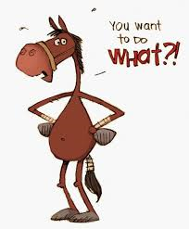
BE SAFE
Morwint.deviantart.com
Notes:
Remember horses are a prey animal. When feeling threatened their first instinct is to kick/bite in the direction of pain then take off – usually over top of you. Even the quietest horse can decide they do not want what you are handing out that day- if so, they will win.
Have them securely tied, stand to the side by their shoulder, be sure of yourself – in quick, pull back, inject. Nothing is worse then a half dozen practice stabs. If you really don’t like doing it, get the vet to do it for you.
Cartoon by: Maximus Expressions by Morwint.deviantart.com

Slide 16
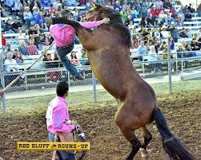
Notes:
Photographer- Larry Smith
Because really, at the end of the day, this is what we want to try and avoid.
If really fractious, may consider sedation- can do other things at the same time while they are calm ie. farrier, trimming, teeth

Slide 17
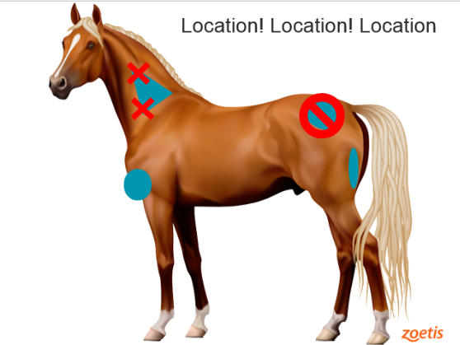
Notes:
We want the fleshy region in front of the shoulder- bigger muscles handle vaccination better.
Areas to inject- neck, chest, semitendinosis/membranosis

Slide 18
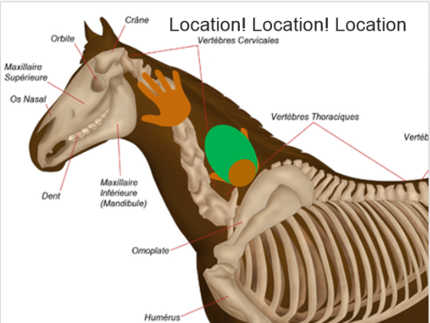
Notes:
Heel of hand hits shoulder blade.

Slide 19
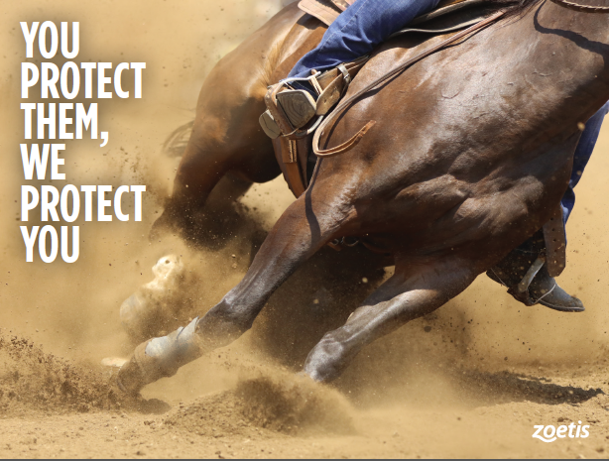
Notes:
ISG- Zoetis’ guarantee that their vaccines are efficacious.
Zoetis’ way of saying “yes, they protect” and standing behind this statement.

Slide 20
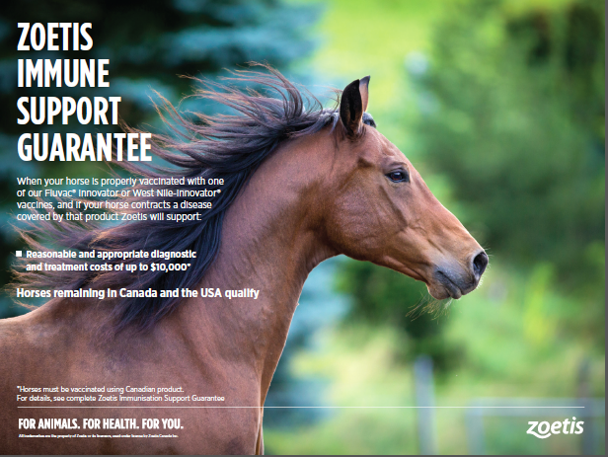
Notes:
There is a hand out provided that list our equine vaccine portfolio as well as the vaccination schedule I had up earlier.

Slide 21
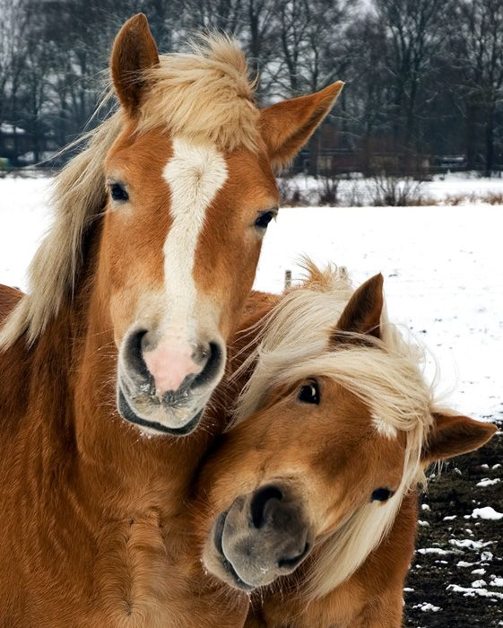
QUESTIONS?

Slide 22
