Slide 1
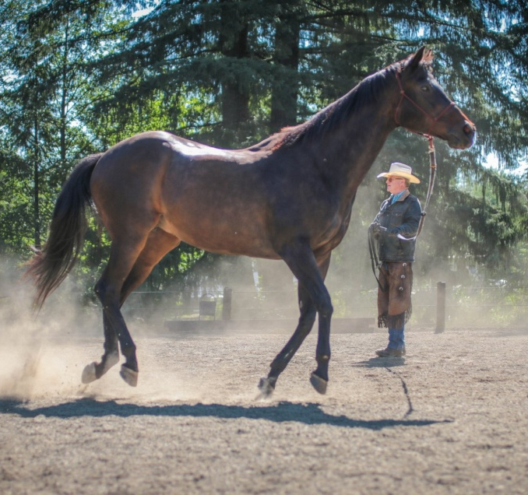

Slide 2
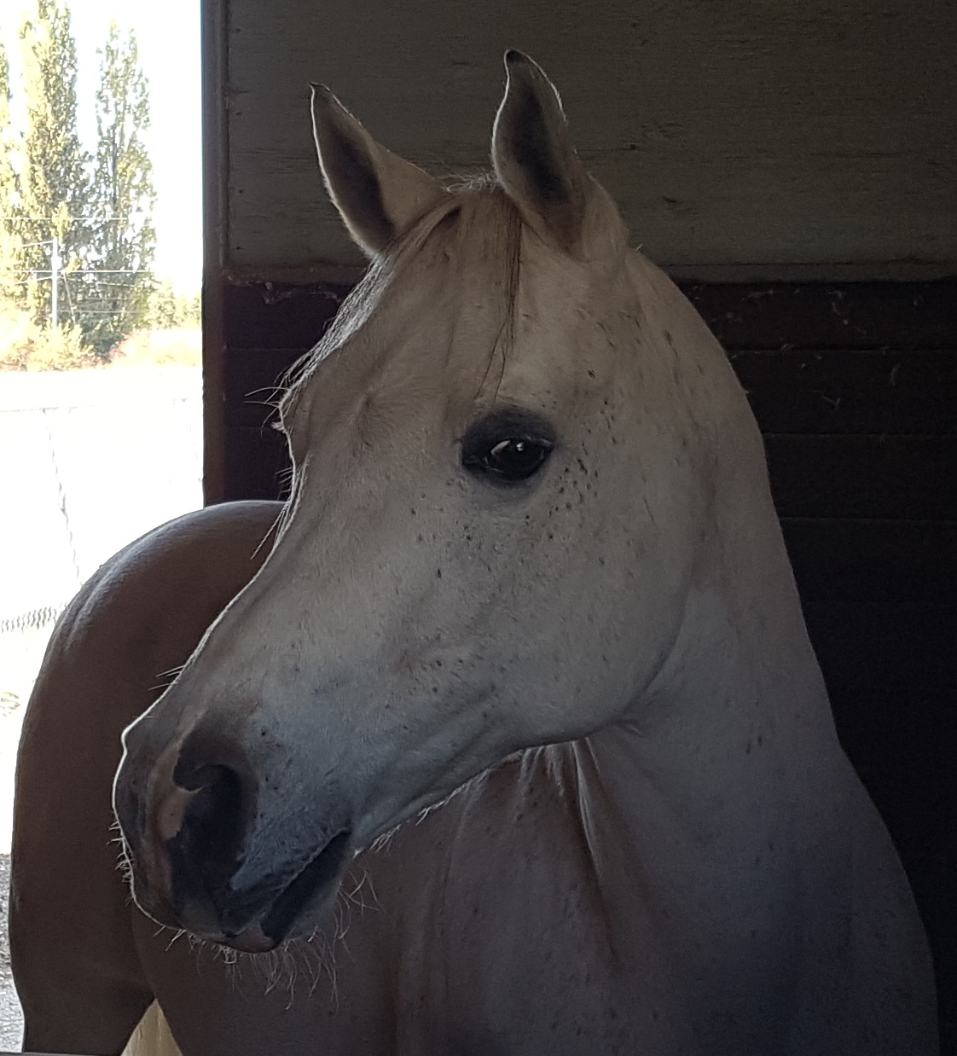

Slide 3
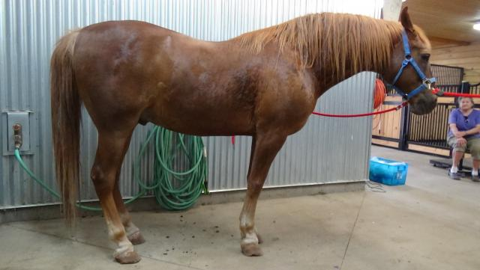
Over –conditioned ponies and horses
Considered over weight if
Between 7-9 henneke scale
Between 4-5 maryland scale
Excessive fat deposition that can be palpated eg crest pf neck along sides of withers, across the ribs, behind the shoulders, on top of the loin,on sides of the tail head.
Over conditioning found in 20-51% of populations.
PAL=54% of laminitis cases

Slide 4
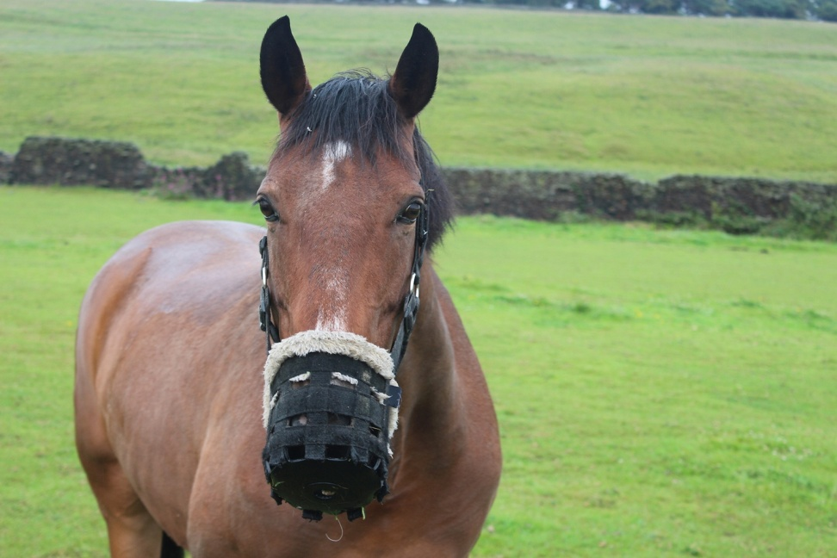
Disorders related to over conditioning
Equine metabolic syndrome
BCS over 7.0 is obese
Insulin resistance
Laminitis
Lipomas
Hyper lipidemia
Osteochondritis dessecans
Reproductive irregularities
Lack of heat tolerance.
Concussion on feet

Slide 5
Season Diet vs AT and gene expression
To determine whether AT gene expression differs for PL and NL ponies.
Effects of diet to simulate spring grass +/or season .
The total no. Of genes whose expression differed between previously laminitic and non laminitic was greater in summer =192 genes compared to winter =58 genes.
40/192 were also seasonally regulated and predominantly associated with inflammation.
The genes modified by dietary intervention and PBMC gene expression did not follow the same pattern as the season study.
AT global gene expression differed between Non Laminitic and Previously Laminitic ponies most in summer compared to winter and these differentially expressed genes prodominantly related to inflammation.

Slide 6
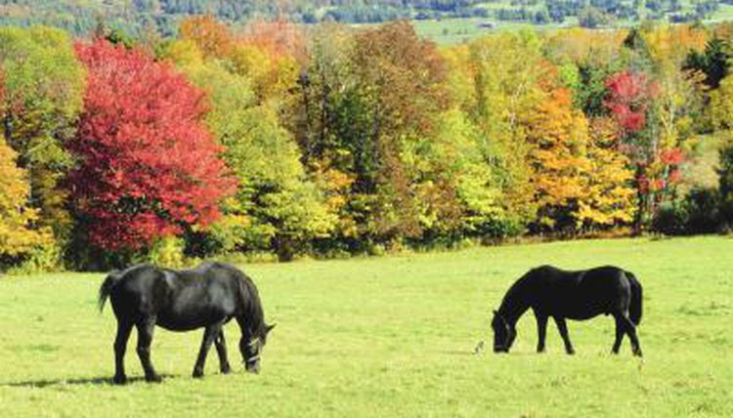
The horse is a grazer, eating many small meals over as much as 16-17 hours/day
The horse is a superb athlete. They have evolved on open range.
They have speed to escape predators and endurance necessary in the search for nutrition.
Selective breeding has further modified these traits.

Slide 7
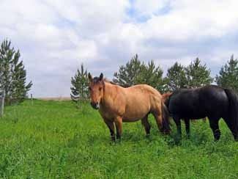
The horse has great athletic capacity . The number one need is energy. Nutrients provide energy, the fuel for all metabolism.
High maximal aerobic capacity (or VO2 max) and CV system.
Large intra muscular stores of energy ,particularly glycogen
High respiratory capacity of skeletal muscle
Splenic contraction ,increases oxygen carry capacity of blood by 50% soon after the onset of exercise.
Highly efficient and adaptable gaits
Well-developed capacity for effective thermoregulation.
Energy is produced either with oxygen or without , the aerobic or anaerobic pathways

Slide 8
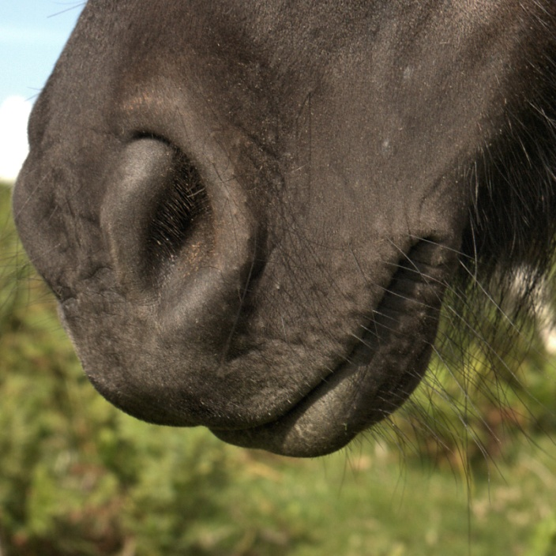
Digestion-begins with selection ,apprehension and chewing.
The horse tries to maximize energy content in each bite.
The horse can select a diet 10-20 % higher in overall nutrient content than an average sample of pasture.
Horses evolved to be quite cold tolerant provided lots of feed available.
Range horses may actually have more tooth ware from soil on grass leaves or from grazing low to the ground.
Eruption of teeth from the jaw stops at around 21 . From then on grinding surface decreases, may become loose.

Slide 9
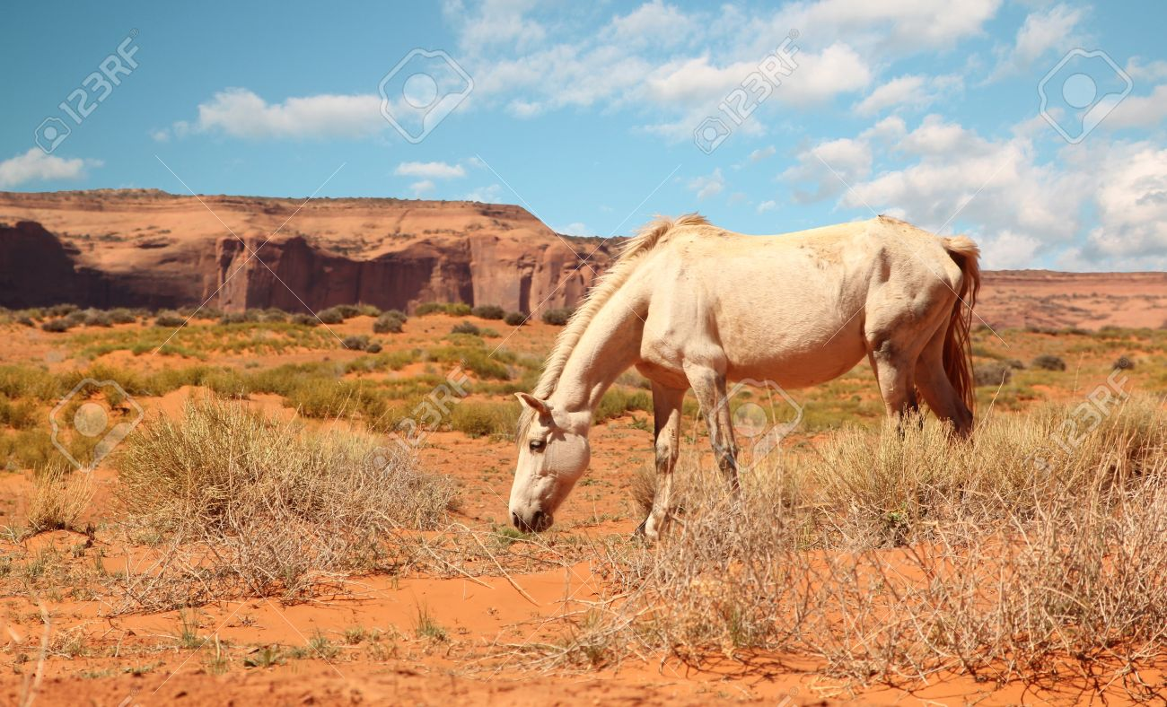
Grazing –rate of pasture intake is inversely related to time.
Horses are periodic grazers and health of the Git depends on this method of eating
Lack of pasture access has been linked to an increased incidence of colic .
Horses consume small frequent meals throughout the day and night
.
Adult horses spend 50-60% of a 24 hour day grazing.
Grazing takes place at all hours but tends to be concentrated right after dawn and before dusk.

Slide 10
Grazing-1 study-
Grazed 63-75% of daylight hours
And 49-50% of the night time hours.
Restricting grazing can result in
in the consumption of a large amount of DMI in a short period of time.
Eg pasture intake in first 4 hours after 15 hours restriction doubled that of a consecutive 4 hour period. Ie equivalent to 35%-44% of assumed max DMI of 2% and 2.5% respectively.
Ponies ate 0.8% of BWt. As pasture dry matter In 3 hours or 1/5 to 2/3rds of expected daily intake.

Slide 11
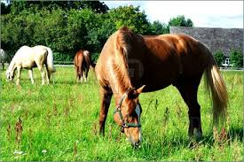
Intake of Feed. A horse eats to maximize energy intake per bite.
Normally , horses eat 2-2.5% of body weight based on hay and grain .
Unlike cattle there is no physical restraint on food intake like the reticulo omasal orifice . This forces ruminants to reduce particle size to fit this opening. Hence chewing their cud.
Horses do not have an appetite regulatory system capable of limiting intake of rich feeds like spring grass.
(or breaking into the feed bin!)
Horses have been seen to consume 3-3.5% of body weight and ponies can eat 5.0% of body weight dry matter on rich grass.

Slide 12
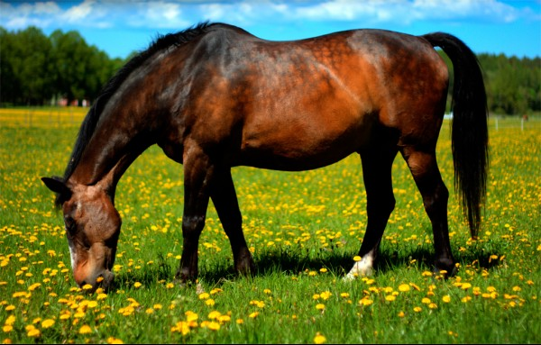
Altered patterns of intake vs accelerated hind gut fermentation and fluid balance.eg larger less frequent grain and hay meals caused cycles of accelerated hind gut fermentation >ROP associated with larger meals and increased substrate.
Large infrequent meals alter hindgut fluid balance because of changes in osmolarity from accelerated fermentation.
Accelerated fermentation and altered fluid balance may contribute to an increased risk of colic.
Research shows on pasture, grazing for 12 hours had similar hind gut pH and fluid balance. Vs 24 hour grazing.
A bolus of 7 grams/kg body weight fructans (FOS ) decreased pH from 7 to 4.5. This dose will cause laminitis.
Fecal pH decreases can be more subtle with lower doses of FOS , OF, or more grain.
Fluid balance was not altered.

Slide 13
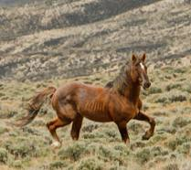
Restricting the number of meals per day has been shown to alter (hay grain), plasma volume in ponies.
Plasma volume decreased by 15% after a single large hay-grain meal vs the same amount in multiple meals that mimicked grazing.
Poss due to increased upper tract secretions.
Pprot increased 12%-reversed at 2 hours after feeding.
At 6 hrs. decreased in PV due to colonic secretion.
Fluid balance was not altered on pasture. Fecal moisture was the same so less danger of impaction colic
No negative fluid balance or fermentation.

Slide 14
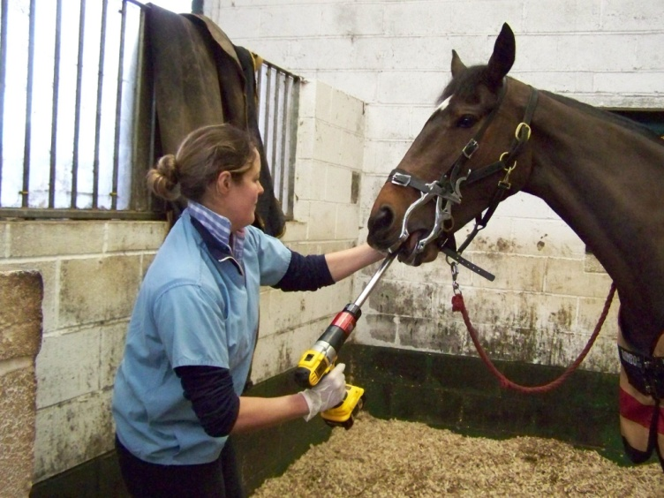
Teeth require maintenance. Recently proven to aid digestion . Significantly reducing particle size.
Horses over 21 will no longer renew growth gradually heading for smooth mouth or marble mouth.
Teeth also loosen with age creating issues.
There are 36 teeth in females and 40 in males.
Grazing-chew 60,000 times per day.
Grain decreases chew time and saliva production .
Hay-40 minutes and 3400 jaw sweeps/kg and more saliva and water intake. (3.5-1)
Grain-10 minutes and 850 jaw sweeps/kg less water intake (2-2.5-1)
Horses do not chew lower quality forage more times or better. .
Long jaw action with range or hay rarely develop sharp edges.
n average

Slide 15
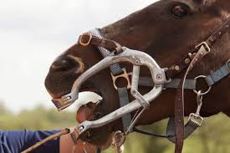
Higher grain less forage changes the jaw action
A horse cannot drool.Saliva only flows after tactile feel on the palate.
Horses are more prone to choke normally.
Horses are prone to choke if dehydrated.
Very coarse or dry feed may cause choke. The horse must moisten a bolus and push it back and over a cuff of tissue protecting the tracheal opening.
A horse will not chew a poor quality hay more times than normal hays. This may set a horse up for colic.

Slide 16
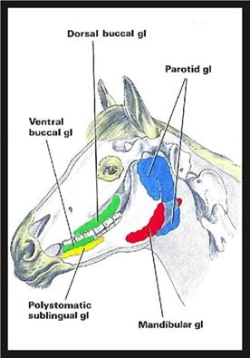
Salivary gland issues.although rare several conditions can impair the glands.
foreign bodies such as awns can puncture the glands or ducts or block saliva flow.
Salivary stones may develop in the glands or ducts.
Head trauma can damage ducts , tumors or melanomas or sarcomas can develop there.
Infections like rabies or Strep equi /strangles can occur.
Appetite and temperament depend on doing teeth.

Slide 17
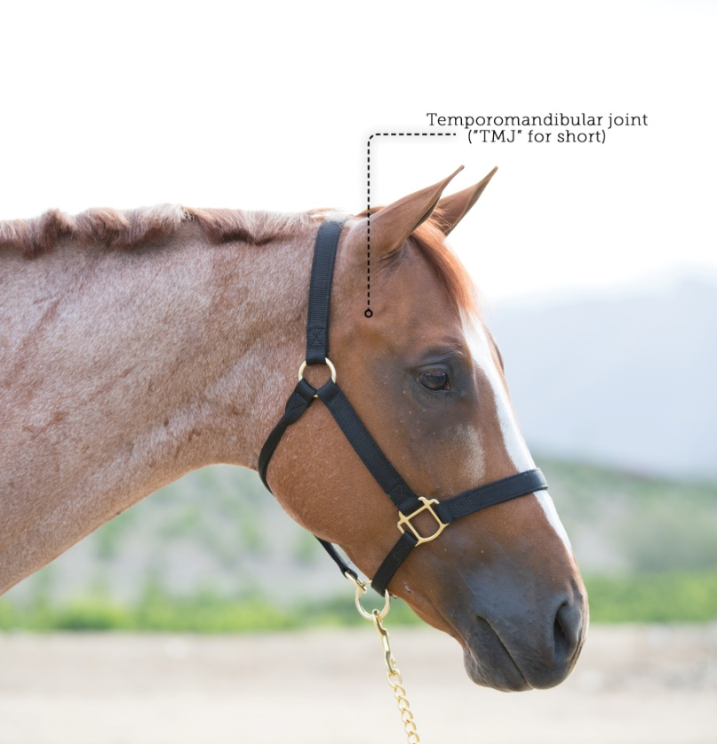
Temporal mandibular joint issues The tmj joint may get arthritis eg with aging, which can negatively impact chewing
Selenium deficiency may damage masseter muscles in adult horses. (Like Wooden tongue in calves).
Three main salivary glands
The parotid, mandibular, and submandibular.
They produce saliva (containing sodium bicarbonate) constantly
under natural grazing conditions.
Production can increase to 50 ml/minute when eating, total
up to 35-40 l/day. pH=8.6-9.1
Very dry feed can be a risk for choke.

Slide 18
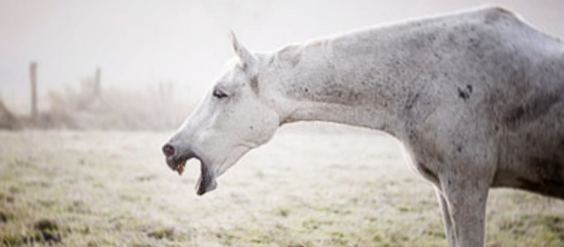
Choke-a blockage of the esophagus. Keep water available at all times , they drink a little as they eat. Use an electrolyte every day .
Choking makes it impossible to swallow. It does not stop breathing and may resolve on its own.
In severe cases it can cause scarring which then increases the risk of future chokes.
Gobbling food like hay cubes, hard dry pellets and unsoaked beet pulp are common causes.
Saliva and feed coming from the nose and coughing or gagging call your vet

Slide 19
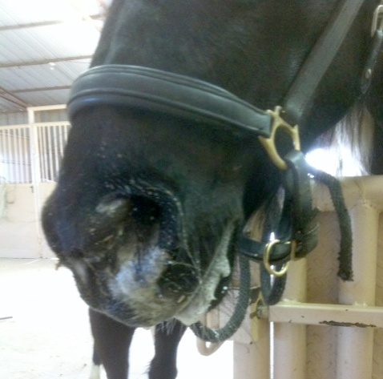
Guard against choke
Prevent choke By Soaking feed
Feed concentrates on the ground in shallow pans or tubs with large rocks added to further slow feeding.
Use slow feeders for hay.
Regular dental work should be done.
Bite sized treats –cut up apples, carrots into thumb sized chunks before offering.
Even very dry hay can be an issue if your horse eats it too fast. Use slow feed nets and or soaking.

Slide 20
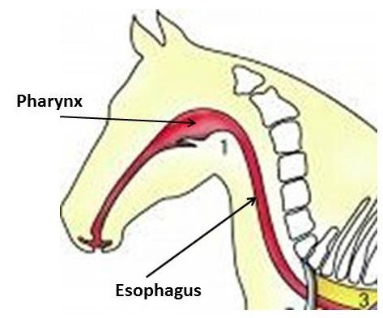
Basic Nutrition of the Horse-Saliva-has sodium bicarbonate and mucus.
Esophagus has striated muscle for initial 2/3ds. A strong sphincter at either end.. Cannot force swallowing .
Mucous glands help lubricate the food bolus. If a bolus gets stuck it may damage the lining . Scarring can cause contraction or a tear can form.
Rate of saliva secretion is stimulated by food intake and mastication.
Greater the dry matter of the food, the greater the amount of saliva and time needed for adequate mastication.
Feed only takes 1 and ½ hours to reach cecum. Provide water at all times.

Slide 21
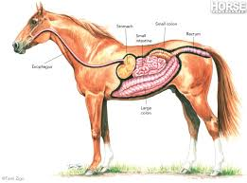
Horses secrete very little amylase enzyme (unlike humans) in saliva to start digestion of starch as per humans.
Primary purpose of saliva is lubrication of bolus and buffering of gastric contents which may promote intra-gastric bacterial activity.
A one way system. Horses cannot belch or vomit . Powerful sphincters control opening to esophagus and pylorus region of stomach to small intestine.
Always feed hay before grain.
Ensure water available at all times.
Horses need 5-10 gallons of water a day. May double in hot weather.

Slide 22
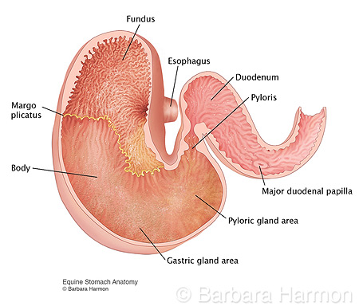
A 3 zone two compartment stomach-the saccus caecus fundic and pyloric zones.it is non-flexible. in natural grazing never completely full. Humans may overload it.
A relatively small stomach (8-15 liters) =8-9% of gut volume.
-top half Lining =stratified sqaumous epithelium, similar to esophagus. not protected from acid. relatively alkaline, No mucus secretory glands with buffering in top half.
Top Half- pH 5-7 -may release soluble sugars allowing some bacterial fermentation .
The stomach is small and inelastic with tight sphincters,
Gas colic from rich grass or from grain is a concern for gastric rupture.
Feed hay before turn out on rich pasture

Slide 23
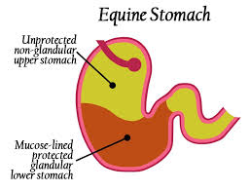
Bottom glandular half –secretes hydrochloric acid 24/7-at a variable rate even if empty. The pH of this higher density more liquid area is approximately 5.4 in fundic area to 2-3 in the pyloric area..
Cells lining the Bottom half secrete mucus and bicarbonate buffer –protecting the lining from a highly acidic environment pH2.
If empty there may be reflux into the stomach from the small intestine of strong bile salts causing glandular ulcers.
Do not allow a horse to go without feed for longer than 5 hours. A horse needs to buffer the acid continuously secreted into the stomach.
It takes as little as only 12 minutes for food to move through the stomach
Explains how grazing can occur for 17 hours/day

Slide 24
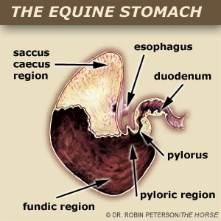
Bottom half- fundic area fermentation stops. Breaks the food down into small pieces.some enzymes like pepsin begin digestion of protein and gastric lipase starts fat digestion.
Decreased roughage intake i.e. if with held , (or early morning naturally eat less), the mean pH in the upper part drops to 4 or less.
Omega 6 essential fatty acids promote protection of the lining by enhancing mucus and bicarb production in cells lining the glandular area.
corn oil (59% linoleic acid) 1-2 cups /day corn oil significantly increased PGE2 and reduced gastric acid output by direct inhibition.
Fat slows the rate of passage.
Protein and fats and simple NSC s are starting to break down into amino acids, fatty acids, and individual sugar molecules respectively . Fructans usually are not broken down here.

Slide 25
EGUS=ESGD and EGGD-
Associated with inappetence, poor BCS, and colic
In addition poor performance (TB in training)
WB’s (47%) and sport ponies (35% ) appeared to have a higher EGGD (grade 2/4 + vs SB’s(0%).
51% of TB in active training have EGGD, 93% ESGD
Squamous lesion score continued to increase , but not glandular lesion.
ESGD in TB and SB ranged from 58-100%

Slide 26
EGUS=ESGD and EGGD-show jumpers
SJ -83 horses-exercising over 6 days a week increased EGGD grade>1/4 or odds ratio 3.5/1, currently showing increased EGGD grade>2/4 or odds ratio 10.2/1,
competing at the international level decreased the odds of EGGD grade 2>4 by odds ratio of.11. possibly eliminated the worst cases.
High exercise intensity OG> ¼ increased the odds ratio of grade >1/4 by 2.8
BP decreased odds ratio of OG>2/4 for EGGD or 0.1-an advantge
EGGD in 58-OG>1/4 or
42=OG2/4
or 14 =OG3/4 and 4 =OG4/4
ESGD in 32 -OG>1/4 or 21=OG2/4 or 3=OG3/4 and 0=OG4/4
Concurent 28-OG1/4 or 14 =OG2/4 EGGD was associated with ESGD
Egus 62 -OG1/4 or 49 OG2/4
70% over OG¼, EGGD, 51% over OG2/4 vs 46-65% average

Slide 28
Show jumpers
WB’s more likely to get EGGD vs other breeds
ESGD was actually lower =39% ESGD >OG1/4 25% >OG2/4 vs sport ponies =51% >OG2/4or WB’s =48% >OG2/4?
Conflicting data EGGD vs ESGD
EGGD does not seem to differ across intensity level for endurance horses ?
Eventing horses do not seem to have a different HR at low vs high level. Higher level 3DE horses have better fitness?
Horses with EGGD may be eliminated earlier.

Slide 29
Show jumpers
Effect of competition requires research
Exercise frequency vs decreased splanchnic blood flow vs EGGD keep training less than or equal to 5 days /wk
Exercise increases stress eg salivary cortisol. Increased responses to ACTH so stress a factor for EGGD.
Exposure increased ESGD
BP decreased risk of ESGD-fiber and saliva/moisture, gastric pH, gastric microbes?
Endurance EGGD was much higher in season .

Slide 30
ulcers
95% of elite endurance horses
90% of race horses
57% of dressage horses
10-30% of pleasure horses
10-40% of wild horses
70% of weaned foals
Consider using magnesium oxide as research shows a 30% reduction in fear response with 10 gram magnesium/day. Fear and stress hormones stimulate acid production.
An alkalizing agent as well.
Maximize forage. Minimum forage 1.5% of body weight.
Consider electrolytes.

Slide 31
Limiting ulcers
Signs= poor appetite or fussy eating, grind the teeth, cinchy or sensitive in the girth area, poor performance, NSAIDS,
Ulcers occur in any horse in stalls with no turn out, or fed large grain meals. Movement stimulates gut motility.
Large grain meals may get fermented in the stomach producing VFA’s or LA, or pass through into the large intestine and undergo fermentation by acid loving bacteria to LA. Excess sugar and starch cause acidosis . “Leaky gut” may occur resulting in system wide metabolic upset including SIRS and laminitis.
.

Slide 32
Limiting ulcers
Fat as part of the diet reduces acid fermentation and slows gastric emptying.
Omega 6 fatty acids promote mucous production by the cells lining the glandular area via prostaglandins and may help prevent ulcers, omega 3 fatty acids reduce inflammation and promote immune function.
Avoid stress. Adrenaline or cortisone (stress /fear hormones) stimulate acid production. The new facial expression systems!
Add super fibers like beet pulp and soy hulls as part of the energy to reduce the need to digest higher levels of grains for energy., plus improves water holding capacity.

Slide 33
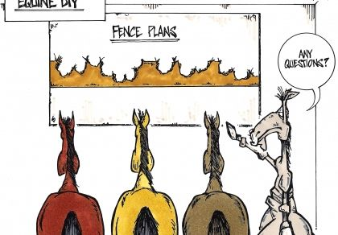
Stomach-use hays that promote chewing and maximize pasture turn out.
Select hays with some crunch or chew factor for good gut health.
Micro organisms may be present in upper area if pH over 4
If pH drops below 4 in the upper area, that mucosa may ulcerate as it has no mucus lining for protection.
Limit grains to 1.5 kg (old max 2.25 kg?) per meal and 1% BW as grain maximum intakes/day. Feed little and often. Starch max 3 grams/kg Body weight/meal
Feeding alfalfa hay will help provide some protection against the acid challenge. Possibly through buffering effects of calcium and protein and potassium.
Use timing of alfalfa.

Slide 34
ulcers
Ulcers can affect appetite, behavior and performance
Keep hay, water and loose salt in front 24/7 if possible
Maximize roughage. Provide 1.5% BW as hay minimum, with 1% body weight as long hay.
Use small frequent grain meals. Possibly 1.5 kg/meal as grains.
Ant- acids have limited value. Acid blockers such as Omeprazole do work.
Ulcers can develop in 5 days or less.
Exercise itself causes the acid portion of the stomach to get pushed up into the unprotected area. Dr. Hilary Clayton
Cribbing behavior creates ulcers.
Gastric ulcers are probably occurring with hind gut ulcers.

Slide 35
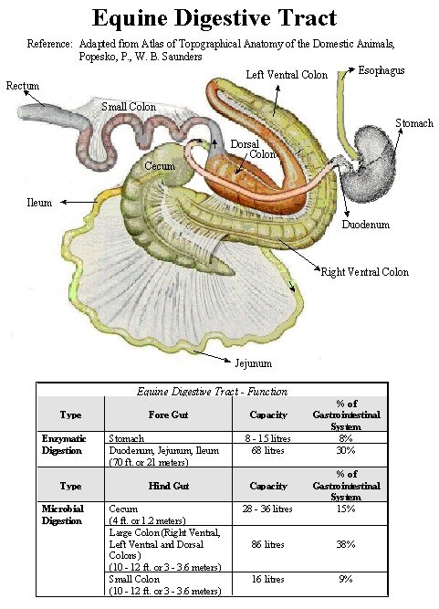
The incretins-the entero insulinary effects
Special cells in the small intestine sense the presence of sugars . GIP and GLP-1 stimulate insulin production before the glucose is actually being absorbed and increasing in the blood.
This allows tight control of blood glucose levels .
GLP-2 while not insulinogenic has an intestinotrophic function enhancing glucose absorption.
A possible target for therapeutic control of ID/laminitis.
ID is a common and poorly understood disorder that increases the risk of laminitis.
Spanish breeds among others may have an enhanced incretin effect and temporary HI.
ID may relate to obesity and system wide inflammation , including laminitis.

Slide 36
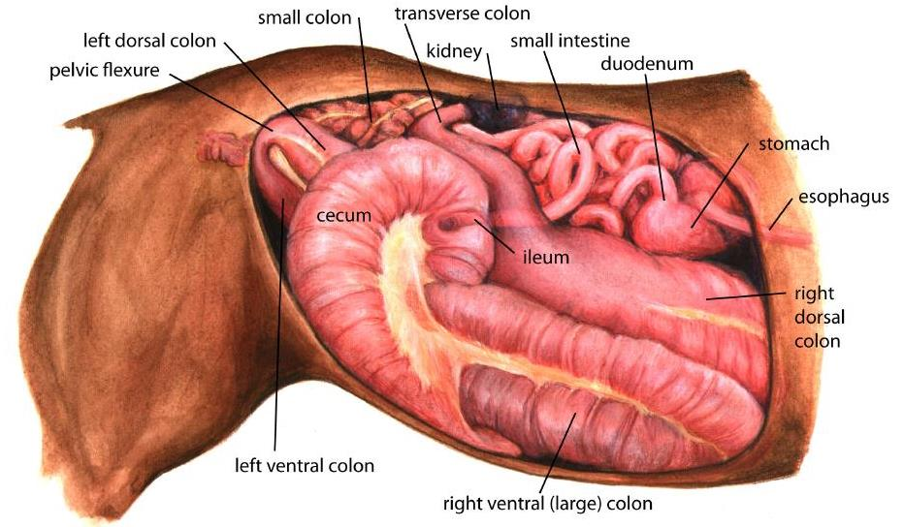
Small intestine-21 m long
-55-70 liters
-28-30% of git food moves through quite quickly at 1 ft/minute.
First the duodenum then to longest section the jejunum then ileum.
Enzymatic digestion produces additional amino acids, sugars and other nutrients absorbed in the latter regions of the jejunum and ileum .
Lower levels of amylase than other species.
Feed only stays 1-2.5 hours in the stomach and small intestine.
Possibly why less starch tolerant and difficult to reload muscle glycogen compared to man ? Horses take 72 hrs to reload glycogen vs man 24 hours. Yet skeletal muscle is higher in initial glycogen content than in man?

Slide 37
Limited Starch Digestion = issues
A 300 lb pig can digest more starch than a 1000 lb horse.
Hind gut -Vulnerable to starch over load.
Max starch 1-1.5 grams per kg bw /meal
Max concentrate per meal 5 lbs old recommendation. Possibly 1.5 kg ideal.
Max concentrate per day= 1% BWT. 10 lbs /1,000 lbs
The starch and sugar in Grain escaping to the hind gut is fermented to lactic acid by gram + bacteria who thrive on sugar and starch. A large amount of LA will drop pH which may kill off fiber digesting gram – bacteria who release harmful substances like exotoxins, endotoxin (LPS) , biogenic amines and other compounds causing diarrhea and damaging the gut lining (leaky gut). Products from the gut absorbed into the blood stream may alter vascular function or trigger laminitis or colic or SIRS, and affect the brain and behavior .

Slide 38
Limited Starch Digestion = issues
The starch and sugar in Grain or fructans in grass escaping to the hind gut is fermented to propionic acid and lactic acid by gram + bacteria who thrive on sugar and starch.
Propionic acid is a glucogenic fatty acid
A large amount of LA will drop pH and damage the lining of the digestive tract. Excess lactic acid may kill off fiber digesting bacteria or gram – bacteria who release harmful substances like exotoxins, endotoxin (LPS) , biogenic amines and other compounds causing diarrhea and damaging the gut lining (leaky gut).
Products from the gut absorbed into the blood stream may alter vascular function or trigger laminitis or colic or SIRS, and affect the brain and behavior .

Slide 39
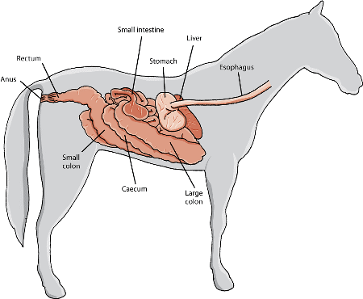
The small intestine
Feed only remains 3-4 hours max
Pancreatic juice has some alkali and bicarbonate.
30-60% of CHO digested and almost all amino acids in small intestine.
Fat soluble vitamins minerals and trace minerals are absorbed here.
A 300 lb pig can digest more starch than a 1000 lb horse.
Hind gut -Vulnerable to starch over load.
Max starch 1-1.5 grams per kg bw /meal
Max concentrate per meal 5 lbs old recommendation. Possibly 1.5 kg ideal.
Max concentrate per day= 1% BWT. 10 lbs /1000 lbs.

Slide 40
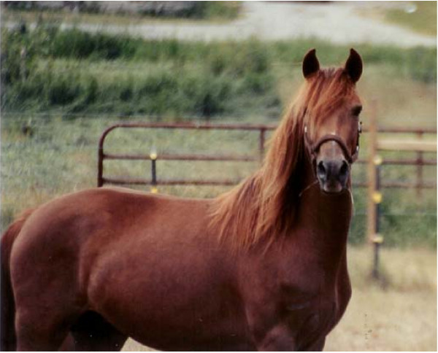
The small intestine-the incretin effect relatively less important than in man but may be a factor in certain breeds eg spanish breeds.
Recent data show the condition ID may be associated with alteration of the entero insular axis and enhanced glucose bioavailability.
Insulin dysregulation is a common and poorly understood disorder that increases the risk of laminitis
Incretin hormones GLP-1 and GIP . Cells sense the presence of nutrients in the intestine and stimulate the pancreas to produce insulin before blood glucose increases.
A recent study indicates GLP-2 may also be effective as it codes for increased absorptive surface area via intestinal cell proliferation while inhibiting apoptosis and gastric motility. Over production may relate to ID

Slide 41
Intestinal Permiability-the role of” leaky gut”
The intestinal epithelium is composed of a single layer of cells with apical and basolateral membranes.
The small intestine epithelium is composed of villi that extend into the lumen lined by specialized cells and crypts . Among these are stem cells creating new epithelium every 5-7 days.
Secretory epithelial cells maintain the digestive or barrier function via hormone, mucin and antimicrobial secretions.

Slide 42
Intestinal Permiability-the role of” leaky gut”
When healthy, the epithelial barrier is impermeable to toxins, pathogens, and antigens and selecting for absorption of nutrients ions and water.
Strong connective bonds exist between epithelial cells
If disrupted, permeation of harmful substances and organisms from the intestinal lumen can result in a cascade of events including immune activation and inflammation triggering intestinal and systemic diseases

Slide 43
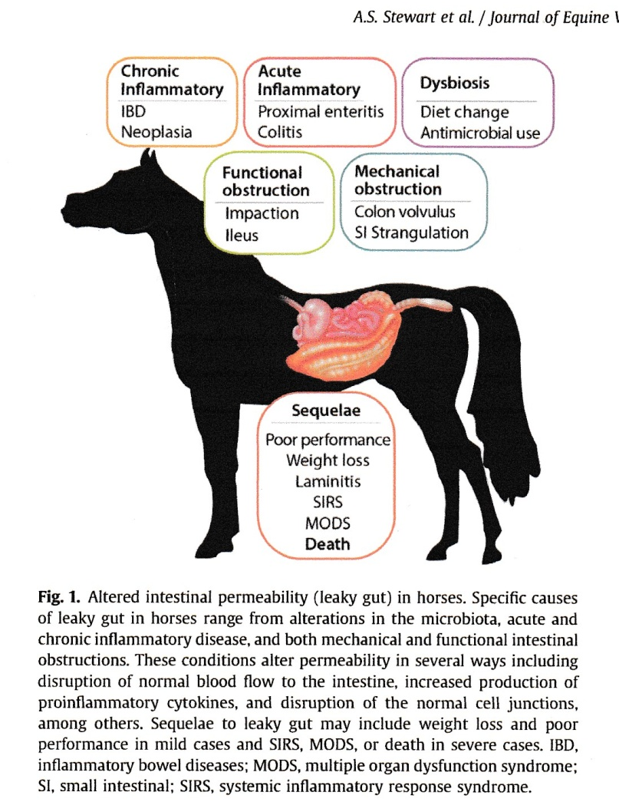

Slide 44
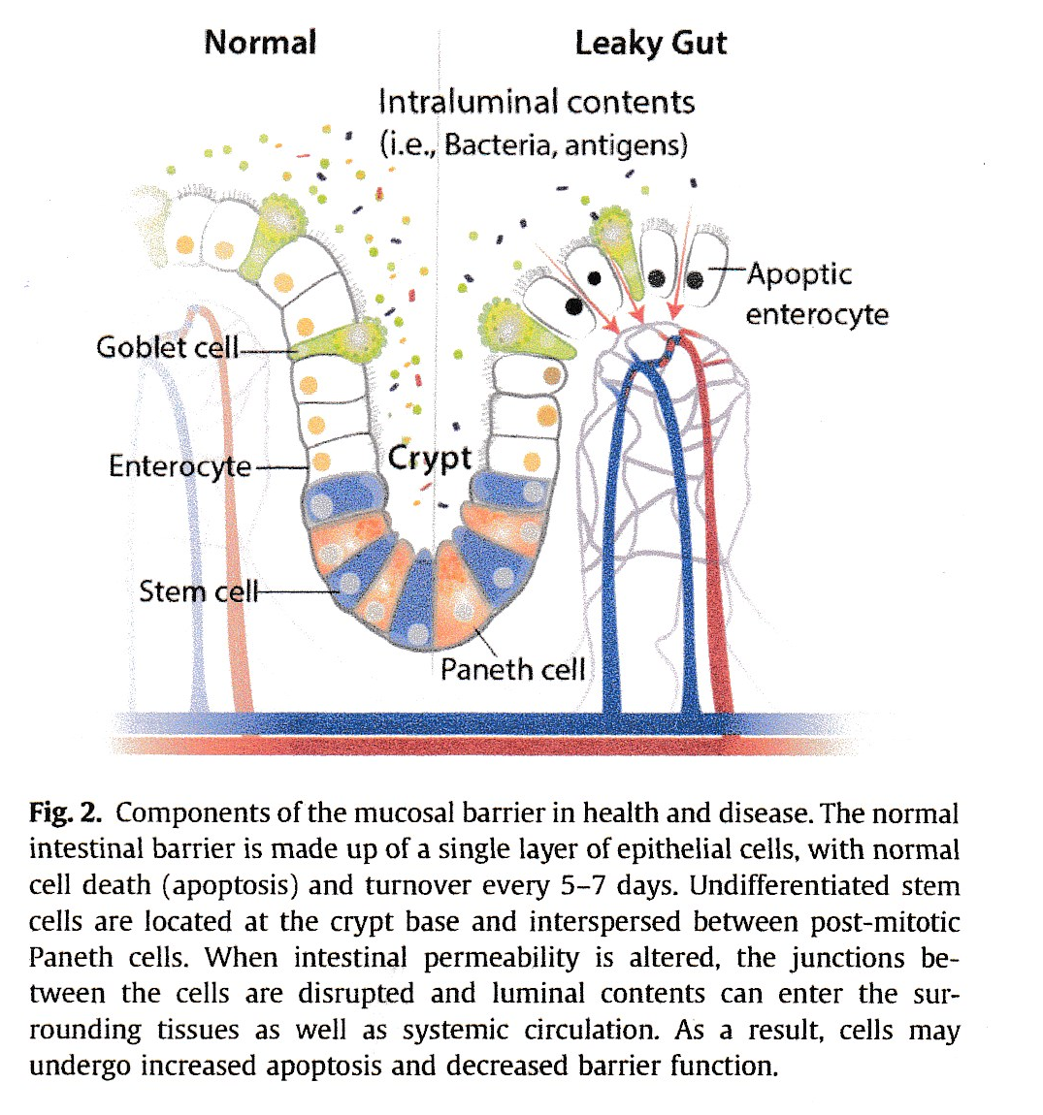

Slide 45
Causes of increased intestinal permeability
Stress induced (physiological, pharmacological, psychological, and others. Simply physical restraint in animals increases cortisone.
Moderate exercise in humans had decreases in jejunal absorption of sodium, chloride , potassium and water.
The mechanisms of stress altered permiability are likely related to changes in tissue perfusion and altered gastro –intestinal motility.
Eg exercise-shown to reduce splanchnic blood flow in an effort to provide blood to working tissues and the skin, leaving the GIT in a state of relative hypoperfusion.

Slide 46


Slide 47
Causes of increased intestinal permeability
Ponies on TM maximal exertion –significant vasoconctriction of the renal and splanchnic vascular beds and resultant decreases in blood flow to the spleen, pancreas, small intestine, and colon, among other organs.
Shunting of blood from visceral tissues to more active tissues during exercise can result in varying degrees of intestinal damage including alterations in permiability.
Heat stress-similar damage with hyperthermia, -blood is distributed preferentially to the periphery to help maximize heat dissipation leaving the GIT in a state of hypoperfusion altering normal permeability leading to increased concentrations of endotoxin and reactive oxygen species promoting significant damage to the intestinal mucosa by disrupting cellular membranes and the tight junctions.
This damage allows influx of endotoxins , primarily LPS, into systemic circulation, stimulating production of proinflammatory cytokines and other immune responses. Local and systemic inflammation can occur due to the increased flood of inflammatory cells. This can lead to mild symptoms like reduced feed intake to severe comsequences like altered immune response and SIRS and multiple organ failure and possibly death.

Slide 48
Other nutrients for Gut Function.
Zinc –functions in cellular turnover , regulation, and repair and is a key component of several enzyme systems
-potential for zinc to enhance intestinal function in disease based on feeding trials with other species.
Selenium and Vitamin E may prove beneficial in improving intestinal permeability as per research with other species.
Pre and pro biotics.
Pro biotics are living organisms may be beneficial for immune system activation, and modulation, enhanced mucosal barrier function competitive exclusion of pathogens, and decreased risk of infection through production of anti microbial substances including lactic and acetic acids.
Butyrate
Glycine.

Slide 49
Other nutrients
Probiotics have been used for treatment of and prevention of IBD, diarrhea, irritable bowel syndrome and gastroenteritis, among others. An example is yea sac live yeast culture Saccharomyces sp
pre biotics short chain fructooligo sacharides have been shown to increase fecal butyrate . Short chain FOS supplementation mitigated an increase in lactate concentration following an abrupt change of barley (starch overdose).
eg Atigen source of biomoss , and the nucleotide product N u Pro a source of nucleotides. Nucleotides feed the entrocytes not the horse.
requires research which is why we use Alltech Products.
research is required.

Slide 50
GIT Ischemia –Reperfusion injury
Interruption of the blood supply results in ischemic injury/damage of metabolic tissues including the intestine.
Prolonged ischemia alters membrane potential, disrupts normal ion distribution, impairs cytoskeletal organization and leads to increases in intracellular volume.
Energy stores become depleted, expression of proinflammatory cytokines, adhesion molecules and bioactive agents such as endothelin and thromboxane A2 become accelerated.
These agents act as potent vasoconstricters and may lead to further alterations in blood flow.

Slide 51
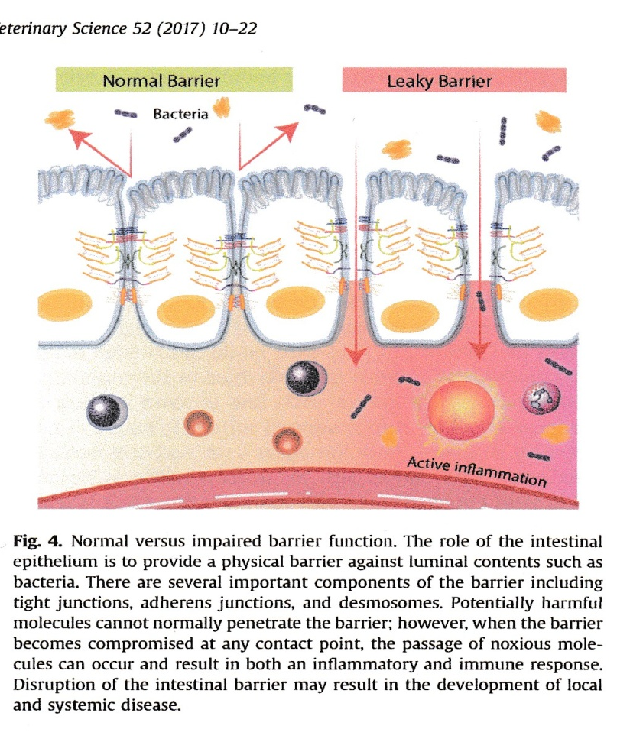
Small intestine villus lining

Slide 52
Reperfusion of ischemic tissue
Results in formation of toxic ROS.
These ROS have high reactivity with tissues inducing oxidative stress and directly damaging cellular membranes via lipid peroxidation.
ROS increase leucocyte activation , chemotaxis, and adherence resulting in a vicious cycle of cellular damage as the activated leucocytes continue to release harmful proteases, elastases, and additional ROS.
Ischemia reperfusion injury seen in shock, vascular surgery, strangulated bowel, trauma, intestinal volvulus, and transplantation.
A decreased chance of survival as the mucosal barrier is lost due to tissue hypoxia, inflammation, and cellular infiltration.
Bacteria can translocate to the systemic circulation contributing to SIRS.
Survival rate for ischemic /strangulating lesions was lower than simple obstructiions. Higher rate of post operative shock likely due to barrier dysfunction and resultant endotoxemia.

Slide 53
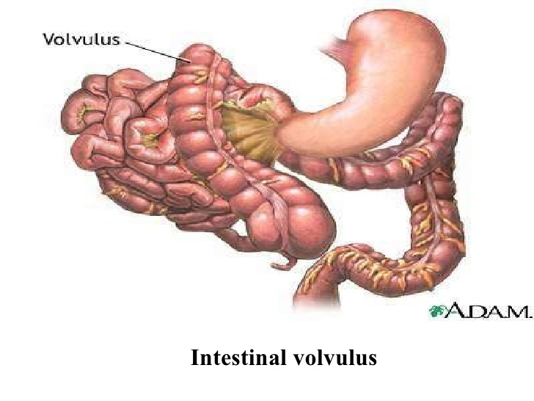
Intestinal volvulus

Slide 54
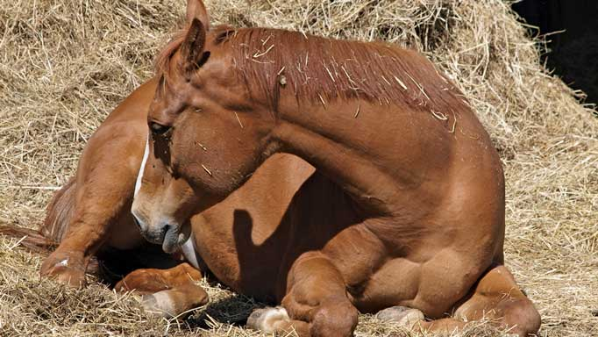
The gut micro flora may change causing abnormal permeability and diarrhea, endotoxemia, and laminitis and colic and colitis
Environmental interactions change symbiotic organisms to pathogens.
Resulting in immune system activation and inflammatory disease.
Genetics
Antibiotic use
Changes in management and nutrition.
Hives and sweet itch from a holistic point of view. The overall immune system is over stimulated.

Slide 55
Amino Acids-
Required for protein, nitric oxide and polyamine synthesis.
And serve as a major fuel for the small intestinal mucosa.
Eg glutamine, arginine, lysine, threonine, and others in gut related disease.
Arginine may affect absorption of other amino acids. Requires research for GIT disease.

Slide 56
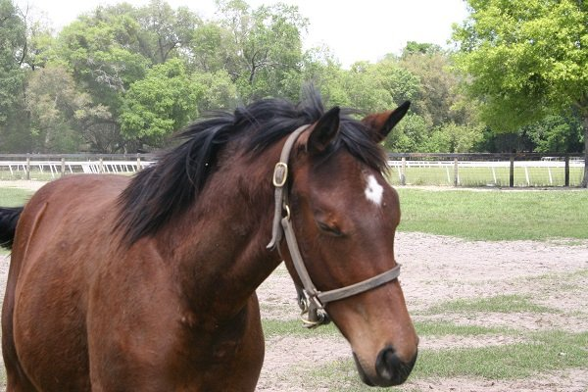
Glutamine-a non essential amino acid-usually adequate in well balanced diets.
Glutamine has several functions. It accounts for the majority of energy generated in the small intestine, along with glutamate and aspartate.
Conditionally essential in stress and disease.
Glutamine showed an increase in the efficiency of intestinal restitution in a model of colitis
No research has been performed re GIT disease in horses, but feeding it has no adverse effects.

Slide 57
The hind gut-the collection of microbes is called the biome
Gram (-) Bacteria ferment fiber producing mild VFA’s (volatile fatty acids).
The VFA’s are taken directly into the blood stream and delivered to tissues without being packaged . VFA’s can normally supply most of the energy needs of horses.
VFA’s are transported to the liver where butyrate and propionate are taken up .
Acetate appears to remain in the blood, and can be used directly by muscle tissue for energy or metabolised by AT.
Propionate is largely glucogenic, 50-61% of blood glucose is derived from colonic propionate, depending on the diet.
Butyrate is converted to acetate and ultimately acetyl –CoA (coenzyme A) which can be oxidized via Krebs cycle for energy or used for fat synthesis. Butyrate is a prime source of energy for cells lining the hind gut, and crucial for gut health.
A proper microbial balance ensures hind gut health.

Slide 58
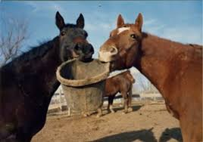
Proportion of fiber to simple carbohydrates (starch and sugars) cause fluctuations in the populations of microbes in the hind gut
Higher starch and sugar result in higher production of hydrogen, lactate and proprionate.
Higher fiber increase acetate.
Preileal starch intake over 3 grams per kg bwt results in a spill over of undigested starch to the large intestine.
Excess starch increases total VFA production , LA, and a drop in pH and acidosis.
Acidosis may damage the epithelium altering permeability.

Slide 59
Hind gut=60-62% of GIT. fermentation provides far more energy as VFA’s than regular digestion on the natural forage diet.
Cecum =33 liters
Large colon =80-90 liters
Small colon =19 liters
Rectum =1-3 liters
Total git =188 liters
The cecum has only one way in and out. This can be prone to impaction colic with very coarse forage or dehydration.
.

Slide 60
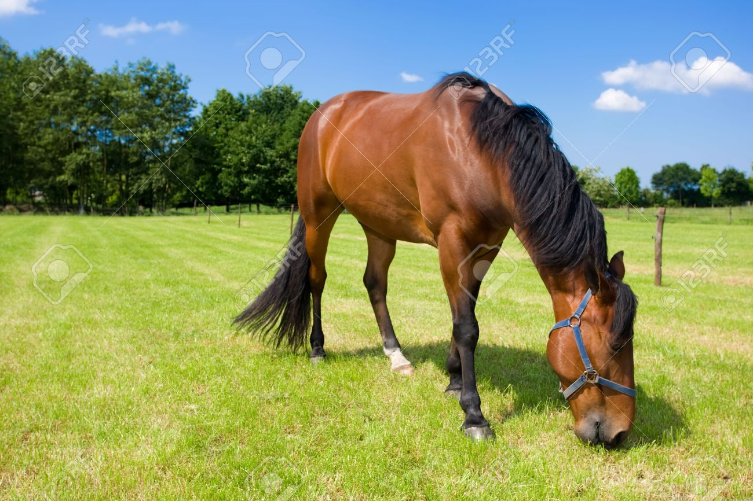
Hind gut-the cecum and large intestine make up the bulk of the GIT with millions of microbes producing the VFA’s and other nutrients..
Acetate 70%
Propionate 17%
Butyrate 8%
Others 5%
Acetate may be 32% of total energy supply to the hind limb.
Higher concentrate diets shift to more propionic /LA and less acetate and butyrate.

Slide 61
Hind gut- the bulk of the GIT with millions of microbes producing the VFA’s and other nutrients..
Excess sugar , starch and OF will be fermented rapidly to LA.
VFA’s can only be metabolized aerobically, high yield but slow release energy .
Butyrate is a prime energy source for the cells lining the hind gut called enterocytes. and is required for gut health and prevention of leaky gut. Butyrate improves intestinal permeability and minimizes intestinal damage.
SCFA’s have anti-inflammatory properties
Prebiotics that stabilize certain bacterial families may have promise for treating equine GIT disease.

Slide 62
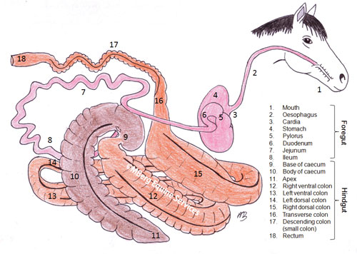
The hind gut-the cecum and large intestine and trans verse colon and short colon finally to the rectum.
7 m long, 140-150 liters.
The food bolus of mostly fermentable feed passes from the ileum through a tiny ileocecal orifice ,into the cecum (30 liters) where fermentation begins.
After about 7 hours of fermentation, feed passes into the large intestine (large colon).
The 12 foot long (large colon) volume =75 liters or 20 gallons.
Dr. Pratt Phillips says this is the most delicate part due to the twists and turns.

Slide 63
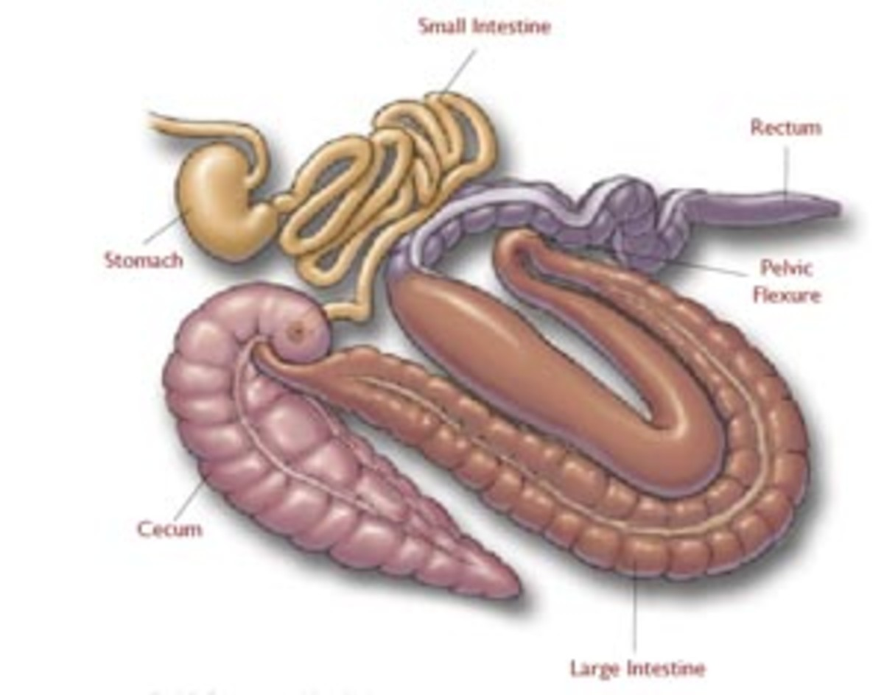
Microbes produce Vit K , b vits , available phosphorus , VFA’s
The final few feet
The small colon decends from the transverse colon , terminating at the rectum and anus.
Here fecal balls are formed and excess water is absorbed before manure is expelled. Susceptible to the squirts.
Note cecum –one way i n and out. Mixes feed. Dry feed with inadequate water may cause impaction. Feed stays for about 7 hours.

Slide 64
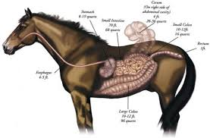
Health risks-use a veterinary supervised health program.
Gastric ulcers
Colic
Internal parasites
(ascarids) round worm
Small strongyles
A less common but more serious condition is larval cyathostominosis , caused by mass eruption of encysted larvae.
Diarrhea a potentially life threatening condition.
Hind gut acidosis due to a sudden decrease in pH from rich food , altering the biome causing upset fermentation , ulceration of the cecum and large intestine, diarrhea and laminitis among other issues.

Slide 65
Water
Most medium sized horses drink 5-9 gallons a day
Double in hot weather
May drink less in winter
Drink more at about 20C
Horses do not drink water if very cold as it deadens nerves in the mouth blocking the thirst reflex.
A horse will not drink if excited or fearful.
Horses sweat is iso to hyper tonic . A horse cannot tell if it is dehydrated. 4% loss in BW as water a problem , 7% fatal
It is difficult to estimate water loss.
Training to drink saline water will enhance water intake and hydration.
Proper training will enhance glycogen reserves by 10%. plasma volume by 10% and heart size by 10% aiding gut health, cooling and performance .

Slide 66
Forage vs ulcers
Ulcers =95% of race horses
90% of elite endurance horses during race season and 46% during off season.
80% of lower level endurance horses
57% of dressage horses
70% of foals at weaning time
20-30% of pleasure horses
20-40% of wild horses
Nearly 100% of cribbers

Slide 67
Forage –fiber fermentation to VFA’s
Provides energy as VFA’s as slow release over time. The VFA propionic acid is largely gluconeogenic about 50-60% of blood glucose , acetate remains in blood and can be used directly for energy or stored as fat.
butyric converted to acetate – converted to acetyl co A and enters energy cycle and provides energy to cells lining the gut promoting good health.
Forage stimulates water intake and soluble fiber in forage and super fibers enable water holding in the gut .
One lb of forage stimulates 3.5-4 lb water intake whereas grain only stimulates 2-2.5 lbs water intake.
Super fibers help as forage substitutes. They provide highly fermentable fiber and water soluble fiber that helps hold water in the GIT.
The large intestine may hold 8-10% of body weight as water and 10-20% of total body sodium, potassium and Chloride.

Slide 68
Forage is the foundation
Average levels of exercise e.g. Lower level endurance riding have about 78% of the ration as forage.
The average amount of grain may be 2.27 kg/day for medium exercise.
Provide a minimum of 1.5% body weight as forage . This is 15 lbs for a 1000 lb horse.
Include 1% of body weight as long stem forage to encourage chewing activity which enhances saliva flow and the bicarbonate it carries. This may also help with behavior reducing stress and gastric ulcers.
Alfalfa - a small amount may be fine as a natural buffer.
Never turn a horse out on rich pasture with an empty gut. Feed hay first to prevent grass colic.

Slide 69
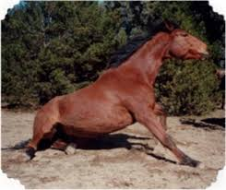
Forage quality is critical.
Moisture over 13-15% leads to moldy hay.
Avoid moldy hay.
Horses are very sensitive to mold. It is a one way system. Mold may damage liver function and other tissues.
Spoiled forage such as haylages may have clostridium botulinum .
The amount of botox a mouse can stand will kill a horse.
Low levels of botox in spoiled haylage will paralyze the gut inducing colic.

Slide 70
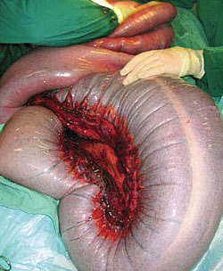
Forage and water add ballast

Slide 71
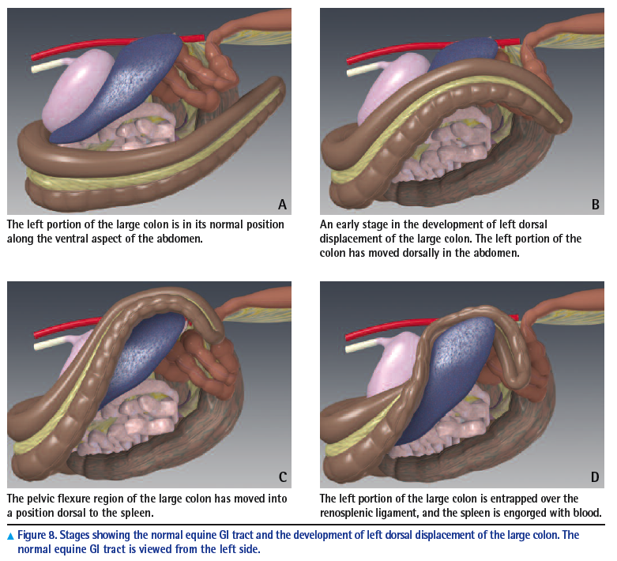
Ballast

Slide 72
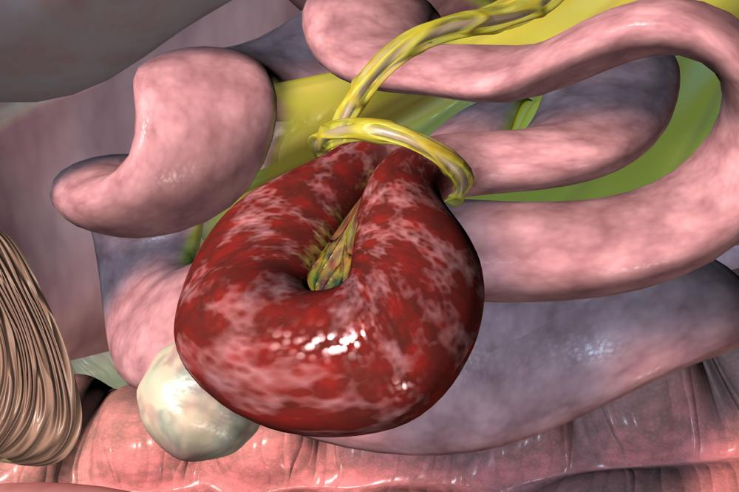
The obese horse is at risk of lipomas and pedunculated fat

Slide 73
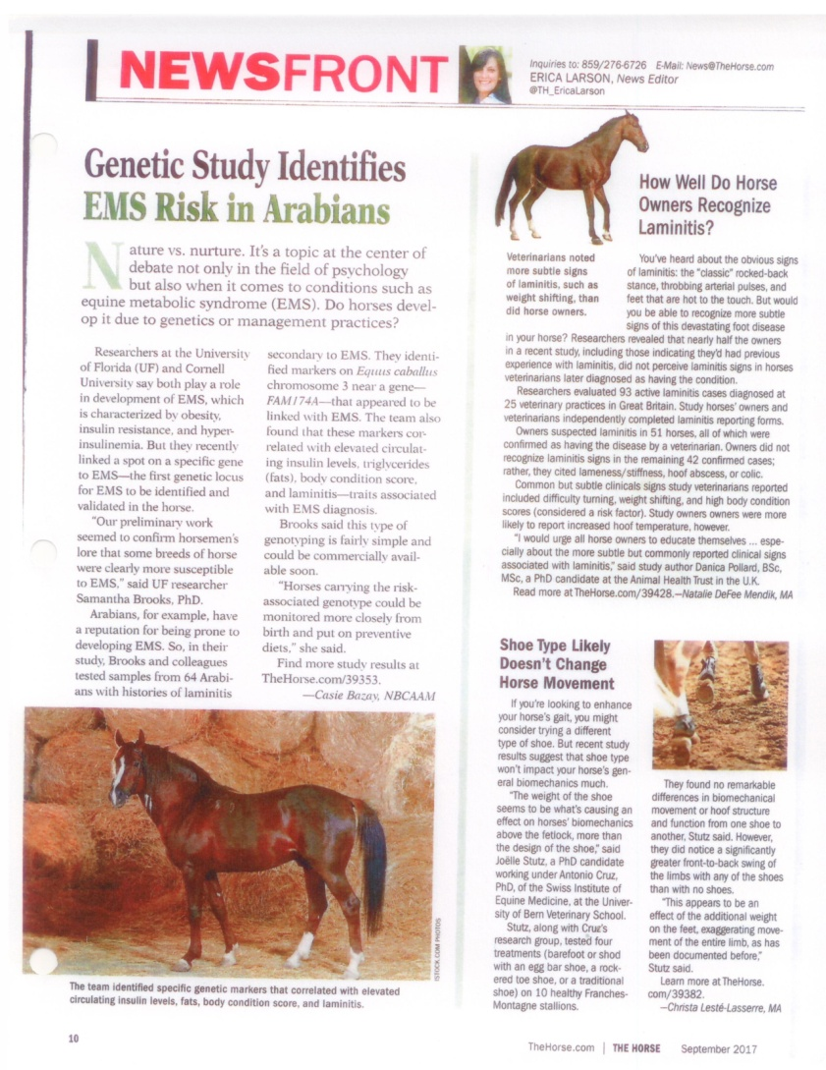
Concentrates
Supplemental energy can come from grains or fat (veg oils).
Some breeds tend to be easy keepers.
Limit starch intakes to a maximum of 1-1.5 grams per kg per meal.
Limit meals of grain to a max of 1.5 kg for a 450 kg horse
Total grain intakes max at 1.0% body wt/day .
Horses eat about 2.5% of body weight total -hay and grain combined
Breeds may vary in ability to use sugar and starch.

Slide 74
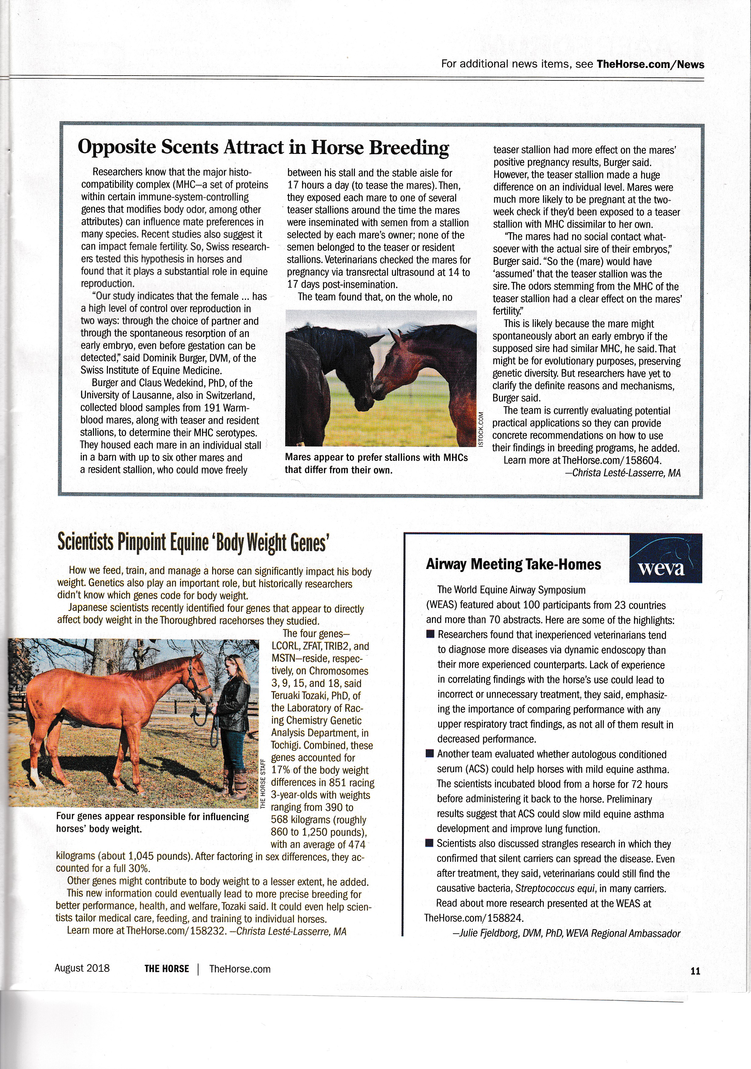

Slide 75
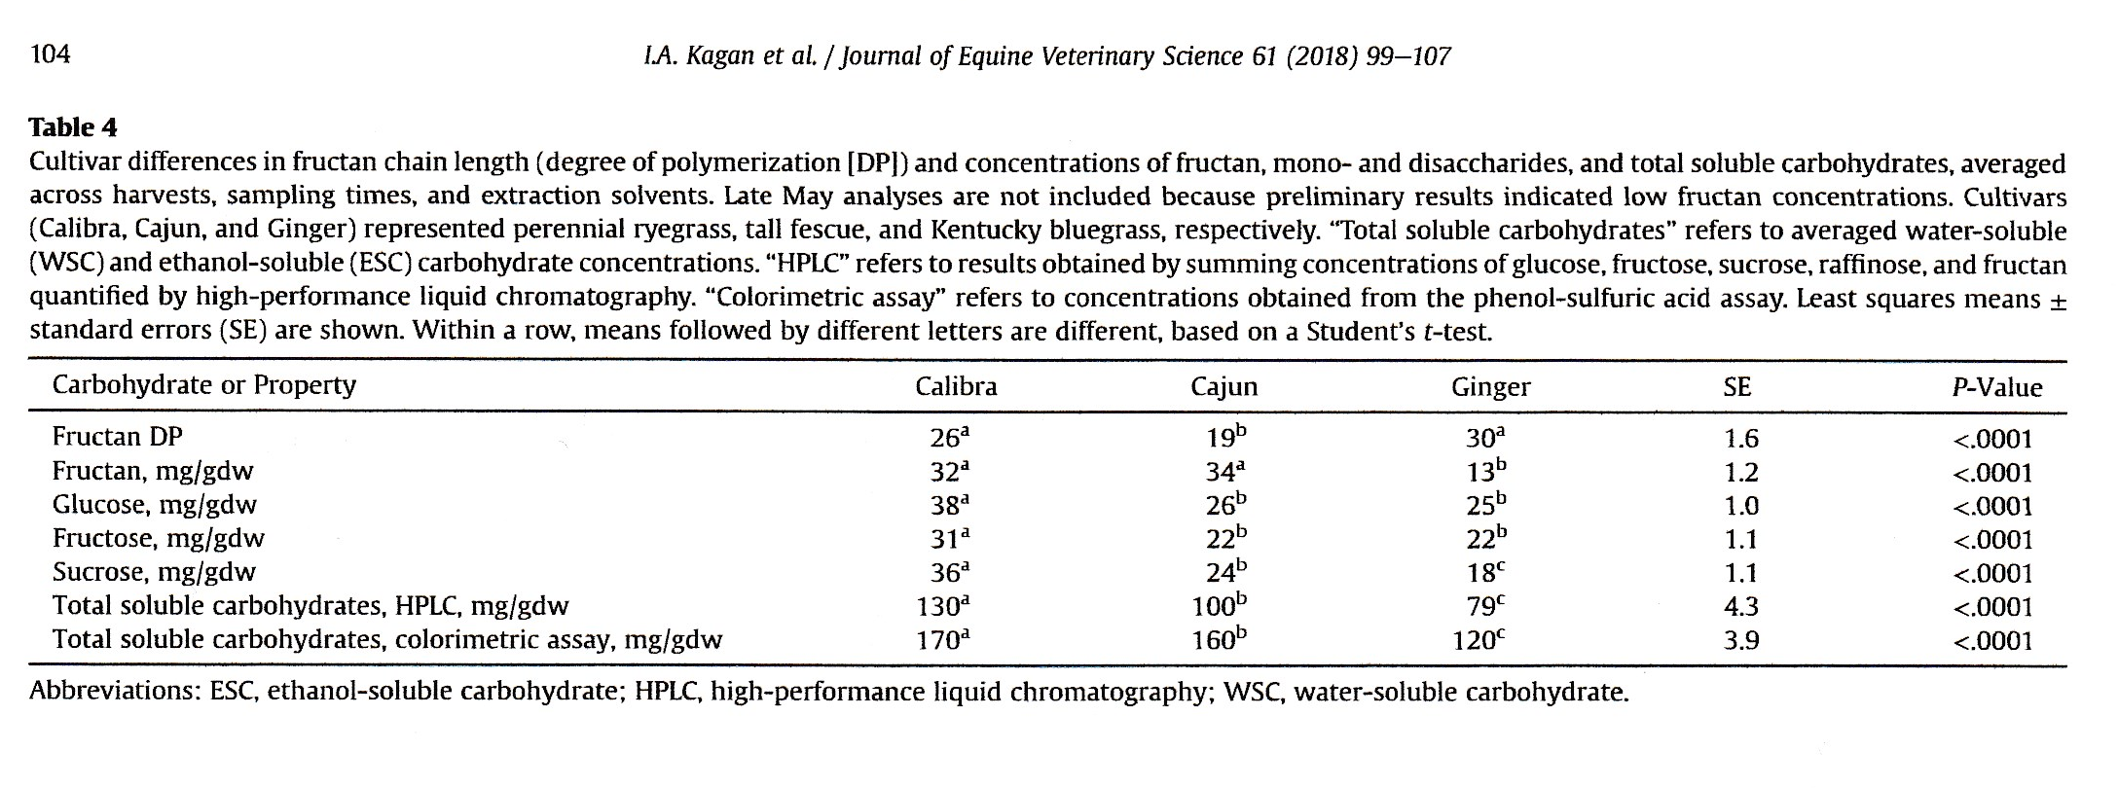
Grass as Forage-photosynthesis

Slide 76
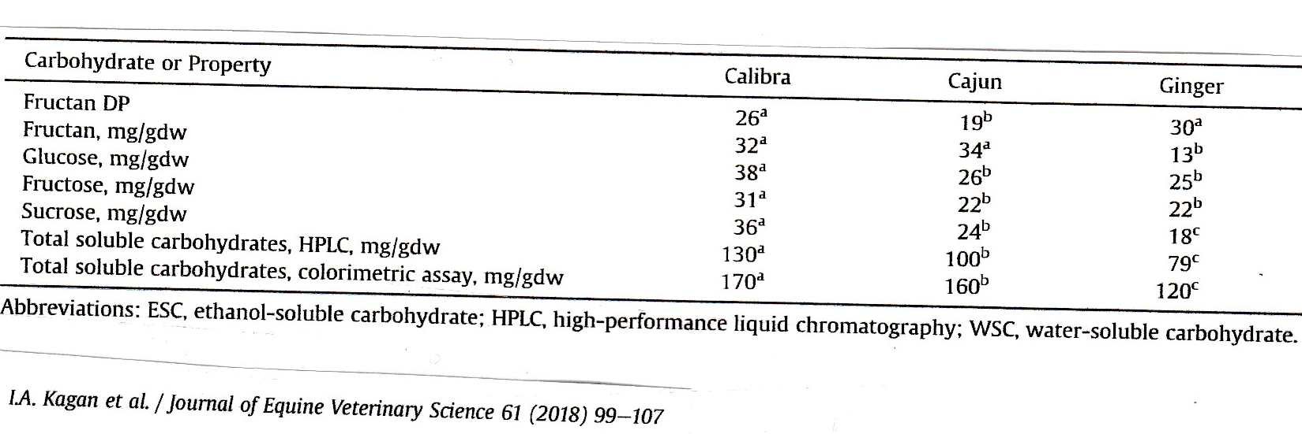
PAL

Slide 77
Possible Role of Micro RNA in Equine IR
These non coding single stranded molecules can regulate genes associated with T2DM and MS.
Levels of specific miRNA’s can can serve as biomarkers for the presence and prognosis
There are different miRNA profiles for IR vs control groups
Possibly a new tool for diagnosis and treatment of Equine Metabolic syndrome. JEVS 63 (2018) 74-79

Slide 78
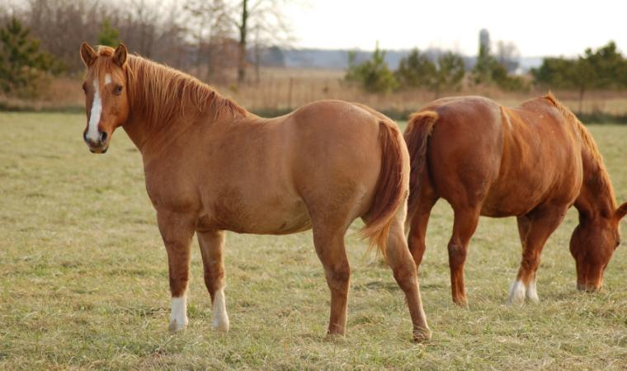
Whole body inflammation-links to EMS, IR. And laminitis
The immune system secretes proinflammatory cytokines in response to infection or injury.
Improper use of glucose can affect the endocrine system.
Body wide inflammmation may occur.
TNF a can initiate IR , beneficial in illness.
Diet and obesity can also stimulate release of the same cytokines.

Slide 79
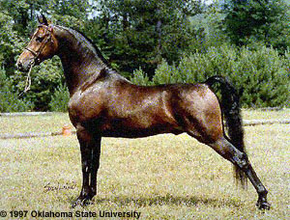
Inflammation and obesity and inflammaging
Depends on breed , exercise, diet and ageing.
When glucose storage goes awry, IR can occur, without exercise and weight control, for prolonged periods.
IR results from inflammation and promotes it bodywide. Adipocytes for example.
More insulin is secreted to control glucose

Slide 80

Glucose and insulin-cause or effect
Possibly related to fermentation of glucose to LA ? OF to LA?
LA kills off gut bacteria, they release lipopolysacharide (LPS), also called endotoxin.
LPS interacts with the immune system in the gut or systemically
If LPS and other substances can pass out of the intestinal tract, “leaky gut”,
A cascade of inflammatory events occurs bodywide.

Slide 81
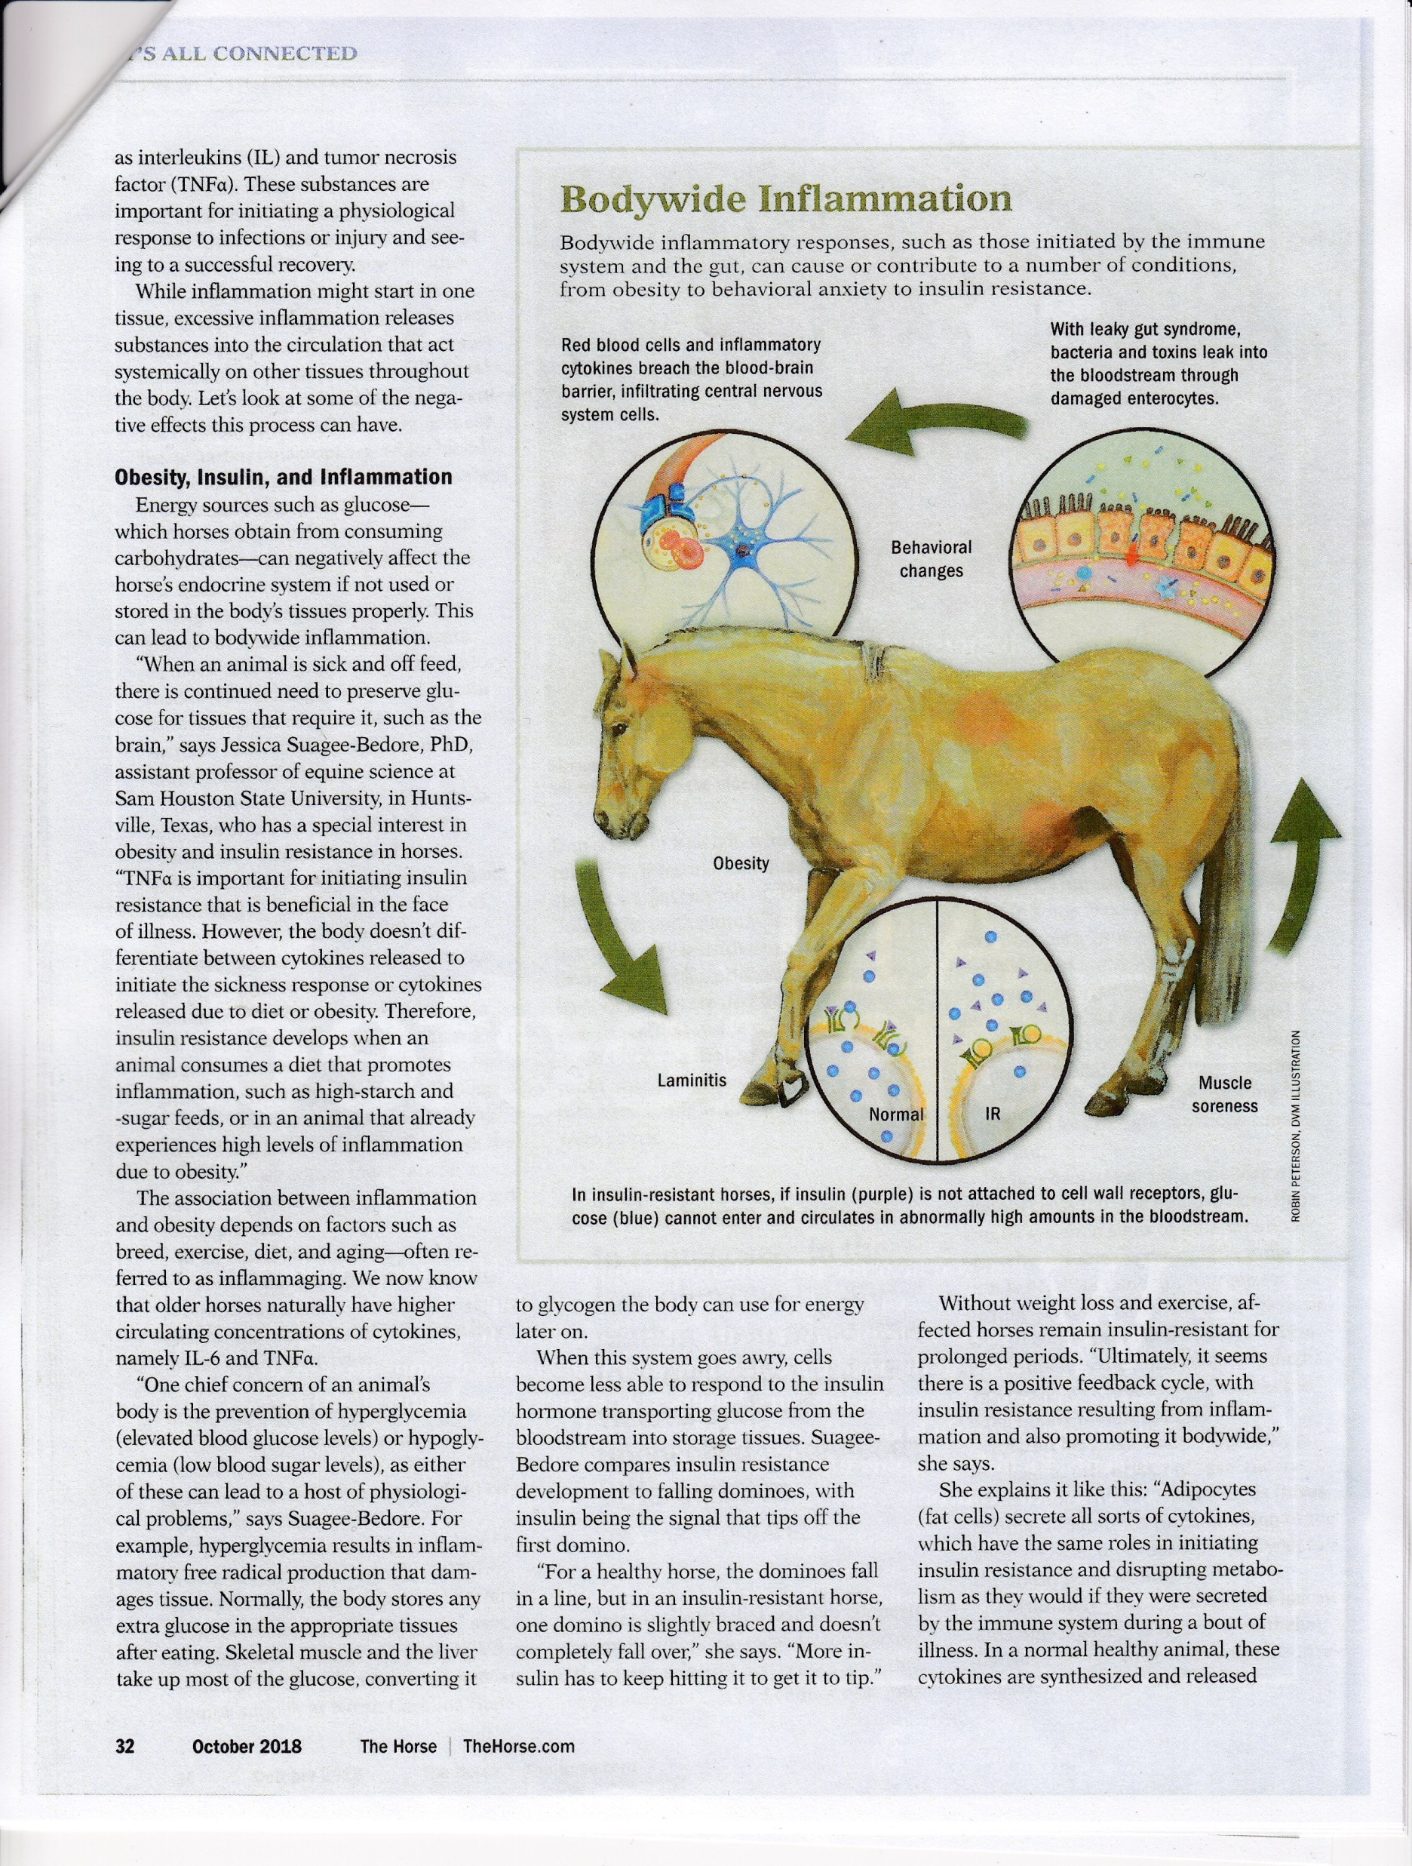

Slide 82
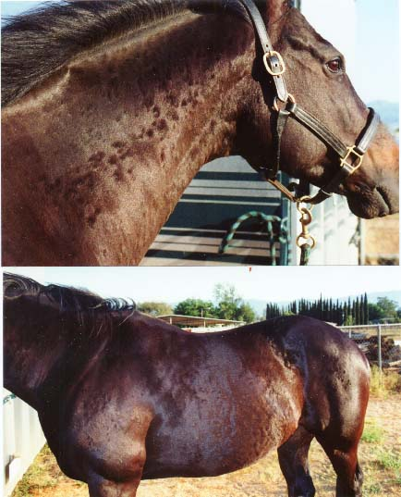
Leaky gut-early life stress may alter DNA resulting in tissues injuring more easily and healing less efficiently.
Intestinal cells are very sensitive to small changes from stress, colic, or disease. A single layer of cells renewed every few days to a week.
Any stress that shunts blood to priority organs (e.g. Brain, kidneys) and not to the gut decreases intestinal blood flow and oxygen to the intestinal lining.
Leaky gut can lead to other types of systemic inflammation such as skin allergies (hives, itching) or laminitis .
The intestinal tract has an amazing ability to repair its epithelial barrier.
Nutrient absorption suffers during the process.
Obese horses may be at a low grade inflammation state to begin with.

Slide 83

Minimize causes of inflammation and behavior issues.
Control weight
Control sugar and starch feeding.
Maximize forage-free choice if possble or slow feeders.
Avoid slug feeding of meals
Obese /ems horses need special care.
Butyric acid is important to enterocyte health . Can it be supplemented?

Slide 84


Slide 85


Slide 86
insulin
Creates fuel reserves
Insulin activates glycogen synthase promoting storage of glucose.
At adipose tissue insulin activates lipoprotein lipase facilitating the shuttling of triglycerides from within chylomicrons and lipoproteins to adipose tissue.
Insulin also has a negative effect on gluconeogenesis , amino acid catabolism, and lipolypis
Insulin controls the vascular system via the NO/ET-1 system
Hormone sensitive lipase may be impaired by IR.
The main substrates for energy production are carbohydrates and fat.
Exercise intensity determines energy source. Fat cannot be burned anaerobically. Horses use a combination depending on type of work
Schedule exercise around feeding times.

Slide 87


Slide 88


Slide 89

Insulin Resistance (IR) vs Hyperinsulinaemia (HI) and the Incretin Effect.
Incretins also slow gastric emptying.
IR is the inability of tissues to respond adequately to insulin.
Hyperinsulinaemia is the circulation of an inappropriate amount of insulin after a given stimulus.
Hyperinsulinaemia can be symptomatic of tissue IR when it occurs as a compensatory response to peripheral tissue IR.
EMS, due to IR, obese BCS>7.0, history of laminitis?
Insulin dysregulation is a better term

Slide 90
Insulin Resistance (IR) vs Hyperinsulinaemia (HI) and the Incretin Effect.
Insulin dysregulation a better description.
Horses do not show pancreatic exhaustion over time and can run high compensatory insulin due to IR for years. Compensatory IR.
Blood glucose will be normal.
Now called insulin dysfunction.
Glucose remains the main stimulus for insulin release .
New-ponies with ID/incretin effects may have greater capacity for post prandial uptake of glucose.
GLP-2 is co secreted with normal incretins, but it has an intestinal trophic function. L cells respond to nutrient intake and stimulates intestinal cell proliferation while inhibiting apoptosis and gastric motility.
Increased secretion of GLP-2 leads to an increase in the absorptive surface area of the small intestine and, therefore enhanced capacity for nutrient absorption.

Slide 91
Glucose uptake vs Incretins EVJ (2018) 1-6
Glucose uptake is facilitated by sodium-glucose cotransporters (SGLT) expressed on intestinal epithelial cells.
In humans with metabolic dysfunction , enhanced glucose uptake occurs through SGTL upregulation.
It is feasible that GLP-2 may contribute to enhanced absorptive capacity through its intestinotrophic activity.
This may make it a potential therepeutic target in animals with ID.
This is the first data in support of the theory that the gastrointestinal peptide GLP-2 may play an important role in ID in ponies. ID ponies had substantially increased levels vs normal ponies.the ID and normal ponies did not differ in bcs when allowed grazing

Slide 92


Slide 93

Endocrinological laminitis-includes EMS and ECD and direct injection of corticosteroids
Inflammation of (the lamellae)? Not usually present .
Massive separation from the basement membrane may not be present.
Not a feature of EMS laminitis?
A slow insidious stretching and lengthening of SEL and eventually PEL. Often No pain showing .
Primary lamellae and the secondary lamellae most affected. Lamellar basal epithelial cells Parabasal cells
Basement membrane Dermal lamellae gradually affected.

Slide 94

Insulin-is laminitis similar to skin cancer?
Controls many metabolic functions
Uptake of glucose into insulin sensitive tissues
Also amino acids and fatty acids into AT
Controls vaso contraction via the NO/ET-1 system
Also a powerful mitogen for cell division and death, wound healing and growth or binds with IGF-1 receptors which does the same.. ID may turn on this system setting in motion lamellar changes .
No major inflammatory effects?

Slide 95

This process is called the entero-insular axis.
The pancreas begins secreting insulin even before blood glucose levels rise which normally is stimulating insulin production.
This pre-emptive increase ensures blood glucose is tightly controlled.
Oral supply of glucose can result in a 2-3 times increase in blood insulin compared to the same dose of glucose given IV in humans .
Some breeds may react more than others. Especially the Spanish breeds.
The Entero-insular Axis may be dysfunctional for various reasons or due to genetics. Hyper insulinaemia may result but only temporairly?
Insulin Resistance (IR) vs Hyperinsulinaemia (HI)

Slide 96

This system, if altered, can result in an excessive insulin response to glucose and other nutrients ***without concurrent tissue IR*** .
This results in transient HI and demonstrates HI can be present without tissue IR. It is the cushings horse with HI who gets laminitis ?Obesity seems a factor as well.
Genetics related E.G. Spanish breeds.
Therefore, tissue IR and HI may represent 2 different arms of a pathological process that can precipitate laminitis.
The Entero-insular Axis
Insulin Resistance (IR) vs Hyperinsulinaemia (HI)

Slide 97
Hi /ID Insulin ? There are no insulin receptors on lamellar tissue
There are insulin receptors on lamellar endo thelial cells
Vaso spasm can occur?
There are receptors for IGF-1 a powerful mitotic hormone and insulin can bind with these receptors.
IGf-1 causes cell division, growth and controls cell death.
Endo crinopathic Laminitis is a slower, stretching of the SEL and lengthening of PEL
Certain enzymes that damage the ECM like ADAMTS and other genes get turned on or off.

Slide 98

ECD-15-30% of horses over 15
-the obese ECD horse may be a EMS horse.
Not all ECD run high cortisol not all ECD have AC hypertrophy laminitis may occur if HI
Wt loss associated with ECD
can also be simply old age
IR, HI, ID –HI is the key for laminitis
parasitism,
chronic bacterial infections,
muscle atrophy and age related factors
ECD –may need more deworming.
It may be only HI that is assoiated with lamellar issues.
resting cortisol is often within resting range.ppid and ems may simply coincide.
Ppid may aggravate the EMS

Slide 99


Slide 100

Determine requirements
EG NRC DE
Strive for BCS 5.0
Base line is energy obesity may result in ID if over bcs 7
The DE rquirements at thermal neutral zone
DE = 0.033 x BWt =Maintennce /light work
DE = 1.20 x Maintenance= light-moderate work
DE = 1.40 x Maintenance=heavy work
DE= 1.60 x Maintenance =heavy work
DE = Maintenence increased as follows
DE=(0.036 x BW) x 1.90

Slide 101

EMS-control IR and HI/ID
10% of horses are HI
HI-obesity-laminitis thin horses may be IR obese horses may have normal Insulin
The size of the nuchal crest and excessive fat in this area important . Why does obesity increase ID. Vs metabolically active fat tissue.
Surveys show 30-70% of horses are obese.
Overnight fasting insulin normal less than 20 uIU/mL
Control wt no more than 1% loss BW /week re hyperlipemia
Control NSC-hay only
Levo thyroxine?-reduction in wt, and neck circumference
Mag oxide
Exercise
Metformin under vets advice

Slide 102

most horses eat 2-2.5% bw DM ponies may eat 2.5-3.0% bw DM
Horses in light to moderate work can obtain most of the energy needed from forage.
Use as much forage as possible-
Encourages chewing , which stimulates saliva production with the bicarb it carries.
It reduces stereotypy behavior
Forage encourages more water intake ie
3-3.5 water to one forage
2.O0-2.5 water to one grain.
Relieves boredom
More forage and water intake provides ballast, preventing colic.

Slide 103

After max forage add concentrates
Gut health is compromised if forage is below 1.5% OF BWT DM BASIS
Harder working horses may need 1.5% BW as good forage. plus up to 1.0% BW as high energy concentrates.
Forages provide some sugars and starch, but they provide majority of their energy by bacterial fermentation of plant fiber and fructan in the hind gut, producing volatile fatty acids (VFA’s).

Slide 104


Body condition for old horses

Slide 105


Slide 107

Special needs-THE OLDER HORSE –movement vs ageing vs inactivity.
They lose aerobic MF’s decreases in M Mass they gain fat mass faster than M Mass.
Age related changes-Influences thermo regulatory function-
Older horses reached a core temp of 40Cin half the time required by the young horses, and their HR’s were substantially greater.
However both groups were similar HR’s and core temperatures by 10 min after exercise.

Slide 108

Older mares compared to younger mares exercise test
During sub max exercise, the older mares were not able to thermo regulate as effectively as younger mares.
The greater HR means greater cardiac out put is required , and they were still unable to dissipate heat as quickly.
In aged horses CO is limited, therefore insufficient blood flow.
Plasma volume is also lower & lack of hypervolemic response! Possibly a neuro endocrine effect.
An impairment in skin blood flow may occur re VASCULAR EFFECTS.

Slide 109
Lose MF structure and function. Connective tissue in muscle increases as collagen which interferes with normal contractile function.
Possibly decreases in blood capillarity and decreases in blood flow. Lower ability to dilate blood flow to the periphery with hormonal changes.
They switch away from fibers related to aerobic metabolism to more anaerobic types of MF’s. Hence a decrease in VO2 max means less oxygen to tissues.
Suppression of thirst may occur. Thyroid function may be lower, other hormones are lower decreasing CO, aerobic and exercise capacity. Decreased immune function, impaired nutrient utilisation , decreased N retn, decreased lean body mass.

Slide 110

Age and Diet Effects-EVJ-50 (2018) 690-696
Insulin responses to IV or enteral NSC challenge increase with age in healthy horses regardless of diet fed
.
SI was lower in aged horses regardless of diet. SS vs FF
Adaptation to a SS diet may or may not occur? Requires research. Is a low NSC diet beneficial.

Slide 111

95% of horses over 15 had dental abnormalities.

Slide 112
Senior horses-avoid obesity.
.They may be prone to lipomas.
Strangulating fatty tumors .
Wrap around the small intestine and cut off circulation or cause an obstruction.
Along with arthritis two most common life threatening issues.

Slide 113

Equine odontoclastic tooth resorption and hypo cementosis
Re canine and incisor teeth
Dental disease probably plays a large role in the incidence of large colon impaction and esophageal choke.
Weight loss may also be related.
Test for ppid
Adjust diet accordingly

Slide 114
Energy
Not a nutrient-energy comes from burning through chemical reactions the nutrients in feed like carbohydrates, and fats and even protein plus the by-products of fermentation of fiber in the hind gut namely the VFA’s.
These nutrients are stored as glycogen in the liver and skeletal muscle in the case of carbohydrates, and fat in various fat deposits.
Energy is moved by sources allowing formation of a high energy compound called ATP
Aerobic energy delivery –a function of HR, stroke volume and O2 extraction by muscle –is the result of a complex chain of events involving the oxygen transport chain. The by product is Co2 and water. Oxygen is required. It is slow but yields a high level of energy over time.

Slide 115
Energy 2
In contrast, anaerobic energy production is more direct and predominates in the rapid delivery of energy for brief periods of intense exercise.
Oxygen is not required. Energy release is very fast but it cannot be sustained for very long. It is not very efficient.
The by products are lactic acid. Increasing acidity is a contributor to fatigue during exercise of very high intensity and short duration.

Slide 116

More anaerobic.

Slide 117

More aerobic

Slide 118

Energy 3

Slide 119

VLA4-the break point aerobic vs anaerobic

Slide 120

Feeding -begin with NRC define the horse and work level and any factors affecting energy needs.
The horse-average metabolism. Calculate DE required (plus other nutrients).
Horses “usually” eat about 2-2.5% body weight as forage and concentrates combined.
Provide pasture with caution .
Sugar and energy levels may be very high in spring and fall.
Horses have a poor appetite regulation, and when allowed rich pasture, horses may consume 3-3.5% of body weight and ponies may eat 3.5 – 5% body weight dm.

Slide 121

Pasture turn out- possible with a grazing muzzle. Reduces intakes 30-80%
Restricting grazing time may not work
Pasture while ideal may have drawbacks if high in fructans-
Limit time feeding on good pasture resulted in ponies consuming 1% body weight as forage within 3 hours. Hard to control.
Grasses may double their sugar content in one day from 15%-30% or more. Some reports of 40% dm nsc’s
Usually turnout early in the morning helps mitigate sugar levels but not if night time temperatures are below 5C

Slide 122

It’s all connected-researchers have linked whole body inflammation to conditions such as EMS, IR, laminitis, leaky gut, and more including musculoskeletal injury.
Inflammation –local and systemic bodywise inflammation
Eg cytokines-
Cells are less able to respond to insulin if over weight and no exercise.
Without weight loss and exercise Affected horses remain IR for prolonged periods.
It seems there is a positive feedback cycle with IR resulting from inflammation and also promoting it body wide.

Slide 123
Obesity , insulin and inflammation
When sick and off feed glucose must still be maintained .
TNF alpha is important for initiating IR that is beneficial during illness.
However, the body does not differentiate between cytokines released to initiate the sickness response or cytokines released due to diet or obesity.
Therefore IR develops when an animal consumes a diet that promotes inflammation such as high-starch and sugar feeds., or in an animal that already experiences high levels of inflammation due to obesity.
The association between inflammation and obesity depends on factors such as breed, diet, exercise, and aging.
Older hporses naturally have higher circulation concentrations of cytokines namely IL-6 and TNFa.

Slide 125

Adipocytes-secrete cytokines same roles in initiating IR and disrupting metabolism as they would if secreted by the immune system.
Normally function to regulate metabolism.
Fat cells enlarging with obesity synthesize greater amounts of cytokines to disrupt metabolism in adipose tissue and skeletal muscle .
This leads to development of IR.
In response the pancreas secretes more insulin to signal muscle cells to take up glucose for the critical task of prevening HG.AT also harbours macrophages part of the immune system which produce and secrete cytokines.

Slide 126

Leaky gut may be involved it may be a cascade of inflammatory events.
Any stress including intense exercise that shunts blood away to the brain/kidneys decreases oxygen to the intestinal lining.
Leaky gut can lead to other types of systemic inflammation.
Eg skin allergies, or laminitis.
The intestinal wall changes and repairs somewhat .

Slide 127

Grazing Muzzles
Why grazing muzzles?
Certain breeds are very efficient with their nutrition and can store fat readily.
While an advantage in cold climates horses gain weight rapidly in moderate conditions.
Rich pastures can promote IR /ID and lead to laminitis.
Reduced IS may occur creating the basis for EMS.

Slide 128

Grazing muzzles-help with EMS and PPID and fat horses without limiting pasture turnout.
Many older horses develop a different disease equine Cushing’s disease-that can lead to laminitis via a similar mechanism.
A muzzle may help prevent these issues in a healthy horse.
They may take a week to adjust
And be keen to figure out how to use it.

Slide 129
muzzles
Introduce gradually longer each day
If aggressive or not eating use dry lot
Not needed year round-if body weight ok
Do not remove for breaks as horses and ponies can eat a lot in one day.
Keep on no longer than 10-12 hours then dry lot. Otherwise leave on watching weight.
Fit so two fingers around the face.check for rub marks daily
Marks indicate too small
Use breakaway safety features.
Some horses and ponies just wreck them and need dry lot.
Some Research shows muzzles only decrease intakes of pasture 30%.
A recent study with ponies shower they ate 1% body weight over 12-14 days.

Slide 130
muzzles
Horses should slowly and safely lose weight over time
Provided water and access to the pasture most of the day.
Water source should accommodate the muzzle
Ensure diet is balanced
Not suited for use with hay
A horse may lose 1% body weight per week
You may not notice the drop until 3-4 weeks.
Rapid weight loss may put some equids at risk of hyperlipemia
Eg donleys and minis. Excessive mobilization of fat can cause liver and kidney damage.
If not losing weight, check fit, limit additives, increase turn out.

Slide 131
muzzles
Muzzled horses do walk more
They will help reduce weight
Allows exercise and socializing.
They are not cruel.

