Slide 1
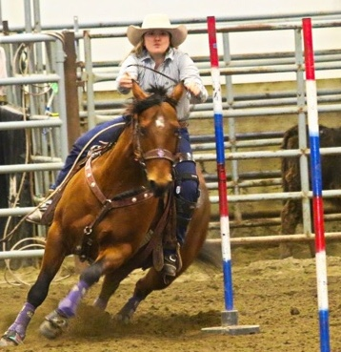
Equine Deworming
Dr Melanie Wowk
Zoetis Manager Veterinary Services- Cattle/EQuine

Slide 2
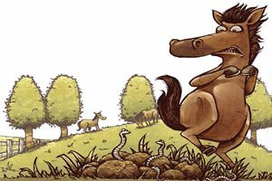
Notes:
There have been changes in our thinking about deworming. The AAEP has put out new recommendations.
We can’t remove parasites from a horse’s environment- they can live in harmony with proper management and deworming protocols.
property="og:image" content="http://www.integralequine.com.au/uploads/7/2/9/4/72949239/2f77da5b05-worms-cartoon_orig.jpg" />

Slide 3
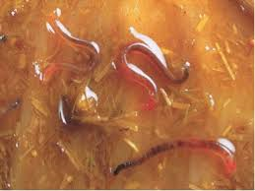
LARGE STRONGYLES
Notes:
Migrate throughout the GIT- mesenteric arteritis.
I have seen them in the fluid that escapes the scrotum when castrating

Slide 4
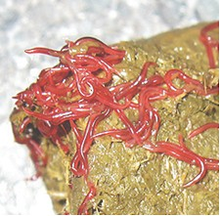
SMALL STROGYLES
Notes:
Do not migrate- are hypobiotic

Slide 5
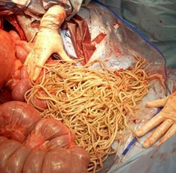
ASCARIDS
Notes:
Summer colds in foals due to migration through the lungs, heavy burdens in foals can cause intestinal obstruction.
It has been reported that fenbendazole (Panacur), at the 5 mg/kg dosage, is somewhat less than 50% effective against P. equorum. Therefore, a heavily infected foal (little more than "worms and eyeballs") is one situation calling for use of the lower dosage of Panacur in a juvenile horse. This "partial treatment" should be followed about one week later by another treatment with fenbendazole at the 10 mg/ kg dosage, or with any other effective dewormer at its recommended label dosage.

Slide 6
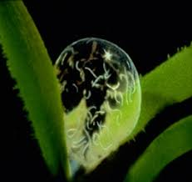
Larval Stages

Slide 7
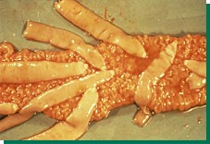
TAPEWORMS

Slide 8
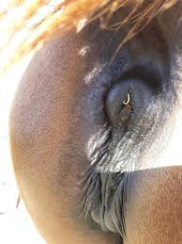
PINWORMS

Slide 9
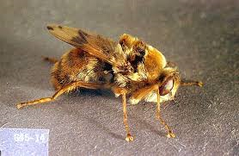
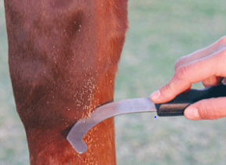
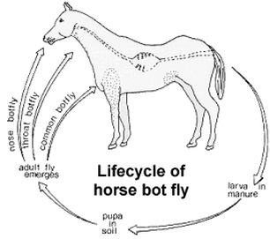
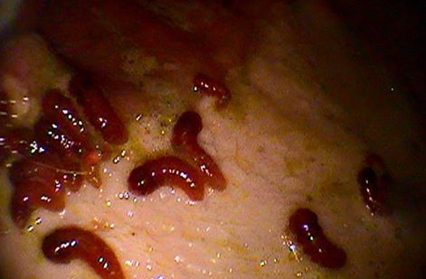
BOTS
Gasterophilus spp.
Notes:
Life cycle of horse bot fly: http://www.eqhc.co.nz/controlling-the-worm-cycle.html and https://www.doctorramey.com/worms/
Image of scraping eggs on leg: https://www.doctorramey.com/worms/
Endoscopy with bots: https://foundationequineclinic.com/blog//horse-stomach-bots
Bots in stomach, lesions: http://helminto.inta.gob.ar/Confe05/fig11.htm

Slide 10

SUPERWORMS
Resistant to dewormers
Notes:
They are able to survive any dewormer you throw at them. They create a population of anthelminthic resistant worms. So how do we prevent this from happening?
We need to step away from past conventional advice to deworm every 6-8 weeks
https://i.ytimg.com/vi/ty6c-fNismI/hqdefault.jpg

Slide 11
Individual plans
It’s ok for your horse to carry some worms- horses and parasites have evolved together
We want some refugia- worms that are susceptible to deworming products
Horses vary in their ability to mount an immune response to parasites
Age of horse is important- horses under 3 and those over 15 years of age
Notes:
Refugia- both in the horse and on the pasture

Slide 12
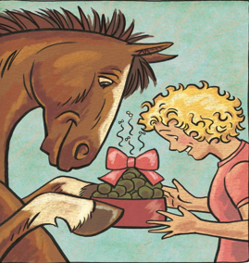
Who should be dewormed
An excellent opportunity to get input from your veterinarian regarding a plan
Varies with type of horse, number and ages, pasture management, and geography
FECs – to determine those with high worm
burdens or to determine if there is resistance
to the deworming agent.
Notes:
Foals and yearlings should be treated as high shedders and require more frequent deworming- 3-4Xs/year
Begin deworming foals at 2-3 moa. Warning...
When deworming your youngsters, remember that ascarid impactions are a well-known consequence of therapeutic deworming in juvenile horses. The best way to avoid impactions is a regular control program that never allows a large population of adult ascarids to develop within an individual foal. But how should deworming be implemented for foals which haven't been on a regular control program, or worse, for those which already have developed obvious signs of ascarid infection?
The first step is to enlist the assistance of your veterinarian.

Slide 13
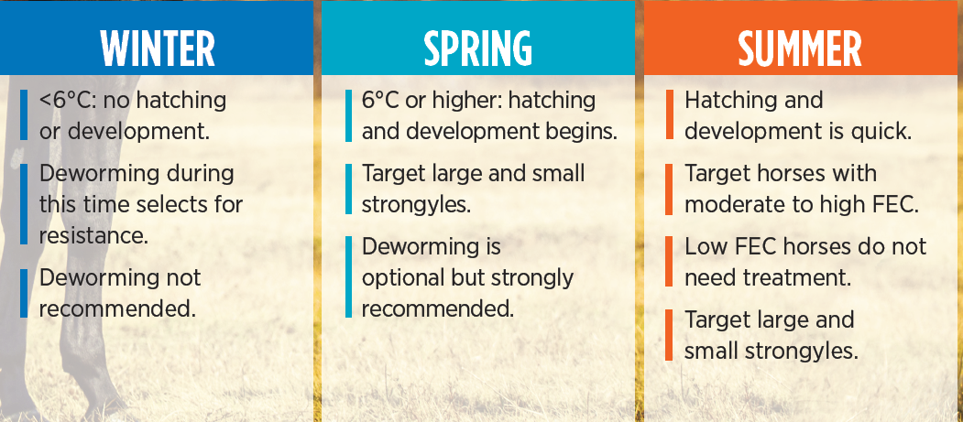
SPRING AND SUMMER DEWORMING PROTOCCOL
AAEP RECOMMENDATIONS

Slide 14
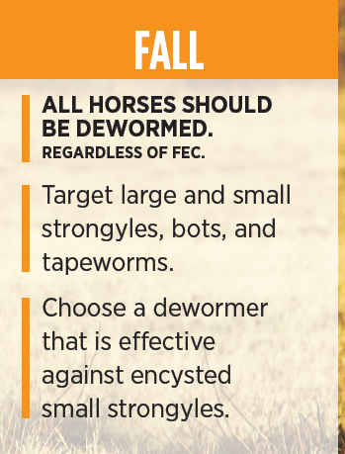
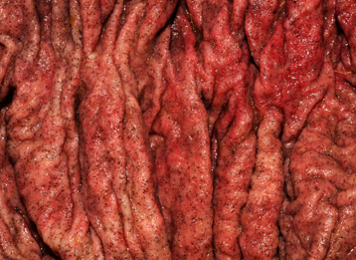

FALL DEWORMING RECOMMENDATIONS- AAEP

Slide 15
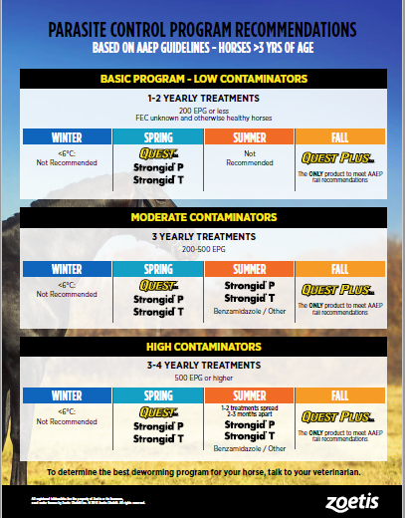
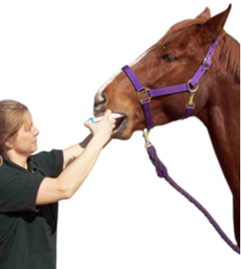
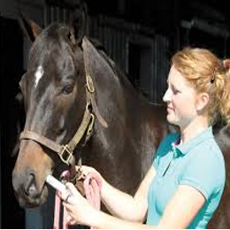

Slide 16
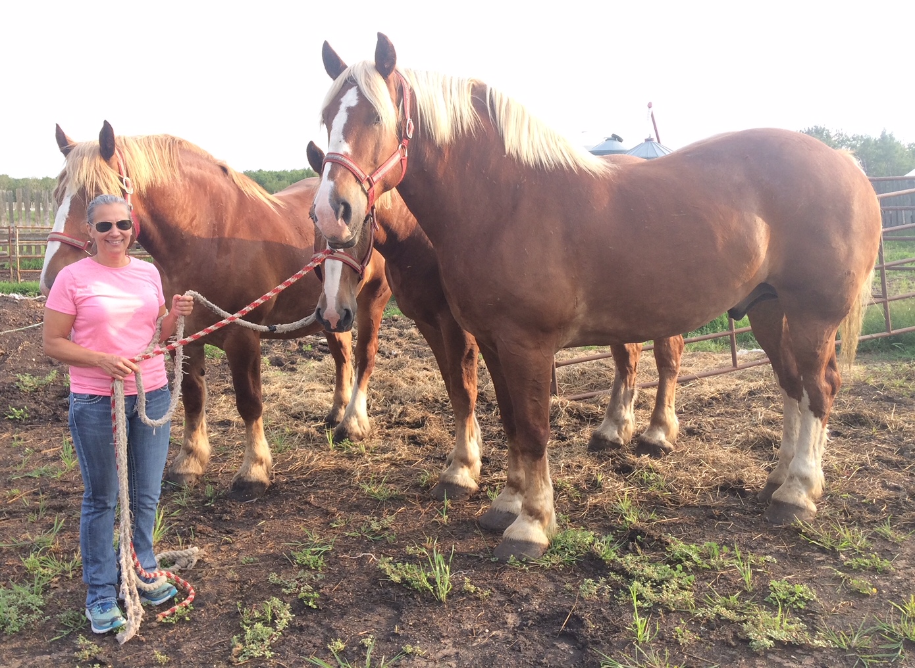
QUESTions?

