Slide 1
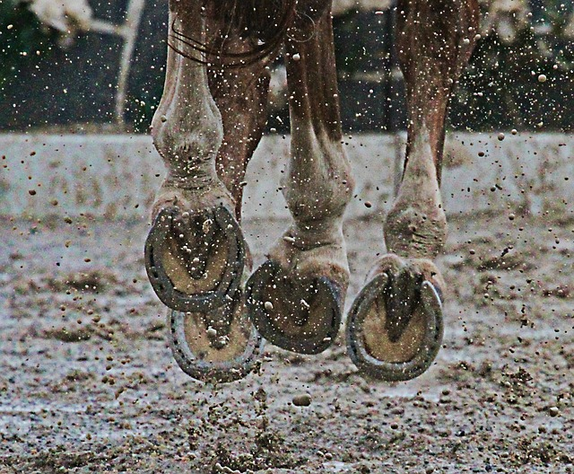
No Hoof, No Horse
Dr. Kate Robinson
B.C. Horse Council Traveling Road Show
Nelson, B.C.
May 5th, 2019
Notes:
Good morning, and thank you for having me here today. For today’s talk, I wanted to focus on the saying ‘no hoof, no horse’, and delve into why the hoof is so important, and then what we can do to help our horses have healthy feet and hooves. You will probably notice me use the terms foot and hoof interchangeably today, although technically speaking the hoof is only the keritanized external tissue, while the foot includes the hoof and all internal structures. Please feel free to ask questions as we go.

Slide 2
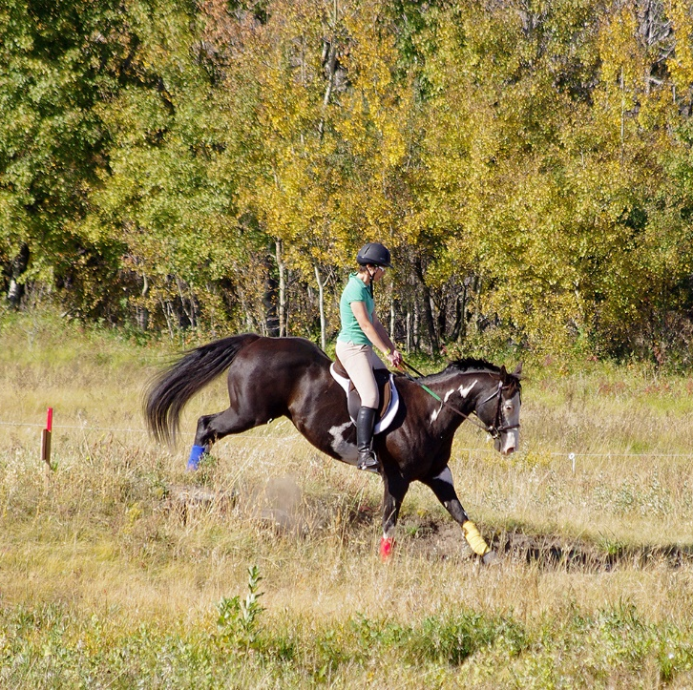
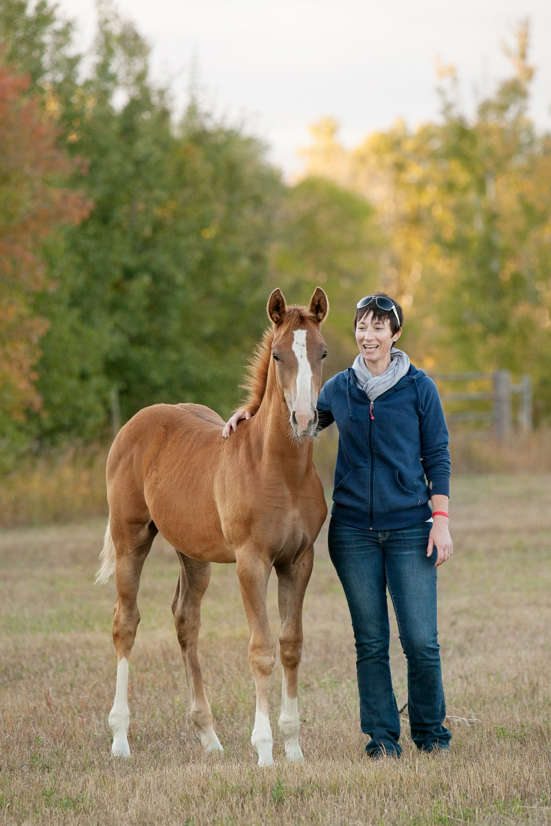
Notes:
You may be wondering ‘why me’, and ‘why this topic’? In addition to be an equine veterinarian, I am also a horse owner. I’ve got my Paint gelding, Sneak, who’s now retired, and my yearling filly, Fern, soon to fill in Sneak’s shoes. Sneak has been retired at a relatively young age due to chronic lameness from navicular syndrome – and he is a big reason that I am so interested in horse hoof health, and podiatry. My major research projects thus far have investigated different treatment options for navicular syndrome, and I’ve created a continuing education group for farriers and veterinarians, back in Saskatoon.

Slide 3
What’s so important about your horse’s hooves?
Connection between rest of the body and the ground
Shock absorption and dissipation
A healthy foot and hoof provides your horse with protection and cushioning
Unhealthy hooves may lead to discomfort and even lameness
Health of a horse’s foot is a reflection of the horse’s general health over the last 6 to 9 months
Notes:
The importance of a good hoof cannot be overemphasized. The hoof is literally all the horse has to stand on, and is the horse’s connection to the ground. A good hoof in the modern horse is influenced by many factors; and most of these factors are things we, as their owners and caretakers, can have significant impact on.

Slide 4
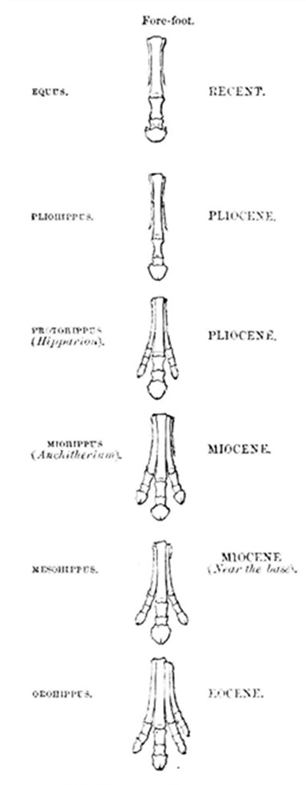
Trivia!
Horses have evolved from a four-toed animal, to the ‘single-toed’ animal we know today.
Which digit (or toe/finger) do horses walk around on?
  Pinky finger?
  Pointer finger?
  Middle finger?
  Thumb?

Slide 5
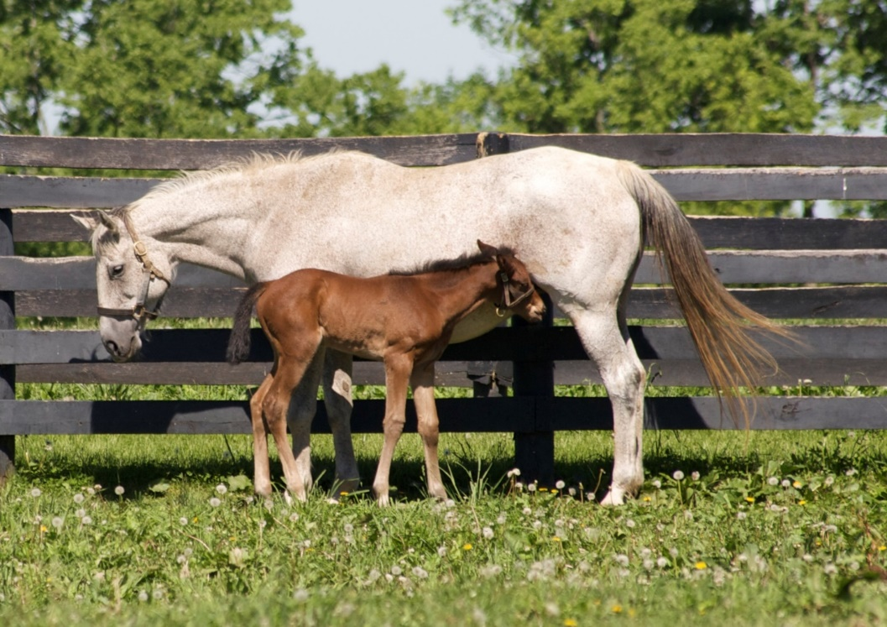
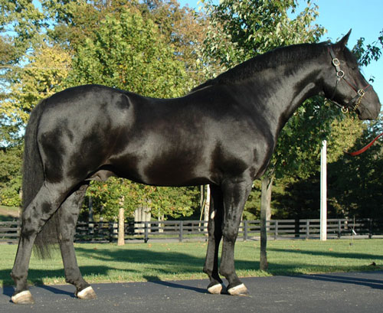
Healthy hooves are influenced before birth!
Notes:
Starting even before conception, choosing only to breed mares and stallions with sound, good quality feet is of utmost importance.
Horses used in breeding programs should have hooves appropriate for the size and substance of the horse.
They should have good quality hoof walls.
And they should have normal anatomy; we should avoid breeding horses with obvious club feet or other deviations.

Slide 6
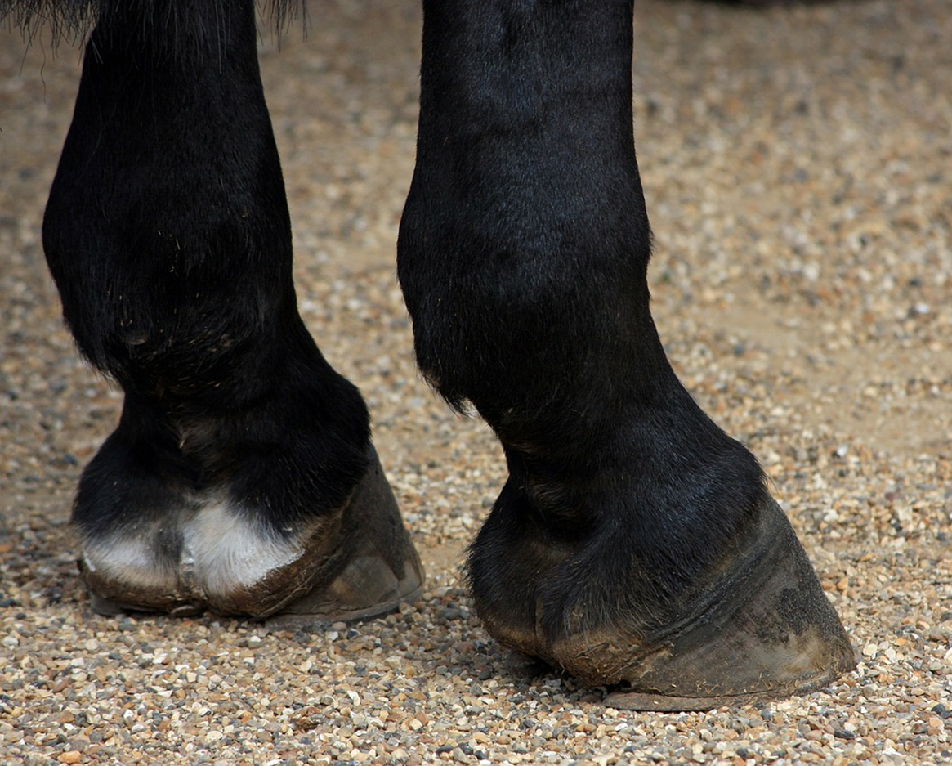
Notes:
So what does this quality foot look like?
In addition to having a strong hoof wall, and hooves that are an appropriate size; the mark of a good quality hoof is naturally well-balanced with appropriate angles, a tight white line, a smooth sole, and a large, healthy frog. Hoof wall angles will vary somewhat with breed, size of the horse, and other conformational angles, such as the pastern axis. Start critically assessing every horse you look at – what do you like about their foot? What don’t you like? And why do you or don’t you like something about it? This will help you develop your eye for a good quality foot, and will help you to be more critical when you are thinking about purchasing or breeding a horse.

Slide 7
Trivia!
True or false?
A horse’s feet should be identical in shape and size.
FALSE!

Slide 8
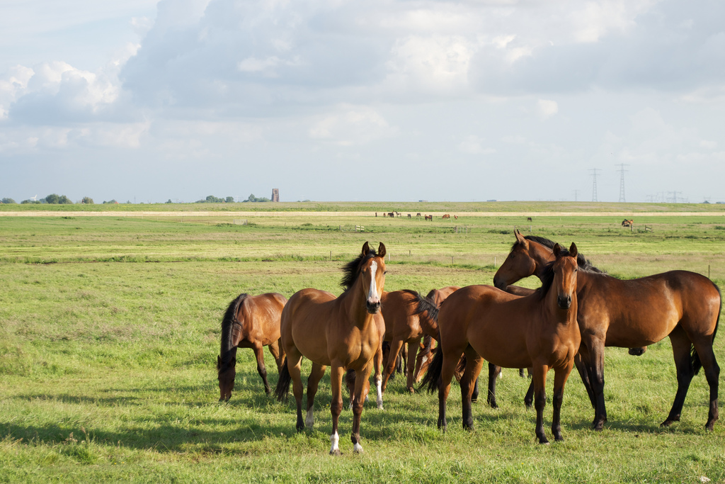
Diet plays a key role in hoof health…
Notes:
And this is true throughout the horse’s life, but again needs to be considered even before birth, in that a well-balanced diet for the mare during pregnancy, with appropriate minerals and vitamins, will likely contribute to a good quality foot in the yet-to-be-born foal.
I recommend consulting with an equine nutritionist for specific diet recommendations.

Slide 9
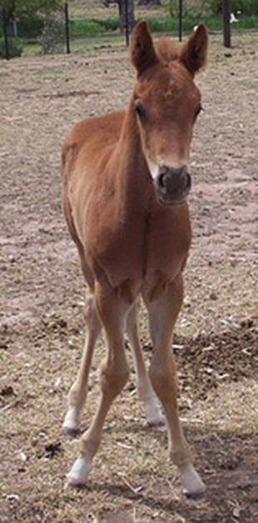
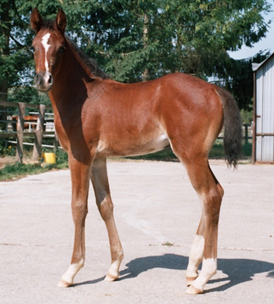
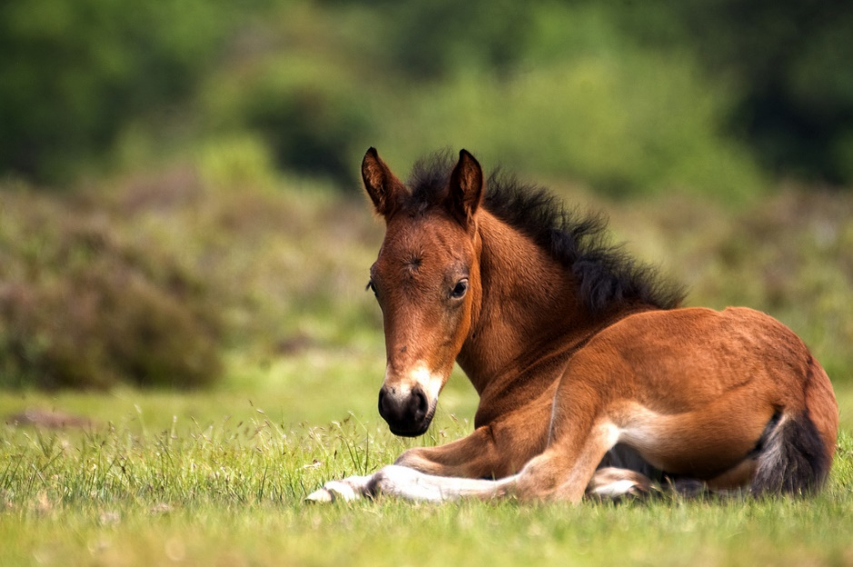
Good foot care starts early!
Notes:
Once the foal is born, early assessment, and if needed, treatment, by a skilled farrier is a necessity. Ideally, every foal should see a farrier by the time they are 1 month old; if there are obvious abnormalities, such as angular limb deformities, a visit by the farrier should happen much sooner, as a skilled farrier can shape the foot the help correct these types of limb abnormalities.

Slide 10
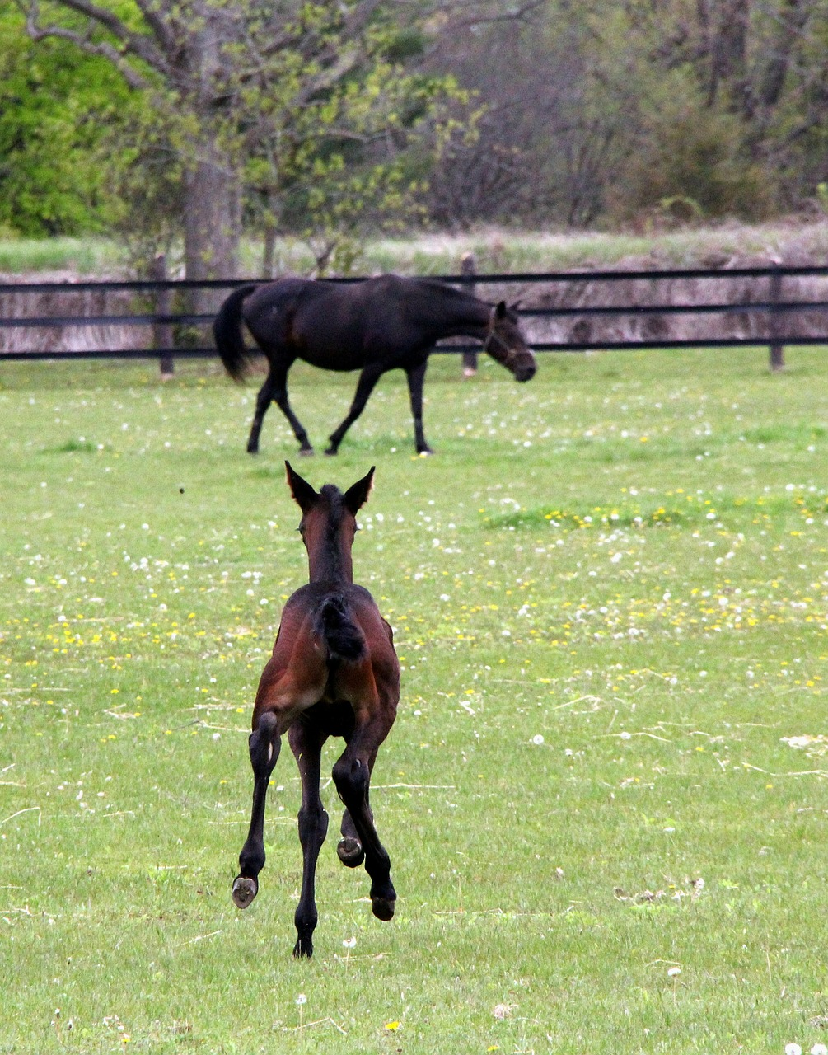
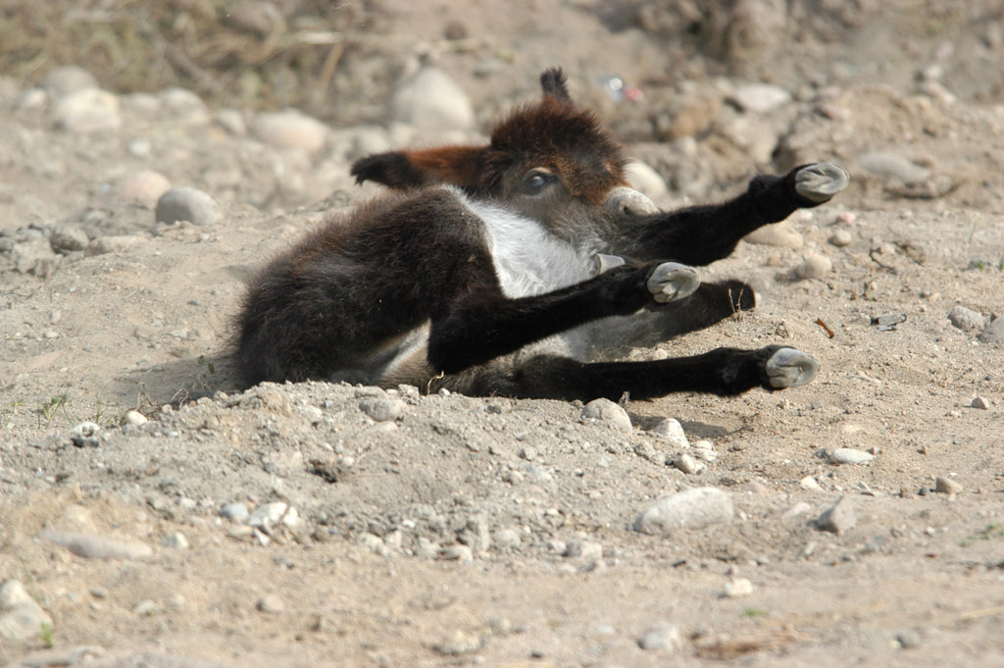
Notes:
To make life easier on our farrier friends, and on your foal, training of the foal to accept the farrier and the types of things he or she will do should also be started early in life. Handle your foal’s limbs and feet regularly, using positive reinforcement when they do what you want them to, and are well behaved. Start slow, don’t make lessons too long, and make sure to end on a positive note (when possible). As your foal learns to accept regular handling of the feet, increase the level of complexity – tap and scrape on their hoof with a pick to replicate some of the sensations (and noises) they may experience with the farrier later in life. Increase the time you expect your foal to keep their foot up off the ground, willingly allowing you to hold it. Swing a leg over and get in the farrier position, so that the foal has practice with that as well.

Slide 11
How do we take care of our horse’s hooves?
Environment and climate play a role in hoof health
Research indicates that the moisture content of hooves is about the same, regardless of their environment
Observations from farriers, veterinarians, and horse owners differ
Too much moisture tends to create a soft hoof
  Described by farriers as ‘mushy’
  May have trouble holding shoe
Too little moisture tends to create a hard hoof
  Risk of cracking and chipping
Notes:
So we’re already aware of the importance of the horse’s hoof, and we’re starting to know some of the influences we can have on hoof health, but how do we take care of our horse’s hooves?
Create drainage, avoid letting manure accumulate, avoid mud if possible, and create dry areas if needed.
Dry areas can be created by making drainage areas or ditches, laying down gravel or even bedding, or by creating a built up area within the horse’s corral or pen.

Slide 12
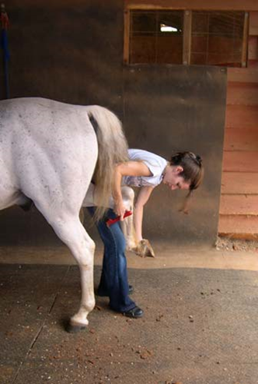
Notes:
Regular, daily inspection of hooves is a critical horse care component that many owners fail to achieve. Feet should be assessed and picked out before and after every ride. If your horse is not regularly ridden, than daily picking of the feet should be the goal. Talk about getting to know normal, and picking up on early changes/abnormalities…muddy environment and thrush example.

Slide 13
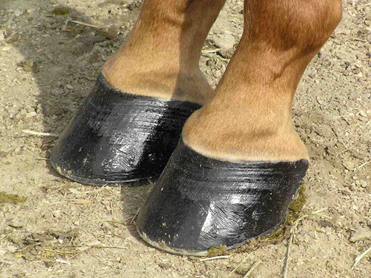
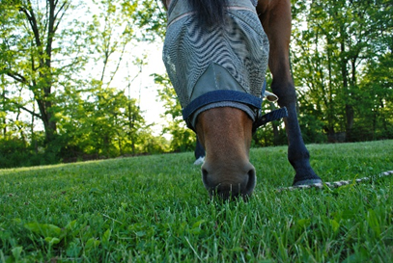
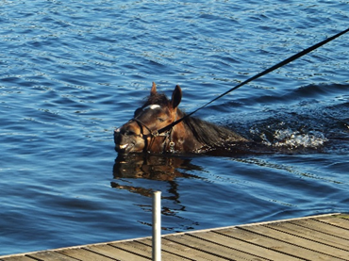
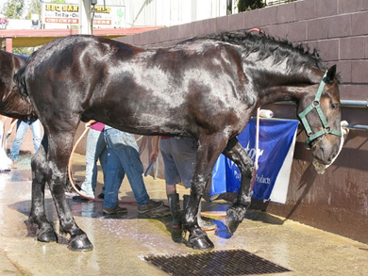
How do we take care of our horse’s hooves?
Notes:
We should avoid over-use of hoof polishes, as they can have a negative affect on the hoof’s moisture balance. And really, we should only use moisturizers or hardeners as needed.
We should also try to avoid too much wet-dry cycling, as this again can have a negative impact on the hoof’s moisture balance. Some wet-dry cycling, like dew on grass, is beyond our control. But the amount of baths we give our horses, certainly is within our control, and is something to consider if you are worried about your horse’s hoof health.

Slide 14
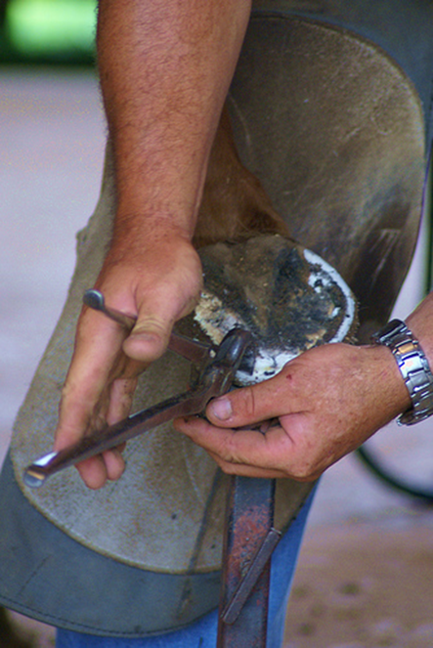
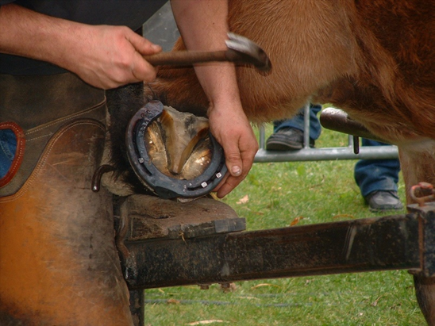
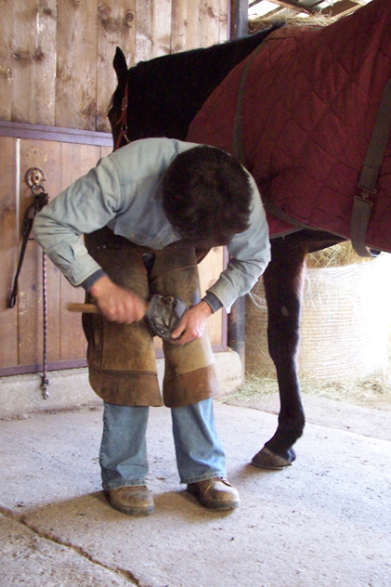
Notes:
Regular farrier care, again, starting at about a month of age, may be the biggest influencer on the health of a horse’s foot. Farriers can’t work miracles, and may not be able to correct significant issues linked to genetics or diet, but given half a chance, a good farrier will be a positive influence on the growth, balance, and soundness of your horse’s hooves.

Slide 15
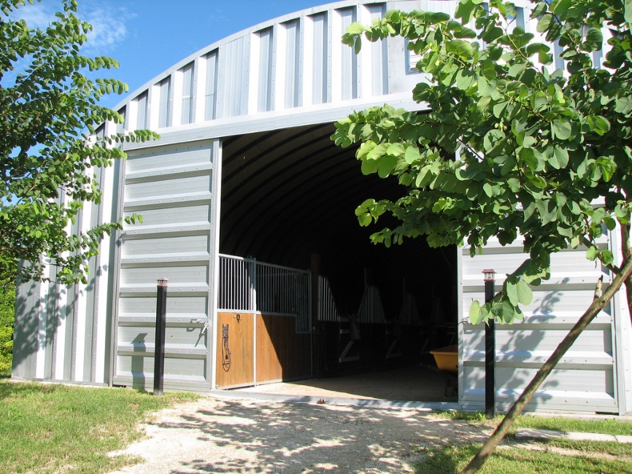
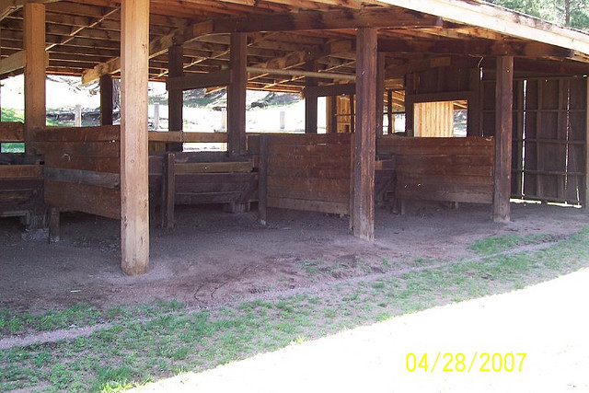
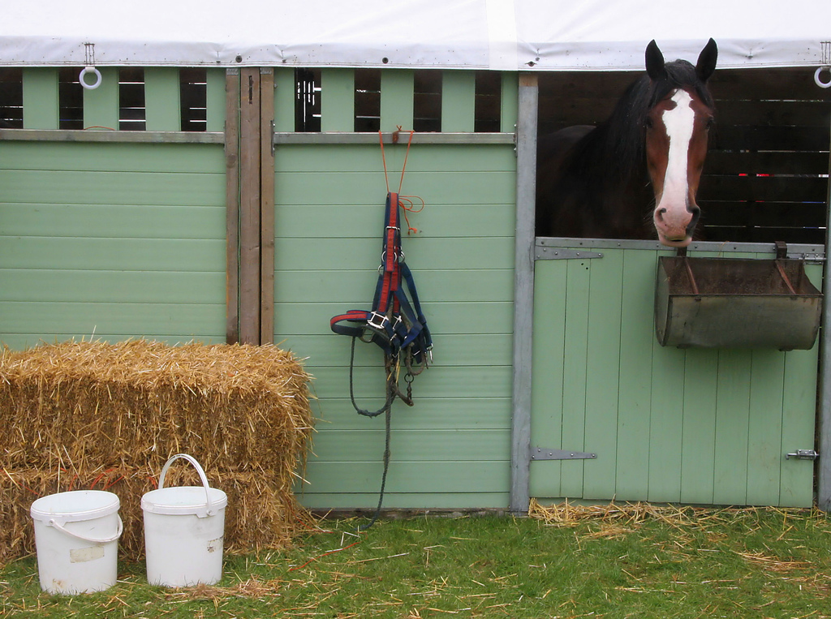
Notes:
Be kind to your farrier – provide them with a clean, dry, well-lit, and protected working environment. Try to have your horse caught and in before the farrier arrives. Pick out their feet, and brush off any mud or dirt on the limbs and body. Always be available to handle your horse for the farrier – farriers should not be expected to perform their job without anyone handling the horse. Being present for your farrier appointments also gives you the opportunity to ask any questions you may have about your horse’s feet, and gives the farrier the opportunity to discuss any concerns they have directly with you. If you cannot attend your horse’s appointment, ask a friend to be there instead. I have known horses and farriers who have suffered severe injuries because no one was available to handle the horse.
Farriery work is hard, physical labor – whatever you can do to make the appointment easier on your farrier (for example, ensuring your horse is quiet and well-behaved for his farrier appointments), will go a long way in helping maintain your relationship with your farrier, and will help ensure that your farrier can have a long, successful career.

Slide 16
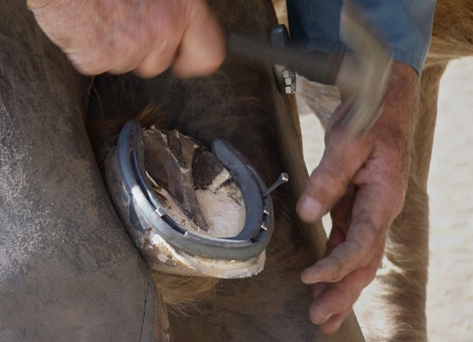
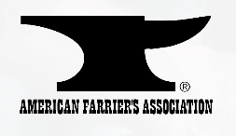
Notes:
Do your homework before choosing a farrier – talk to other horse owners, ask if the farrier has references. Ideally, you would find a farrier that is certified by a governing body, such as the American Farriers Association. Working with a certified farrier gives you the assurance that they are well educated in their craft, have passed certifying exams, and attend continuing education events to maintain their certification.

Slide 17
Trivia!
How fast does a horse’s hoof grow?
  1cm per month?
  ½ cm per month?
  2cm per month?
  ¼ cm per month?
1cm!
Factors that affect hoof growth:
  Age
  Nutrition
  Use/activity level
  Season
  Breed
Notes:
By comparison, our nails grow approximately 3mm every month!

Slide 18
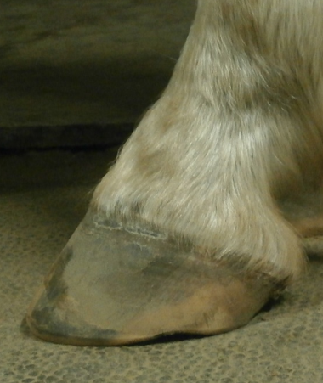
Notes:
Regular farrier care, typically every 6 to 8 weeks, will help keep your horse’s foot balanced, decreasing the likelihood that lameness issues will develop due to strain put on the horse’s leg by an imbalanced foot. The recommendation of trimming every 6 to 8 weeks is based on how fast the average horse wears their feet, and how much hoof growth they experience. Regular trimming is a necessity of modern horse keeping, as we often limit the amount of exercise a horse has, as well as the types of terrain they walk on, thereby making it so the horse does not naturally wear its hoof in an appropriate shape, or at an appropriate rate.
Treat each horse as an individual, and have the farrier out on a schedule that is appropriate for that particular horse.

Slide 19
Trivia!
True or False?
White coloured hooves are weaker than black coloured hooves.
FALSE!

Slide 20
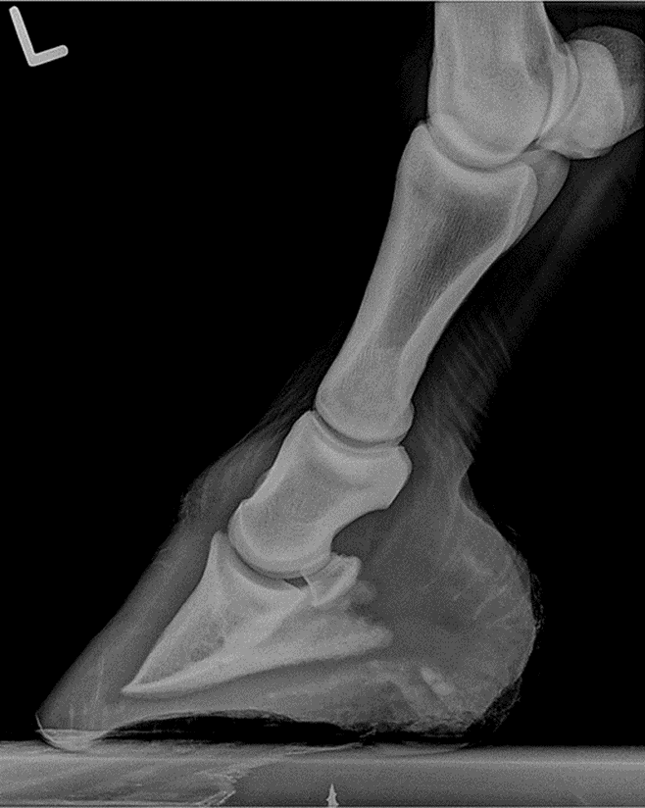
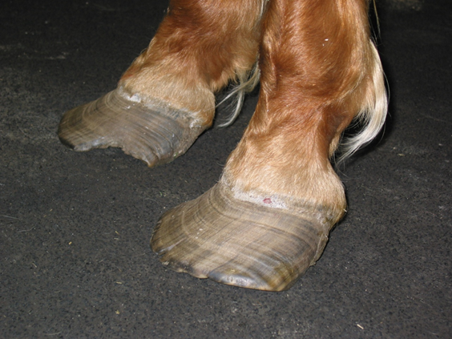
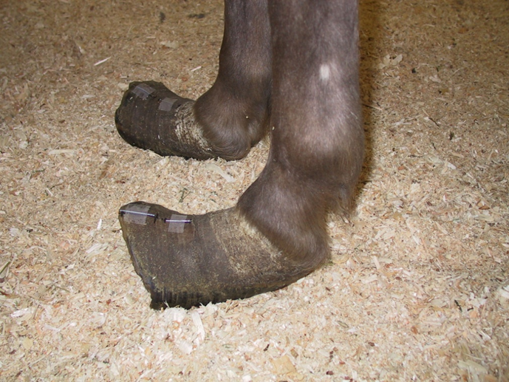
Abnormal hoof shapes…
Courtesy Dr. D. Wilson
Courtesy Dr. K. Lohmann
Notes:
Diseases that may contribute to the shape a horse’s hoof takes, and the rate of growth, include laminitis, and navicular syndrome.

Slide 21
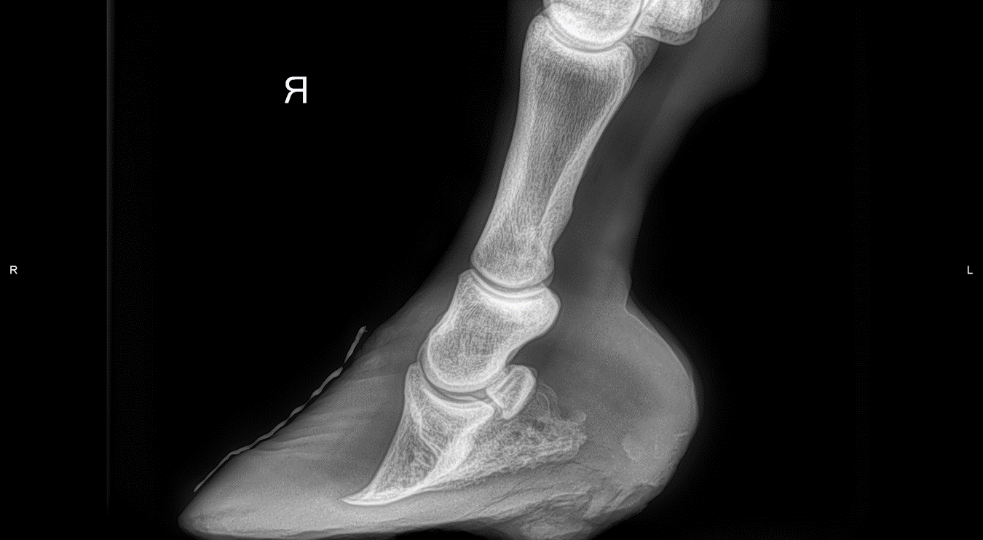
Laminitis
Notes:
In extreme cases, a horse with laminitis may develop a slipper foot – this happens because the hoof wall continues to grow at a normal rate in the heels and quarters, but is much slower at the toe, where the majority of the damage to the internal lamellae occurs. A foot that has suffered from laminitis may be rehabilitated by a skilled farrier, but that hoof will likely always be slightly weaker, and at risk of additional bouts of laminitis. Often a more frequent trimming schedule is required to help return the hoof to a more normal shape. In addition, shoes, boots, or padding may be required to alleviate some of the forces off the toe and hoof wall, and recruit the frog and palmar hoof structures in more weight bearing. And unfortunately, not all cases of laminitis are able to be saved.

Slide 22
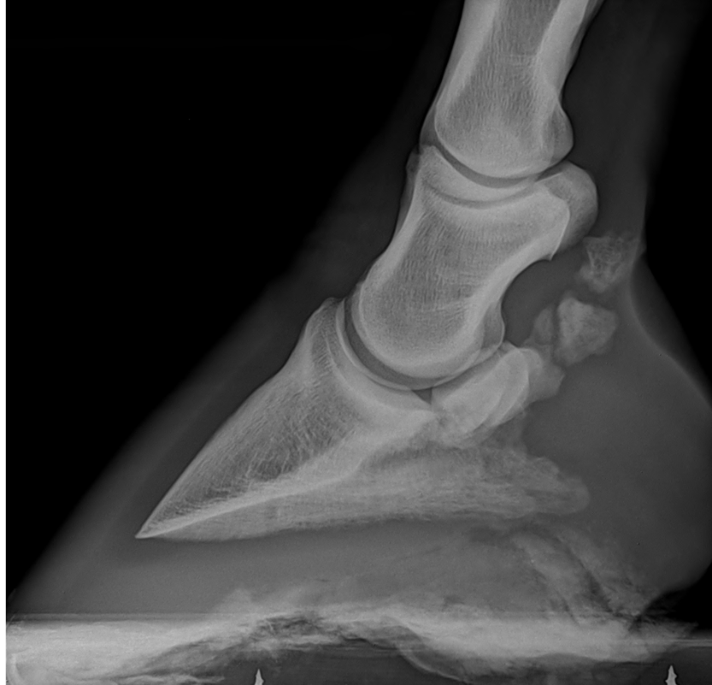
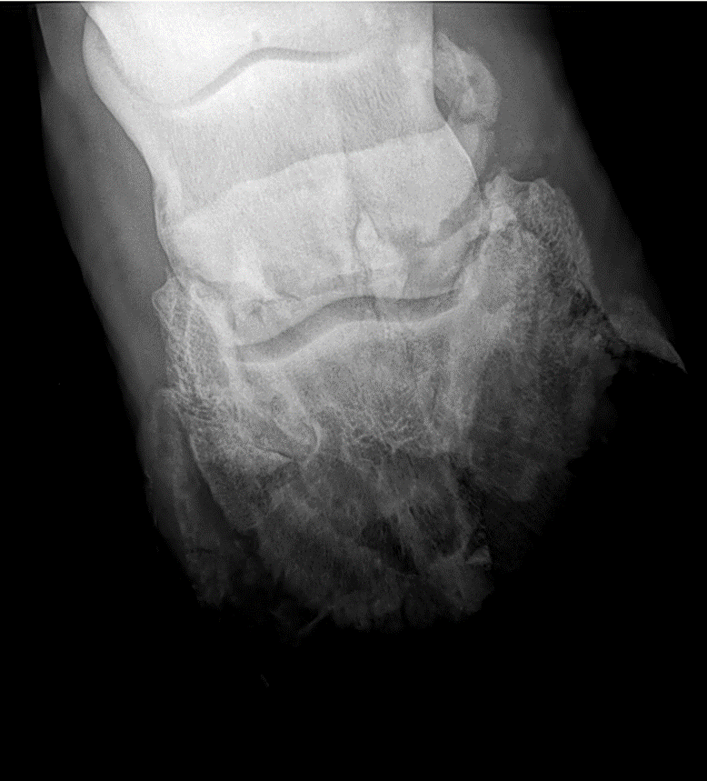
Navicular Syndrome
Notes:
Horses who suffer from navicular syndrome can have a wide variety of hoof shapes, and it may be that hoof shape and imbalances contribute to the onset of navicular syndrome. Some horses with navicular syndrome have large, flat hooves with underrun heels and long toes. Others have small, upright feet, and may even be club-footed. Again, a skilled farrier can be a great asset to these horses, but it must be kept in mind that as part of this syndrome, significant damage can occur to the tendons and ligaments in the heel region of the foot. Sometimes permanent soft tissue damage, and therefore permanent lameness, is a factor in these cases.

Slide 23
Does my horse need shoes?
Not all horses need shoes!
When shoeing to help correct a lameness problem, keep in mind that a trial and error approach often needs to be taken
  There is no ‘one shoe fits all’
  Veterinarian or farrier may suggest something, try it for a few weeks, and if not working, switch to something else
Notes:
Necessary when wear exceeds growth
Farrier will help you determine
To correct faulty conformation or gait
A skilled farrier can make just about any shoe that your horse may need – and in certain situations, special shoes may be needed. But in general, letting your farrier know what you use your horse for (and if there are specific shoes required for the discipline) and then letting him or her come up with what they think will work for your horse is probably the best approach.
In cases of lameness, your veterinarian and farrier will work together to come up with a shoe design based on radiographs and other diagnostics that will best help the horse recover and reduce his pain.

Slide 24
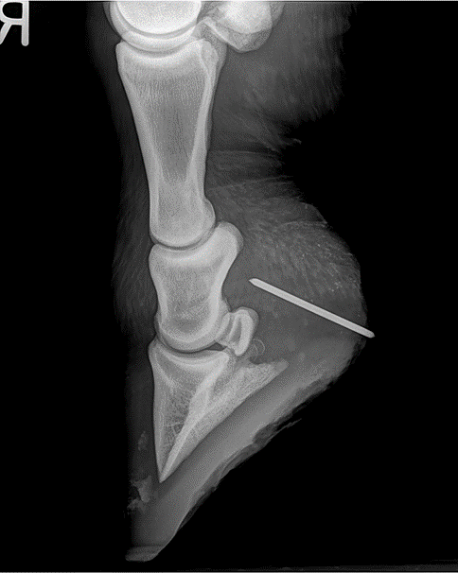
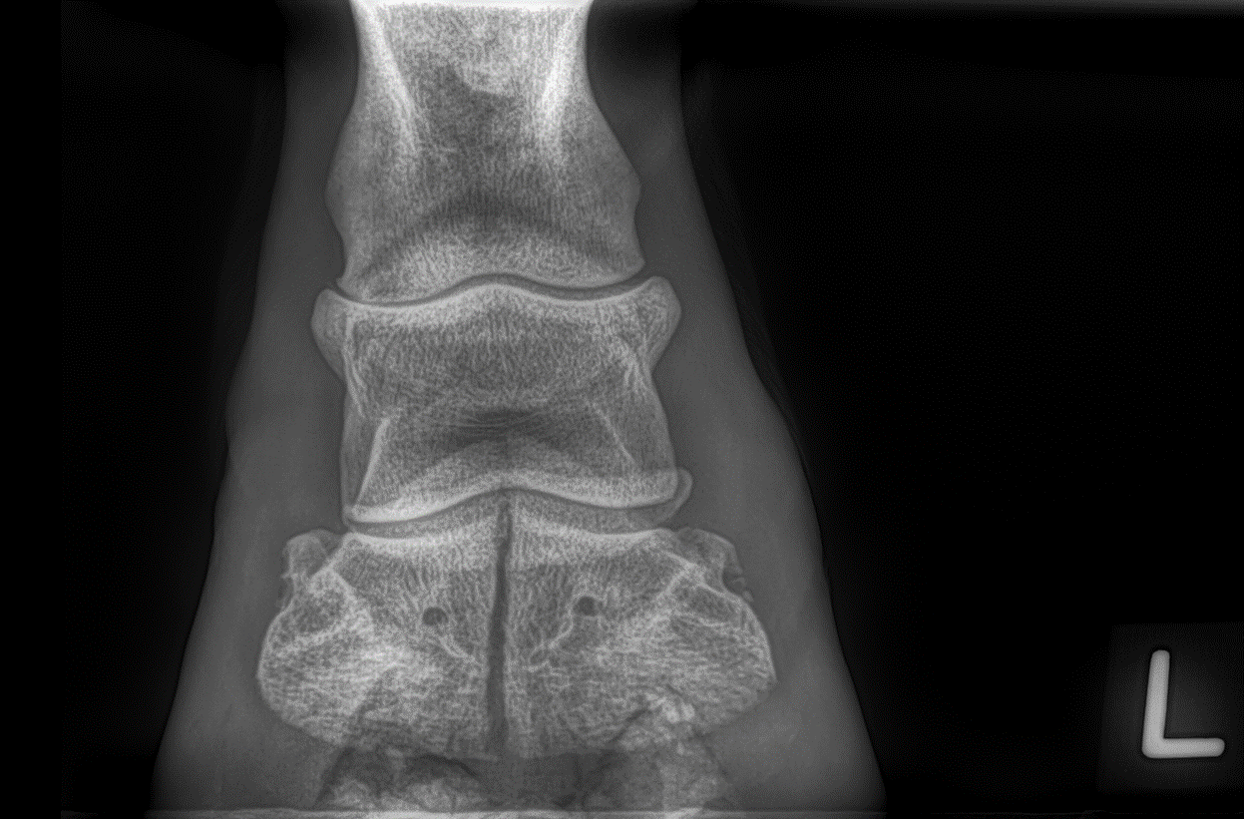
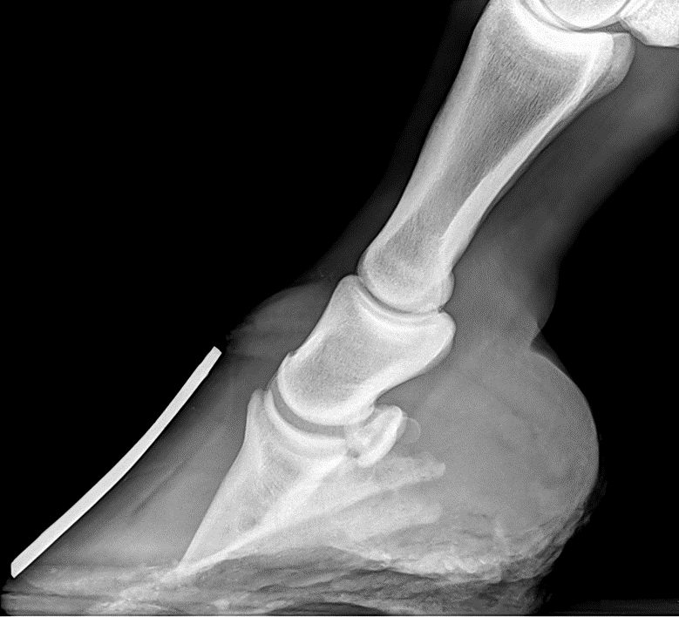
Notes:
And what’s with all these radiographs?! This is really where the farrier-veterinary relationship comes together, allowing for optimal care of your horse’s feet. Radiographs also allow us to detect and diagnose problems that we may not be able to see otherwise.
Radiographs are currently the quickest and easiest way to assess the internal structures of your horse’s foot. We cannot assess tendons or ligaments readily with radiographs, but we can assess the bones and joints easily, and based on the alignment of the bony structures within the hoof, can get a pretty good idea of how those soft tissues are being affected.

Slide 25
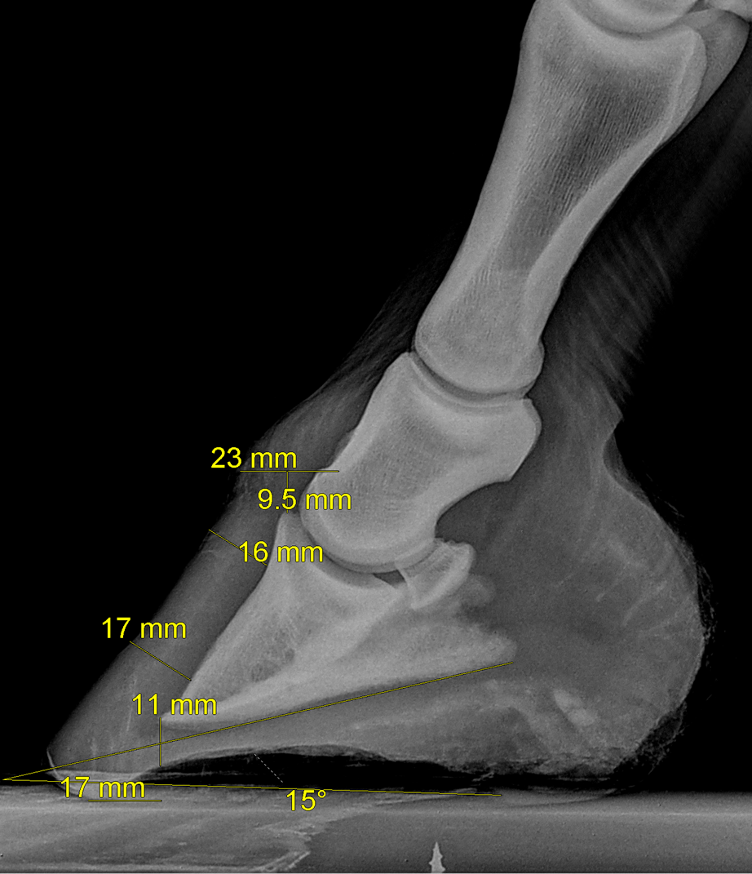
Notes:
Arguably the most useful radiograph for a farrier is the lateral to medial shot. This allows us to assess the structures from side to side, and we can perform many measurements to help assess deviations from normal, and can also to track changes over time. Radiographs are limited by the fact that they are a static (still) image, but are currently the gold standard to assess the bony column of the hoof and distal limb.

Slide 26
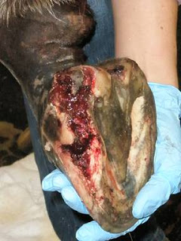
Who should I call?
Call your veterinarian in any situation where live tissue is exposed or blood is noted:
  Bleeding quarter crack
  Infected toe crack
  Abnormal growth (tumour)
  Hoof wall injury
http://hoofrecovery.blogspot.ca/2009/04/fancys-hoof-injury.html, May 1, 2014

Slide 27

Who should I call?
Call your veterinarian for:
  Any unexplained lameness
    Regardless of severity or chronicity
  Puncture wound in sole or frog
  Horse found with nail (or any other object) in foot

Slide 28
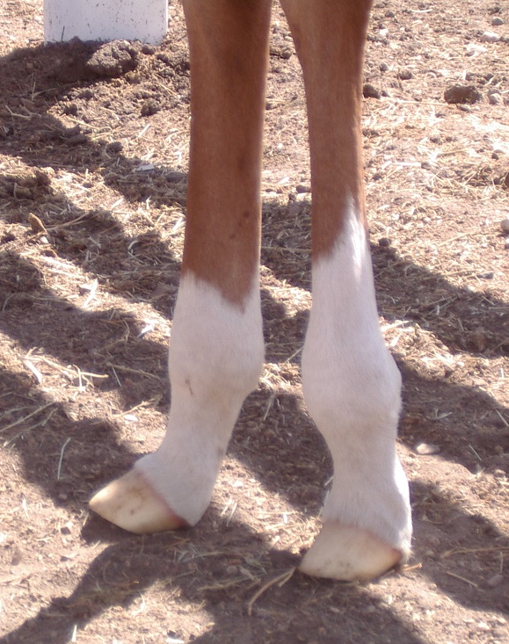
Who should I call?
Call your veterinarian when:
  Limb abnormalities in foals
    Angular deformities
    Flexural deformities
    Farrier should also be called in these cases

Slide 29

Who should I call?
Call your veterinarian when:
  Radiographs are needed
    Farrier may ask for radiographs to help assess:
      Sole depth
      Foot conformation
      Suspected rotation
      Extent of white line disease
      Solar margin fractures (may mimic sole bruising)

Slide 30
Who should I call?
Call your farrier when:
  Concern that the present shoeing or trim may be a cause or contributing factor in a case of lameness
  Lameness or disease is localized to the foot and shoeing should be part of the therapy
    Veterinarian will often call farrier on your behalf once they have determined where the problem is coming from and how they would like to correct it
Notes:
Both scenarios when your veterinarian may be involved initially, and may put in a call to your farrier to seek their help in solving the problem.

Slide 31
Who should I call?
Call your farrier when:
  Major conformational hoof abnormalities
  Extensive hoof wall defects needing repair
  Farrier input is necessary on a particular problem
    Building a shoe to treat a problem in the foot
    Building a brace to treat a problem above the foot
Notes:
Again, these represent situations where a vet may have been out to see your horse and will call the farrier on your behalf to address what needs to be done to help your horse.

Slide 32
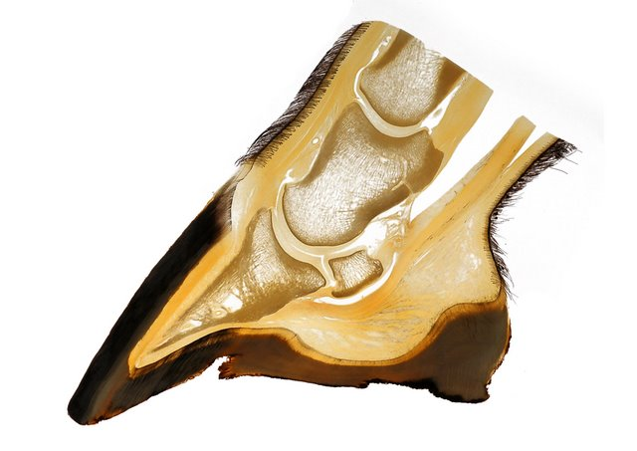
Internal Structures of the Hoof
Common digital extensor tendon
Short pastern bone
Deep digital flexor tendon
Coffin joint
Navicular bone
Coffin bone
Navicular bursa
Digital cushion
Hoof wall
Heel
Sole
Notes:
Foot – the hoof (capsule) and everything inside it:
Coffin bone
Third phalanx, P3, distal phalanx
Navicular bone
Short pastern bone
Second phalanx, P2, middle phalanx
Coffin joint
Ligaments
Deep digital flexor tendon
Common digital extensor tendon
Navicular bursa
Ungual cartilages
Blood vessels
Laminae
Digital cushion

Slide 33
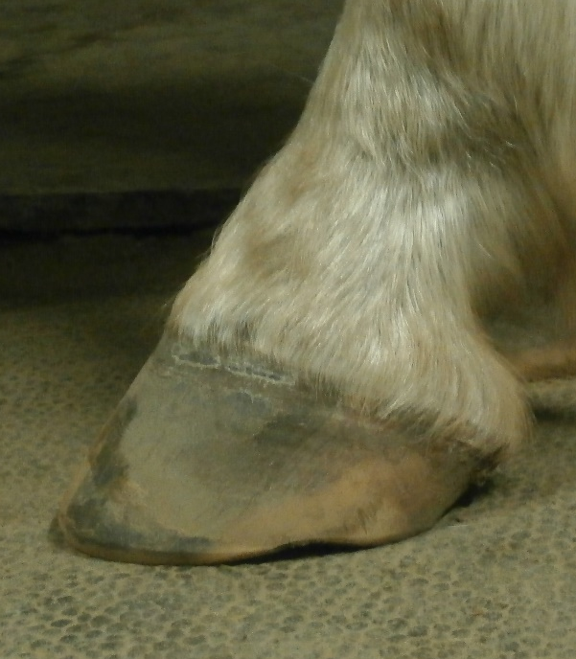
External Features of the Hoof
Periople
Heel
Toe
Quarter
Notes:
Hoof – tip of the toe of ungulates, made up of keritanized (cornified) tissue
A specialized form of skin
Similar to our finger and toe nails
Regions:
Toe, quarter and heel
Wall, white line, sole and frog
Coronet
Junction of the skin of the distal limb and the hoof wall
Also known as the coronary band
Periople
Similar to our cuticle
Attaches dissimilar structures
Skin and hoof wall
Protects the coronet
Surrounds the very top of the hoof capsule
Waxy/rubbery substance
Provides some moisture protection to the hoof wall and often parts of it will grow down with the hoof
Widens at the heel
Easiest to see on moist hooves (freshly washed and trimmed)

Slide 34
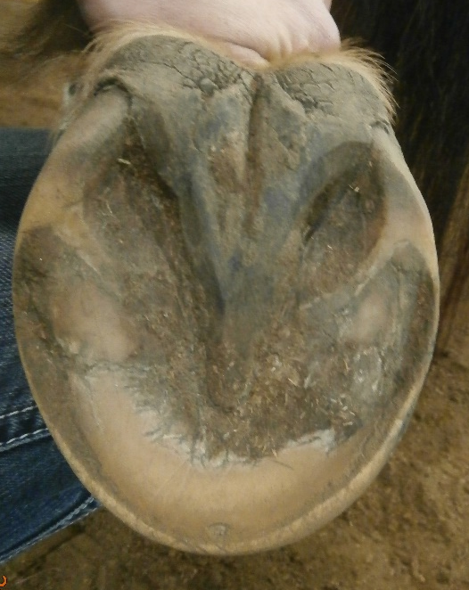
External Features of the Hoof
Heel bulb
Angle of the wall
Central sulcus of frog
Collateral sulcus of the frog
Angle of the sole
Frog
Bar
Apex (point) of the frog
Sole
White line
Hoof wall
Notes:
White line is an area marking the meeting of the sole and the hoof wall.

Slide 35
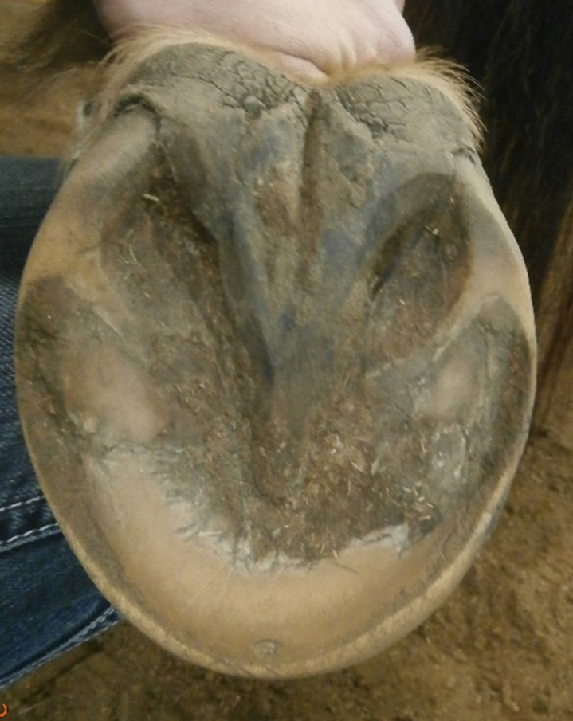
Trivia!
What part of the horse’s hoof is outlined by the circle:
  Sole?
  White line?
  Bar?
  Frog?
Bar!

Slide 36
Factors Contributing to Healthy Hooves:
Genetics
Diet
Environment
Management
Exercise
Daily hoof care
Regular farrier care
All of these factors can be influenced by you!
Notes:
Just as a bit of a recap…

Slide 37
What your vet and farrier would like you to keep in mind…
  Veterinarians and farriers cannot work miracles
  Regular maintenance is your responsibility to your horse!
    Daily picking of feet
    Paddock/environment management
    Trimming every 6-8 weeks

Slide 38
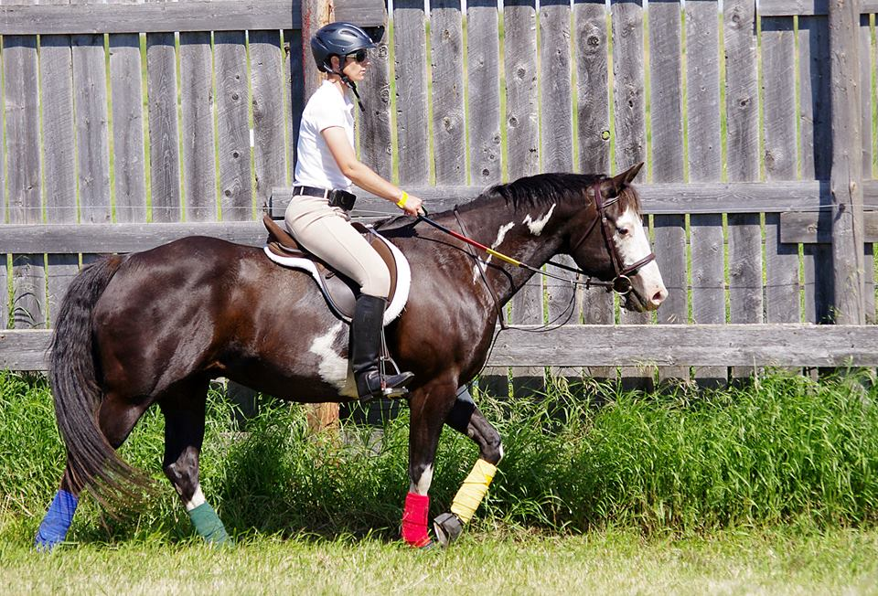
Questions?

