Slide 1

Water Management
Langley Environmental Partners Society

Slide 2
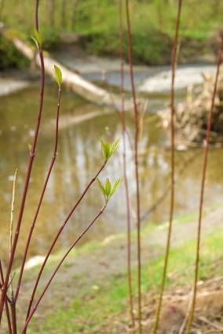
Water Management
Andrea Lawseth – Langley Environmental Partners Society
Taken from the Land Management Guide for Horse Owners and Small Lot Farmers. Available from Horse Council BC.

Slide 3
Water Management
It is vital you maintain clean drinking water for yourself and your horses by keeping manure piles and any chemical substances a safe distance from wells and domestic water sources.
Potential pollutants include nitrogen, chemicals and bacteria, which can come from animal manure or chemical sources.
Keeping animals out of streams, locating manure piles at a safe distance, and properly storing agrochemicals will help prevent any pollution problems.

Slide 4
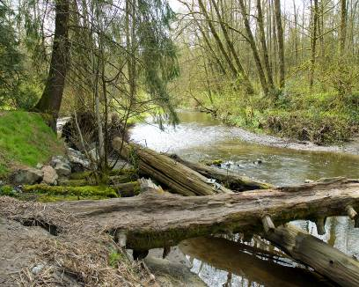
Water Management
Keeping streams and drainage ditches
clean will help sustain habitat for fish
and aquatic organisms.
When managing our animals we need
to take into account surface water including:
–creeks
–ditches
–streams
–swamps
–wetlands
–groundwater

Slide 5
The Watershed
What is a Watershed?
An area of land that catches rain and snow and drains it into waterways.
Is defined by the height of the land and the surrounding topography.

Slide 6
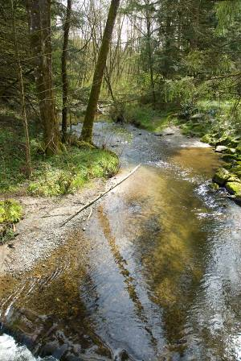
The Watershed
Collected water is received as precipitation which drains or seeps into surface water or groundwater which flows into nearby rivers and out into the ocean or lake.

Slide 7
The Watershed
Even if your property is not located near a stream or lake your management practices can still have an effect on water quality through groundwater or drainage ditches; thus it is your responsibility to manage the quality of the water that leaves your property.
Manure creates excess nitrogen can cause algal blooms and the growth of aquatic vegetation, which use up oxygen as they decompose.
Fish and other aquatic organisms breathe dissolved oxygen and require it to survive

Slide 8
The Watershed
Excess nitrates leaching into groundwater can cause health problems for humans as well, such as blue baby syndrome, cancer and other birth defects.
Identifying where the watercourses run in your watershed will help you to make appropriate water management decisions.

Slide 9
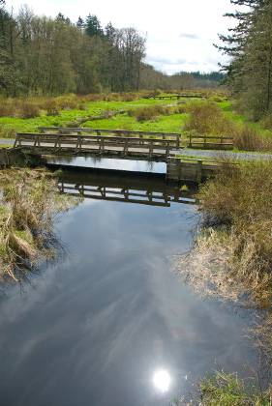
Riparian Management
What is a riparian area?
Refers to the land immediately surrounding or adjacent to a waterway or other source of water.
Should contain a diversity of indigenous trees and shrubs.

Slide 10
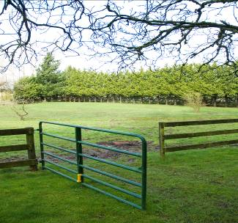
Riparian Management
Vegetated riparian areas support a very high level of biodiversity and are highly susceptible to trampling by horses and cattle.
They serve many important functions including:
Windbreak
Wildlife corridors
Shade and protection
Nesting habitats
Filtration for runoff
Provides food supplies

Slide 11
Riparian Management
How do I manage my riparian area?
Signs that indicate damage to riparian areas:
Reduction in the number of saplings and the reduction in plant height
Pugging (hoof tracks left in the soft soil) or hummocking (soil that has been pushed up by pugging due to trampling near the watercourse)
Manure or urine in watercourses could lead to riparian area damage

Slide 12
Riparian Management
To eliminate detrimental impact on riparian habitat:
Use alternative water sources to reduce trampling of vegetation and pugging of soil.
Provide salt, mineral and supplemental feeds away from the riparian areas to reduce the risk of water contamination.
Fence off the riparian area completely to provide a vegetative buffer for pasture run off.

Slide 13
Riparian Management
Avoid soil erosion by:
Use of buffer strips to protect land if the area is prone to flooding.
Providing limited access points with better footing (ie: gravel)
Providing shade (ie: a roofed shelter or treed area) beyond the riparian zone to draw livestock away from the sensitive areas.

Slide 14
Riparian Management
Four good reasons to restrict livestock access to riparian areas:
Prevents drowning during periods of high flow
Prevents foot rot to less loitering in muddy streams
Maintains healthy water quality for aquatic organisms and livestock
Prevents erosion by protecting stream banks from pugging

Slide 15
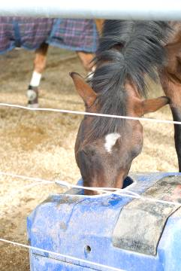
Livestock Management
What type of watering systems are available?
Solar powered pumps
Sling pumps
Water Harvesting Systems
Gravity fed pumps
Nose pumps

Slide 16
Livestock Management
Solar Powered Pumps
Use photovoltaic solar panels as a source of energy
Solar panels convert sunlight to DC electricity, which operates the pump and delivers water to livestock watering systems.
Sling Pumps (or Flow of Stream pumps)
Use water current as a source of energy
Continuous pumping action during 24 hour period compensates for slow flow rates. Water storage may be required to meet the full needs at certain times throughout the year.

Slide 17
Livestock Management
Water Harvesting Systems
Use stored rainwater as a source of energy
Utilizes storm water runoff. Must be filtered to meet drinking water standards.
Gravity-Fed Pumps (or flow through livestock waters)
Uses gravity-pressured water supply as a source of energy
Constant flow of water prevents the formation of ice. Can be some water waste. Water should be stopped when not required by animals and outflow contained.

Slide 18
Livestock Management
Nose Pumps
Uses a diaphragm pump as a source of energy
Animal pushes a lever with its nose and delivers about one liter of water
Water can be lifted up to 8 meters. One pump can provide water for up to 30 horses. Fully enclosed, which prevents pollution, ice formation and disease transmission.

Slide 19
Livestock Management
Locate the watering system at least 30m away from watercourses and wells
Situate the system away from feeding areas to encourage manure distribution
Provide a firm base (concrete or rubber mats) around watering area to prevent muddy soil conditions
Ensure adequate drainage for spillage and overflow
Check system for leaks regularly and other mechanical performance

Slide 20
Livestock Management
How should water be managed in a confined livestock area?
Confined livestock areas include feedlots, paddocks, corrals, exercise yards and holding areas.
Regulations state that these must be at least 30m from the high water mark from any watercourse or wetland. Livestock may not have access to any natural watercourses or riparian areas.
Any contaminated runoff from a confined livestock area must be contained and managed as manure.

Slide 21
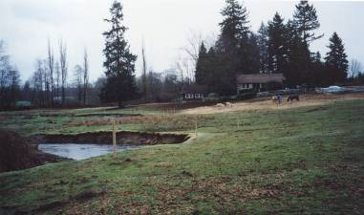
Livestock Management
How should water be managed in a seasonal feeding area?
Seasonal feeding areas are locations that support livestock feeding operations for part of the year and may produce a crop.
Livestock waterers are encouraged in these regions.

Slide 22
Livestock Management
How can I feed our animals to limit water pollution?
Controlled grazing in riparian zones can prevent streambank damage in wet weather and maintain vegetation.
Locating feeding sites where the ground slopes away from the watercourse and at least 30m from waterways and wetlands will further prevent damage.
Move livestock feed and supplements around the pasture to evenly distribute manure and reduce loitering near streambanks.

Slide 23
Livestock Management
Four good reasons to keep manure out of water:
Prevents the spread of pathogens to other livestock, farms and people.
Prevents water contamination and unpalatable water sources.
Prevents algal growth, which depletes the water of oxygen.
Prevents ammonia contamination in watercourses.

Slide 24
Storm Water Management
Why should I manage my storm water?
Storm water management is important in areas with high rainfall as barn, house and other building roofs can collect large amounts of muddy water that can run off to the ground.
One inch of rain on a 20ft by 50ft barn roof can produce up to 2347 liters of water, which is the equivalent to one and a half average-sized hot tubs.

Slide 25
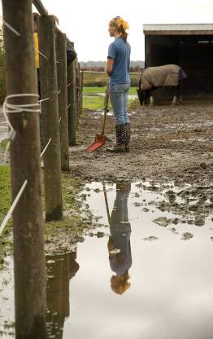
Storm Water Management
Mud can cause a multitude of health problems such as foot rot and thrush.
This water should be directed away from high use areas in order to reduce mud.
Plastic pipes can be used to direct water away from animal confinement areas to places that are more easily drained.

Slide 26
Storm Water Management
When land drainage is a serious concern, drainage management features can be installed, such as French drain lines or drainage tiles.
Grassed waterways, water bars, ditches and dry wells can also be created to prevent water pooling. Planting native trees and shrubs or other water-loving species, such as willow, cottonwood and red osier dogwood can help to “soak up” some of the water runoff and prevent siltation and contamination of nearby watercourses.

Slide 27
Ground Water Protection
Why Should I protect groundwater?
“Groundwater” refers to the water that infiltrates through the ground and accumulates in the underground bodies called “aquifers”
Groundwater can resurface in wetlands and floodplains as springs and percolate into streams to be pumped by wells to the surface
Many landowners depend on this water for drinking purposes so it is important to ensure that it remains clean

Slide 28
Groundwater Protection
To safeguard groundwater against pollution there are a number of ways you can protect it.
Determine where your well is in relation to your manure pile, grazing areas, drainfield, etc
Keep Livestock away from the wellhead – heavy animals can damage the drainfield by compacting soils and damaging buried pips
Divert surface water away from the wellhead

Slide 29
Groundwater Protection
Locate your manure pile at least 30 m away and downhill from the wellhead
Test well water annually for fecal coliform bacteria and nitrates.
Avoid leaving hoses immersed in contaminated stock tanks to prevent backflow.
Fence off the septic field area to avoid the spread of diseases by grazing livestock

Slide 30
Soil Erosion Control
How do I control soil erosion?
Soil erosion is a serious concern in all areas of the Province. Whether you live in wet climate that suffers from soil runoff or a dry climate where wind dispersal is a concern, soil loss is an issue we all need to deal with.
Soil can sluff into watercourses and cause siltation problems. Sild can cloud the water so that fish are unable to see food sources, smother trout and salmon eggs and cover spawning habitat.

Slide 31
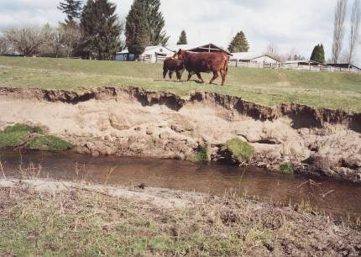
Soil Erosion Control
Minimize these effects of soil erosion through the use of buffer strips, shelterbelts or hedgerows.
All of these buffers that are planted at the edge of the pasture to reduce the risk of wind or water runoff.

Slide 32
Soil Erosion Control
Buffers can also provide potential income if saleable crops such as raspberries or fruit trees are planted
If you are looking for aesthetic benefit then grasses, flowering shrubs and trees, floral plants and ornamental plants can also be planted
The width of the buffer zone will be dependent on the slope of the field, the soil type and the density of the species you choose to plant

Slide 33
Soil Erosion Control
Some of the advantages of a buffer zone include:
Filters mud, manure, pesticides and bacteria out of water flowing across or through the air
Improves infiltration of water into the soil
Provides food and cover for wildlife
Protects land from erosion caused by water and wind
Creates an attractive landscape
Can save on fence installation and repair

Slide 34
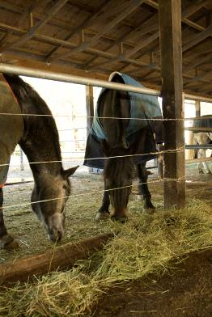
Chemical Handling and Storage
Manure and agrochemicals are not the only pollutants present on small farms. Animal medical waste and petroleum products are often prevalent and ignored when it comes to land management.

Slide 35
Chemical Handling and Storage
Animal medical waste must be disposed of in a responsible and safe manner
Grind them down or destroy syringes and needles to eliminate chances of puncture, then package and pack the sharps in a rigid container
Both needles and syringes should also be boiled for 5 minutes or soaked in disinfectant before disposal

Slide 36
Chemical Handling and Storage
Other medical supplies, medicine bottles and old medication should be taken back to the supplier or pharmacy for disposal as these can have serious consequences on aquatic organisms if they are allowed in the sewage waste system.
Used medication should never be added to your manure or compost piles

Slide 37
Chemical Handling and Storage
How do I safely use and dispose of petroleum products?
Fuel tanks should be maintained to avoid any pollution to the surrounding environment.
Tanks should be equipped with anti-siphoning devices included in discharge unless there is already a self-closing nozzle
Drains must be lockable and in a closed position at all times if not being used
Drips, leaks and over flow should always be avoided when dispensing fuel and care should be taken when filling the tank to prevent any overflow

Slide 38
Chemical Handling and Storage
Storage tanks must be built with accepted engineering practices and may include a concrete, diked storage area
Tanks must be located away from yard drains and set back at least 30m from any watercourse or ditch
Tanks should be well protected from direct collision by farm vehicles
When disposing, all excess petroleum products should be brought to an appropriate hazardous waste facility in your area

Slide 39
Congratulations!
You have completed the Water Management Online Course
To purchase the Land Management Guide for Horse Owners and Small lot farmers
Visit the HCBC bookstore at
www.hcbc.ca

