Slide 1
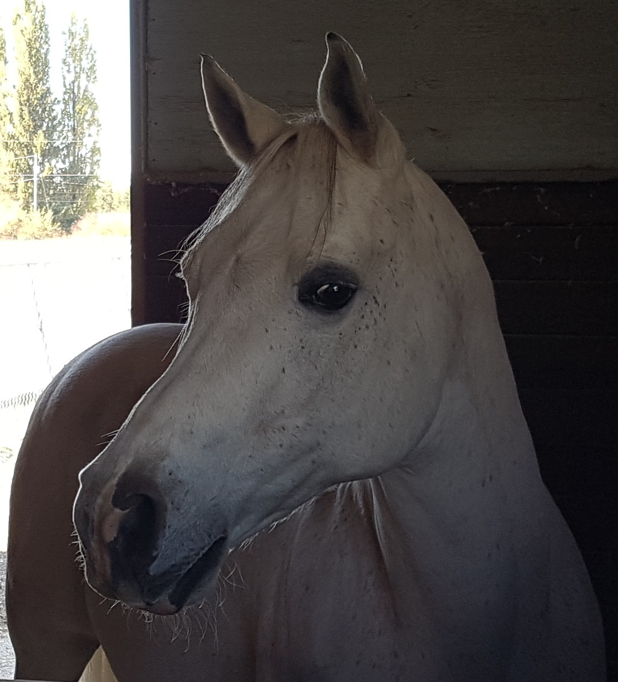

Slide 2
Forage and Hay Analysis
Maximize forage intakes at all times.
The digestive tract is designed for many small meals of forage high in fiber. The fiber is fermented in the hind gut providing energy for the horse in a safe, consistent, steady manner.
Horses evolved to graze as much as 16-17 hours a day, walking 10-12 miles (or more) a day
Forage can provide all the energy and most of the other nutrients .
Forage ensures water is held properly for nutrition and gut digestive function and health .
Horses eat 2-2.5% of Body Weight as hay or average pasture.
.
Pasture intakes can vary greatly use caution with spring or fall grasses. Horses can eat 3-3.5% of body weight as lush spring grass and ponies can eat 5.0% of body weight.

Slide 3
Forage and Hay Analysis
If more energy is needed use better hay . If still more energy is needed, concentrates may be used but keep a minimum of 1.5% forage in the diet and use a maximum of 1.0% concentrates per day.
Note –horses have no brakes on energy intake.
Forage analysis will tell you if you are meeting the NRC (National Research Council) requirements for nutrients.
Most horses can get all the energy they need for maintenance and light work from hay and pasture. Forages are low in some nutrients that need to be provided by the owner. These may include the protein, and usually phosphorus and trace minerals. Unless you feed green grass essential fatty acids and vitamins are probably deficient.

Slide 4
Maximize forage
Forage for chewing and saliva production
Horses drink more water with forage ‘
Forage adds ballast
Prevents colic.
Overall gut health - fluid reserve
A significant supply of electrolytes
Mental well being.
Promotes a healthy biome.
Prevents leaky gut.

Slide 5
Horses need set amounts of nutrients every day-defined by the NRC forage analysis can tell us nutrient levels in feeds.
Energy is not a nutrient it is the life force provided by nutrients in feeds
Forage analysis For like the fiber , sugars and starch and fat which provide energy plus protein, major minerals like cal phos and micro minerals , i.e. Trace minerals like copper, zinc, manganese and selenium.
Fat soluble vitamin levels (A,Dand E) in fermented forage or in cured hays discounted because of sunlight damaging vitamins and oxidative loss in storage .
Provide A least NRC minimum nutrients possibly more in stress or unusual circumstances
Good forage intakes under low stress may allow bacteria in the hind gut to produce adequate B vitamins.
Anything like ageing , stress/ ulcers, infections, parasites etc that ramp up metabolism eg excess cortisol from PPID, may increase Nutrient requirements.

Slide 6
Energy Needs Must Be Met First
The NRC provides us with guidelines for amount of energy needed for maintenance and various work loads. The energy is measured as Mega Calories (Mcals) of digestible (usable) energy, DE, needed per day. Horses will sacrifice other tissues to ensure brain function.
Forage analysis allows us to determine if we need more nutrients from concentrates. Most horses at maintenance or light work can derive all the energy they need from forage.
The environment and stress plays a major role in determining energy needs.
Age and Ageing (inflammageing) is also important
Genetics play a major role

Slide 7
Excess energy is stored as fat.

Slide 8
Obesity-excess energy id stored as fat
Surveys show levels of 50% or more.
Fat depots become metabolically active. Eg TAC new. Low grade inflammation.
Feed for BCS 5.
Endocrine issues occur long with oxidative stress. ID
Body fat vs colic vs ovary issues
Mechanical load

Slide 9
The NRC for Horses

Slide 10
NRC Micro Nutrients

Slide 12
Hay Types
Our cool season grasses store energy mainly as fructans in the leaves and stems and roots. Levels of sugars like fructans can vary greatly . There is no practical upper limit e.g 40-50% NSC
Grass hays are modest for calcium. Grass hays are low phos and most trace minerals are lower than requirements for even maintenance. Manganese and zinc are very low on glacial till soils . Copper is low in wet acidic “muck” soils.
Selenium in certain areas is a special case. Usually low (<0.1ppm) re alkali disease- especially grey wooded soils but some pockets of higher levels in the interior. Low rain fall tends to keep it in the upper soils layers . More subject to soil moisture and organic matter of soils.
Because of low rainfall from the sea in Nelson, iodine is also a concern. Rain shadow efects in hays from interior.
High rainfall removes calcium and phos in fact creating a reverse ratio where calcium may be lower than phos.
We assume most trace minerals are low in local hays and pastures. Dairy manure will move values up. Potassium may be very high with manure re HYPP. Iron can be very high in forages grown here or imported.
Energy may be low to quite high.
AND MOST VITAMINS ARE LOW in hays. Do not rely on hays for vitamins and omega three fatty acids .
EG -EMND.

Slide 13
Legume hays
Alfalfa stores it energy as starch. There is an upper limit to NSC , often lower than cool season grasses for NSC.
High protein
High calcium
Ideal for ageing or growing horses, lactating mares , hard working horses. I do not train endurance horses on alfalfa but use some during the race.
Consumed at higher levels than grass hays.
A natural buffer

Slide 14
Sampling Forage-use a hay probe

Slide 15
Sampling Hays
Do not use a grab sample
Sample a minimum of 10 bales from small lots randomly chosen.
Insert the probe 12-18 inches straight in from the end of the bale.
Seal immediately in a zip lock bag and send it to the lab. Freeze if possible.

Slide 17
Lack of fiber-the unique stomach

Slide 19
NRC
Horses need set amounts of nutrients per day.
The NRC assumes horses will eat 2.5% of body weight for heavy and very heavy exercise , lactating mares and growing horses .
And 2% of BW for all other classes on dry matter basis.
Minimum maintenance is for horses with a sedentary lifestyle, due to either confinement or to a docile temperament .
Average maintenance applies to adult horses with alert temperaments and moderate voluntary activity.
Elevated maintenance applies to adult horses with nervous temperaments or high levels of voluntary activity.
If energy must be decreased to reduce excess body condition , other nutrients still need to be maintained for the function or work.

Slide 21
Interpreting analytical results
The first number is DM/moisture.
Purchase hay at less than 15% moisture.
Hays tend to increase in moisture with storage on the west coast. Hay under 10% moisture may be dry and dusty causing choke or COPD
If border line high in moisture, Stack on pallets no higher than 4-5 bales high. Use space between stacks for air circulation. Tarp .
Hay over 15% moisture can mold and 17% moisture hay has a high chance of molding and 25% may be a fire hazard. I have seen hay testing 13.8% moisture in the fall eventually start to smoke in the spring.
The mouse story C.Botulinum
And listeria
Mold affects nutrient content, contains toxins, and mold spores affect respiratory function.

Slide 22
Determine digestible energy level of the hay-DE / kg in Mcals per KG
Do normal hay intakes at the DE indicated for the hay match the horse’s needs?
Horses have virtually no regulation on energy intakes. They eat to maximize energy intake per bite. Given the opportunity they will over consume energy. Surveys show 45% or more of horses are obese.
Calorie level relates to forage maturity which affects levels of fiber and digestibility of the fiber.
ADF is a good indicator of energy level
NDF is a good way to estimate intake level.
Fiber digestion which is controlled by lignin levels.
Horses eat more hay as cubes
Horses do not chew coarse hay better.
The senior horse over 21

Slide 23
Hay Analysis –Protein level vs Quality (amino acid composition)
CP is N x 6.25 =crude protein.
Grass hays range from 6-14% CP. If a grass hay is quite high in CP (18-20%) it may not be ALL true protein. Consider asking for nitrate levels . Nitrates are less harmful to horses than cattle but I suggest
Max 0.2% nitrates for mature horses .
Max 0% for broodmares and foals.
ADICP- (acid detergent insoluble nitrogen crude protein ) is protein bound up with the lignin due to heat damage and less available for digestion. I assume 70-100 % ADICP is not digested. Discount anything over 30% of the ADICP and subtract from CP.
Lysine has arequirement in the NRC.
It is one of ten essential amino acids that must be present for protein to work. Muscle, ligaments and tendons require proper lysine. Other essential amino acids have various functions. We add the amino acids lysine, methionine and threonine based on recent research. Labs will calculate the lysine in hay or we can give you values.

Slide 24
Fiber levels-the cell walls / structural tissues in plants formed from cellulose and hemicellulose and Stiffened with lignin. Fiber is fermented by bacteria in the cecum and large colon. Lignin lowers digestibility. Excess levels of lignin lower energy, increase risk of colic and ulcers and reduces digestibility.
Fiber – The horse relies on hind gut bacteria to break it down through fermentation producing VFA’s a prime energy source for horses. Bacteria cannot digest lignin.
ADF =acid detergent fiber=cellulose plus lignin . As forage matures lignin is added reducing digestibility.
Values of 30-35% are acceptable for horses. ADF determines energy level. ADF Values over 45% are not digested.
NDF=neutral detergent fiber includes ADF and hemicellulose plus other components like pectins and soluble carbohydrates that must be fermented for energy.
NDF is used to calculate intakes. 40-50% are good. Horses likely will not eat hay over 65% NDF which also indicates impaction colic and digestive issues.

Slide 25
Special considerations Seniors minis Colic Consider cubes or hay and pasture stretchers.
Alfalfa –
Stage ADF NDF
Pre Bllom <30 <35%
Early Bloom 30-35 35-39
Mid-Bloom 33-41 41-47
Late Bloom >41 >48
Grass
Stage ADF NDF
Pre Head <25 <55
Early Head 30-35 56-61
Head 36-44 60-65
Post Head >45 >65

Slide 26
Hay Analysis-Carb fractions
ESC =all true simple sugars such as sucrose, glucose and fructose. These are digested in the small intestine and directly affect insulin levels.
WSC = water soluble carbohydrates , this includes the fructan fraction and the simple sugars (the ESC).
An estimate of fructan levels is WSC-ESC=fructans
High Fructan levels are an issue because they are fermented in the hind gut producing lactic acid. Very high levels can cause hind gut acidosis, and leaky gut, possibly leading to inflammation and laminitis.
Starch plus ESC directly affect insulin.
10% DM for PSSM horses , PPID horses or laminitis prone horses or horses with insulin dysfunction
NSC =All non structural carbohydrates =non fiber cell contents=WSC + Starch.

Slide 27
Hay Analysis-Carb fractions
NSC= Keep levels below 10% DM for PSSM horses , PPID horses or laminitis prone horses , horses with active laminitis, horses with insulin dysfunction and endocrine issues. Horses with less serious endocrine issues may tolerate 12% NSC with insulin monitoring.
Some experts suggest ESC plus starch less than 10% DM for Insulin Dysfunction and fructans do not matter? This has not worked for me. Follow your vet’s advice.
Grass hays are 7-18% NSC average 12%, but vary greatly with high levels of fructans possible . Grasses concentrate fructans in the leaves and stems, especially the crown and rhyzomes. Avoid grazing below 4in.
Legume hays average about 15% NSC and do not get overly high in NSC’s They store energy as starch in leaves.
Oat Hay average 22%. NSC. Note hay/oat stubble can be very high in NSC’s.
Young plants tend to be higher in NSC , mid bloom grass is lower in sugars and very mature grass can be very high in fiber and very low in sugars.
Very coarse hays will be unpalatable and may cause impaction colic and gut issues. Very coarse forage can cause diarrhoea, fecal squirts and ulcers. Senior horses are at risk with coarse forages.

Slide 28
Hay Analysis-Carb fractions
Starch is usually fairly low in grasses. Grass hays are 7-18% NSC average 12%. Legume hays average about 15% NSC and Oat Hay avg 22%.
Young plants tend to be higher in NSC , mid bloom grass is lower in sugars and very mature grass can be very high in fiber and low in sugars and actually will be unpalalatable and may cause impaction colic and gut issues.
Grasses from hay cut in the morning if night temperatures are above 40F will be lower in NSC while hay cut later on a sunny day may be high in NSC. Weathered hay will be lower in NSC. Grass stressed from sudden drought, or frost may be higher in NSC
Grasses can vary from 15% in the AM to 30% in the PM .Some show 40-50% NSC’s DM . Complicated by high pasture intakes . Levels relate to photosynthesis and light intensity.
Soaking may help lower NSC levels but is variable.
High NSC hays can be mitigated by dilution with pure soy hulls or no molasses beet pulp .
Slow feeders and grazing muzzles may help . Limit feeding is tricky and may not work .

Slide 29
Hay Analysis-Carb fractions
Keep total NSC below 10% for metabolic or endocrine issues . I have seen laminitis in ponies with ESC and starch less than 10% dry matter on free choice pasture but higher NSC.
Other experts feel only ESC plus starch need to be below 10% dry matter as these components directly affect insulin and fructans do not matter. They may suggest 13% NSC is fine for horses with insulin issues if ESC and starch are below 10%. Work with those experts if you feel comfortable with using that approach. I suggest you use dynamic analysis for insulin .
The fructans may not directly affect insulin initially but will affect the biome at high levels and may have other effects . Watch manure quality and gut issues.
NSC: 10-15% is low, 15-20% is medium and 15-20% a safe maximum. NSC over 20% NSC may cause digestive issues for trim horses with no endocrine issues. These are only workable if insulin is kept in line. Horses with obesity , behavior or metabolic issues may need lower NSC levels. Ponies and minis should not be fed very coarse fiber diets.
Pasture dry matter intakes or intakes of rich soft hay may be very high compounding the problem of high NSC levels. Pasture also allows selection so horses with endocrine issues should not be on pasture.

Slide 30
Too much NSC

Slide 31
PAL =50% of all cases , associated with high NSC levels. Endocrine related HI central but not the only factor The enetero insular axis and GLIP-2-new
Spring pastures can be very high in NSC.
Recent research using spring pasture showed large numbers of genes are turned on and off, many of which control inflammation and possibly the MAPK metabolic pathway. NSC levels were high in the grass. Is it just NSC?
Feeding over 20% NSC from “ready grass” (rye grass) in the following winter to mimic high NSC Pasture did not result in a match for the genes turned on and off during spring grazing.
Pasture Laminitis involves more than just the effects of high NSC in spring grass . The genes turned on may be inflammatory or oncogenic. Horses with a history of laminitis may not do well on grass.
Insulin is not needed by lammellar tissue. However, Insulin has many effects possibly through IGF-1 and mitogen effects stimulating the MAPK system. . Hybrid insulin and IGF-1 receptors can be found in lamellar tissues.
There is a circulatory effect of insulin . Insulin controls the NO system for vaso dilation . The bounding pulse in laminitis does occur.
Also, biogenic amines can be absorbed from the damaged hind gut which may complicate or trigger the laminitis. FLS and the mechanical effects also complicate matters.

Slide 32
The future –feed for insulin function.
The principle pathophysiological theory is that insulin is acting directly through the stimulation of growth factor receptors all of which activate MAPK and other signalling pathways. High insulin or insulin dysfunction is key to understanding laminitis.
The IGF-1R gene transcript is more abundant in the lamellae than the insulin receptor.
New-There are also insulin/IGF-1 hybrid receptors another binding target for insulin in the lamellae.
Signalling proteins downstream of the IGF-1R are activated in the lamellae during hyperinsulinaemia possibly allowing treatments if this is the mechanism.
Other factors like low plasma adiponectin and high serum basal insulin or insulin post dexamethadone concentrations could be used to identify increased risk of laminitis before the disease occurs.
Very recent research shows the incretin effect may be an important factor related to high production of GLP-2 which has receptors in lamellar tissue. In fact it may be an underlying mechanism stimulating insulin production in horses.
The GLP-2 causes an increase in the absorptive capacity for glucose of the small intestine. It may be a target for control measures for horses prone to insulin dysfunction.

Slide 33
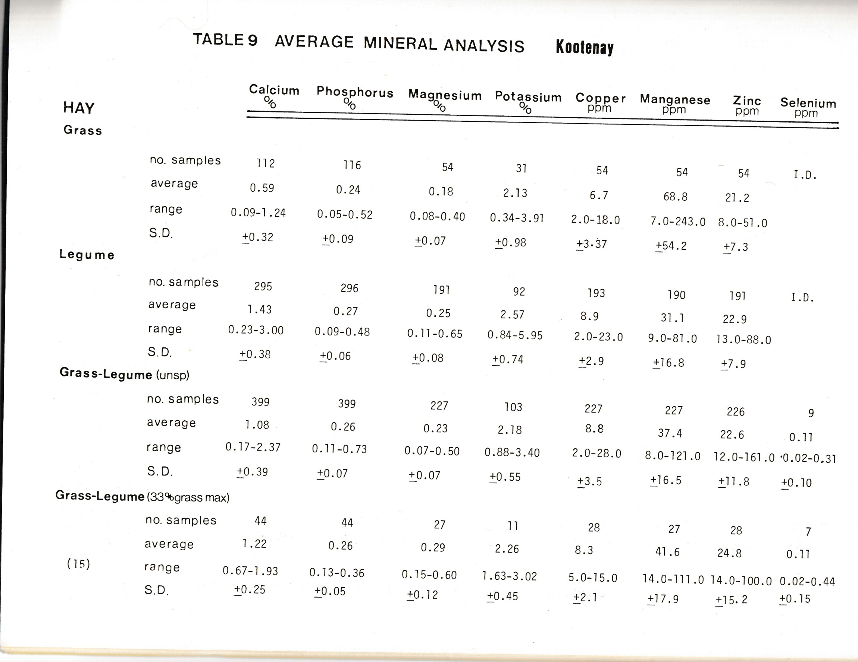

Slide 34
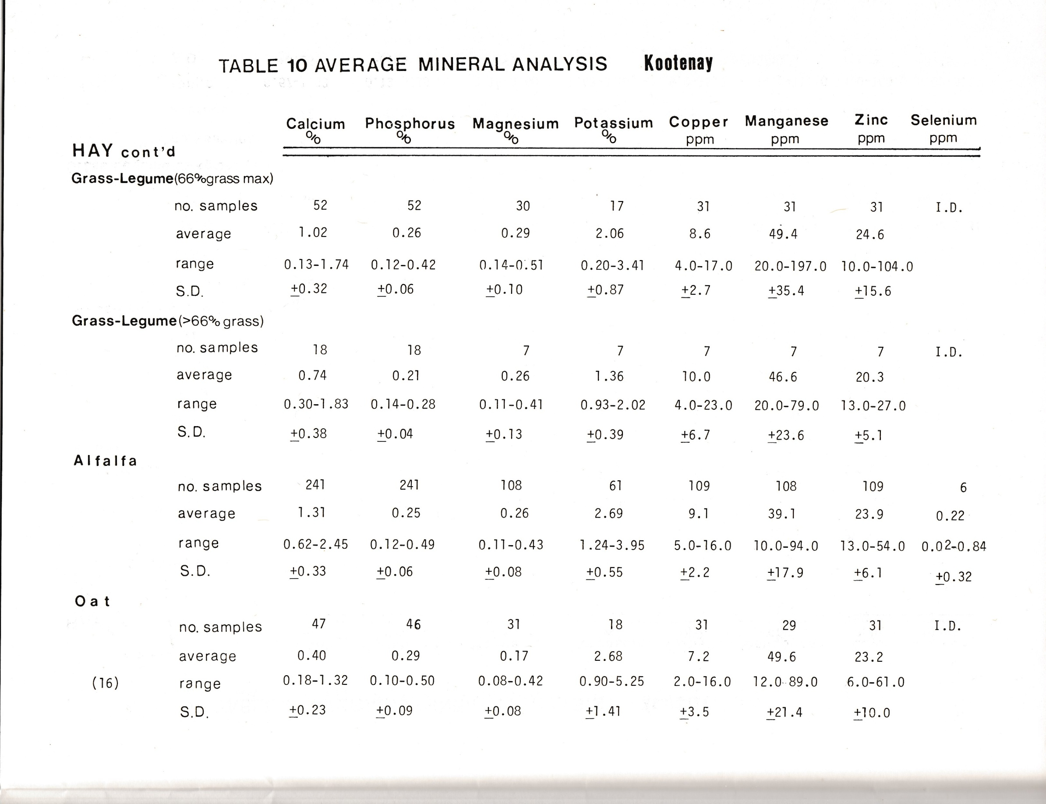

Slide 35
Maximize Hay
Evaluate how hay meets NRC requirements fed at approximately 2% body weight or predicted intakes.
Predicted intakes are 23.6 lbs per day in example.

Slide 36
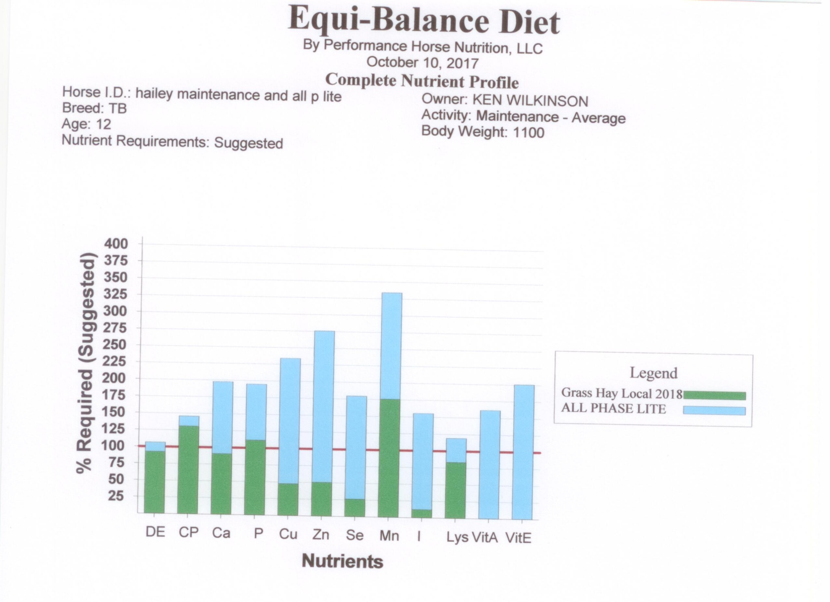

Slide 37
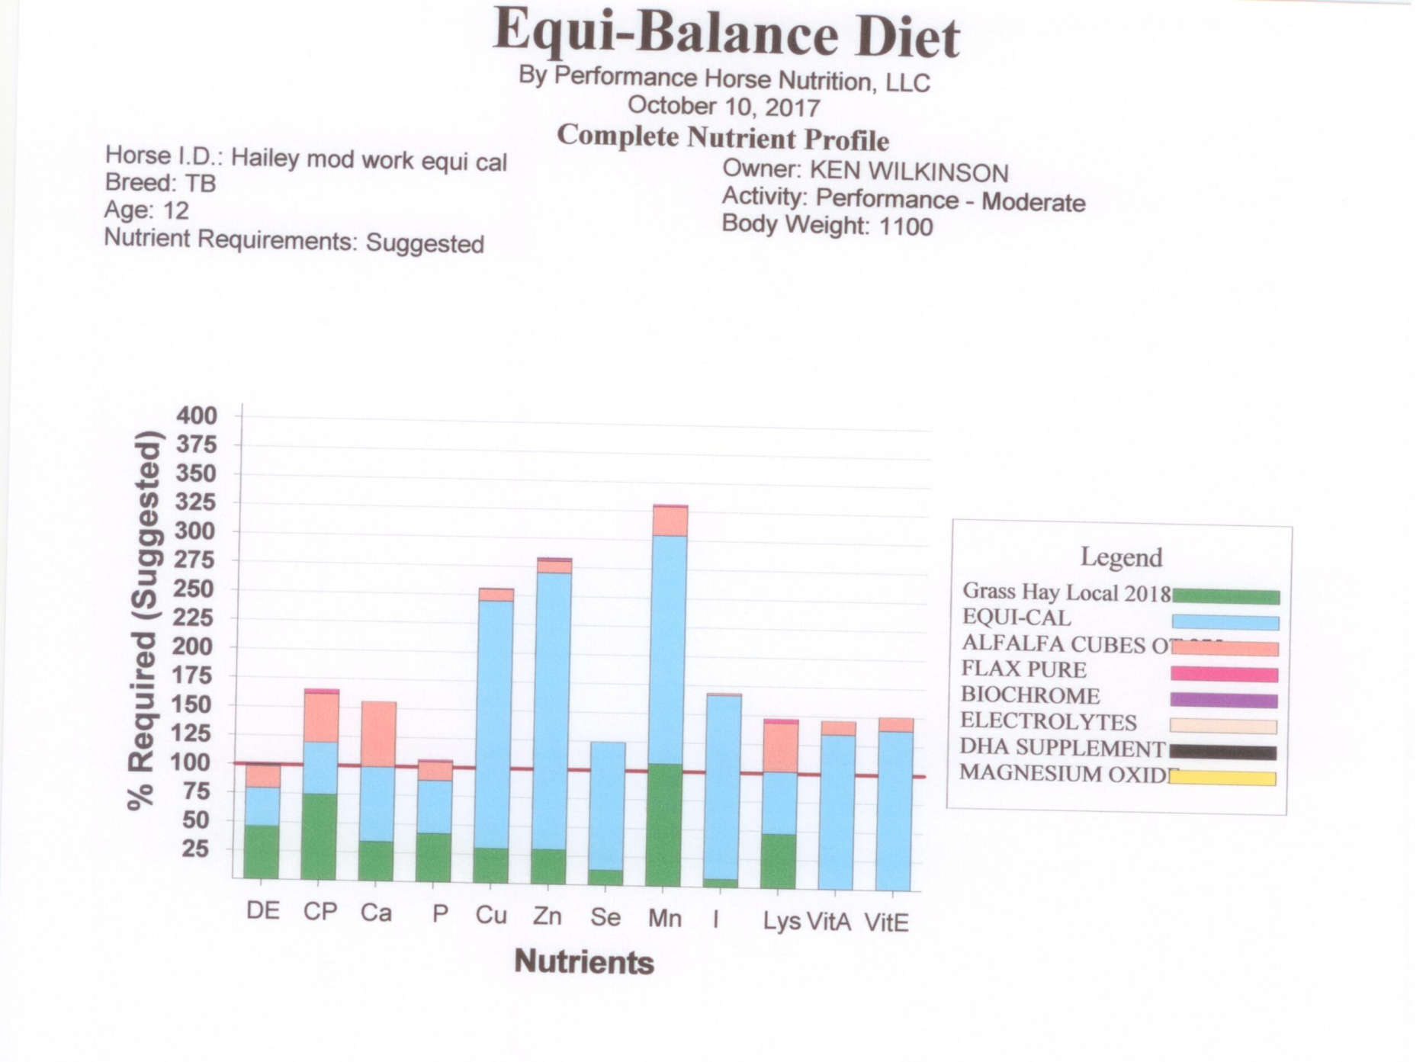

Slide 38
Selenium levels Okanagan

Slide 39
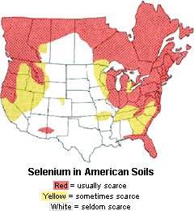

Slide 40
Selenium Most of B.C. Island, Okanagan-Central interior-Kootenays
An area generally deficient but local levels may vary., usually equal or less than approximately 0.1 ppm in the Kootenays. Be aware alkaline soils are more conducive to selenium uptake and pockets of high selenium exist. Soil Levels less than .6 ppm considered deficient, 5 ppm safe upper limit in soils.
A major component of enzyme glutathione peroxidase. Protects cell membranes. Works in conjunction with vitamin E-
Required for the control of thyroid metabolism. Activates thyroid hormone.
For fertility.
High selenium may benefit horses exercising in polluted environments.
Deficiency more pronounced in foals with WMD at birth.
Mature horses partly protected by other factors but these drop off with age.
recent mortality reported from Washington state U with mature horses showing myo-necrosis of head and skeletal muscles, subcutaneous edema, pleural effusion, and ulcerative glossitis (an ulcerative and inflamed tongue). Suggests a full body involvement.
The glossitis probably from pica due to mineral deficiency. Mortality had occurred. Herd wide selenium deficiency and myodegeneration were found. Watch for ventral edema, weakness and death.

Slide 42
Selenium deficiency has been reported at WSU
Many horses-mild or subclinical deficiency, signs decreased immune function, or impaired reproduction.
Acute cases –severe muscle abnormalities and prognosis for survival is poor.
Both foals and adults are susceptible NMD/WMD, a degenerative condition in which muscles actually breakdown with massive muscle damage. Clinical signs and severity vary depending on muscles affected.if heart affected prognosis is poor.
Affected foals weak at birth, or may look normal for first 24 hours and be weak and recumbent or unable to nurse later on.
Signs include severe cramps , sweating, stiffness, increased pulse.
May have red or brownish urine, indicating muscle damage.

Slide 44
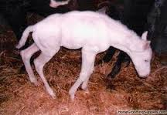
Selenium deficiency more common in young foals

Slide 45
Selenium deficiency has been reported at WSU
Skeletal muscles heart , and the chewing muscles are more commonly affected in adult horses, and the muscles involved in nursing in foals. In holland the most consistent clinical symptoms are
Muscular weakness, inadequate suckle reflex and stillbirth. Clinical signs showed severely increased serum muscle enzymes and low GSH-pX values
A severely affected horse will have painful muscles and be stiff , reluctant to want to walk, and is sore when touched. They may not be able to swallow or chew. Treat with Selenium and vitamin E. Supplement properly, blocks may not work.
Milk is not a significant selenium source for the foal. Colostrum and maternal reserves are critical.
Provide 1-3 mg/day . We prefer an organic source Sel Plex from Alltech. Usually more available and selenomethionine possibly a future reserve for Se in proteins as GSH-pX activity remains longer.

Slide 46
Selenium deficiency has been reported at WSU
Vitamin E in Green grass may mask a deficiency. But vitamin E was normal in Holland. Se deficiency may be more likely to trigger muscular necrosis and E deficit is more related to fat necrosis.
Sel met influences fermentation. Butyrate is an important food source for cells lining the large colon.
Soils <.6 ppm require fertilisation. Follow up supplementation. manage soils for optimal fertility for pH, organic matter and phosphate content to stimulate Se uptake by crops, as available Se. Near neutral soil with high phosphate is ideal. Analyze soil Se every 4 years. Analyze Se status in mares . Special care if liver function an issue.
Mares with ragwort poisoning and reduced lever function did nor respond normally to treatment.eg a link between liver disease and Se deficiency occurs in man.

Slide 47
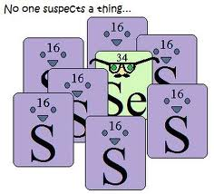
Selenium Excess > 5 mg/day
Vitamin E in green grass may mask a borderline deficiency.
Affects keratinization , Acute excess =blind staggers or chronic excess =alkali disease. Foot and coat issues.gut, lung, heart and kidney issues.
Excess Se may replace sulfur in tissues.
May only see poor frog and chronic thrush in marginal excess.
2-3 mg/day recommended no more than 5 mg/day.

Slide 48
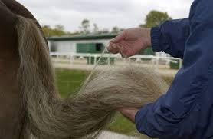
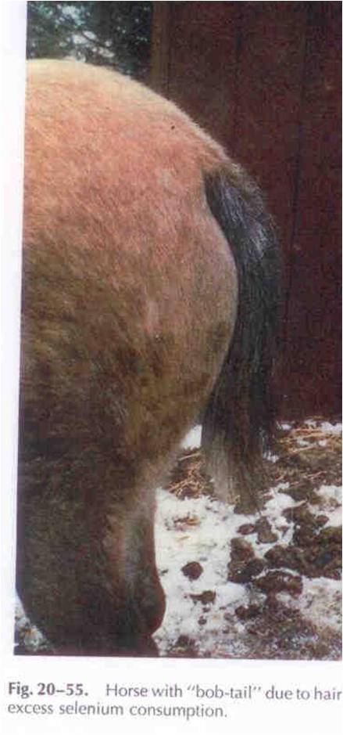
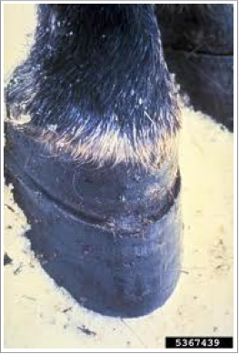
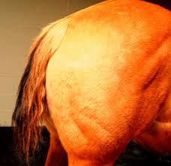

Slide 49
Copper-average values are low in B.C. often less than half NRC
In multiple cellular functions
Essential for the function of the protein ceruloplasmin which transports iron around the body for Mobilization of iron stores and haemoglobin formation. Anemia suspected as iron deficiency may actually be due to copper deficiency.
Myelination of nerves
Keratin formation eg for cracked feet .
Part of the enzyme lysyl oxidase, controlling synthesis and maintenance of connective tissue/cartilage formation and elastase for ligaments and tendons in the fetus and growing horse
drives the formation of cross linkages in collagen fibers. The mare must provide needs for the foal as milk is low and foals rely on reserves when born.

Slide 50
Copper
For bone formation. Ensure the pregnant mare is well supplied as the foal depends on reserves when born.
Detoxifies superoxide a compound deployed by the immune system to kill invading micro organisms.
Part of copper and zinc superoxide dismutase, contributes to cell respiration and antioxidant capacities.
Excess zinc may compete with copper for absorption , strive for 1 pert copper to 3 parts zinc assuming copper needs are met.
Copper stores as ceruloplasmin in the ECF and copper thionein in the ICF act as temporary buffer against a shortage.
Grassses are usually 6-8 ppm and grains 4-7 ppm therefore often well below requirements.

Slide 51
copper
Copper for synthesis of ceruloplasmin, and erythrocuprein . Copper in the suckling neonate is not absorbed when born so the newborn foal relies on liver reserves at birth.
Milk copper levels are low.
Over the first month the foal gradually reaches mare levels.
Copper supply may modify the occurrence of osteochondrosis . Trials with TB broodmares showed supplementing mares in late gestation increased foal liver reserves and foals had significant reduction in the physitis scores and number of cartilage lesions.
Supplementing the foals only showed no difference. Copper as high as 25-30 ppm may be useful for broodmares.

Slide 52
Copper-average values are low in B.C. often less than half NRC
For bone formation. Ensure the pregnant mare is well supplied as the foal depends on reserves when born.
Detoxifies superoxide a compound deployed by the immune system to kill invading micro organisms.
For enzyme responsible for melanin synthesis ie coat colour. Eg results in brown and black pigments. Many coat colours have some level of brown and black in them including buckskins, chestnuts, bays and blacks. The latter two colours are also influenced by zinc.
PPID can also cause poor coat colour. Check with your vet.
Depigmentation and impaired keratinization of the coat indicate low copper or zinc status.
Chestnuts appear yellow and blacks have a rust colour.coats resist sun fading better. If copper adequate

Slide 53
copper
Copper and zinc share same absorptive site. Excess of one antagonizes the other.
Also, water sulfer, iron and very high forage Mo?
Some forages are very high in iron.
Often no outward symptoms, just sluggish behavior. Possibly osteoporosis or arthritis, fragile bones, or deformations.
Worms etc may lower absorption.
Use care to balance holistically as adding excess trace minerals they may cancel each other out.

Slide 54
Zinc- along with manganese most glacial soils are low as are plants
Functions in many tissues a component of many enzymes. Highest in pancreatic tissue, and hoof horn and liver. Intermediate levels in muscle.
Required for replication of DNA/RNA and cell growth and gene function especially reproduction. Critical for normal cognitive and emotional function. Prevents mental retardation, but excess is neorotoxic.
An important impact on the immune system.
Deficiency causes immune disorders like lymphopenia and thymic atrophy due to high losses of T and B cells precursors in the bone marrow, producing a rapd decrease of antibody and cell-mediated responses.
Zinc is a co-factor for thymulin a hormone that induces T cell differentitaion in thymus, and it may be critical for the activity and binding of protein kinase C in lymphocyte membranes and for the activation/inactivation of immunoregulatory genes.
Signaling pathways for the activation of monocytes and dendritic cells in response to bacterial LPS require optimal Zn levels.

Slide 55
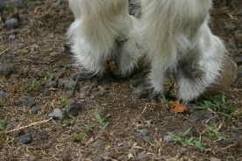
Zinc- along with manganese most glacial soils are low as are plants
For insulin function if required for Glut-4 mediated glucose uptake , therefore a function in cellular energy metabolism.
Monocytes, natural killer cells, and neutrophil granulocytes show decreased function after zinc depletion, with the activity of natural killer cells and IL-2 production markedly decreased in deficiency.
The production of T helper cell (TH1) cytokines and interferon –alpha by leucocytes is decreased.
Also failures in the humoral immune response.
Mitogenesis disfunction leading to low serum Ig and a reduced level of antibody response to T-dependent antigens.
For multiple functions of the immune system and therefore the defense against pathogens are affected by zinc deficiency.

Slide 56
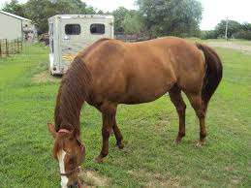
Zinc deficiency
Zinc dependent enzymes are involved in keratinizaton therefore zinc is linked to skin health. Deficiency causes hyperkeratosis/parakeratosis. Low hoof strength, and hardness may occur.
Inappetance in foals, reduced growth rate, alopecia, and decreased horn strength and hardness. Zinc deficiency can occur frequently in foals causing subclinical bone, reproductive foot, and immunologic disorders, depending on passve transfer from colostrum.trans placental and lactogenic from mothers may occur until weaning.
Fetal liver often higher than mothers.
For general weakness, stunted growth, and achromotrichia –loss of pigment in the hair and alopechy loss of hair in spots.

Slide 57
Growth disorders in foals with decreased alkaline phosphatase, hair loss and decreased growth rate.
Excess zinc has caused OCD/DOD in foals.
Low zinc=80-100 ug/ml serum
Deficiency =<80 ug/ml
Hypogamma globulinemia in yearlings and 2 year olds if low zinc.
Zinc stabilizes protein structures, cell signalling and gene expression, fetal development, growth, tissue repair, reproduction, and the immune system through over 200 enzymes.
Nrc supplementation may be low in some surveys eg foals in argentina =40% deficient on balanced diets.highest incidence of low percentage of gamma globulin, possibly affecting immune response.nrc suggests 400-500 ppm depending on situation. Most hays are below nrc.

Slide 58
Pastures are often ½ nrc.
Excess calcium or phos may produce serum zinc deficiency, animals have a limited mobile store of zinc to prevent deficiency.
iron to zinc at 2 to 1 up to 5 to 1 will lower zinc
Copper seems to be best at 1 to 3 or 4-5 ratio to zinc
Foals seem most vulnerable and a deficiency is often seen affecting foals in the first two years of life.
Oversupply of zinc may tie up copper causing OCD if extremely high . Ratio of 3:1 zinc to copper ideal as they share the same absorptive mechanism.

Slide 59
Zinc- along with manganese most glacial soils are low as are plants
For insulin function.
For cognitive function
Monocytes, natural killer cells, and neutrophil granulocytes show decreased function after zinc depletion, with the activity of natural killer cells and IL-2 production markedly decreased in deficiency.
The production of T helper cell (TH1) cytokines and interferon –alpha by leucocytes is decreased.
Also failures in the humoral immune response.
Mitogenesis disfunction leading to low serum Ig and a reduced level of antibody response to T-dependent antigens.
For multiple functions of the immune system and therefore the defense against pathogens are affected by zinc deficiency.

Slide 60
Manganese-glacial soils are very low in manganese and zinc.
Mn -Essential for many enzymes as part of the enzyme or activating the enzymes. For carbohydrate and lipid metabolism.
The manganese superoxide dismutase enzyme is located in the mitochondria and in liver tissue.Ensures protection of DNA against superoxides. It may help with EMND
Required for synthesis of chondroitin sulfate necessary for cartilage formation. The specific pathway is not well known.
Half the zinc, copper and manganese is deposited in the last two months of gestation.
Ratios as per other trace minerals are wise. Use 1 :3:3 for copper zinc and manganese as a guide.
Little is known about manganese deficiency , and most feeds are relatively high in manganese. Effects of deficiency in other species include enlarged joints, reproductive problems, abnormal development of cartilage, and crooked limbs. There is no storage depot in horses.

Slide 61
Manganese-glacial soils are very low in manganese and zinc.
Manganese deficiency can occur in the developing fetus,and as a result, the developing fetus may have limited endochondral bone growth resulting in skeletal abnormalities.
Protects cells from oxidative damage. Involved with fertility and central nervous system function.
There is no manganese storage in the body as per selenium which has no storage depot. It must be there every day.
Milk levels are low.
Relatively safe to use at higher levels. Suggested levels are 400-500 mg/day -NRC . Relatively safe to use at higher levels, but excessive levels may interfere with phosphorus absorption. There is no known case of manganese toxicity.
Ratios as per other trace minerals

Slide 62
Trace minerals
After birth the neonatal foal obtains minerals from body reserves, ie liver, mare’s milk, forages, mare concentrate, and creep feed.
Neonatal foals have low levels of serum Cu, which can reach normal adult values at 28 days.OC?
A sudden drop in iron within first 24 hours after birth, several weeks are required to return to normal values.
Modest supplementation of tms above NRC to mare may not influence the mineral status of the mare and foal.
Extra zinc and Cu did not change Zn or Cu in milk,
Mare’s milk is low in Fe and does not increase with extra supplementation in late gestation or lactation.
The concentration of Cu, Zn and Fe mare’s milk sig decreased throughout the first 16 weeks of lactation.

Slide 63
Tm’s
Cu and Zn use the same vehicle for absorption so they must consume them in proper amounts. NRC suggests 4:1 or consider
5 :1:3:3 Fe , Cu, Mn, Zn with insulin issues possibly 10 for iron if no issues.
Zinc is part of over 100 different enzyme systems, many of which involve protein and carbohydrate metabolism. Excess zinc is tolerated provided ratios ok. Excess is related to DOD.
The highest zinc concentrations are found in the iris and choroid (between the sclera and retina) of the eye, pancreas,hoof horn, liver and muscle.
A min of 400-500 ppm zinc is required per day . Wheat bran, middlings, brewers grains are good sources. Forages can be low on the island.

Slide 64
Trace minerals
Mare’s milk is low in Cu and Fe especially, so the foal is in a negative plane of nutrition for Cu and must mobilize copper from liver stores until copper intake is increased by the consumption of other feeds.
To meet its Fe requirement the foal is dependent on Fe stores in soft tissue and/or ability to conserve iron until intakes increase.
Mares with TM’s greater than nrc had no differences in foal growth and development, mare milk, mare and foal serum Cu, Zn, Fe .
No differences in Foal serum bone specific alkaline phosphatase or foal bone mineral content were detected.
The horses homeostatic system maintains serum trace mineral levels within very narrow levels.
No adverse effects are noted so modest insurance levels can be used re forage.

Slide 65
copper
Vital roles maintaining connective tissue (eg ligaments and tendons especially PPID)
Aiding antioxidant enzymes
Melanin (pigment of skin, hair, and eyes)synthesis
Iron stores mobilization.
The liver stores and metabolizes Cu.
Avg horse requires minimum of 100-125 mg Cu per day for heavy work or last trimester . Horses easily tolerate 50 ppm copper and a maximum of 250 ppm
Copper is usually low on the island . Excessive zinc affects weanling foals and iron may affect needs . Moly has less effect
Molasses brewers grains and soymeal are good sources of copper.
Deficiency results in abnormal bone growth in growing horses, and now other nutritional and non nutritional factors are considered for DOD.
In mature horses connective tissue weakens and elastin (main protein in connective tissue ) synthesis declines. Horses seem to tolerate excess Cu very well possibly as absorption will decrease with increased intakes.

Slide 66
Iron
Do not add extra iron.
Most feeds and forages have more than adequate iron.
Excess iron is correlated to insulin levels in the blood and may cause laminitis if ID occurs. Serum ferritin could be associated with beta cell function, IS or both. Some experts suggest no association with beta cell function.
If iron is high check for insulin levels and signs of liver dysfunction e.g. AST, ALT and GGT or vet’s advice.
Pima indians iron a role only in hepatic IR?
An inflammatory marker may not be present and inflammation does not explain the correlation of ferritin and IS. Inflammation unlikely the cause of the association of ferritin and decreased IS.

Slide 67
Iron
Excess iron possibly cytotoxic, causes toxic free radicals, abnormal glucose metabolism, poor immunity, chronic laminitis attacks were alleviated by removing excess iron supplements , horses with high ferritin had higher insulin responses. Dr. Neilson has comments qualifying the latter statement.
High iron disrupts fat cell metabolism from human research. Adiponectin may be lower.
Water may be a significant iron source
While horses can tolerate 500 ppm try to use far less for horses with ID
Note –sweat can be 25 ppm iron.
Hard working horses can sweat 10-12 liters per hour
Very hard working horses can lose 250-300 mg/hour as iron, a significant amount.
Otherwise horses can reduce absorption but cannot remove iron in excess unless phlebotomy is conducted.
Horses showing iron deficiency may have parasites or EGUS so consult your vet for a proper exam.

Slide 68
iron
The B horizon of soils in the Nanaimo plain is high in iron and aluminum.
Forages grown on acidic soils will be high iron.consider soil analysis and liming soils
Balance iron with trace minerals ideally at
Iron 5 parts, copper 1 part , zinc 3 parts and manganese 3 parts .
Some experts suggest the tissue ferritin levels be used and TSI= follow vet’s advice.
Ferritin actually sequesters iron rendering it harmless according to some experts.
The real problem is its effects on the liver and a veterinary program should be implemented to ensure liver function is not compromised. A major job of the liver is clearing insulin after a meal. Anything compromising liver function may cause insulin dysfunction/hyper insulinaemia and that can set off a cascade of events leading to laminitis.
Excess Iron will tie up other trace minerals as well creating secondary trace mineral deficiencies.
The horse must be looked at holisticqally under veterinary guidance.

Slide 69
Weeds a possible source of iron

Slide 70
Iodine
Goiter from over or under supply.
A component of thyroid hormones
A role in ovarian function
For BMR growth tissue renewal.
TH levels differ between breeds based on metabolic rate.
Crucial for embryo /fetal development.the iodine requirement of mares increases early in gestation. Early iodine deficiency will adversely affect the nervous system and cause congenital hypothyroidism.
Over 10 mg iodine per day will increase the risk of thyroid dysfunction in new born foals. Weakness, muscle immaturity, tendon contraction, and skeletal abnormalities have been describd in newborn foals associated with I toxicosis.
Grass forage is typically .2-.3 ppm but intensive farming will lower levels.
Areas in a rain shadow from the sea may lower in iodine, and extreme heat may have an effect.

Slide 71
iodine
Natural hays and pastures will be very low . Unstable in heat when curing hays.
Grains and oil seeds are very low <.1 ppm
Iodine in feed affects iodine in milk an dhence foals.
Iodine uptake can be impaired by nitrate, thiocyanate, goitrin, thiouracil, and perchlorate.
Nitrates may be an endocrine disrupter , i suggest .2 ppm max for horses and zero for pregnant mares and foals. A judgement call.
Cyanates if controled as per feeding flax properly are no problem
Provide 2-5 mg iodine max /day to meet nrc recommended levels depending on age and work and stage of reproduction.
Very difficult to analyze for.
Selenium is required for activation of iodine thyroid hormone.
Easy to over-supplement with some kelp based supplements.
Do not rely on salt block consumption to supply salt and iodine, just a back up.

Slide 72
Sweat losses
During submaximal exercise horses under high heat and humidity can lose 12 L per hour.
This large volume of sweat results in proportional decreases in body weight , total body water and plasma volume.
This can compromise venous return , cardiac filling pressure, cardiac output, and the ability to thermo regulate.
Blood flow is then reduced to the non obligate tissues to maintain flow to the muscles etc. This may compromise gut health causing colic or affect kidney function. Heart rate must go up to compensate.
Thermal regulation is sacrificed for muscle supply . Shock may occur.

Slide 73
Water and Hot Weather
Horses can lose 2-4 gallons of sweat per hour. Horses normally drink 5-10 gallons per day.
Less evaporation occurs during high humidity.
Thermal neutral zone is about 5C-25C
Heat stress reduces feed intakes. Less feed especially forage means less water intake and less chewing and buffer added.
Horses can adapt after 14-21 days to heat and humidity.
Provide clean fresh water at 45-64F temp. At all times.
Water intakes may double in hot weather. Use top dress electrolytes 4 hours before work and consider pastes or 1 oz every 1 hour or 10 miles according to vets advice (add on feed at rest stops with water).
Use electrolyte water and plain water free choice to rehydrate.
Transport in coolest part of day water every 4-8 hours.

Slide 74
summary
Idle horses drink about 25 liters per day
Range 20.5-33.5 l/d
Drink more water with all hay diet 3.2-4.4:1
Vs grain mix 2-2.60:1
More grain means less water consumed.
Lactating mares need at least 37.5-50 liters or more depending on diet, temperature, possibly 40-70 l per day.
Suckling foals need water and respond best to a bowl or bucket easily accessible at 75-90 cm high.
Horses fed dry feed drink around time of feeding and prefer cool to luke warm water. They only drink 5-6 minutes /day. Possibly 5-8 gallons per day at maintenance. Horses drink less cold water, 20C is ideal. Colic may be an issue if water is cold in winter.
If feed deprived, they spend more time drinking.

Slide 75
Trace Minerals in the Okanagan

Slide 76
Horses differ in glycogen metabolism
Glycogen stores are much higher in horses but
Glycogen replenishment following exercise is much slower.
Venous infusion will help
It may require 72 hours for full recovery
Electrolyte supplementation along with hay and grain feeding results in greater glycogen replenishment than does feeding without electrolytes.
Glycogen is stored in a hydrated state. A dehydrated horse is slow to reload.
Differences due to greater initial storage and horses do not increase insulin sensitivity following exercise as do other species, nor increase glycogen synthase as much as other species. They are less efficient at digesting starch and absorbing glucose.

